Slide 1
Overview of Web Technology
MAPD 712 Web Technologies for Mobile Platforms
Week 1

Slide 2
About the course
This course provides students with the foundation in web technologies that is necessary for developing applications in the mobile web space. Students will be exposed to technologies such as HTML5, CSS, JavaScript, AJAX, and jQuery.

Slide 3
About the course
Explain the architecture of a web application and constraints introduced by mobile clients.
Demonstrate good understanding of web technologies and standards.
Build responsive websites with HTML5, CSS3 and JavaScript.
Use latest standards and frameworks such as AJAX, jQuery, Bootstrap.
Apply standards for web design, development and testing.
Apply best practices and standards to manage and deploy web content.
Develop creative concepts for responsive web development.
Apply basic security measures in the web development.

Slide 4
About me
MSc in Software Engineering (Poland and Sweden)
Co-founder and CTO Mobi-Learning Inc.
Member of Executive Board of Directors of International Association for Blended Learning (IABL)
Research interests:
Cloud computing
Mobile and blended learning
Currently working on a mobile language literacy solution (project funded by SSHRC)

Slide 5
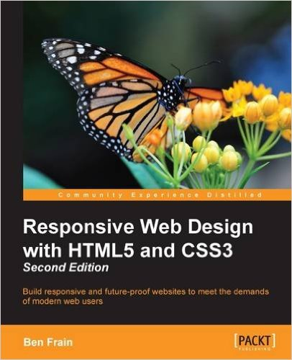
Book
Responsive Web Design with HTML5 and CSS3 - Second Edition (2015)
by Ben Frain
ISBN-10: 1784398934
ISBN-13: 978-1784398934
Publisher: Packt Publishing

Slide 6
Assessment
Assignment: 15%
Mid term test: 15%
Project milestones 50%
M1: 10%
M2: 10%
M3: 15%
M4: 15%
Project final submission
and presentation: 20%
Total: 100%

Slide 7
Assignment
Individual work covering various aspects discussed in class
Worth 15%
Detailed instructions and marking scheme will be provided

Slide 8
Mid-term test
Individual work covering various aspects discussed in class
Worth 15%
Details will be provided closer to the exam

Slide 9
Project
Project is a group work (3-4 students)
Broken down into 4 graded milestones covering group formation, requirements analysis and design, wireframe building, prototyping and testing
Finishes with a presentation that is marked separately

Slide 10
Why web?
Tools
HTML5 overview
CSS
Selectors
Pseudo-classes
Colors and typography
Advanced styling

Slide 11
Discussion: Why web?
What makes it good? What are downsides?

Slide 12
Client-server architecture
Web server
Protocols and Uis
Websites

Slide 13
Client-server architecture
Web server
Protocols and Uis
Websites
Application server
Applications – business logic
Database server
Application’s data storage

Slide 14
System architecture
Clients
Chrome, Internet Explorer/Edge, Firefox, Safari
HTML5, CSS3, JavaScript, AJAX
Servers
Apache, Microsoft IIS, lighttpd, …
Database
MySQL, Oracle, DB2, Mongo, etc. …

Slide 15






Web technology – Server side
PHP
Python (Django)
Rails (Ruby)
JavaScript (jQuery, Node.js)
ASP (Asp.Net, C#)
JSP (Java/EJB)
Flash
CGI/Perl

Slide 16
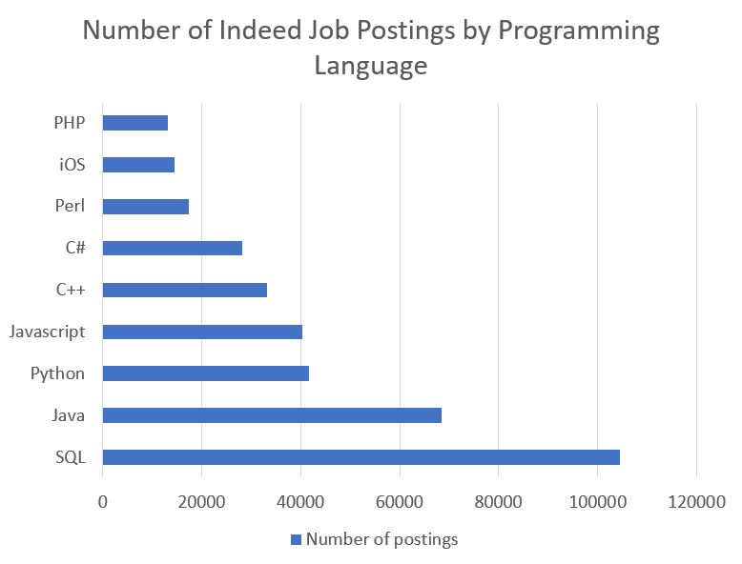
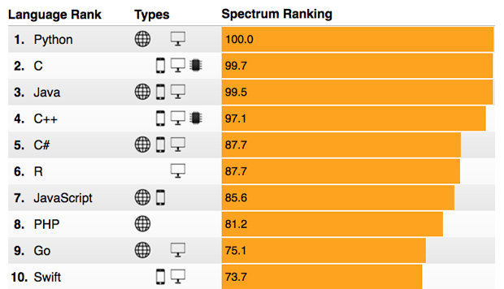
Server side languages: Stats
You should also look at Scala which is next language growing in popularity and new development approach

Slide 17
Evolution of web
From static to dynamic pages
From Flash to HTML5
From information to social networks and more

Slide 18
Tools

Slide 19
IDEs
You can go as simple as Notepad++ or Sublime
Or use more advanced tools like Dreamweaver from Adobe, Eclipse, WebStorm or PHPStorm, MS Visual Studio (makes it easier to work with Azure)
Use, the tool that you are comfortable with

Slide 20
Server
Apache
In-house
Cloud
Other severs eg. Node.js
Server-lite
Lite-server
Serve (https://www.npmjs.com/package/serve)

Slide 21
Deployment

Slide 22
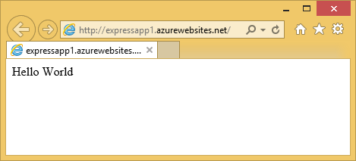
Deploy
Uploading your code to the server
In-house server
Cloud
Azure
Amazon
other

Slide 23
Web development basics
HTML & CSS

Slide 24
HTML5 Overview

Slide 25
HTML5 Overview
Page structure
Head and body
Meta-data
Scripts and styles (CSS, js)
Page tags
Headers
Div
Sections
Articles

Slide 26
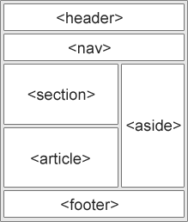
Semantics
<article>
<aside>
<details>
<figcaption>
<figure>
<footer>
<header>
<main>
<mark>
<nav>
<section>
<summary>
<time>

Slide 27
Why semantic HTML5 elements?
With HTML4, developers used their own favorite attribute names to style page elements: header, top, bottom, footer, menu, navigation, main, container, sidebar, etc., ...
This made it impossible for search engines to identify/understand/process the correct web page content.
With HTML5 elements like: <header> <footer> <nav> <section> <article>, this will become easier.

Slide 28
Why semantic HTML5 elements?
According to the W3C, a Semantic Web:
"Allows data to be shared and reused across applications,
enterprises, and communities."

Slide 29
Semantic Tags
Tag | Description
<article> | Defines an article
<aside> | Defines content aside from the page content
<details> | Defines additional details that the user can view or hide
<figcaption> | Defines a caption for a <figure> element
<figure> | Specifies self-contained content, like illustrations, diagrams, photos, code listings, etc.
<footer> | Defines a footer for a document or section
<header> | Specifies a header for a document or section
<main> | Specifies the main content of a document
<mark> | Defines marked/highlighted text
<nav> | Defines navigation links
<section> | Defines a section in a document
<summary> | Defines a visible heading for a <details> element
<time> | Defines a date/time

Slide 30
Transition to HTML5
Typical HTML4 | Typical HTML5
<div id="header"> | <header>
<div id="menu"> | <nav>
<div id="content"> | <section>
<div id="post"> | <article>
<div id="footer"> | <footer>

Slide 31
Omitting tags
Some tags that used to be mandatory can be now omitted, however, it is not recommended
In the HTML5 standard, the <html> tag and the <body> tag can be omitted
In the HTML5 standard, the <head> tag can also be omitted

Slide 32
Obsolete syntax and semantics
Old tag | Suggested replacement
<applet> | Use embed or object instead
<acronym> | Use abbr instead
<frame> | Use iframe
<frameset>
<listing> | Use pre and code instead
See complete list of obsolete features and tags : https://www.w3.org/TR/html5/obsolete.html

Slide 33
CSS overview

Slide 34
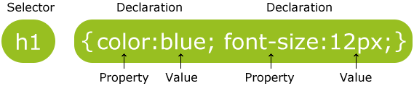
CSS Overview
Selectors:
tags and relationships among them
Classes
Ids
Properties: from color to animations
Values: depend on the property

Slide 35
CSS Basic
CSS Colors
CSS Backgrounds
CSS Borders
CSS Margins
CSS Text
CSS Fonts
CSS Padding
CSS Height/Width
CSS Links
CSS Lists
CSS Tables
CSS Box Model
CSS Outline
CSS Display
CSS Max-width
CSS Position

Slide 36
Why CSS?
Why do we use CSS?
What are basic rules of CSS application?

Slide 37
Syntax

Slide 38
Selectors: element and id
The element selector selects elements based on the element name
The id Selector
The id selector uses the id attribute of an HTML element to select a specific element.
The id of an element should be unique within a page, so the id selector is used to select one unique element!
To select an element with a specific id, write a hash (#) character, followed by the id of the element.

Slide 39
Selectors: Classes
The class Selector
The class selector selects elements with a specific class attribute.
To select elements with a specific class, write a period (.) character, followed by the name of the class.
You can also specify that only specific HTML elements should be affected by a class.

Slide 40
Pseudo-classes
A pseudo-class is used to define a special state of an element.
For example, it can be used to:
Style an element when a user mouses over it
Style visited and unvisited links differently
Style an element when it gets focus
selector:pseudo-class { property:value; }

Slide 41
Pseudo-element
A CSS pseudo-element is used to style specified parts of an element.
For example, it can be used to:
Style the first letter, or line, of an element
Insert content before, or after, the content of an element
p::first-line { property:value; }

Slide 42
Attribute selector
The [attribute] selector is used to select elements with a specified attribute.
The [attribute="value"] selector is used to select elements with a specified attribute and value.
The [attribute~="value"] selector is used to select elements with an attribute value containing a specified word
The [attribute|="value"] selector is used to select elements with the specified attribute starting with the specified value
^-starts, *-contains, $-ends (value)

Slide 43
CSS Combinators
There are four different combinators in CSS3:
descendant selector (space)
child selector (>)
adjacent sibling selector (+)
general sibling selector (~)

Slide 44

Box Model

Slide 45
Colors
RGBA
rgba(255, 0, 0, 0.3); /* red with opacity */
HSL
hsl(120, 100%, 50%); /* green */
HSLA
hsla(120, 100%, 50%, 0.3); /* green with opacity */

Slide 46


Gradients
Linear gradient
background: linear-gradient(direction, color-stop1, color-stop2, ...);
Radial gradient
background: radial-gradient(shape size at position, start-color, ..., last-color);

Slide 47
LESS and Sass
With either language, you can write your own mixins to help with vendor prefixes.
In Sass, you can use Compass, and Compass will keep itself updated, and thus the prefix situation is handled for you.
http://compass-style.org/

Slide 48
CSS performance and optimization
Selectors don’t make much difference in terms of performance
Watch for expensive attributes
Transparencies
Images and gradients
Shadows

Slide 49
Let’s get to work …
Build your profile page, we will use it as your portfolio web and place there all your work in this course.
Feel free to add there sections referring to your work from other courses
Try to make it responsive, but do not worry if it does not work well yet

Slide 50
Hands-on
Make sure that your profile page obeys HTML5 standard
Use new semantics to structure your page (where you see it useful)
Configure your project with Saas
Define variables
Deployment:
If you have server installed on your machine use it
You are also free to use any cloud solution or web server you want to use

