Slide 1
Fluid layouts and relative units Responsive media
MAPD112 Web Technologies for Mobile Platforms
Week 3

Slide 2
Last week
Media-queries
SEO
Introduction to JavaScript

Slide 3
This week
Embedding media
Responsive video
Fluid layouts
Relative units
Flexbox

Slide 4
Multimedia

Slide 5
Multimedia
Multimedia comes in many different formats. It can be almost anything you can hear or see
Name some multimedia types commonly used on websites

Slide 6
Multimedia
Multimedia comes in many different formats. It can be almost anything you can hear or see
Name some multimedia types commonly used on websites
images,
music,
sound,
videos,
animations

Slide 7
Audio
Before HTML5, there was no standard for playing audio files on a web page
Before HTML5, audio files could only be played with a plug-in (like flash)
The HTML5 <audio> element specifies a standard way to embed audio in a web page
<audio controls> <source src="horse.ogg" type="audio/ogg"> <source src="horse.mp3" type="audio/mpeg"> Your browser does not support the audio element. </audio>

Slide 8
Audio
Play, Stop, Pause, Volume
<audio controls> <source src="horse.ogg" type="audio/ogg"> <source src="horse.mp3" type="audio/mpeg"> Your browser does not support the audio element. </audio>
Multiple formats, browser will play first recognized
Message displayed in case format is not recognized by the browser

Slide 9
File formats / Media types
File Format | Media Type
MP3 | audio/mpeg
Ogg | audio/ogg
Wav | audio/wav

Slide 10
<object>
The <object> element is supported by all browsers
The <object> element defines an embedded object within an HTML document
It is used to embed plug-ins (like Java applets, PDF readers, Flash Players) in web pages
<object width="400" height="50" data="bookmark.swf"></object>

Slide 11
<embed>
The <embed> element is supported in all major browsers
The <embed> element also defines an embedded object within an HTML document
Web browsers have supported the <embed> element for a long time. However, it has not been a part of the HTML specification before HTML5.
(The element will validate in an HTML5 page, but not in an HTML 4 page)

Slide 12
Responsive video

Slide 13
How can you add video
<video width="400" height="300" ...
<iframe width="400" height="300" ...
<object width="400" height="300" ...
<embed width="400" height="300" ...
Declaring static widths isn't a good idea in fluid width environments.
What if the parent container for that video shrinks narrower than the declared 400px?

Slide 14
Video
You can add controls using controls attribute
It is a good practice to give user a choice before downloading the video (preload=none)
Poster is an image that replaces video until it’s ready
<video controls preload="none" poster="parrots-poster.jpg"> <source src="parrots.mp4" type="video/mp4"> <source src="parrots.webm" type="video/webm"> </video>

Slide 15
Video – adjust width
Use % if you are using standard HTML5 video,
That will make the video fit the width of the container.
It's important that you remove the height declaration when you do this, so that the aspect ratio of the video is maintained as it grows and shrinks
Use <video> when you have a file e.g. mp4 or ogg
video {
width: 100% !important;
height: auto !important;
}

Slide 16
Adding other players
<iframe> (Youtube, Vimeo)
Don’t omit height, otherwise browsers will render the iframe at a static height of 150px
16:9
<div class="videoWrapper“ padding-bottom=“56.25%”> <!-- Copy & Pasted from YouTube -->
<iframe width="560" height="349“
src="http://www.youtube.com/embed/n_dZNLr2cME?rel=0&hd=1" frameborder="0"
allowfullscreen width=“100%” height=“100%”>
</iframe>
</div>
Fluid wrapper

Slide 17
Adding other players
<object> / <embed> (Viddler, Blip.tv, etc.)
Use the same trick that was used for iframe (fluid wrapper)

Slide 18
Hands-on
Add responsive video to your profile page

Slide 19
Relative units

Slide 20
Let’s talk
What’s wrong with fixed pixels?

Slide 21
Relative units
Unit | Description
em | Relative to the font-size of the element (2em means 2 times the size of the current font)
ex | Relative to the x-height of the current font (rarely used)
ch | Relative to width of the "0" (zero)
rem | Relative to font-size of the root element
vw | Relative to 1% of the width of the viewport*
vh | Relative to 1% of the height of the viewport*
vmin | Relative to 1% of viewport's* smaller dimension
vmax | Relative to 1% of viewport's* larger dimension
%

Slide 22
Conversion from fixed to fluid
Use font size as a base with em units
100% – Default size defined by the browser
body {
font: normal 100%
Helvetica,
Arial,
sans-serif;
}

Slide 23
Conversion from fixed to fluid: example
Let’s assume that the base font size is 16px -> 100%
Let’s assume h1 font size is 24px
Let’s assume li font size is 14px

Slide 24
Conversion from fixed to fluid: example
How to convert from px to em
Target is a font size you would use in the fixed-pixel design
Context is the base font size
Result is the em size for your responsive design
target ÷ context = result

Slide 25
Conversion from fixed to fluid: example
Let’s assume that the base font size is 16px -> 100%
Let’s assume h1 font size is 24px ->24÷16=1.5em
Let’s assume li font size is 14px -> _________ em

Slide 26
Conversion from fixed to fluid: example
h1 {
font-family: Georgia, serif;
font-size: 1.5em; /* 24px ÷ 16px = 1.5em */
}

Slide 27
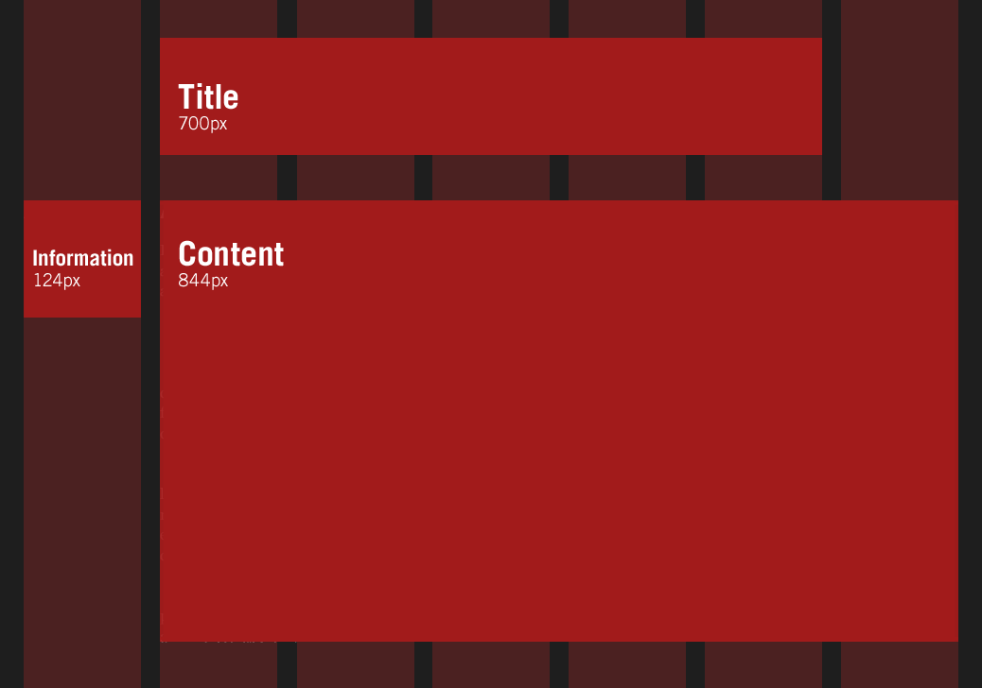
Grid system
Your fixed-pixel page was most likely design in 12 or 7 column grid

Slide 28
Grid system: example
Seven columns of 124px each
Separated by 20px-wide gutters
All of which totals up to a width of 988px
Our sample design:
Title: 700px
Content: 844px
Information: 124px

Slide 29
Grid system: example
Use same rule that we used for fonts
Our target is 988px
max-width: 61.75em; /* 988px / 16px = 61.75em */
Calculate sizes for title, content and information boxes

Slide 30
em vs. %
Test your design by resizing window
Would it scale?
Why?/Why not?

Slide 31
em vs. %
Let’s change the context – our context now is the size of the parent container
Size of the nested element would be calculated in relation to the parent size using the same formula that divides target by context
Example:
700 ÷ 988 = 0.7085 gives us 70.85% as a width of the title box in relation to the page width
Margins can be calculated in exactly the same way

Slide 32
Flexbox

Slide 33
Some issues with known approaches
Whitespaces between inline blocks
Annoying white spaces between elements (you have to use some simple hacks to get rid of them)
Floats and rounding
Inconsistent rounding throughout the browsers
CSS table and table-cell display
Additional element is required and table-cell cannot be wrapped onto multiple lines

Slide 34
Flexbox
It can easily vertically center contents
It can change the visual order of elements
It can automatically space and align elements within a box, automatically assigning available space between them
It can make you look 10 years younger (or at least reduce stress)
It is not supported in IE 9 and below

Slide 35
Basic syntax
.flex {
display: flex;
flex: 1;
justify-content: space-between;
}

Slide 36
Prefix hell
.flex {
display: -webkit-box;
display: -webkit-flex;
display: -ms-flexbox;
display: flex;
-webkit-box-flex: 1;
-webkit-flex: 1;
-ms-flex: 1;
flex: 1;
-webkit-box-pack: justify;
-webkit-justify-content: space-between;
-ms-flex-pack: justify;
justify-content: space-between;
}
Each provider has own prefix and implementation
Flexbox is extreme example of prefixing
Luckily, there are tools that can do it for us (check our book p.48 for some ideas)

Slide 37
Flexbox: basics
Direction
Alignment
Ordering
Flexibility

Slide 38
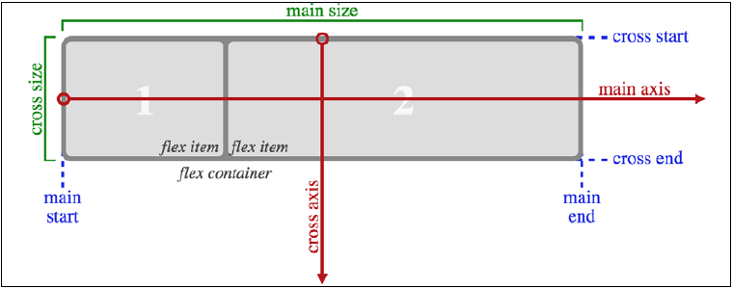
Starting point for design

Slide 39
Example
.CenterMe {
/* other properties */
display: flex;
align-items: center;
justify-content: center;
}
Setting display to flex is the min requirement
align-items sets the alignment of the items in the box
justify-content allows you to position the main axis of the content: left, fight, center

Slide 40
Flex direction
row – a default value, elements positioned in a row and wrapped when needed (default)
row-reverse – reverses an order of the items in the row
column – elements in the box ordered top to bottom
column-reverse – works as column but with reversed order of the elements

Slide 41
Flex wrap
nowrap – The flex container is single-line
wrap – The flex container is multi-line
wrap-reverse - Same as wrap but start and end are swapped

Slide 42
Inline-flex
A version of flex that can be used inline
When items are set as inline-flex anonymously (for example, their parent element is not set to display: flex;) then they retain whitespace between elements, just like inline-block or inline-table do.
If they are within a flex container, then whitespace is removed, much as it is with table-cell items within a table.

Slide 43
Flex alignment
The align-items property positions items in the cross axis.
flex-start – The cross-start margin edge of the flex item is placed flush with the cross-start edge of the line.
flex-end – The cross-end margin edge of the flex item is placed flush with the cross-end edge of the line.
center – The flex item’s margin box is centered in the cross axis within the line. (If the cross size of the flex line is less than that of the flex item, it will overflow equally in both directions.)

Slide 44
Flex alignment
baseline – if the flex item’s inline axis is the same as the cross axis, this value is identical to flex-start. Otherwise, it participates in baseline alignment: all participating flex items on the line are aligned such that their baselines align, and the item with the largest distance between its baseline and its cross-start margin edge is placed flush against the cross-start edge of the line.
stretch – if the cross size property of the flex item computes to auto, and neither of the cross-axis margins are auto, the flex item is stretched. Its used value is the length necessary to make the cross size of the item’s margin box as close to the same size as the line as possible, while still respecting the constraints imposed by min-height/min-width/max-height/max-width.

Slide 45
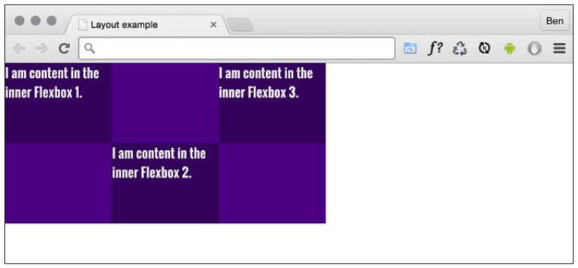
Changing just one
align-self – allows you to overwrite the alignment set by the container (outer box)
align-self used here

Slide 46
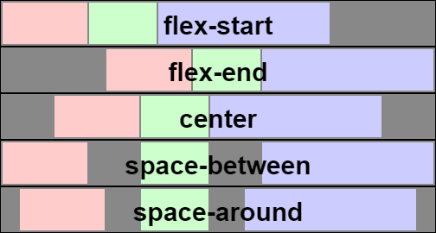
Alignment
flex-start
flex-end
center
space-between
space-around

Slide 47
Flex property
The flex property is actually a shorthand way of specifying three separate properties:
flex-grow - is the amount, relevant to the other flex items, the flex-item can grow when free space is available
flex-shrink - is the amount the flex-item can shrink relevant to the other flex-items when there is not enough space available
flex-basis - is the basis size the flex-item is sized to
flex: grow [shrink [basis]]

Slide 48
Hands-on
Redesign your profile page using flexbox
Make sure that you use media-query where needed to maintain responsiveness of your solution
https://css-tricks.com/almanac/properties/f/flex/

Slide 49
Responsive images

Slide 50
Providing multiple sizes: srcset
<img src="scones_small.jpg"
srcset="scones_medium.jpg 1.5x, scones_large.jpg 2x"
alt="Scones taste amazing">
src – specifies the smallest size and is a fallback
srcset – file names and resolutions hints

Slide 51
Providing multiple sizes: srcset
You can be more specific providing details of the image size and thresholds to switch the size (media queries)
<img srcset="scones-small.jpg 450w, //450px wide
scones-medium.jpg 900w" //900px wide
sizes="(min-width: 17em) 100vw, //full width
(min-width: 40em) 50vw" //50% width
src="scones-small.jpg" alt="Scones">

Slide 52
picture, source, img
<picture>
<source media="(min-width: 30em)" srcset="cake-table.jpg">
<source media="(min-width: 60em)" srcset="cake-shop.jpg">
<img src="scones.jpg" alt="Your cake.">
</picture>

Slide 53
Hands-on
Add responsive images to your profile page
Make sure that you have at least 3 sizes: for phone, tablet and desktop

