Slide 1
AES-128 Encryption Validity and Statistical Analysis
November, 20, 2017
Jack Nelson, Laurie Harris, and Tim McWilliams
MSDS 7349: Data & Network Security
A Detailed description on AES-128, validation steps, & NIST Statistical Analysis

Slide 2
AES-128 Algorithm
Ten rounds of encryption
Each round, a plaintext transforms through using the corresponding cipher key.
The key and the state
4x4 matrix of bytes
Key Expansion
128-bit expands into eleven round keys
Eleven round keys are each 128 bits in size

Slide 3
How AES-128 Algorithm operates
10 rounds of encryption ^{[1]}
Round 1
Add Round Key operation
First round key is XORed to the plaintext
Nine structured rounds follow the initial one
Each round composed of the following transformations:
substitute bytes
shift rows
mix columns
add round key
^{[1]} U. Kretzschmar. (2009, July). AES128 – A C Implementation for Encryption and Decryption.

Slide 4
Key Expansion ^{[1]}
Comprised of two separate steps for computing round key from round key
Step 1
Compute the new first column of the next round key
Substitution takes place for bytes in the old fourth column using the subbytes Operation
The bytes in the old fourth column shift vertically by one-byte position using the shiftrows operation.
XORed to the old first column.
^{[1]} U. Kretzschmar. (2009, July). AES128 – A C Implementation for Encryption and Decryption.

Slide 5
Key Expansion ^{[1]} Cont.
Step 2
calculate columns 2 thru 4 of the new round key
The calculations are as follows:
new second column
(new first column) XOR (old second column)
new third column
(new second column) XOR (old third column)
new fourth column
(new third column) XOR (old fourth column)

Slide 6
Testing for Randomness & Unpredictability
Randomness
RNG or PRNG produces a stream of zeros and ones
Each outcome (0 or 1) should be equally likely
Independence from other elements of the stream
Unpredictability
The seed used to generate the stream should be unknown and also random
Because the AES-128 algorithm is known, secrecy of the key is imperative

Slide 7
NIST Statistical Test Suite
There is an unlimited number of statistical tests that could be employed to test for randomness
National Institute of Standards and Technology (NIST) has selected 15 statistical tests to be included in its test suite
Each test compares the characteristics of the generated stream to what would be expected from a random stream of bits

Slide 8
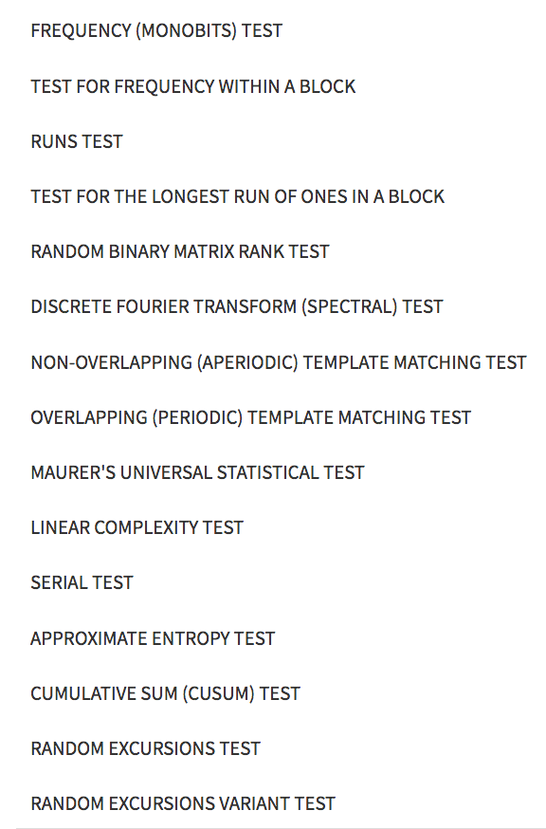
NIST Statistical Test Suite - Tests
Total of 15 tests
Can be performed in any sequence
It is recommended that the two frequency tests are applied first
If the frequency tests fail, there is a high likelihood that the remaining tests will also fail

Slide 9
Frequency Tests
Frequency (Monobits) Test - tests the overall proportion of zeros and ones within the sequence
Frequency within a Block – tests proportions of zeros and ones within a specified block length
Serial - examines the frequency of overlapping patterns of a specified bit length
Approximate Entropy – similar to serial test; frequency of overlapping blocks of two consecutive/adjacent lengths

Slide 10
Runs, Linear Dependency and Patterns
Runs - uninterrupted sequences of identical bits
Longest Run of Ones – irregularity in Ones implies irregularity in Zeros
Random Binary Matrix - sequence is portioned into sub-matrices; examines linear dependence
Linear Complexity – examines complexity using Linear Feedback Shift Register
Discrete Fourier Transform (Spectral)– transforms zeros to -1 and examines peak heights

Slide 11
Patterns (continued)
Non-Overlapping Template Matching – examines occurrence of repeating patterns in blocks of the sequence. Once pattern is found, search resumes to bit following the pattern
Overlapping Template Matching – also examines occurrences of repeating patterns. Once found, search resumes at the next bit
Maurer’s Universal Statistical Test – examines the number of bits between repeated patterns. Purpose is to test for compressibility, which would imply non-randomness

Slide 12
Excursion Tests
Final three tests examine the excursion from zero by converting zeros to negative ones
Cumulative Sums – examines the maximum excursion from zero for the sequence
Random Excursions – examines occurrence of excursion from zero to states between -4 and +4
Random Excursions Variant - examines occurrence of excursion from zero to states between -9 and +9

Slide 13
AES Analysis using Python
Ciphertext blocks were made and tested using various python programming packages
PyCrypto, Matplotlib, OS, Random, NumPy, SciPy, and Functools
NIST Randomness Test were generated from an existing program uncovered during existing work research^{[2]}
Program was validated with NIST documentation^{[3]}
Written in Python 2, programs altered for analysis and converted to Python 3.
All work done within a Jupyter Notebook
^{[2]} https://gerhardt.ch/random.php
^{[3]} http://nvlpubs.nist.gov/nistpubs/Legacy/SP/nistspecialpublication800-22r1a.pdf

Slide 14
Ciphertext & Key Generation
128 bit plaintext blocks were made randomly selecting alphabetic letters at the frequency used in the English language
128 bit keys were generated using the local OS PRNG
AES object made from PyCrypto to encrpyt plaintext blocks with the key in its default mode, ECB codebook
3 scenarios conducted
constant key / variable plaintext
variable key / constant plaintext
variable key / variable plaintext
Ciphertext blocks concatenated with one another to form a stream of ciphertext to be tested (1,000 blocks generated)

Slide 15
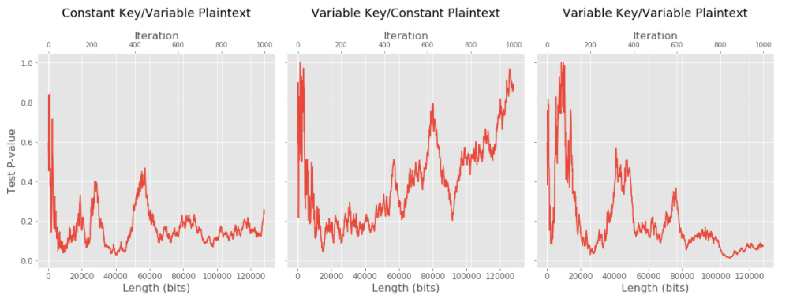
NIST Randomness Test 1: Frequency (Monobit) Test
Test to see number of ones and zeros in a sequence is what’s expected
Trend is constant plaintext chart is to be expected, other 2 pose interesting downward trend that could investigated further

Slide 16
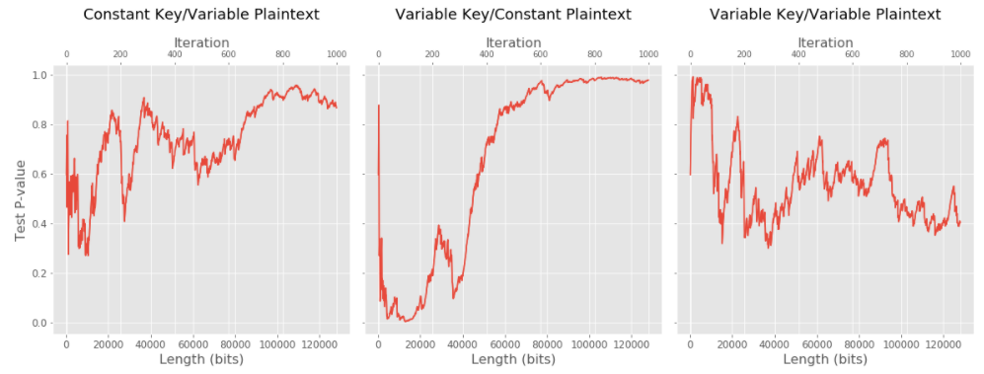
NIST Randomness Test 2: Frequency Test within a Block
Test to see number of ones in M-bit block is what’s expected
All charts don’t show a significant enough downward trend, assumed from test all 3 are not non-random

Slide 17
Total NIST summary: 1,000 ciphertext blocks
 | NIST Randomness Test | Constant Key / Variable Plaintext | Variable Key / Constant Plaintext | Variable Key / Variable Plaintext
1 | Frequency (Monobit) Test | 0.23818884632901338 | 0.89327283014221182 | 0.070976951821933892
2 | Frequency Test within a Block | 0.86493047722218519 | 0.97750139394763769 | 0.40307506381006941
3 | Runs Test | 0.33434025922699118 | 0.69966546585653511 | 0.21797286413711014
4 | Test for Longest Run on Ones in a Block | 0.0096632450286555753 | 0.01476713564124443 | 0.58906899338825158
5 | Binary Matrix Rank Test | 0.64423936615994748 | 0.12489293423400831 | 0.18236679345242507
6 | Discrete Fourier Transform (Spectral) Test | 0.66280712807416475 | 0.71952594951789639 | 0.53816712596984573
7 | Non-overlapping Template Matching Test | 0.802828998445688 | 0.21857423402532378 | 0.09146728527434074
8 | Overlapping Template Matching Test | 0.73352043376311626 | 0.39481149434459084 | 0.96816489052340682
9 | Maurer’s “Universal Statistical” Test | 0.96316949176598032 | 0.10885724404456396 | 0.34127707478933444
10 | Linear Complexity Test | 0.068248535725128928 | 0.50387978615488227 | 0.90206401922504831
11 | Serial Test* | 0.74716238712813898 | 0.14380904943053613 | 0.85809899712386595
12 | Approximate Entropy Test | 0.88063894276832877 | 0.23170361112045387 | 0.16497078716966482
13 | Cumulative Sums (Cusum) Test | 0.21973193273917388 | 0.55642547438274725 | 0.040690353872457161
14 | Random Excursions Test* | 0.075252495815051015* | 0.094833912376626972 | 0.0022042402144366608
15 | Random Excursions Variant Test* | 0.01444018299689381 | 0.28884436634648492 | 0.10402683558047786
Only 2 tests out of the 15 in all 3 scenarios yielded a significant p-value to suggest the sequence it non-random according to NIST standards.
*Some tests return a series of p-values for different states of the test, the lowest p-value was recorded since all must pass for the test to pass

Slide 18
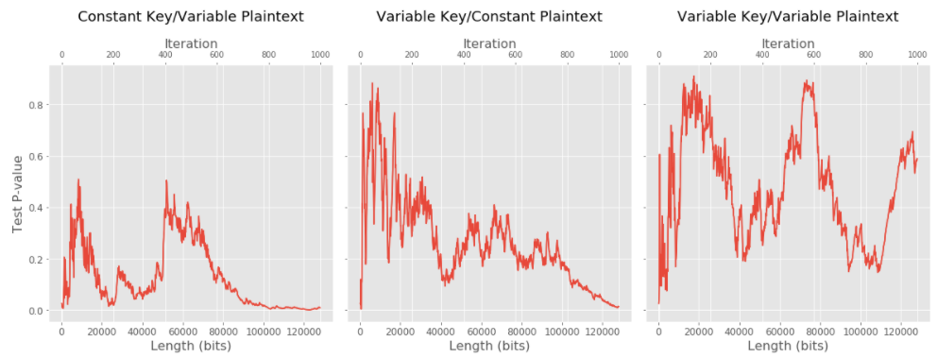
NIST Randomness Test 4: Test for Longest Run on Ones in a Block
Test to see if longest run of ones is what’s expected
Both constant key and constant plaintext scenarios show a strong downward trend towards non-randomness.

