Slide 1
Coexpression
VS
Glc-TOR
Effect of Glu
On WT
(BvsA)
P < E-63
674/749
(90.0%)
sigBA-
4736 genes
tor-
2357 genes
Effect of Glu
on bHLH
(DvsC)
P <<E-330
1744/1792
(97.4%)
sigDC-
9625 genes
tor-
2357 genes
Effect of bHLH
in Min
(CvsA)
P < E-105
142/1022
(13.9%)
sigCA-
6246 genes
tor-
2357 genes
Effect of bHLH
in Glu
(DvsB)
P < E-56
513/635
(80.8%)
sigDB-
3896 genes
tor-
2357 genes
(Glc-TOR on right)
-5
+5
Log2FC

Slide 2




Coexpression
VS
supplementary
Effect of Glu
On WT
(BvsA)
P ~ E-10
184/222
(82.9%)
sigBA-
4736 genes
supplement
823 genes
Effect of Glu
on bHLH
(DvsC)
P ~ E-22
181/435
(41.6%)
sigDC-
9625 genes
supplement
823 genes
Effect of bHLH
in Min
(CvsA)
P ~ E-37
233/359
(64.9%)
sigCA-
6246 genes
supplement
823 genes
Effect of bHLH
in Glu
(DvsB)
P ~ E-24
56/233
(24.0%)
sigDB-
3896 genes
supplement
823 genes
(supplementary on right)
“List of genes with different root expression between ABA-treated wild type and abi4 mutant plants”
-5
+5
Log2FC

Slide 3
Effect of bHLH in min
VS
Effect of bHLH in glu
(CA on left vs DB on right)
P ~ E-262
1289/1832
(70.4%)
sigCA-
6246 genes
sigDB-
3896 genes

Slide 4
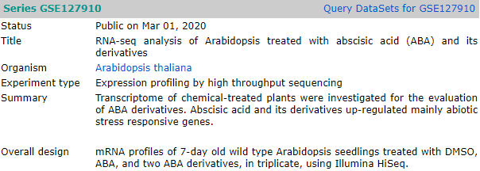
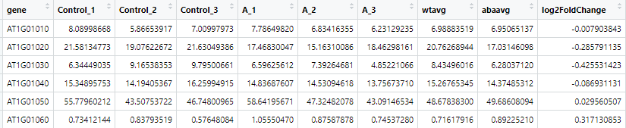
7 day old seeds. 10 µM ABA for 6 hours
TPM > log2FC (cutoff 0.5)

Slide 5
Coexpression
VS
ABA
(7 days old)
Effect of Glu
On WT
(BvsA)
P ~ E-92
1405/2195
(64%)
sigBA-
4736 genes
aba
8755 genes
Effect of Glu
on bHLH
(DvsC)
P ~ E-164
1751/4232
(41.4%)
sigDC-
9625 genes
aba
8755 genes
Effect of bHLH
in Min
(CvsA)
P ~ E-209
2107/3112
(67.7%)
sigCA-
6246 genes
aba
8755 genes
Effect of bHLH
in Glu
(DvsB)
P ~ E-96
933/1882
(49.6%)
sigDB-
3896 genes
aba
8755 genes
-5
+5
Log2FC

Slide 6
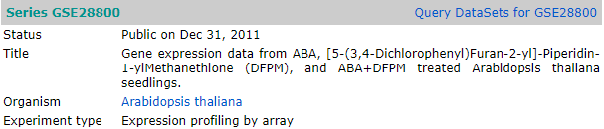

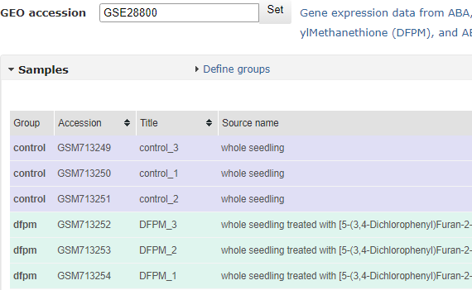
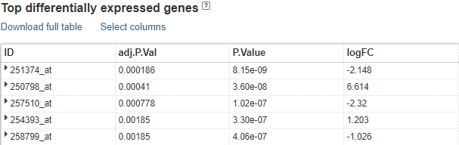
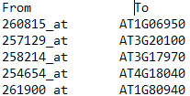

“DFPM … rapidly down-regulates ABA-dependent gene expression and also inhibits ABA-induced stomatal closure. Transcriptome analyses show that DFPM also stimulates expression of plant defense-related genes.
12 day old seeds

Slide 7

Coexpression
VS
ABA
(12 days old)
Effect of Glu
On WT
(BvsA)
P ~ E-31
593/787
(75.3%)
sigBA-
4736 genes
aba
3016 genes
Effect of Glu
on bHLH
(DvsC)
P ~ E-19
658/1331
(49.4%)
sigDC-
9625 genes
aba
3016 genes
Effect of bHLH
in Min
(CvsA)
P ~ E-57
843/1085
(77.7%)
sigCA-
6246 genes
aba
3016 genes
Effect of bHLH
in Glu
(DvsB)
P ~ E-14
431/592
(72.8%)
sigDB-
3896 genes
aba
3016 genes
-5
+5
Log2FC

Slide 8




Coexpression
VS
DFPM
Effect of Glu
On WT
(BvsA)
P ~ E-11
224/343
(65.3%)
sigBA-
4736 genes
DFPM
1376 genes
Effect of Glu
on bHLH
(DvsC)
P ~ E-11
95/624
(15.2%)
sigDC-
9625 genes
DFPM
1376 genes
Effect of bHLH
in Min
(CvsA)
P ~ E-81
608/644
(94.4%)
sigCA-
6246 genes
DFPM
1376 genes
Effect of bHLH
in Glu
(DvsB)
P ~ E-3
114/243
(46.9%)
sigDB-
3896 genes
DFPM
1376 genes
-5
+5
Log2FC

Slide 9
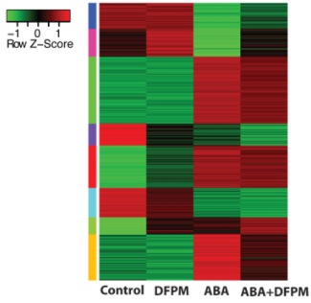
“DFPM also inhibited ABA-mediated physiological responses, including ABA-induced stomatal closure and ABA-inhibition of stomatal opening.
In contrast, DFPM hardly affected ABA-induced delay in seed germination, indicating that DFPM does not control the entire ABA signaling network but rather acts preferably on a subset of ABA responses.
In addition, DFPM does not affect endogenous ABA, suggesting that DFPM disrupts ABA signaling steps rather than ABA metabolism.”
Identification of DFPM as an activator of plant immunity-related gene expression (Fig. 2A, B) provided evidence that DFPM negatively affects ABA signal transduction through activation of plant immune signaling.
“Transcriptomic analysis shows that groups of ABA-induced genes are down-regulated by DFPM (30 µM) (n=3 microarrays per condition). The heat map contains 470 probesets regulated by ABA (292 up-regulated / 178 down-regulated”

Slide 10
