Slide 1
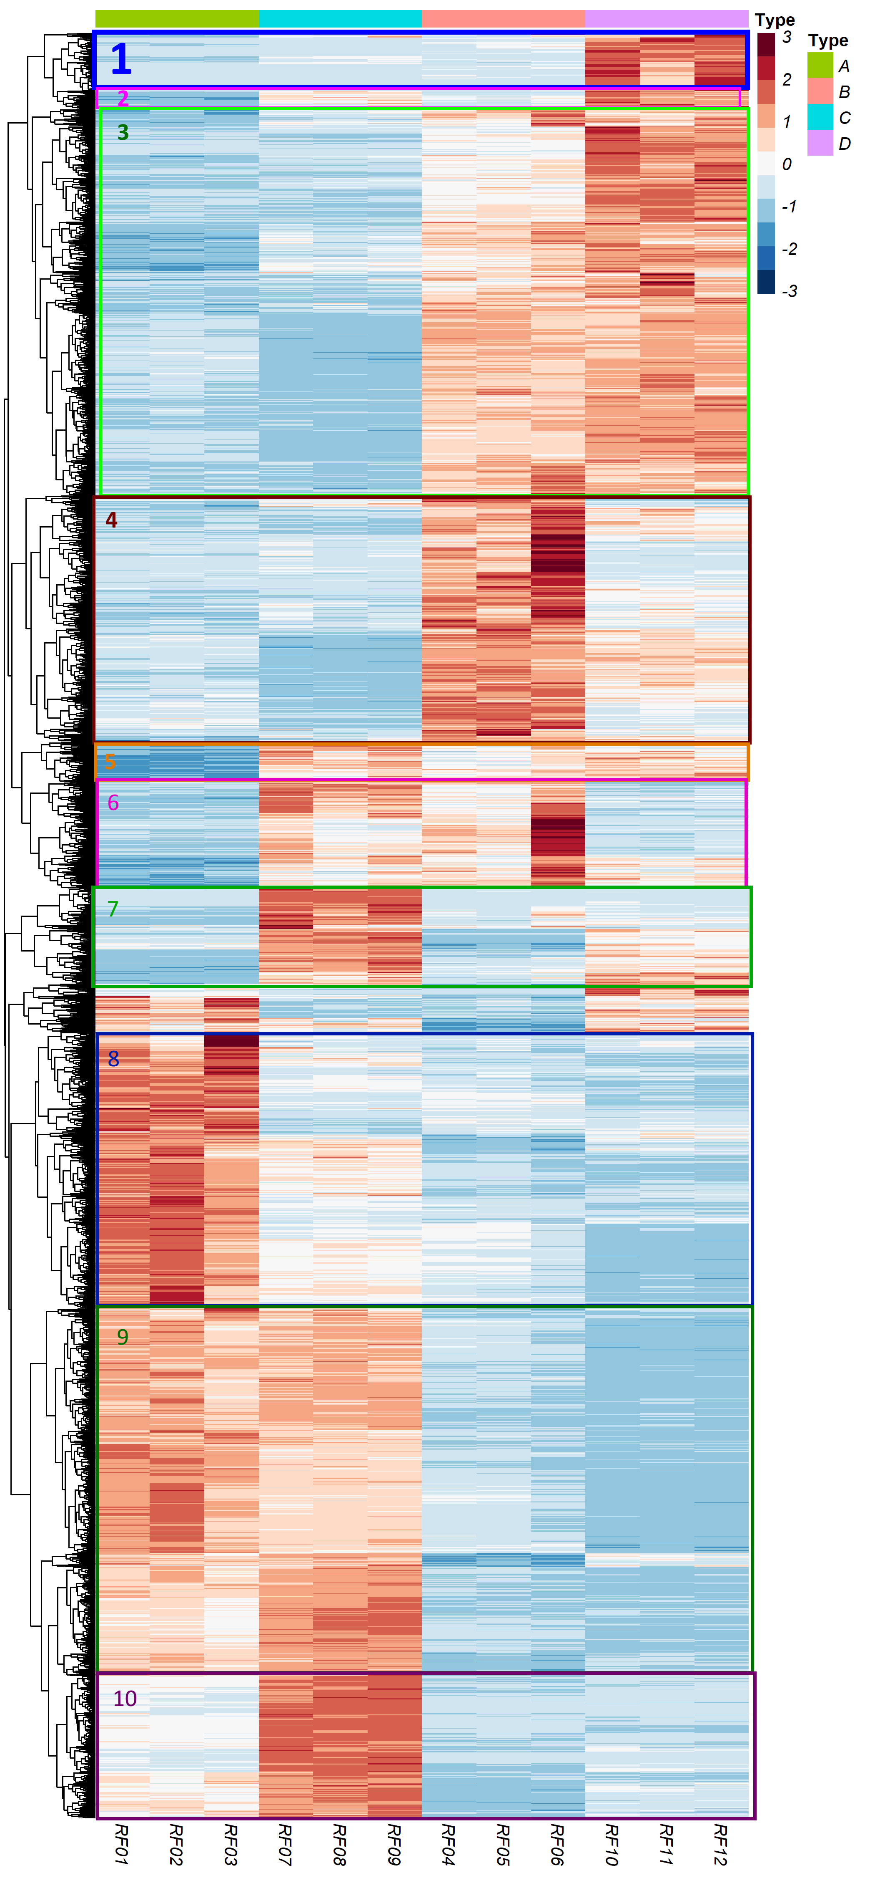
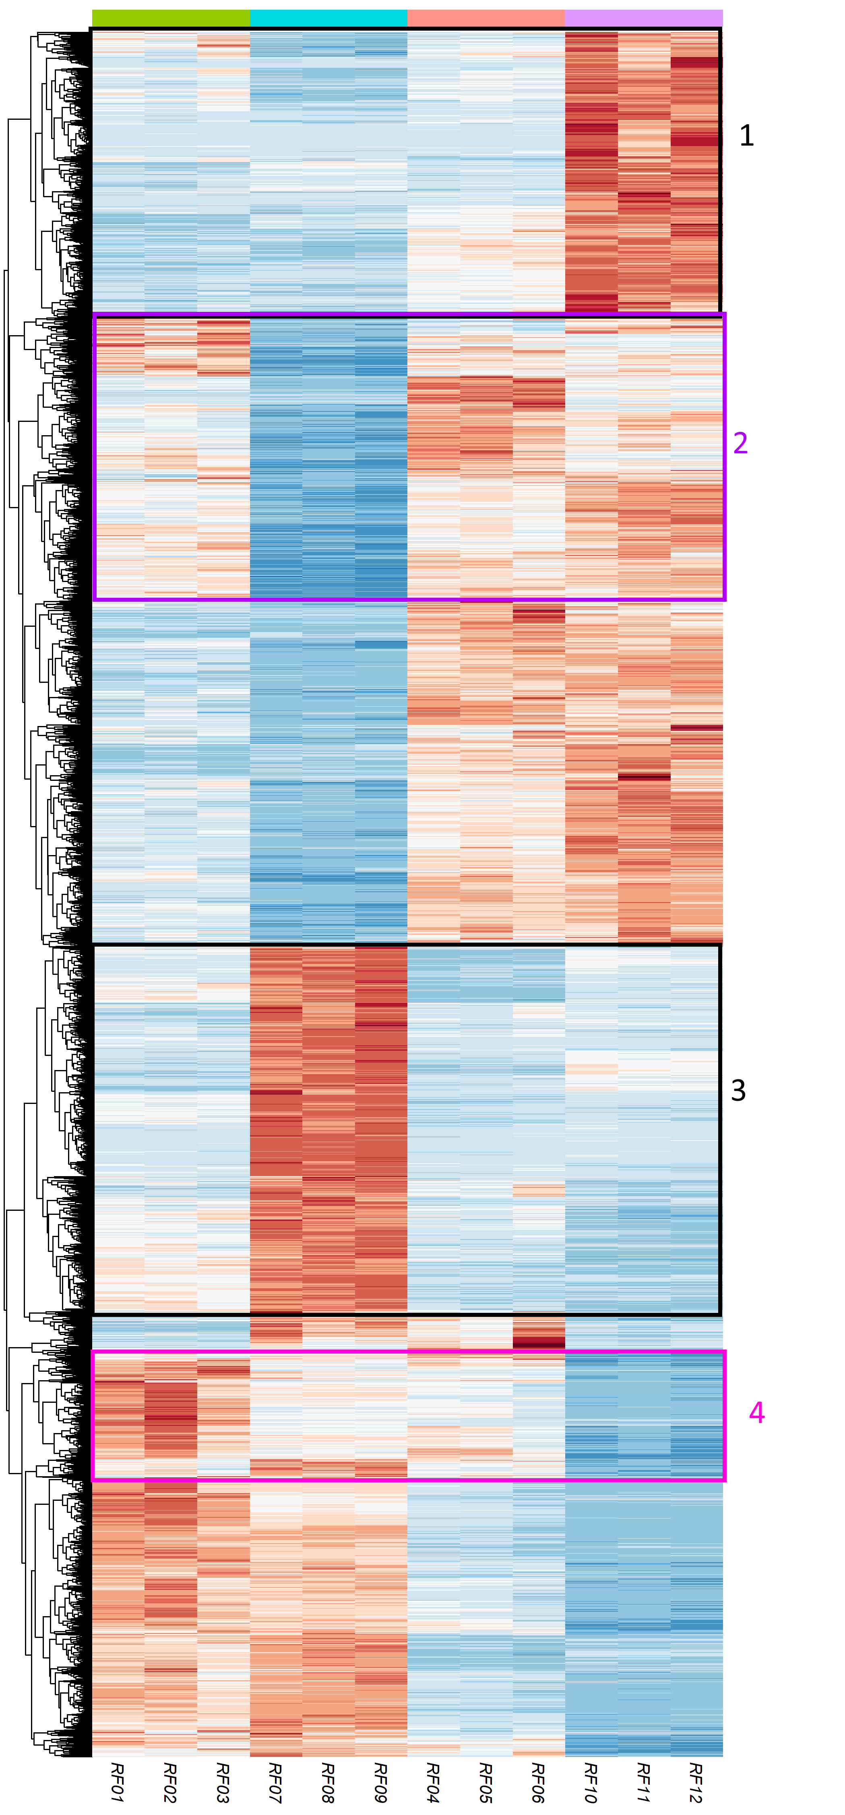
A vs B:
A C B D
C vs D:
A C B D
A = wt min
B = wt Glc4
C = YFP-bHLH48 min
D = YFP-bHLH48 Glc4
AB = Glc-reg in wt
CD = Glc-reg in Y-bHLH
AC = bHLH reg on min
BD = bHLH reg on Glc

Slide 2
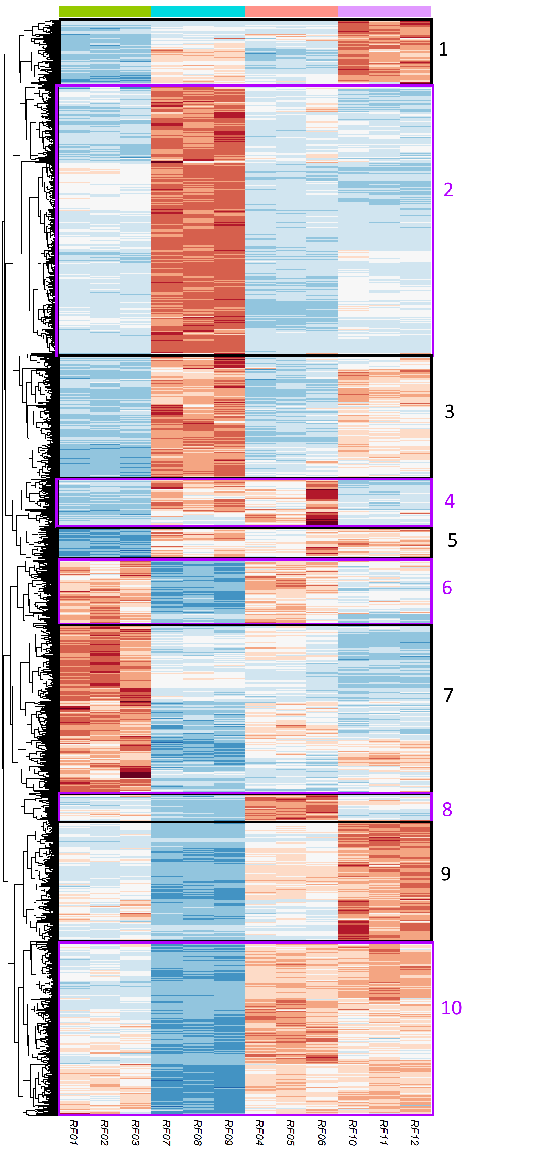
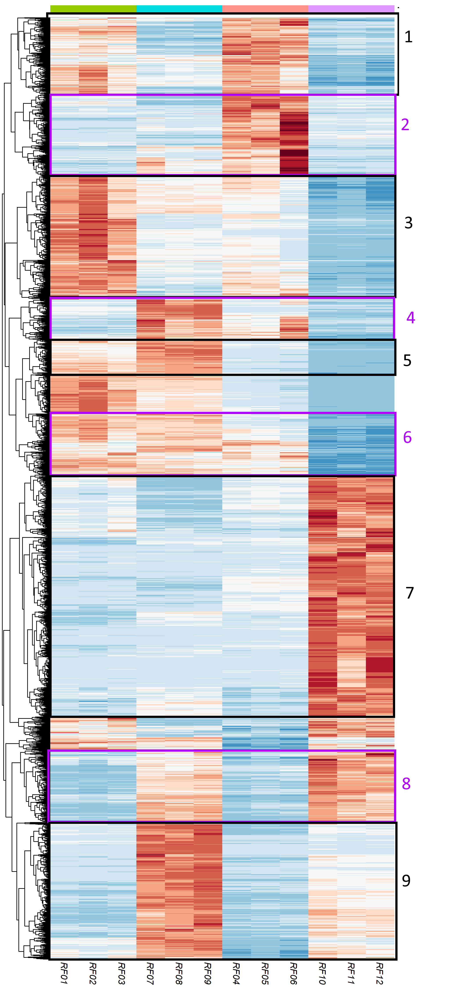
A vs C:
A C B D
B vs D:
A C B D
A = wt min
B = wt Glc4
C = YFP-bHLH48 min
D = YFP-bHLH48 Glc4
AB = Glc-reg in wt
CD = Glc-reg in Y-bHLH
AC = bHLH reg on min
BD = bHLH reg on Glc

