Slide 1
C:\Users\username\AppData\Roaming\Microsoft\Windows\Start Menu\Programs\Startup
Choose time for daily word definition to appear (24 hour clock):
Make the code able to handle single digits for any numbers less than 10
00
:
00
Hour
Min
Only appear if start button pressed and time not correct (not within the 24 hour clock, or empty).
Time entered incorrectly
Add program to startup folder (needed to keep program running after computer reboot)
Start
Startup folder
Change
:\Users\username\AppData\path……
Hour
00
:
Min
00
Appear if toggle button pressed.
Only show path up to box width – have the ability to scroll sideways

Slide 2
Change time for program to run (24 hour clock):
00
:
00
Or
Stop program
Ok

Slide 3
Word of day
Include word and colon first
Word:
Word
Definition:
Definition, definition, definition, definition, definition, definition, definition, definition
Add word to priority word list
Daily priority word
Word: definition, definition, definition, definition , definition , definition , definition , definition
If there are no words in the priority word list, print this instead:
Daily priority word
Currently no words
Reveal word definition

Slide 4
Add words
Add word
Add word definition
A new word gets added to the top of the edit word list
Add
Edit words
Delete all words
Priority word
Word: definition
Delete
Edit
Word: definition………………………………
Opens a dialog box to confirm delete
Toggled on for current priority words – immediately changes the json file.
Opens a dialog box to confirm delete
Opens a dialog box
(next slide), with two text boxes that can be edited (1) word and 2) def), and a ‘Save’ button.

Slide 5
Program currently running
Program not currently running
Change time for program to run (24 hour clock):
Choose time for daily word definition to appear (24 hour clock):
00
:
00
00
:
00
Hour
Min
Or
Add program to startup folder (needed to keep program running after computer reboot)
Stop program
Startup folder
Change
:\Users\username\AppData\path……
Edit word list
Ok
Edit word list
Start

Slide 6
Each one will require its own exe file
User input main. Will be run when the icon, or its exe file, is clicked on. When run, it figures out if the program is running or not, and then brings up the appropriate API (start or stop program). The edit words API is started via a button in the start and stop APIs.
Main running. This is the code that runs the API to present the daily word. Some additional things that it needs are.

Slide 7
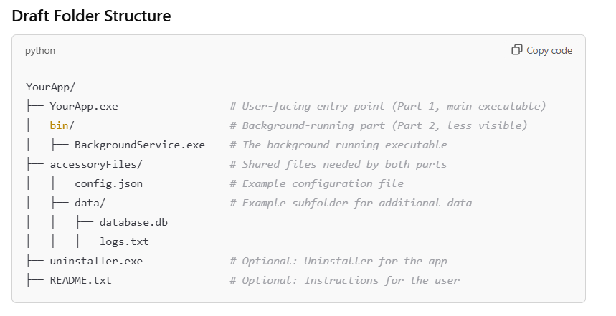
For when making installer

