Slide 1

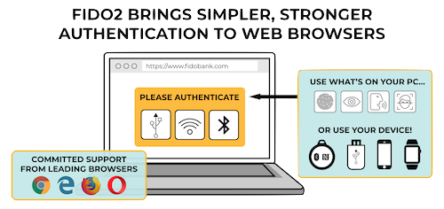

Security Evaluation of Multi-Factor Authentication in Comparison with the Web Authentication API
Master’s Thesis
Internet users are at constant risk, given that data breaches happen nearly daily.
This master's thesis introduces and evaluates different methods of authentication and multi-factor authentication solutions, e.g., one-time passwords, with a focus on their security. Further, the Web Authentication API is explained and compared with the other multi-factor authentication solutions. The question has to be answered, whether the Web Authentication API can replace existing multi-factor authentication solutions or to what extent it can be used in conjunction with them.
Author:
Tim Brust
Course of studies:
Information security and forensics
Submitted by:
09/30/2019
First supervisor:
Prof. Dr.-Ing. habil. Andreas Ahrens
Second supervisor:
Prof. Dr. rer. nat. Nils Gruschka
Web Authentication API (WebAuthn)
The Web Authentication API is a joint efforts of the FIDO alliance and the W3C and an evolution of the U2F protocol.
In comparison with other MFA solutions, WebAuthn provides resistance against phishing attacks and lets the user decide which authenticator should be used, e.g. a built in authenticator or an external token.
WebAuthn provides resistance against phishing attacks and has the potentials to replace passwords, but is not fully implemented in all web browsers, yet.
(Time-based) MFA
A commonly used method to achieve MFA besides the password is the usage of authentication by possession of the shred secret for time-based one-time password. However, the transport mediums, such as SMS, and service providers are a lucrative attack target.
Time-based one-time password are not phishing resistant and especially the transport mechanisms are a subject to exploit vulnerabilities and social engineering attacks
Conclusion:
Multi-Factor Authentication can increase the security, but is still subject to phishing attacks. It can be made phishing resistant, but it requires a change of the transportation medium or the usage of other authentication methods.
Also, the Web Authentication API has the potential to replace passwords. However, it is not yet usable enough for the end consumer, mostly because the API is not fully supported in all operating systems.
* Source: https://www.w3.org/2018/04/pressrelease-webauthn-fido2.html
Faculty of Engineering Department of Electrical Engineering and Computer Science
www.fiw.hs-wismar.de

