Slide 1
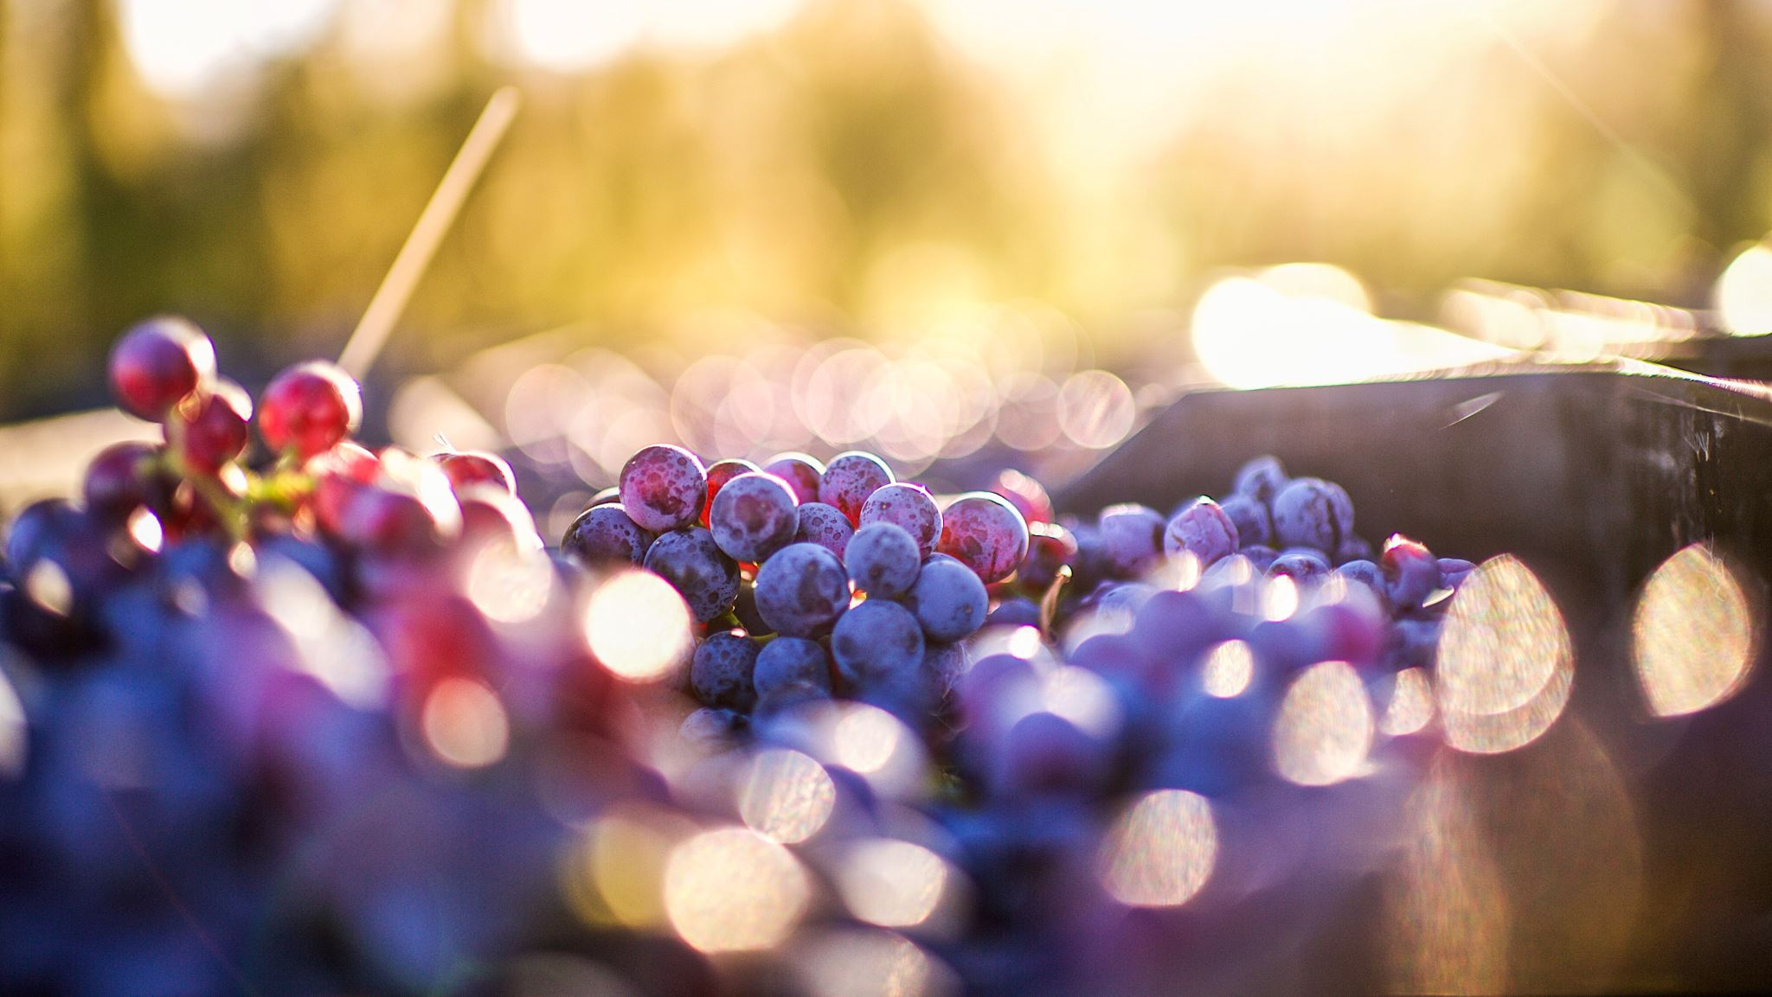
Wine Quality Prediction
By:
Tim Chen and Graeme Fraser

Slide 2

Introduction
Family owns and operates wine bars throughout the SoCal region
High restaurant profits are synonymous with high alcohol sales
Analyzed physiochemical properties to determine wine quality
We used several wine classification ML algorithms such as K-NN, Naïve Bayes, Decision Tree, Random Forest, and Neural Networks
The models were evaluated on several different metrics to determine the optimal model for deployment.

Slide 3

Research Questions
1) Determining whether physiochemical properties can generate insight into understanding consumer wine preferences
2) Indicate which chemical properties are more important in classifying wine quality
3) Determine whether higher or lower levels of physiochemical properties will produce exceptional wine quality.

Slide 4
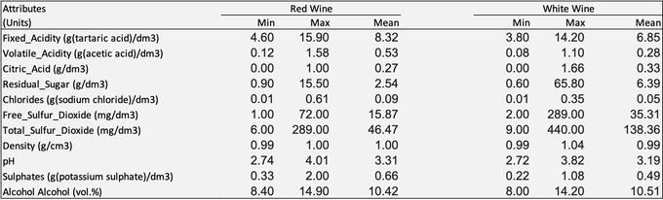
Data Description
Created by University of Minho and Vinho Verde winery
The red and white wine datasets consist of 1600 and 5900 rows, respectively
Dataset donated to UCI ML repository
11 different input features and 1 output feature, Quality

Slide 5
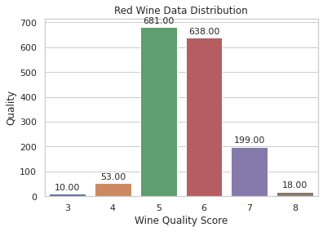
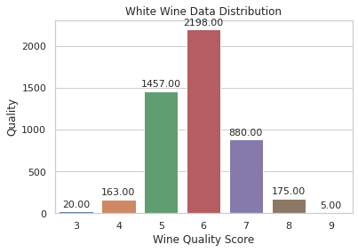
Data Description Continued
Quality scores 5 and 6 constitute 82% of the red wine dataset and 72% of the white wine dataset.

Slide 6
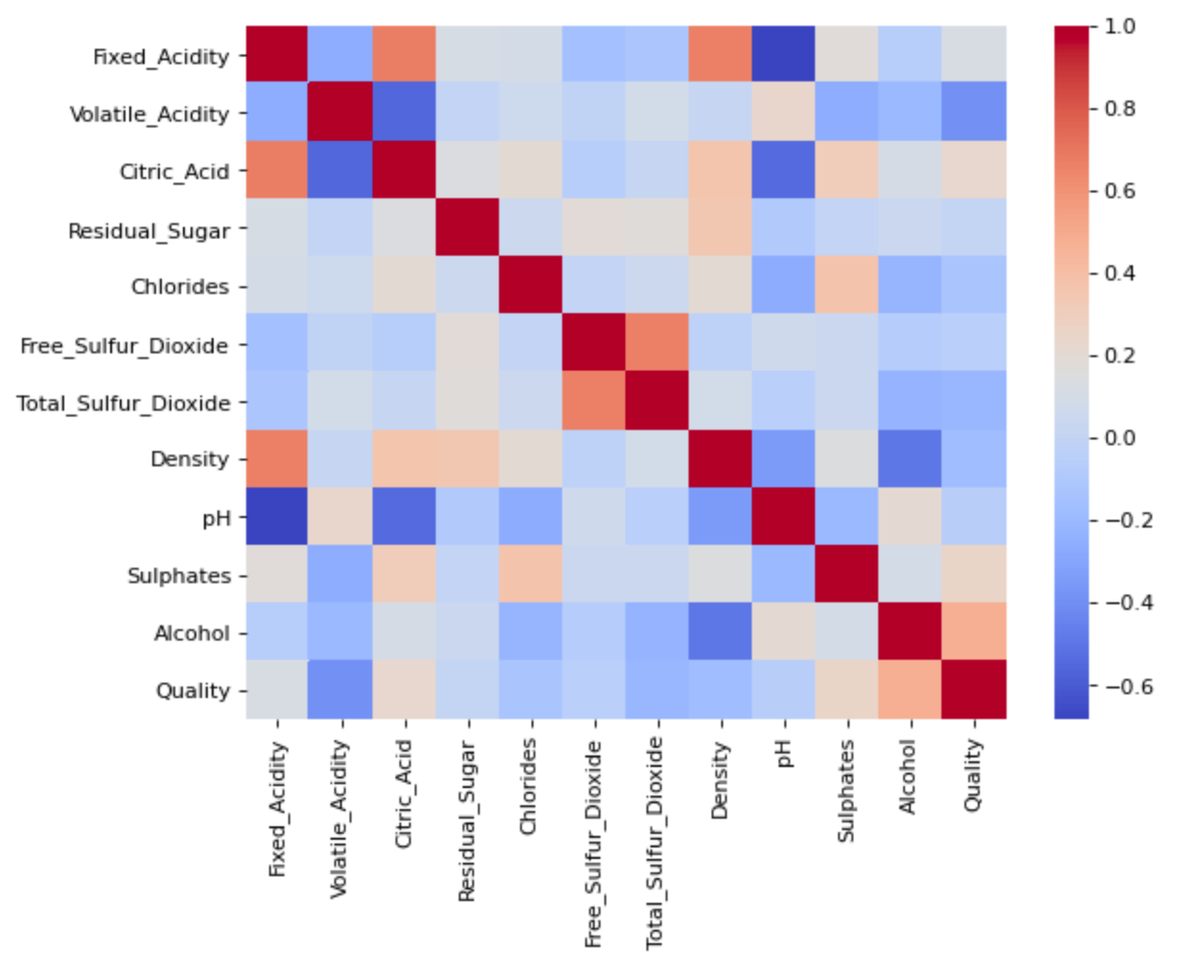
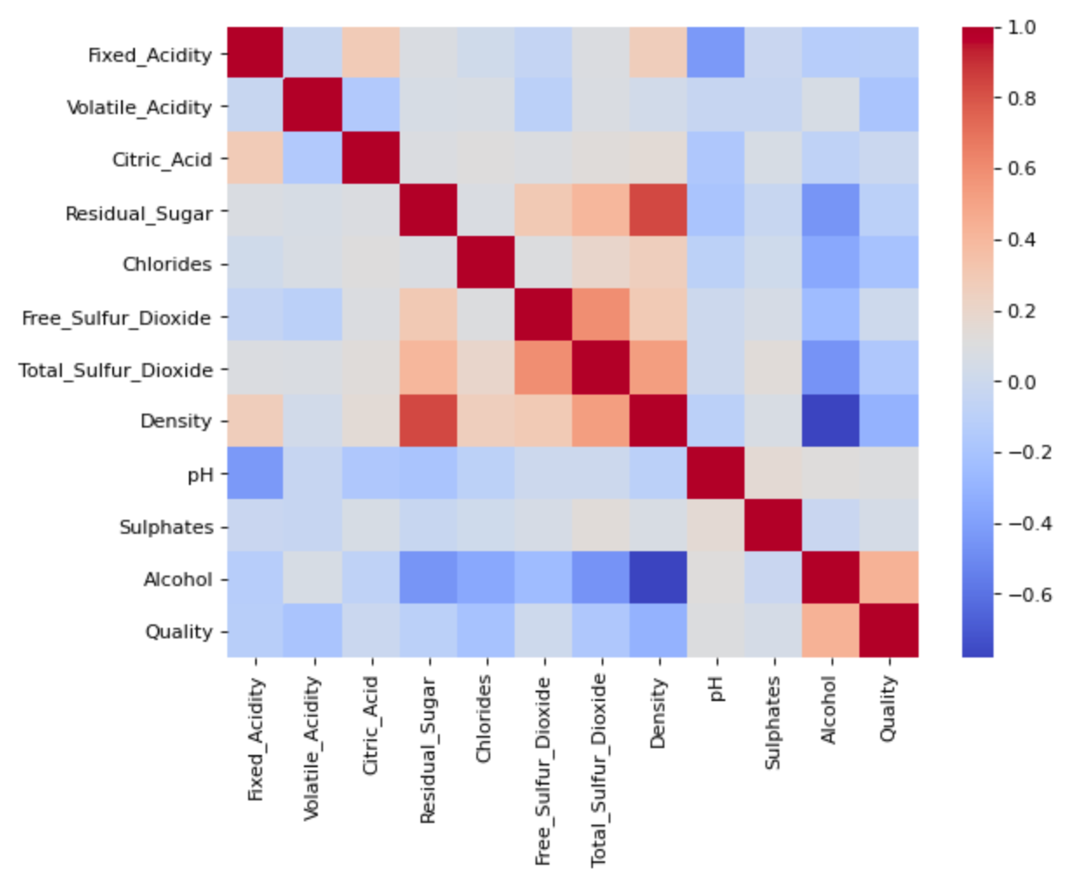
Prediction Results
Determined X and Y values by eliminating colinear features
Outliers within each feature were replaced with the mean value
Scaled the dataset for all algorithms except Random Forest due to performance
Notes:
First, we cleaned the data by replacing the space with _
Then, we use scatter plot to visualize some columns. We found some outliers and we replaced those with mean values.
Third, we scaled the data except random forest.
Lastly, we look at the correlation heatmap and remove columns to prevent multicollinearity issue.
For
Red: dropped Citric Acid and Fee sulfur Dioxide
White: dropped Residual Sugar

Slide 7
Model Development
80% Training – 20% Testing for each algorithm
Created functions to facilitate the coding process
Experimented with logistic and multi regression
Models | Specific Algorithmic Information
K-NN | Scaled data, n_neighbors = 1 for red and white algorithms
Naiive Bayes | Scaled data
Decision Tree | Scaled Data, max_depth 39 for red and 69 for white, feature importance
Random Forest | n_estimators = 400, max_features = log2, feature importance
Neural Network | Target feature categorical, scaled data, test and training set, 3 hidden layers, drop out and early stopping function, red ran for 39 epochs and white for 70 epochs

Slide 8
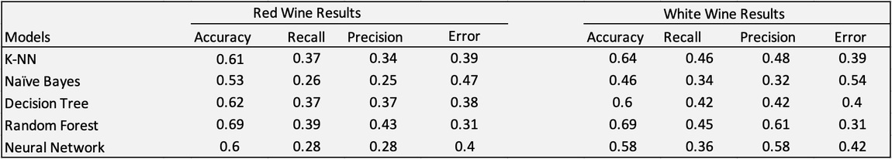
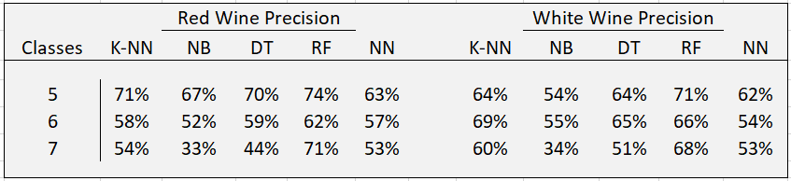
Comparing Model Results

Slide 9
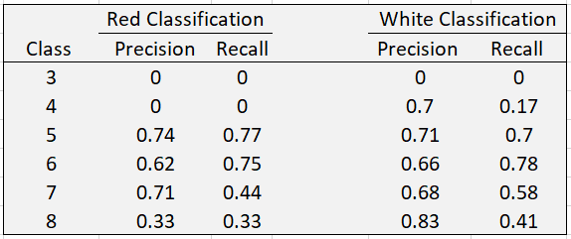
Random Forest Results
The above graph indicates precision and recall for the red and white Random Forest algorithms for each class.
Notes:
To conclude.... switch

Slide 10
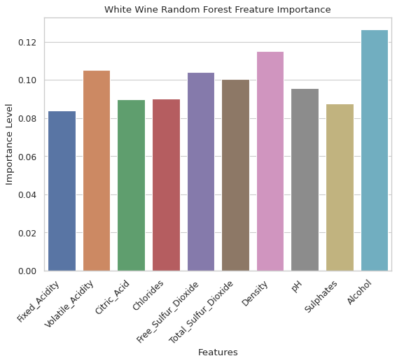
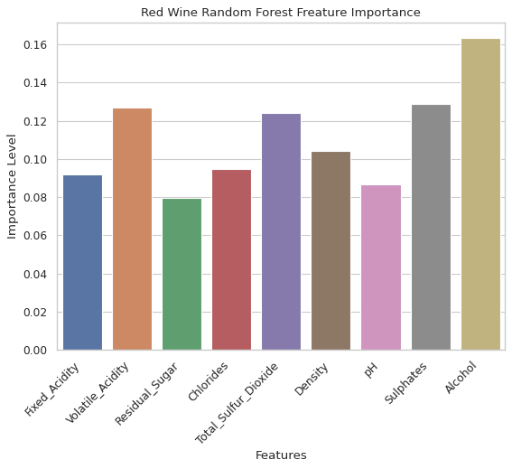
Random Forest Feature Importance
The Random Forest red wine algorithm determines that Alcohol, Volatile Acidity, Total Sulfur Dioxide, and Sulphates are of greatest importance.
Alcohol is of greatest importance and Volatile Acidity, and Density follow closely behind for the white wine algorithm.
Notes:
overall.....

Slide 11
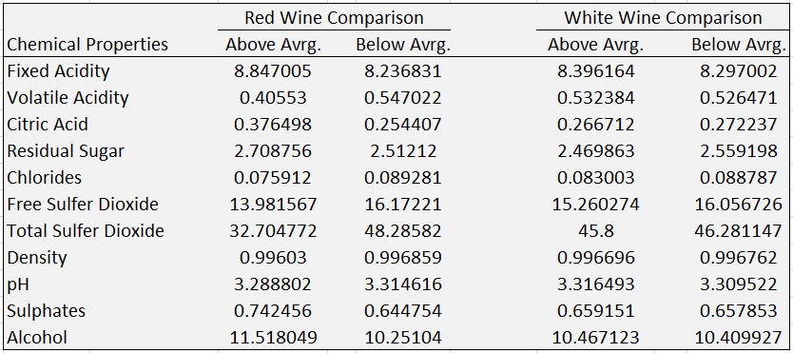
Feature Comparison
We conclude that higher quality red wine should have lower Total Sulfur Dioxide and Free Sulfur Dioxide, and higher Alcohol content.
For the white wine dataset, lower levels of Free Sulfur Dioxide and Total Sulfur Dioxide produce higher quality wine.
Notes:
overall.....

Slide 12
Conclusion
Produced an algorithm that classifies wine quality with 70% accuracy derived from physiochemical properties.
We conclude that Alcohol, Volatile Acidity, Total Sulfur Dioxide, and Sulphates are important classifying features for the red wine dataset.
Additionally, Alcohol, Volatile Acidity, and Density are significant chemicals when predicting white wine quality.
We determined that higher quality red wine should have lower Total Sulfur and Free Sulfur Dioxide, and a higher Alcohol content.
Lastly, lower levels of Free Sulfur and Total Sulfur Dioxide produce higher white wine quality.
We believe the NN model with specific hidden layer functions and a unique output function would produce higher accuracy.

Slide 13
References
Cortez, P., Cerdeira, A., Almeida, F., Matos, T., & Reis, J. (2009, June 9). Modeling wine preferences by data mining from physicochemical properties. Decision Support Systems. https://www.sciencedirect.com/science/article/abs/pii/S0167923609001377?via%3Dihub.
Cortez, P., Cerdeira, A., Almeida, F., Matos, T., & Reis, J. (2009, May 22). Modeling wine preferences by data mining from physicochemical properties. http://www3.dsi.uminho.pt/pcortez/wine5.pdf.
Chen, T., & Fraser, G. (2021). Modeling Wine Preferences by Machine Learning . https://colab.research.google.com/drive/1ddy3xpRIF0k-p1LzQaxemakOB76f4Gfb?usp=sharing&fbclid=IwAR1-pEvkyK25IC4ZSv7ANdpzgclJOn2yAP51P64FMPWHID9DZHQPE-4Nw44.
Chen, T., & Fraser, G. (n.d.). Wine Prediction with Neural Networks. Google Collaboratory. https://colab.research.google.com/drive/1vnyHsJv-CRr49FfSNN8u9YPz7TiBtevJ?usp=sharing.

