Slide 1
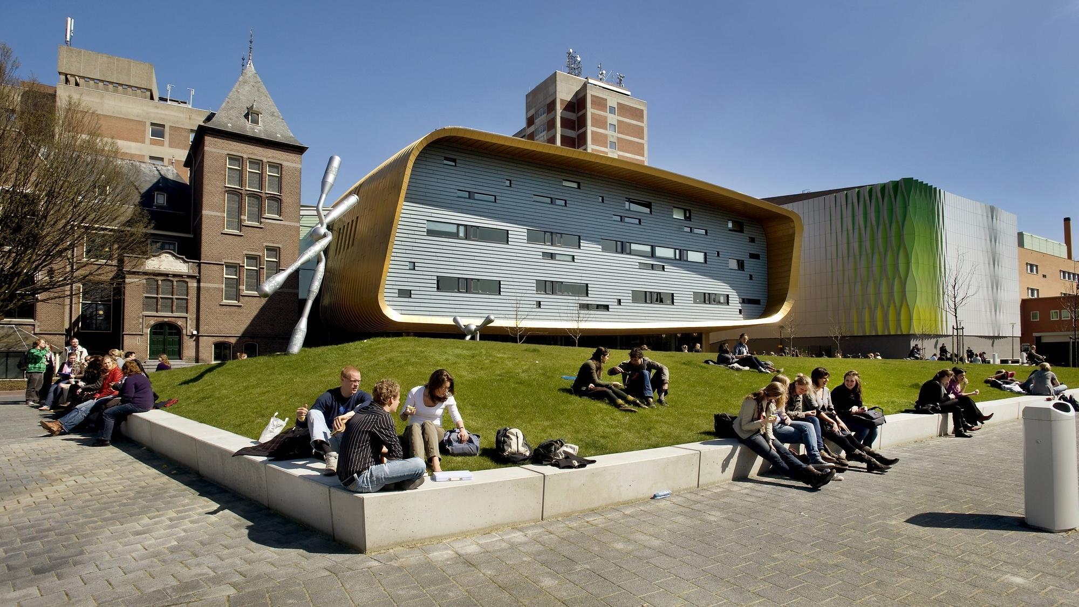


From Data Discovery to Federated Analysis
Supporting the Research Journey
Bella Anna Binoy, Tim Cadman, Andreas Türk, Kurt Macjen, Brenda Hijmans, Hessel Haagsma, MOLGENIS catalogue & armadillo teams, BBMRI-ERIC collaborators, Gerieke Been, Eleanor Hyde, Morris Swertz
(MOLGENIS · UMC Groningen · BBMRI-ERIC)
m.a.swertz@umcg.nl · European Biobank Week 2026

Slide 2
the researchers JOURNEY
Data-seeking researcher
needs data on a particular topic
A collection custodian
one group hosting its own collection
Data infrastructures
implement and operate supporting data fabric
Consortium architect
builds multi-centre studies & collaboration networks, i.e. data federations
Large (Institutional) biobank
hosts many small biobanks
(e.g. CBCH @ UMCG)
Research infrastructures
set standards & facilitates collaboration
(e.g. BBMRI-ERIC, Health-RI)

Slide 3
OUR Journey FROM FAIR AT SOURCE TO FAIR RESEARCH FEDERATIONS
Kim Monkhorst
Departure ‘building blocks’
Multi-centre data can transform healthcare and prevention
But many research consortia still rebuild the ‘data plumbing’
And months lost negotiating collection-by-collection
We are often involved in these ‘building blocks’ without spending enough time on the whole.
Destination ‘research journeys’
FAIR at the source → FAIR research federations
Using free and open data infrastructure tools & standards
And sustained collaborations with all researchers / infrastructures involved
We dream of creating multi-center facilities where research can flow without obstacles
MOLGENIS is a data infrastructure enabling national and EU consortia to accelerate health research

Slide 4
ACT 1 — FAIR AT SOURCE
Building blocks to make individual collections FAIR

Slide 5
FAIR AT THE SOURCE · step 1 · MAKE REUSABLE
Data deposition for local (re)use
Screenshot: a real collection / registry in the platform
Often data is collected for own use
The first ‘reuser’ is usually the next PhD student
Then emerges the need for a repository: Structured · manageable · queryable · QC · backed up
This initiated MOLGENIS data platform — for biobanks/cohorts/trials/registries · flexible · free & open source — no vendor lock-in · best practice data models

Slide 6
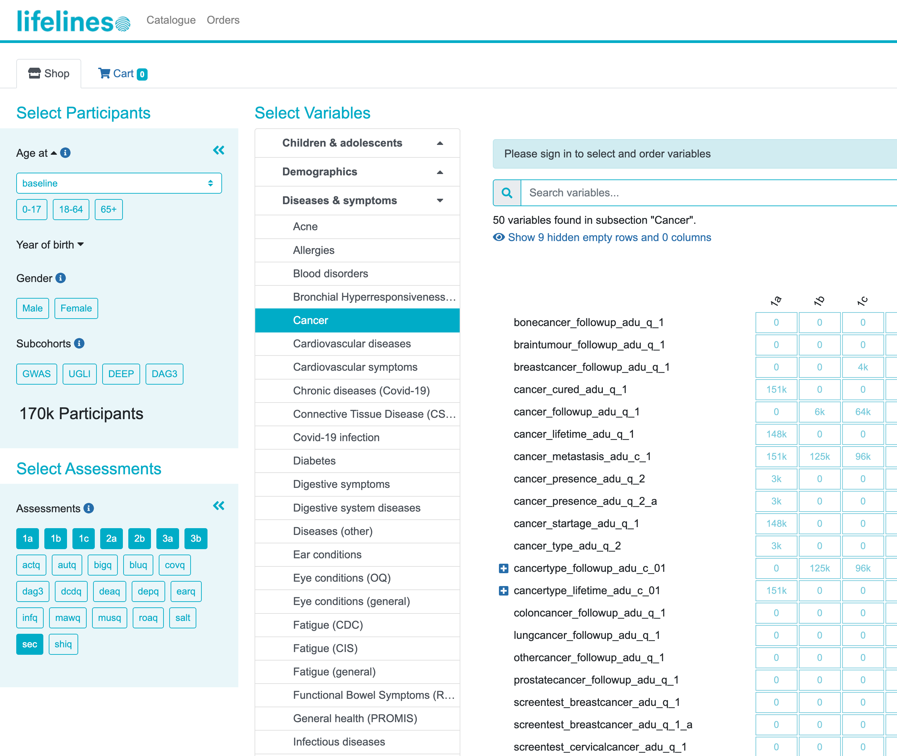
FAIR AT THE SOURCE · MAKE REUSABLE
catalogue for collaboration
At some point a collection concludes that reuse can be a great multiplier — co-authorships, citations, grants, collaborations
A catalogue is the tool to help make the collection discoverable
Advanced version: catalogue → select → request → decision → delivery
For example: Lifelines — data catalogue + request flow
Sijtsma (2022) Cohort Profile Update: Lifelines

Slide 7
FAIR AT THE SOURCE · MAKE ACCESSIBLE
Enable trusted ANALYSIS ACCESS
Close collaborators stay informal — but external users need policy & contracts
Carve out a clean subset — derived/anonymised for a specific use
Holder decides what leaves, and in what form
Modes:
Secure download
Queryable database
DRE / secure remote desktop
HPC for large data
Schematic: subset extracted into a secure remote desktop environment

Slide 8
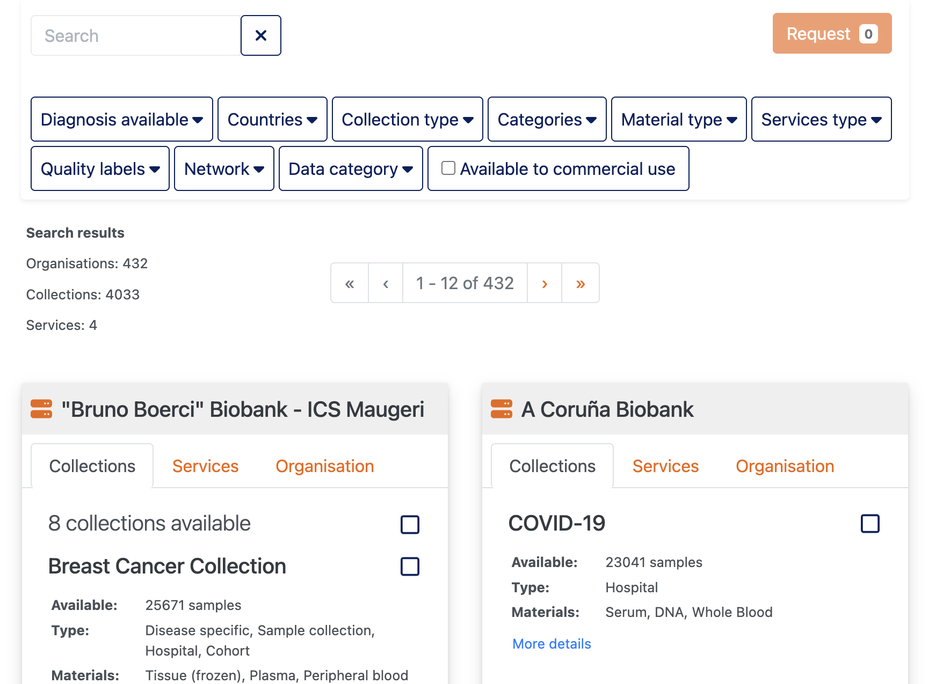
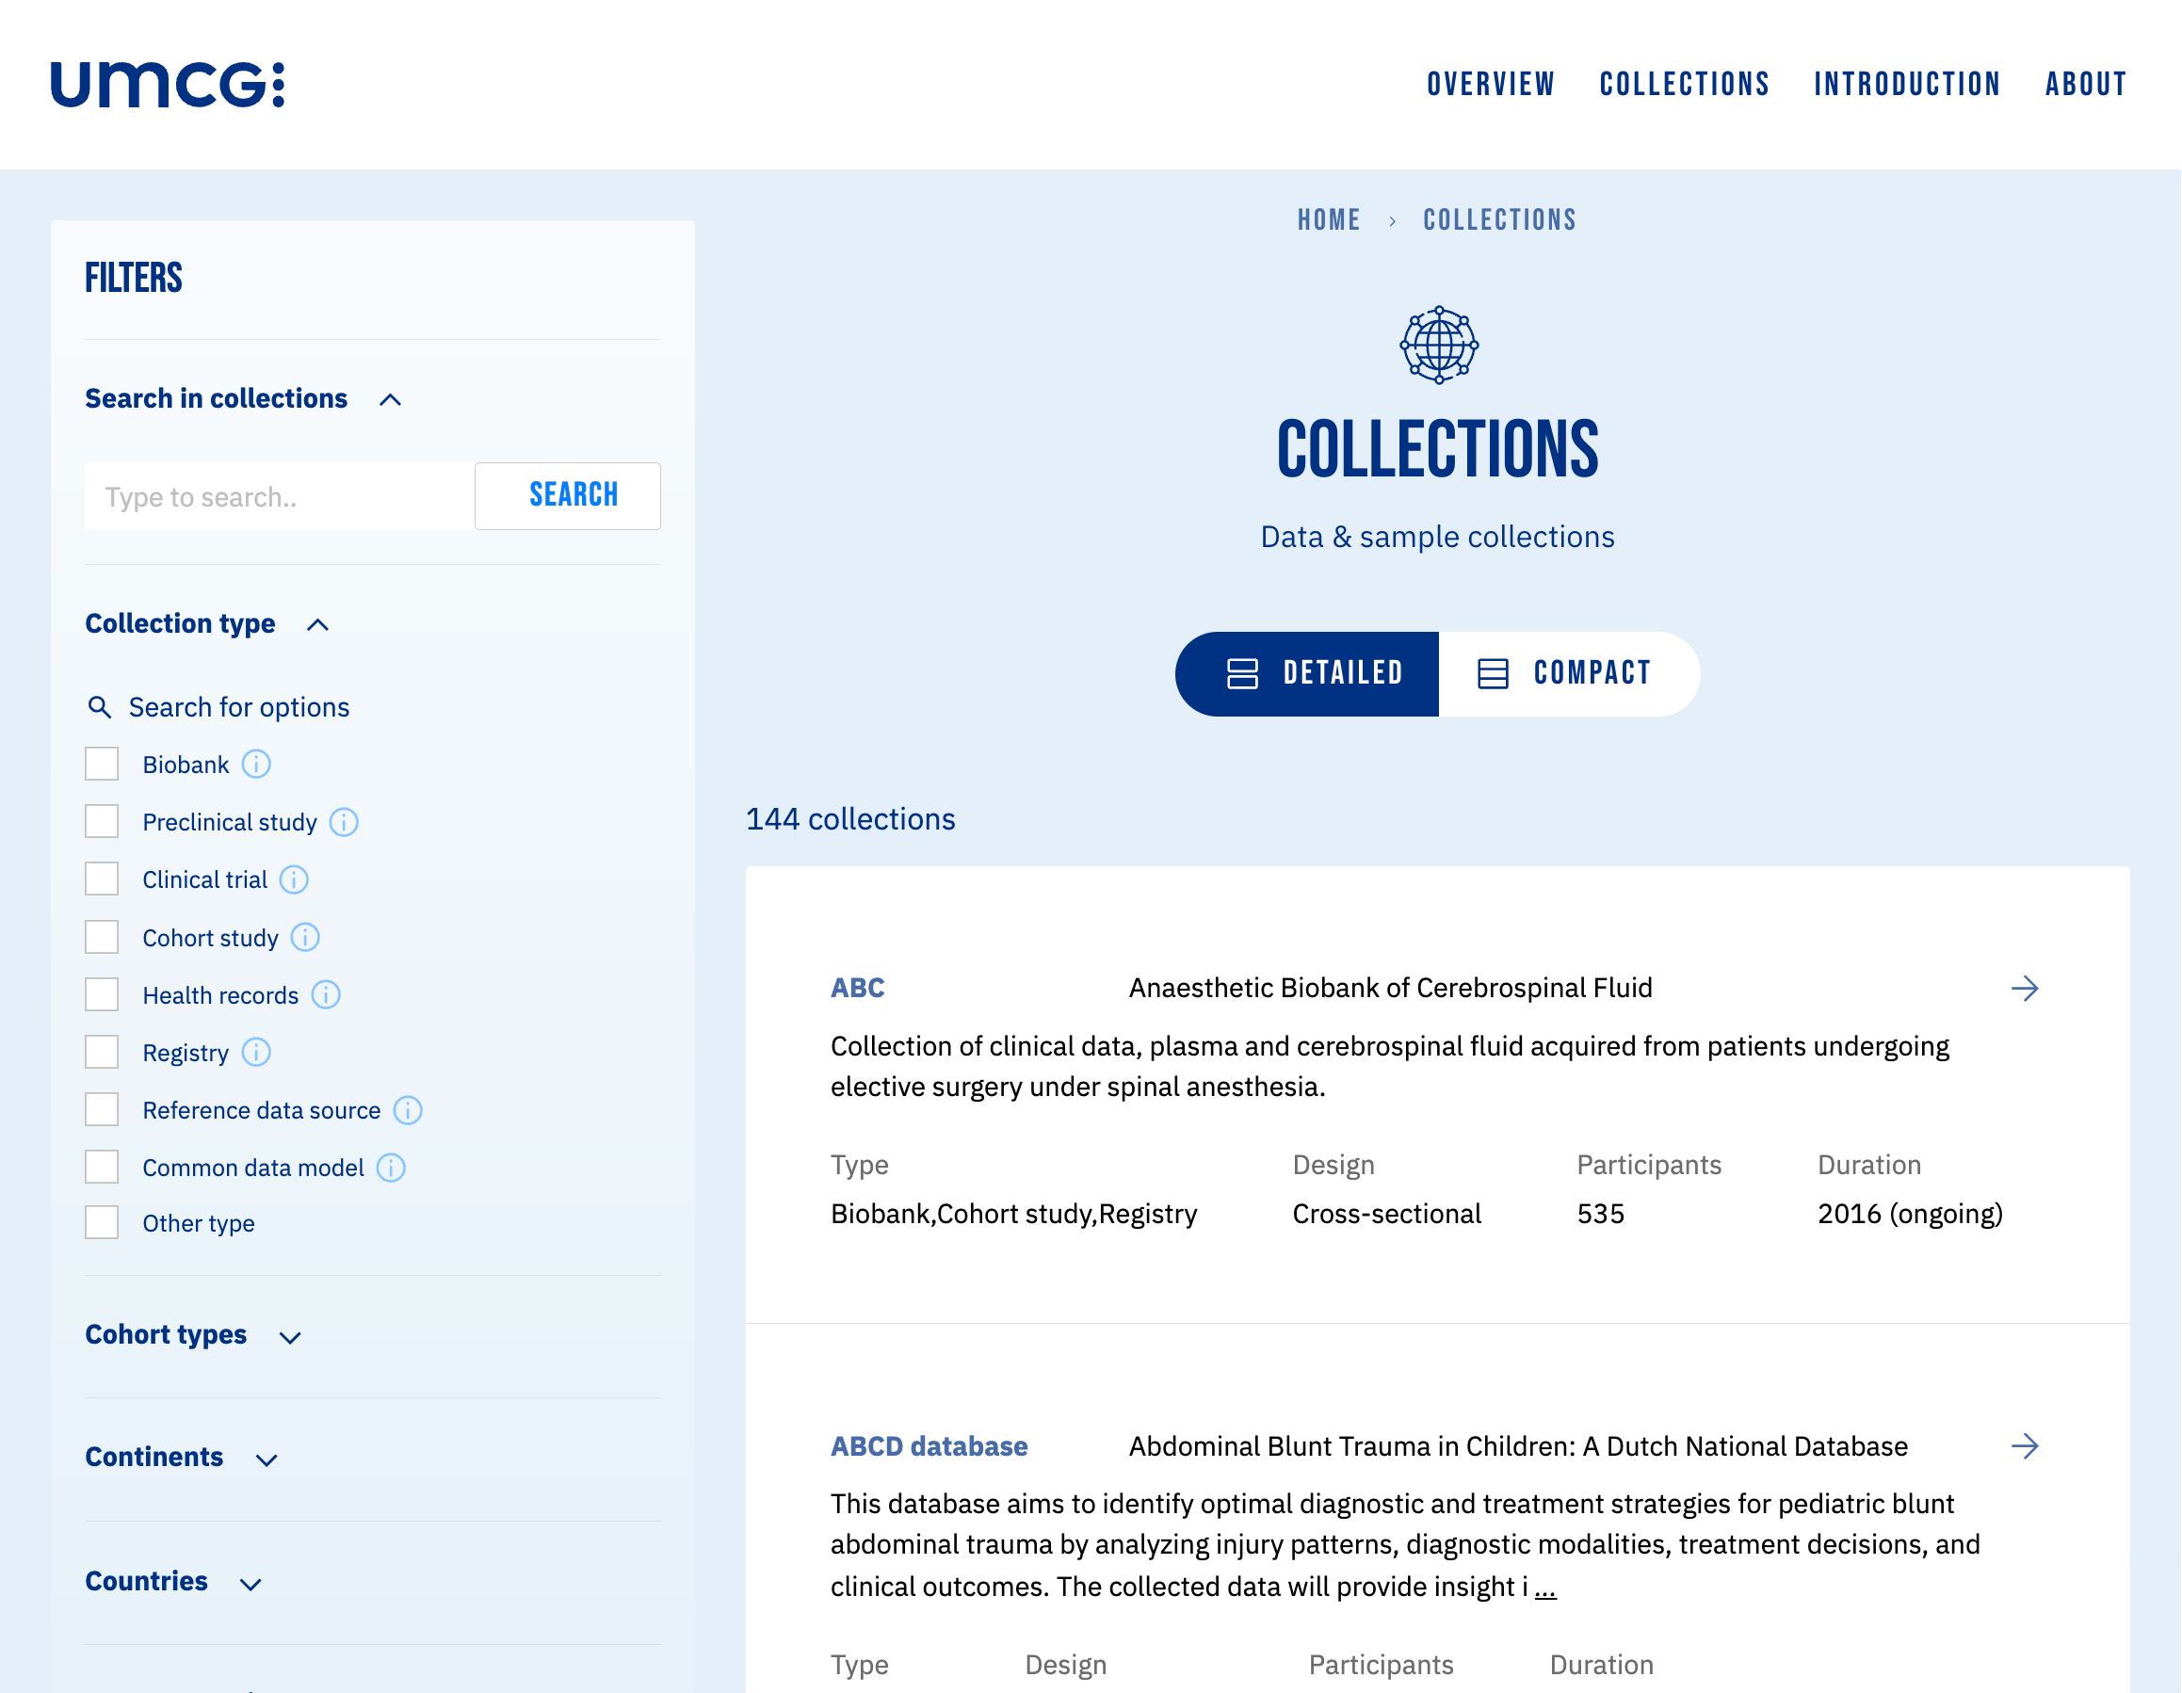
FAIR AT THE SOURCE · MAKE FINDABLE (many) CATALOGUES FOR RI and INSTITUTIONS
BBMRI-ERIC DIRECTORY
https://directory.bbmri-eric.eu
UMCG CBCH DATA CATALOGUE
https://umcgresearchdatacatalogue.nl
Holub et al. (2016) BBMRI-ERIC Directory

Slide 9
ACT 2 — FAIR FEDERATIONS
Building blocks for collaborations of collections

Slide 10
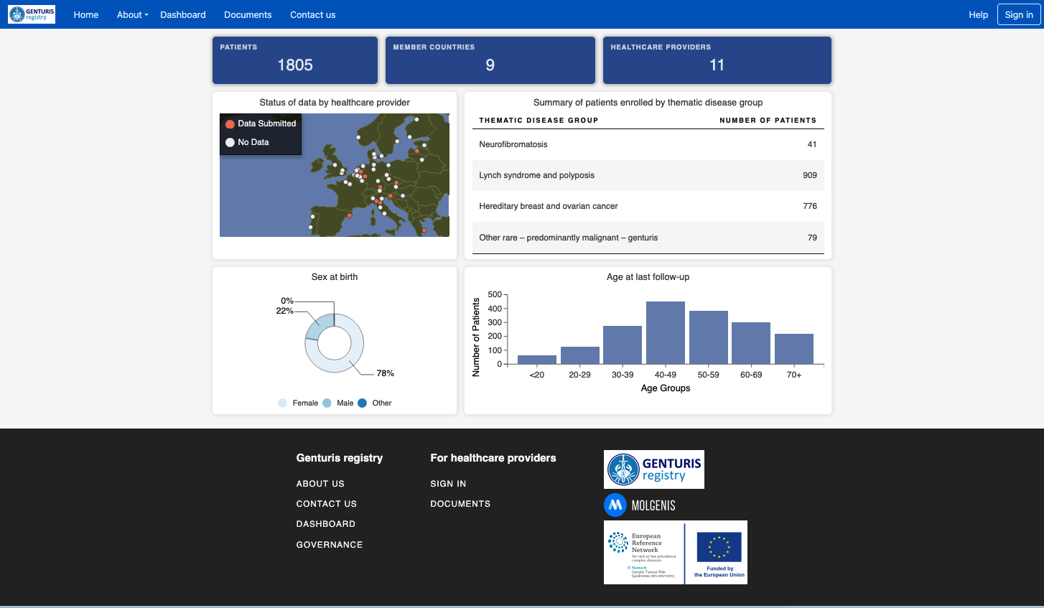
FAIR RESEARCH FEDERATIONS · CENTRAL ROUTE
Central data deposition, central analysis ACCESS
Often chosen in rare disease — small sample sizes per site
Also when trust between partners is high enough
Central analysis is easier — the analyst can see the data
Examples: ERN patient registries, Solve-RD/ERDERA joint analysis of 20k+ patient genomes.

Slide 11
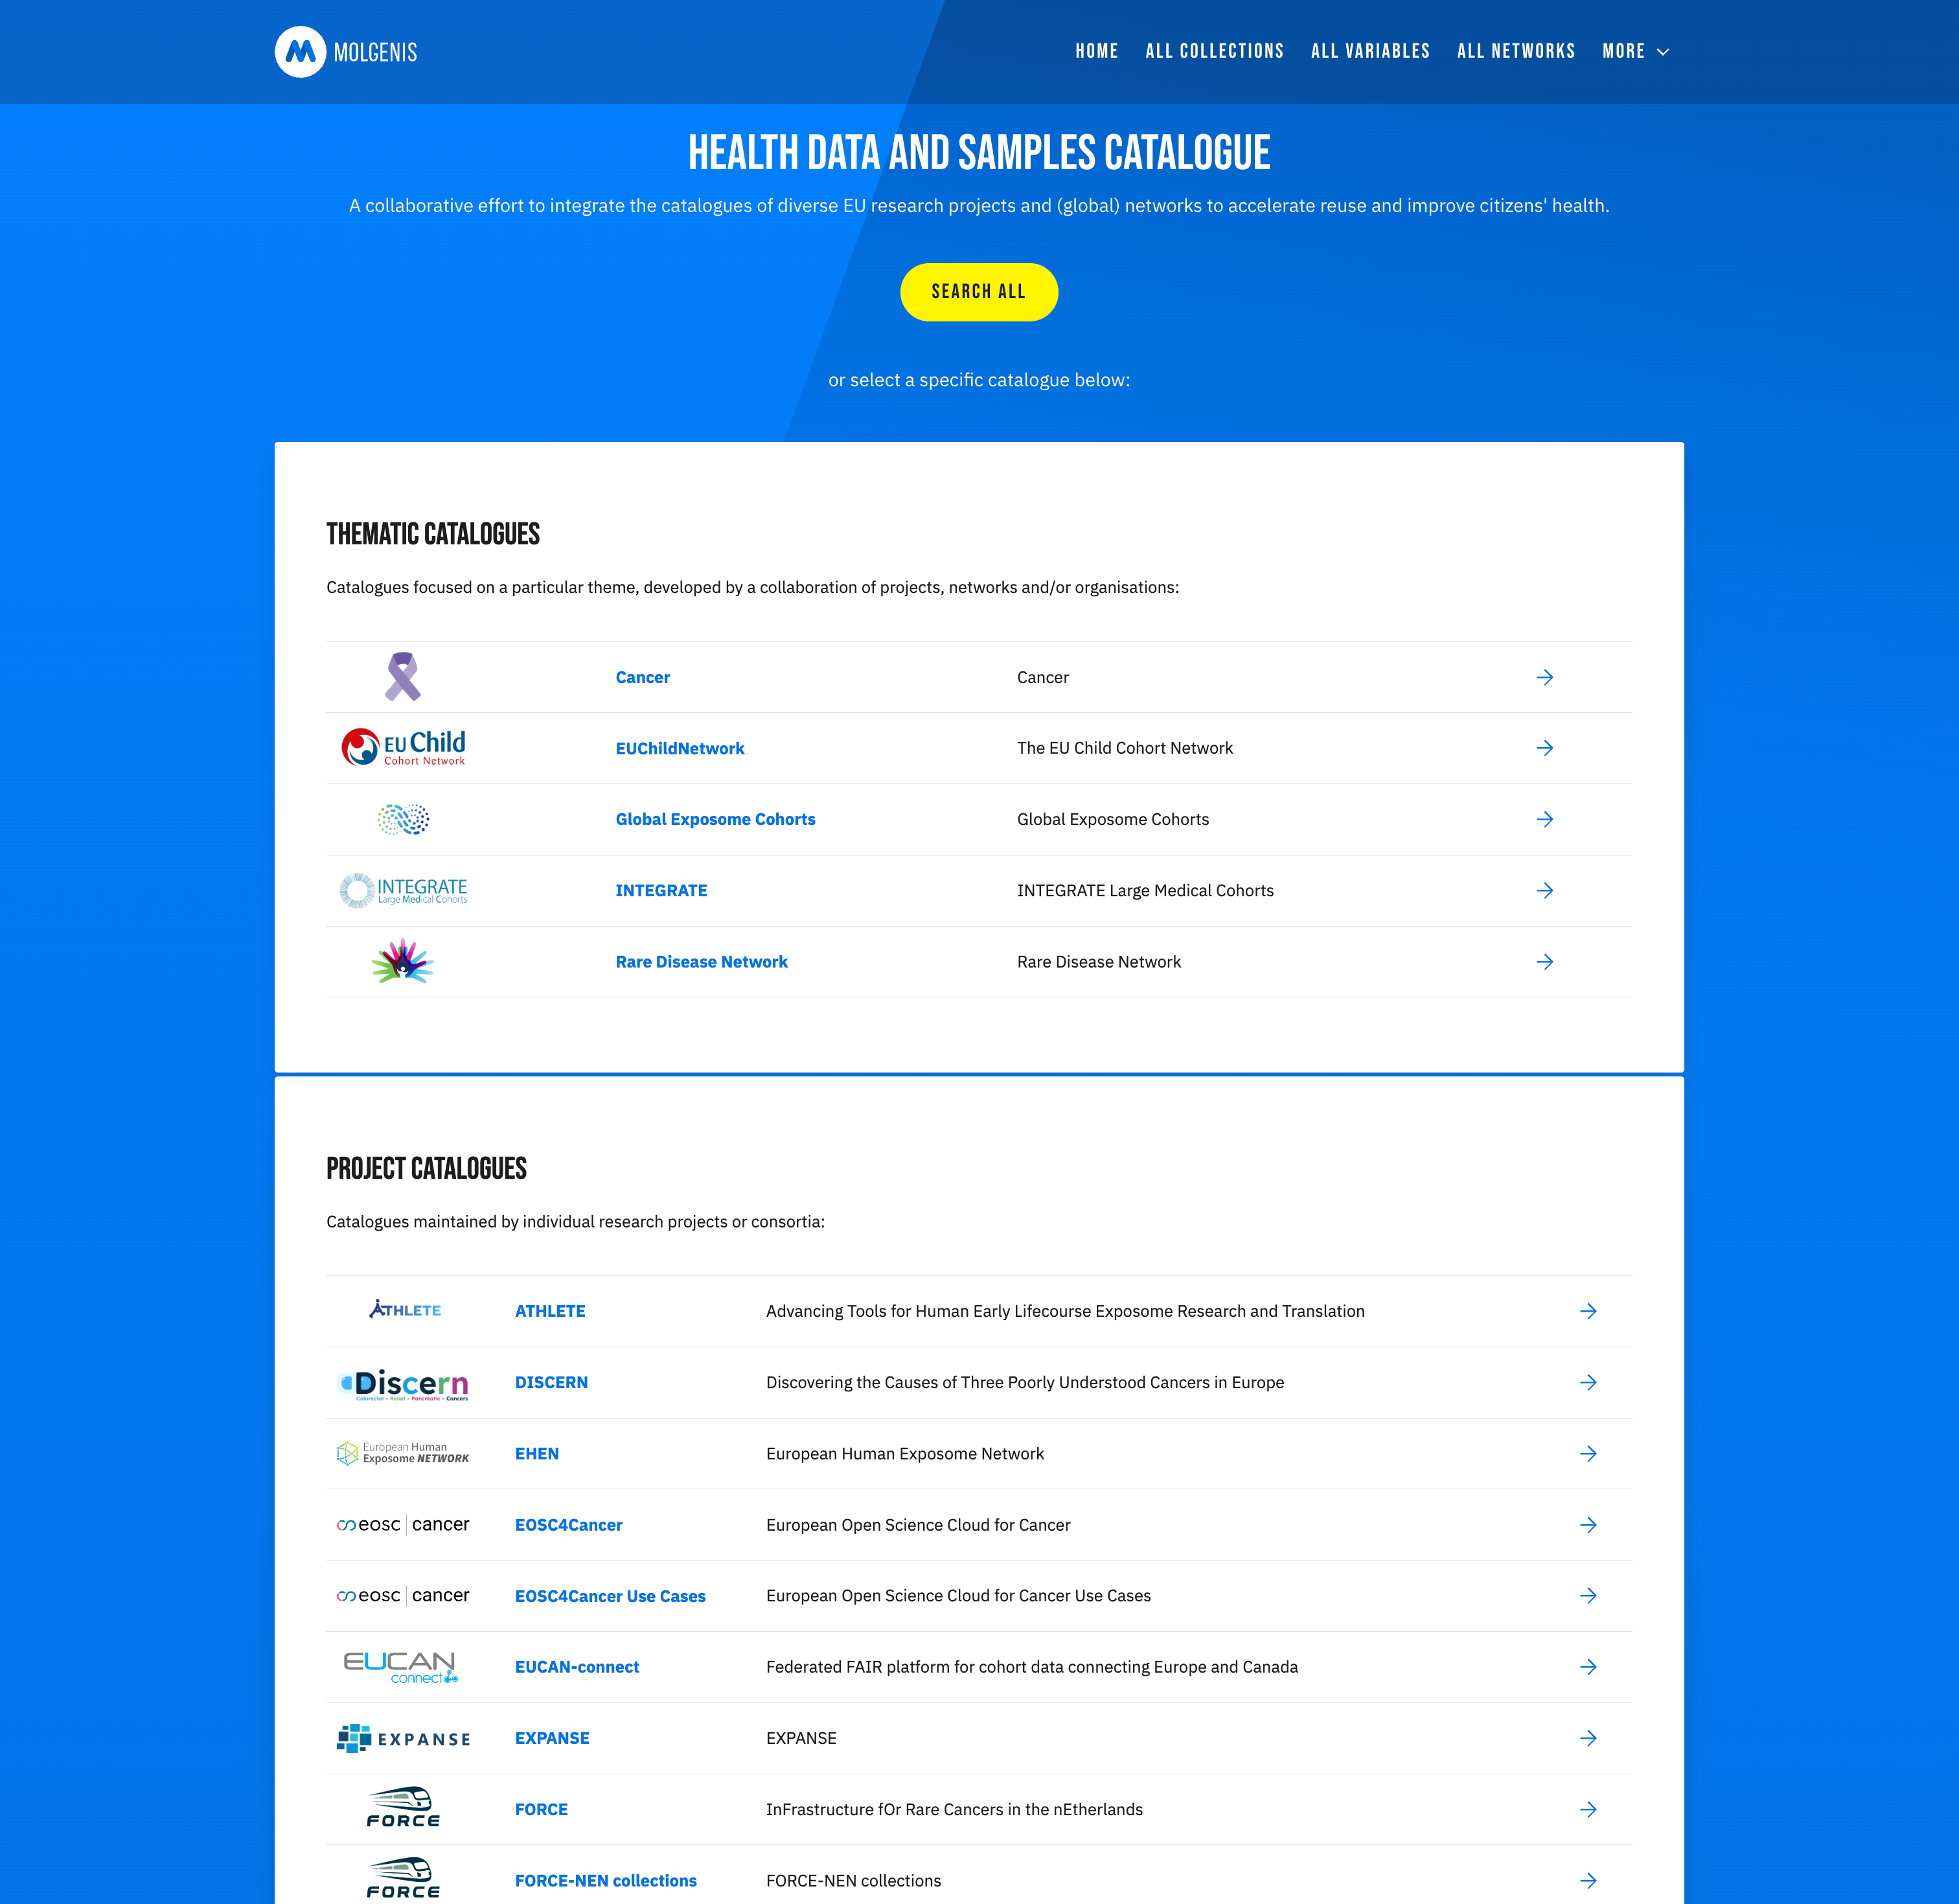
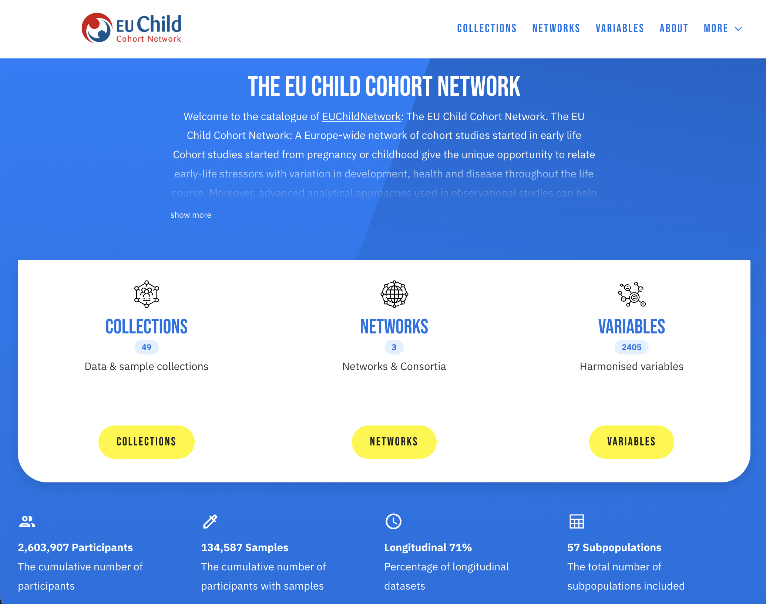
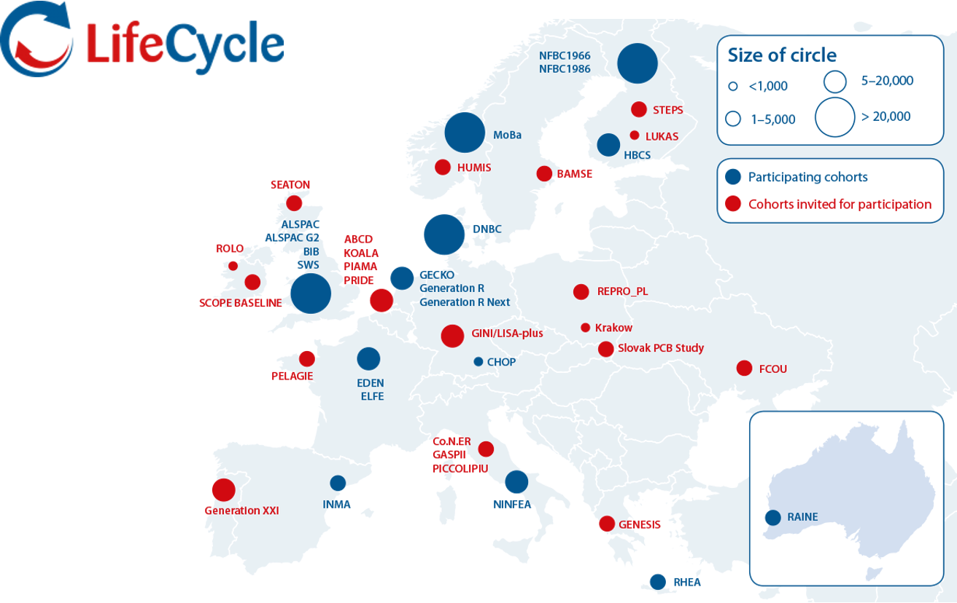
FAIR AT THE FEDERATION · MAKE FINDABLE CATALOGUE CONSORTIA / ‘data federations’
https://molgeniscatalogue.org/ ‘catalogue of catalogues’
Collections & Variables
Health-DCAT compatible
Directory mappable
Focus on data less on samples
Swertz et al. (2022) Towards an Interoperable Ecosystem of Research Cohort and Real-world Data Catalogues Enabling Multi-center Studies

Slide 12







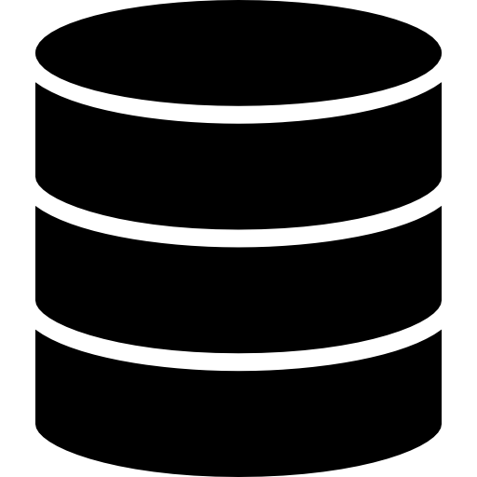


FAIR RESEARCH FEDERATIONS · FEDERATED ROUTE
Distributed deposition, federated analysis aCCESS
Analysis travels to the data · only safe summary statistics are shared
Reduces angst around DTA/MTA/GDPR
Unlocks analyses that would not be granted otherwise
We started to use DataSHIELD + MOLGENIS Armadillo — lightweight server per cohort
In LifeCycle, ATHLETE, LongITools, EUCAN-Connect — 20+ nodes in production
only summary statistics, no data sharing

Slide 13
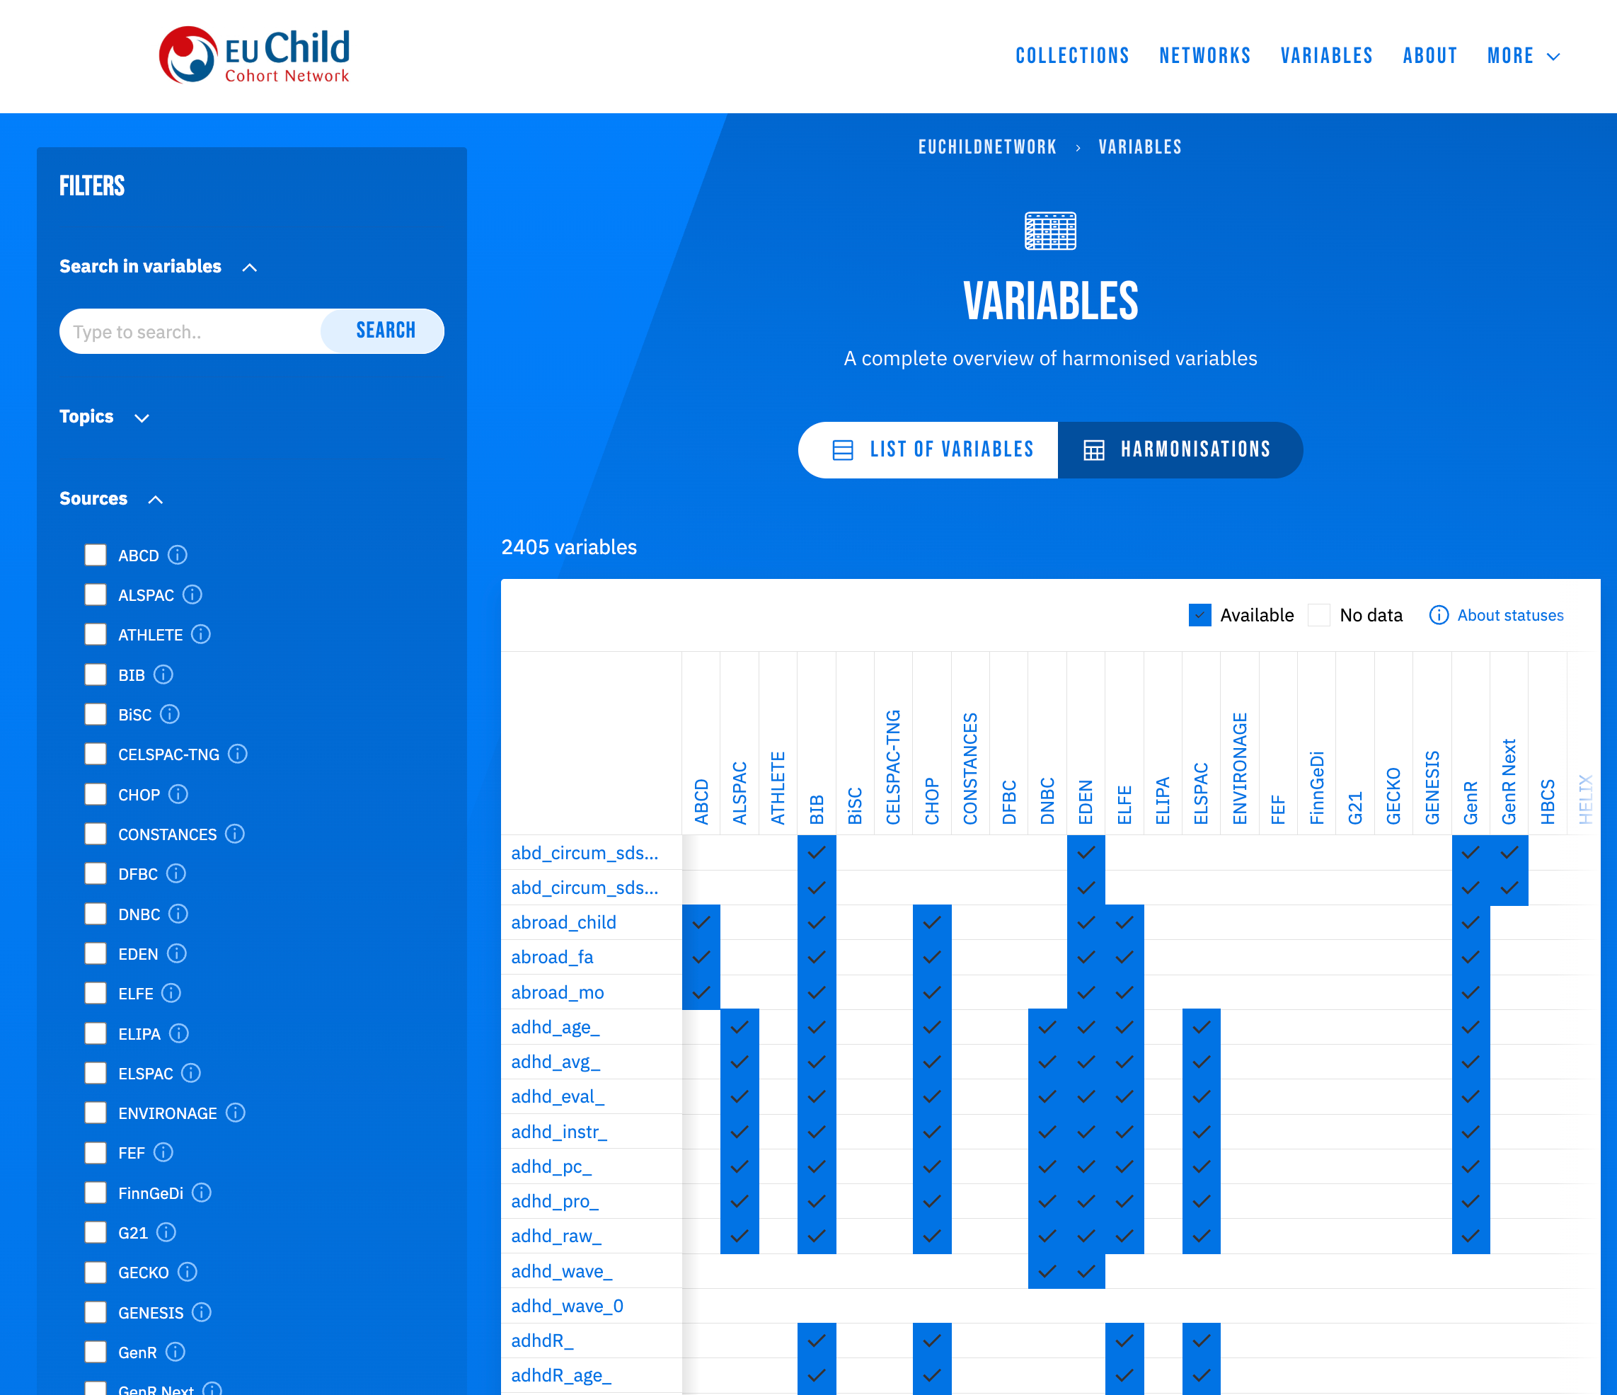
FAIR RESEARCH FEDERATIONS · MAKE INTEROPERABLE
Data harmonisation
https://molgeniscatalogue.org/
Metadata integration aiming to enable pooled analysis to increase statistical power · replication across settings · extended coverage of the life-course:
Map collected onto harmonized* / standard variables (aka transform to common data elements)
Done alone: slow, costly, never complete
Done together by a consortium: driven by research, results roll over to the next
Example: LifeCycle → ATHLETE → STAGE
Example: used MOLGENIS data catalogue to document
*Fortier et al. Life course of retrospective harmonization

Slide 14
FAIR RESEARCH FEDERATIONS
Multi-centre access requesting
Figure: one request fanning out to many holders, linked to EHDS DAAMS
One request — not twenty emails
BBMRI-ERIC Negotiator —
Modular, open
Each holder keeps its own yes/no · governance & audit trail
Prepare to interoperate with the EHDS DAAMS
Reihs et al. 2021 — Negotiator

Slide 15
ACT3 — FROM TOOLS TO JOURNEYS
From Data Discovery to Federated Analysis - Supporting the Research Journey

Slide 16

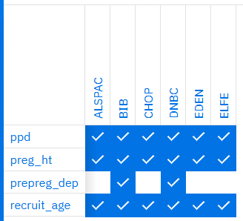

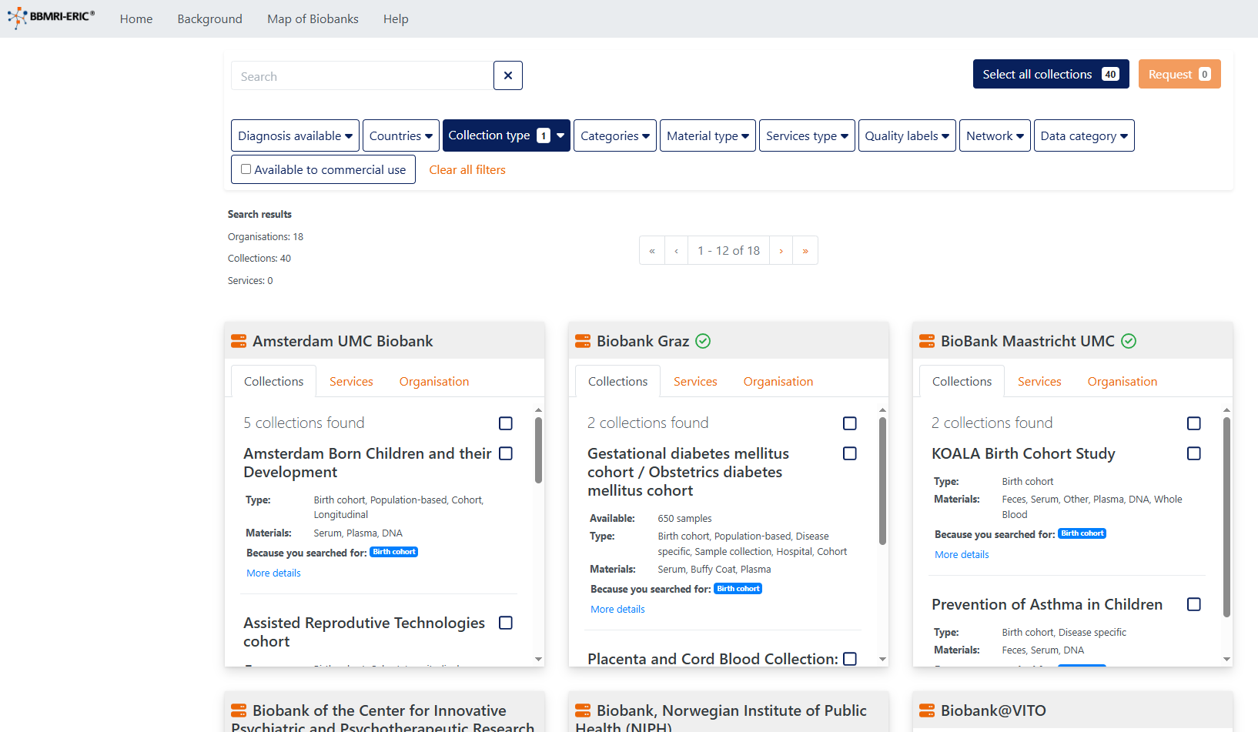
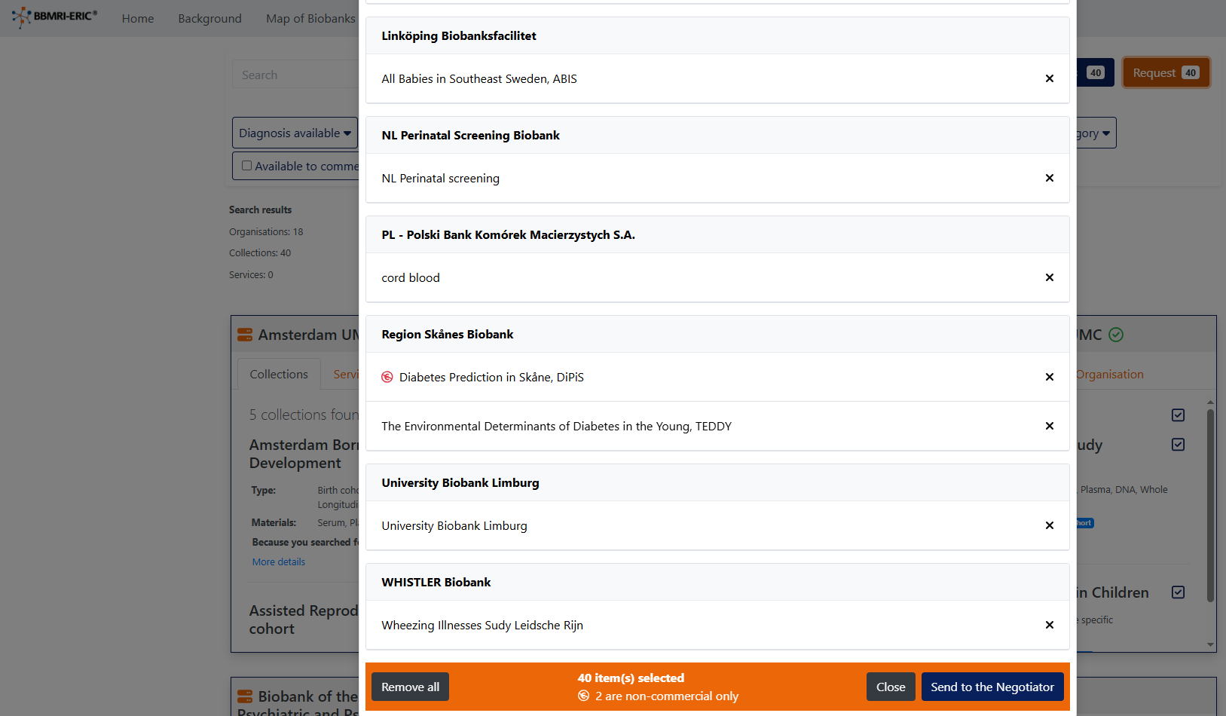
Use case and pilot design
Search
catalogues
Select
cohorts
Negotiate
data access
BBMRI Negotiator

Slide 17

Use case and pilot design
Analyse data

Slide 18
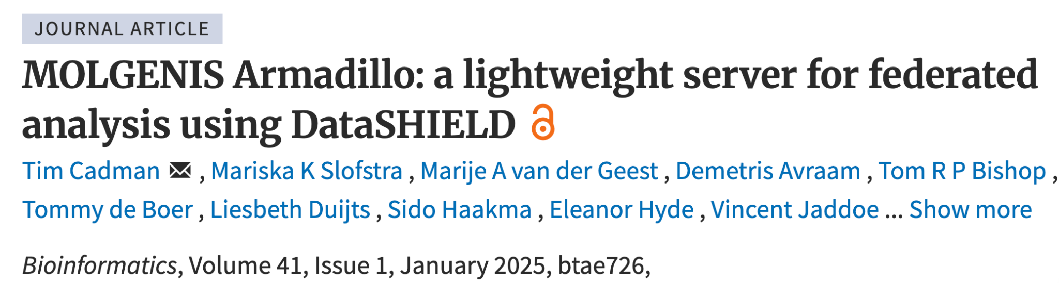
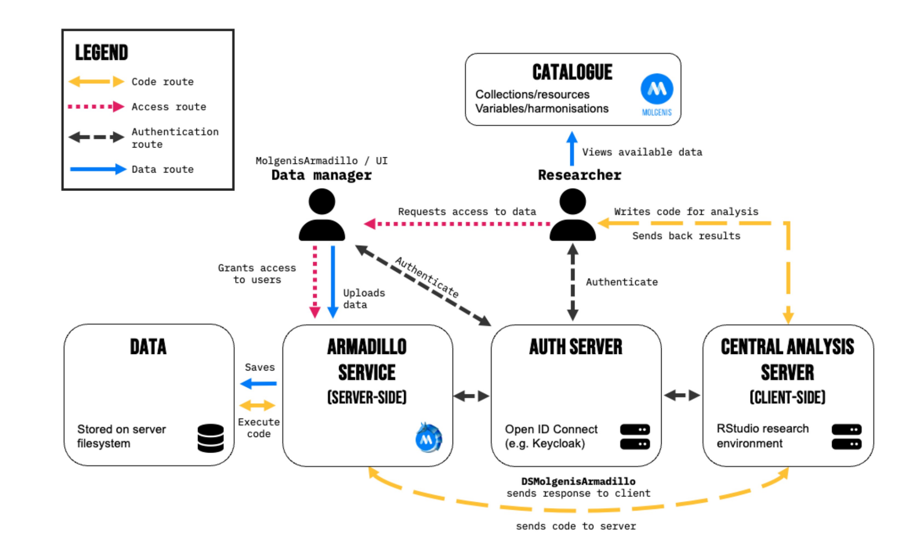
Operating DataSHIELD was hard (getting it installed in all centers)
Currently we operate 22 datashield servers in 4 networks
(more and more ‘hosted’)

Slide 19

Datashield
Privacy controls
Example disclosure controls:
Not returning cells with small N
Not running models with too many parameters
Anonymising graphs
https://wiki.datashield.org/en/opmanag/disclosure-control

Slide 20
APPLICATION
The datasets
Figure: the six cohorts as nodes on a map
INTEGRATE-LMEDC, WP12.3 — built on the LifeCycle birth-cohort network
Three cohorts: BIB, DNBC, Gen-R
Harmonised variables already in place — reusing earlier consortium work
Each cohort hosts its own data; nothing centrally pooled

Slide 21
Step 1: Defining research question
The correlation between mode of birth (e.g. vaginal, caesarian) and maternal psychological health has been studied, but not extensively.
The aim is to examine how different modes of birth are associated with adverse maternal psychological health, in particular post-partum depression.
Associations between mode of delivery and psychological health with be assessed via 2-Stage Individual Participant Meta-analysis using data from multiple birth cohorts.

Slide 22
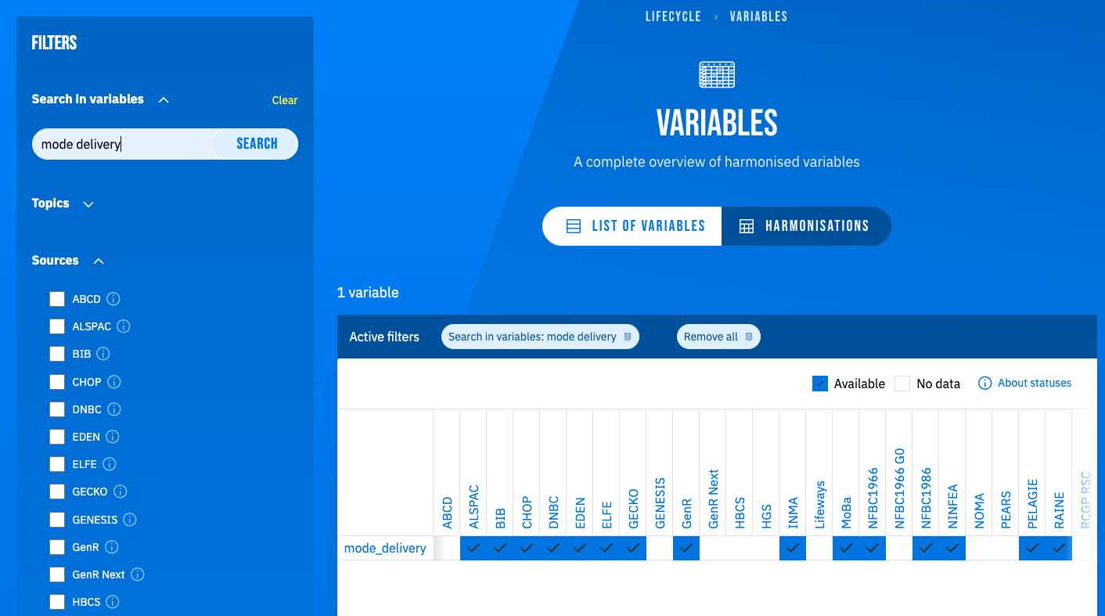
Step 2: Searching metadata catalogue
Identified 3 birth cohorts from existing network of harmonised data:
Born in Bradford (UK)
DNBC (Denmark)
Generation-R (NL)

Slide 23
Step 3: Apply for data access
Each cohort was contacted directly and individual Data Access Agreements were arranged

Slide 24
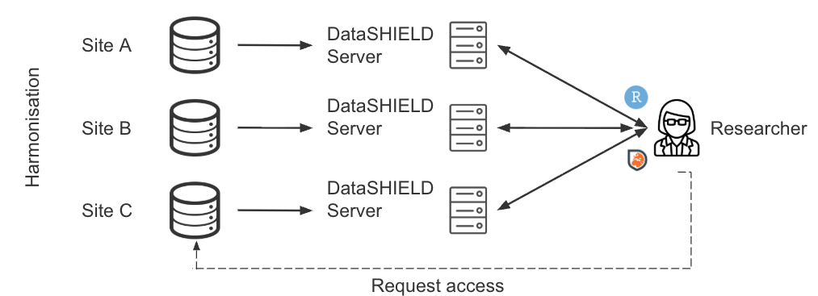
Step 4: Set up federated analysis infrastructure

Slide 25
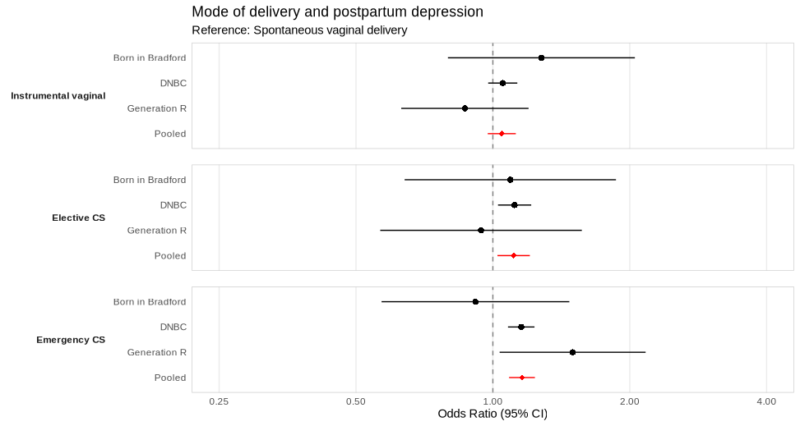
Step 5: Analysis and preliminary findings

Slide 26
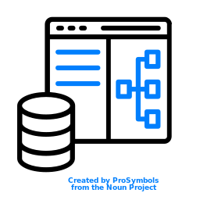
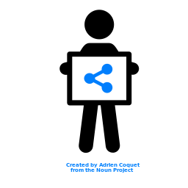
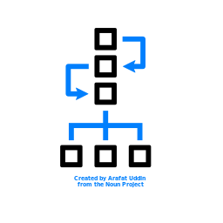
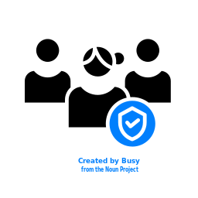
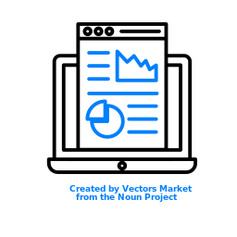
APPLICATION · DEMO
Find
A real question: which cohorts have harmonised variables for postpartum depression & gestational hypertension? Searched in the MOLGENIS catalogue — found the six LifeCycle cohorts.
Screenshot: catalogue search → six LifeCycle cohorts
Local data
Catalogue
Request
Access
Analyse
one open stack — same at every scale

Slide 27
APPLICATION · DEMO
Request
One request in the BBMRI-ERIC Negotiator — fans out to all six cohorts; each independently approves or declines.
Screenshot: the Negotiator request across six cohorts
Local data
Catalogue
Request
Access
Analyse
one open stack — same at every scale

Slide 28
APPLICATION · DEMO
Access
Approvals become executable authorisations — identity & permissions provisioned via LS AAI/Keycloak.
Screenshot: approval → provisioned analysis environment
Local data
Catalogue
Request
Access
Analyse
one open stack — same at every scale

Slide 29
APPLICATION · DEMO
Analyse
Federated analysis across all six cohorts — data never moves; only safe summary results are pooled. The question is answered, end to end, ; an Armadillo node stood up at each cohort.
Screenshot: federated analysis result
Local data
Catalogue
Request
Access
Analyse
one open stack — same at every scale

Slide 30
Part 4 — Concluding remarks
From a demo to a blueprint — and the road ahead

Slide 31
CONCLUDING REMARKS
A common blueprint, variationS per domain
Figure: the journey diagram 3× — birth cohorts · rare disease · clinical biobanks
Seen often now — the common blueprint is starting to complete
Same open stack, every scale — only the level changes
Modular, open blocks — MOLGENIS, XNAT, Armadillo, Negotiator — no lock-in
Varies per research: data model · variables · analysis protocol
We argued it in 2007 — generate the infrastructure, don’t over-standardise

Slide 32
CONCLUDING REMARKS
NEXT STEPS — and what it asks of us
Where it’s going
EHDS — consortia can be trusted data holders, simplified procedure
A series of consortia reusing each other’s work
MOLGENIS can host it — cheap to keep alive, costs only when used
Toward EOSC-node hosting; across RIs (BBMRI-ERIC, ECRIN, …)
What it asks of us
Don’t rebuild the base layer — connect (single-login, standards, ELSI)
Holders keep FAIR at the source · RIs provide & maintain the base
Nodes take a role and deliver components · standards enabling, not prescriptive
MOLGENIS’ mission: be the enabler

Slide 33
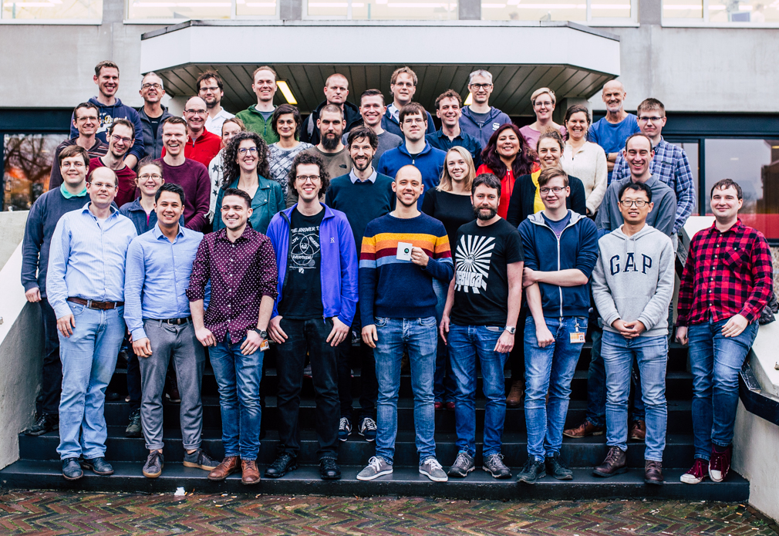
Thank you
Questions?
m.a.swertz@umcg.nl
Read more Swertz & Gini 2022 — catalogue ecosystem · Cadman et al. 2024 — Armadillo · Reihs et al. 2021 — Negotiator · Fortier et al. — harmonisation · Swertz & Jansen 2007 — the blueprint
Find us molgenis.org · github.com/molgenis · molgeniscatalogue.org

