Slide 1
Armadillo vs Opal
Performance benchmark
Tim Cadman
Senior Data Scientist

Slide 2
Background

Slide 3
Why benchmark?
We assume that Armadillo is faster than Opal — but we haven't systematically measured it
We know Armadillo is more light-weight, but again we have not measured it
Leon (NCC) asked for benchmarks to help choose between Armadillo and Opal
Stats could be useful in the future when marketting Armadillo

Slide 4
Objectives
To test the following:
Footprint
Resting memory and on-disk storage efficiency
Speed
How fast Armadillo (Rock) and Opal are when deployed

Slide 5
Methods

Slide 6
Servers tested
Server | R engine | Host | Version | Spec
Armadillo | Rock | armadillo-demo.molgenis.net | 5.12.2 | 2 vCPU · 8 GiB
Armadillo | Rock | localhost | 5.14.0-SNAPSHOT | 2 vCPU · 8 GiB
Opal | Rock | opal.molgeniscloud.org | 5.7.2 | 2 vCPU · 8 GiB
Opal | Rock | localhost | 5.7.1 | 2 vCPU · 8 GiB

Slide 7
Footprint
What was measured and how
Metric | Armadillo | Opal
Resting memory | Armadillo + Rock engine | Opal + MongoDB + Rock engine
Data on disk | Example 10,000-row data, stored as Parquet | Same data file, stored in MongoDB

Slide 8
Speed
Where the time goes
Server compute
the function runs in R — command end − start Armadillo GET /lastcommand · Opal GET /datashield/…/command/{id}
System overhead
serialise · protocol · dispatch · auth — (localhost round-trip) − compute
Network
round-trips on the wire — (remote round-trip) − compute − overhead
Polling delay
client waits between async status checks — DSI poll-sleep fixed at 2 ms (0.002 s)

Slide 9
Performance
Functions benchmarked
Family | n | Functions (dsBase server function)
Summary statistics | 5 | meanDS · varDS · quantileMeanDS · corDS · tableDS
Metadata / introspection | 8 | classDS · dimDS · colnamesDS · lengthDS · levelsDS · numNaDS · lsDS · isValidDS
Transform & recode | 11 | asFactorDS1 · asFactorDS2 · asIntegerDS · asCharacterDS · asDataMatrixDS · BooleDS · recodeValuesDS · recodeLevelsDS · changeRefGroupDS · repDS · replaceNaDS
Data-frame manipulation | 6 | dataFrameDS · dataFrameSubsetDS1 · dataFrameSubsetDS2 · cbindDS · mergeDS · reShapeDS
Modelling | 5 | glmDS1 · glmDS2 · glmSLMADS1 · glmSLMADS.assign · lmerSLMADS2
DSI | 9 | rmDS · login · workspace_save · workspace_load · assign.table · tables · profiles · workspaces · pkg_status

Slide 10
Performance
Repeats & shuffling
Each call was timed over 5 shuffled passes — every pass randomises the call order, then repeats each call 5 times :

Slide 11
Results

Slide 12
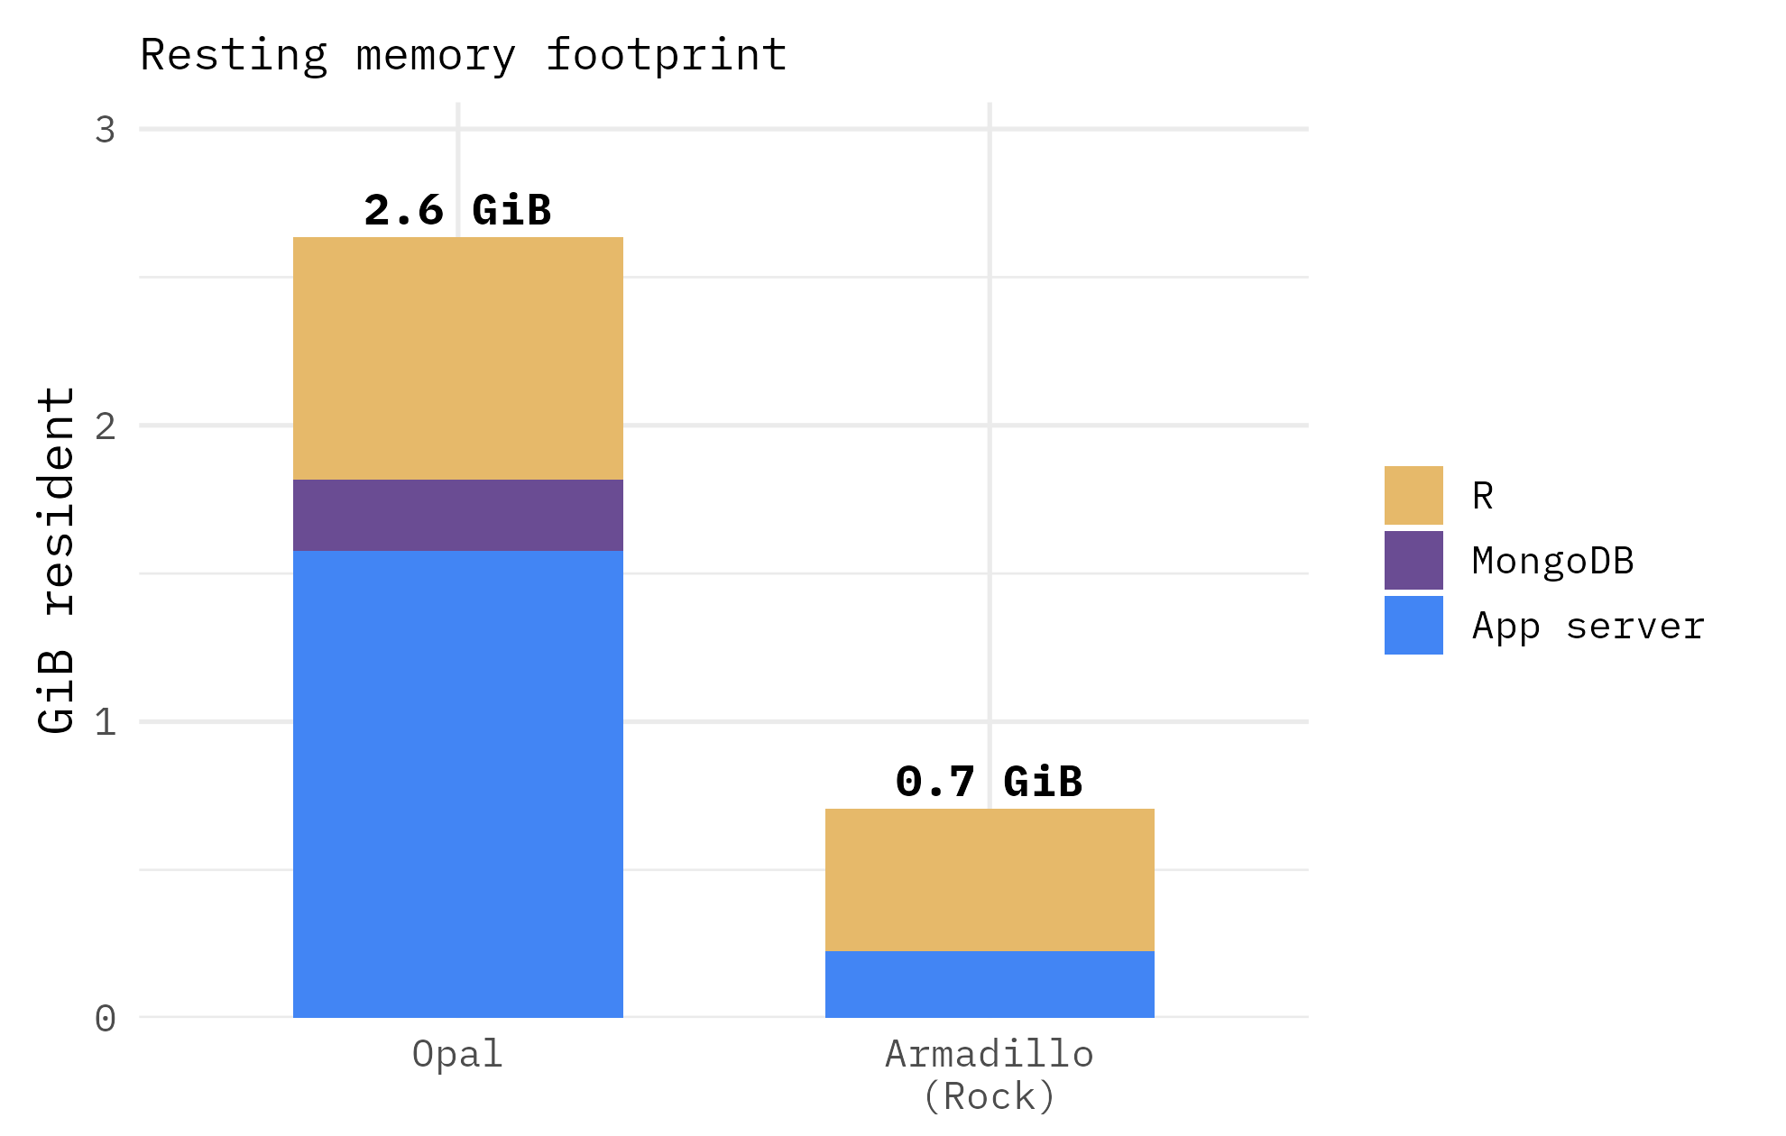
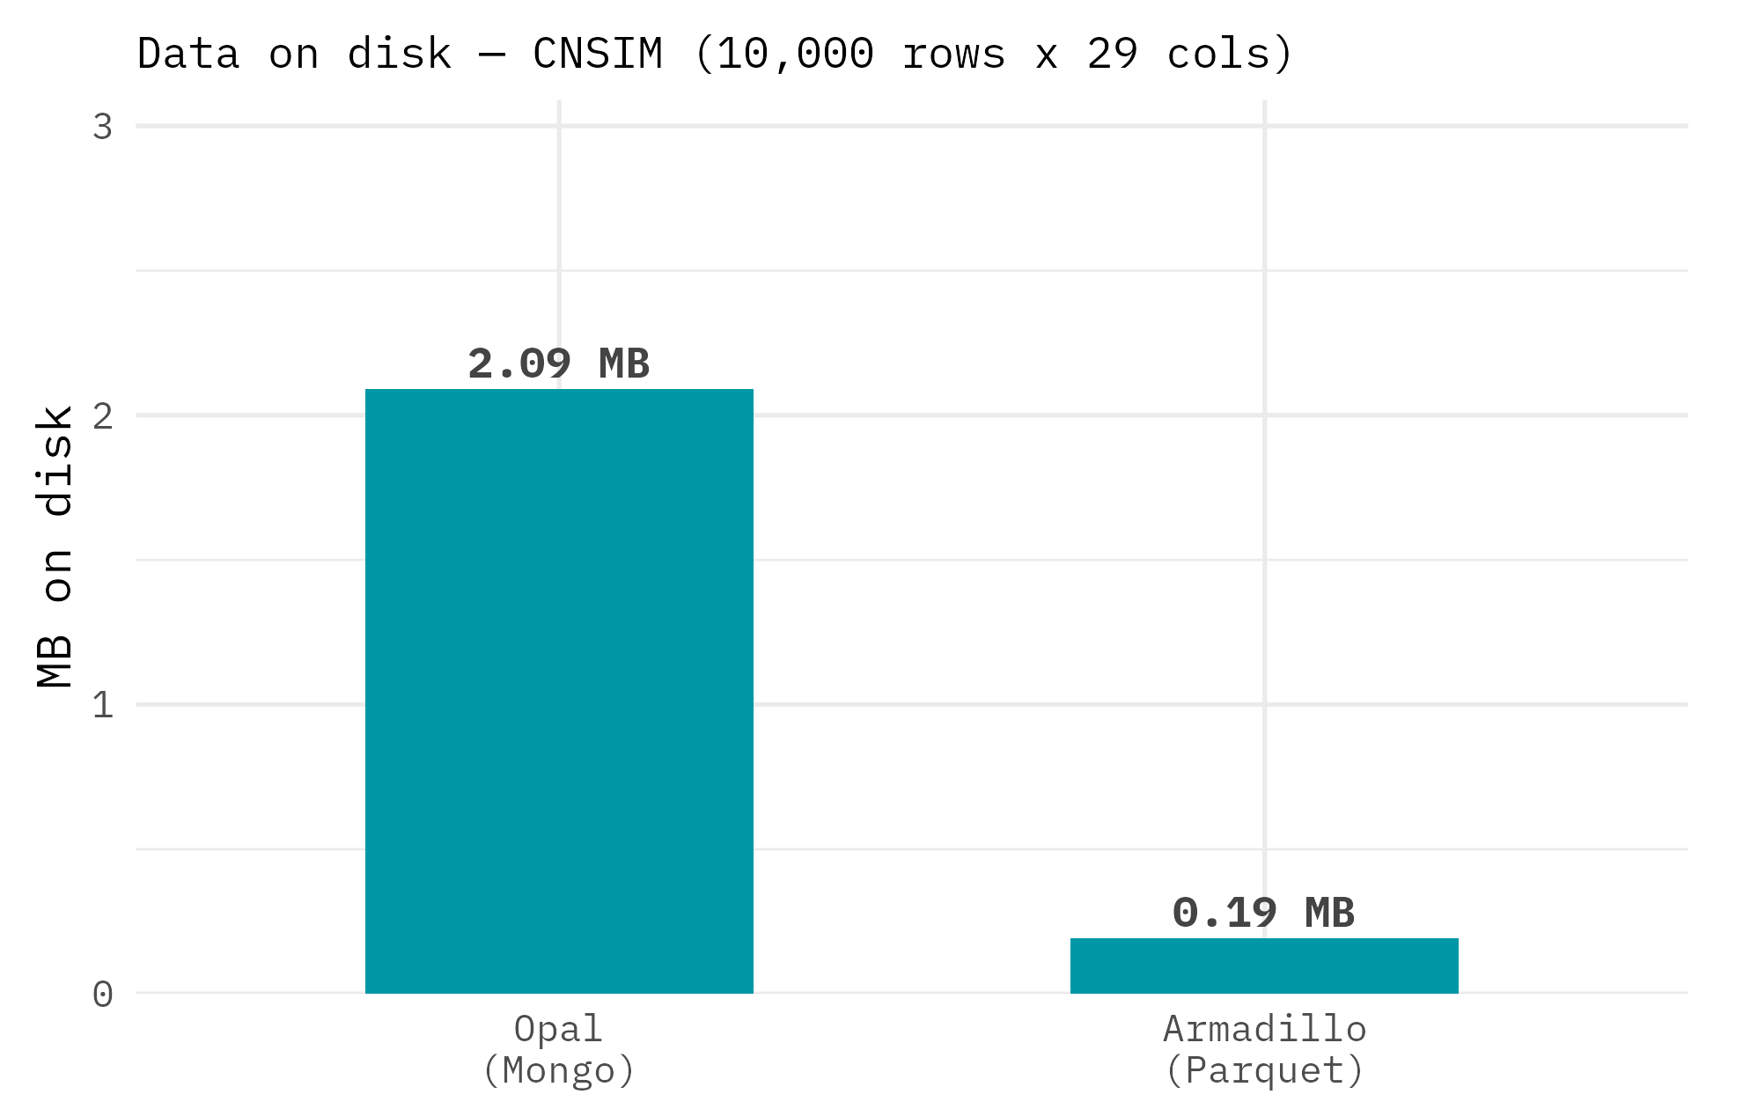
Footprint
Memory and disk space

Slide 13
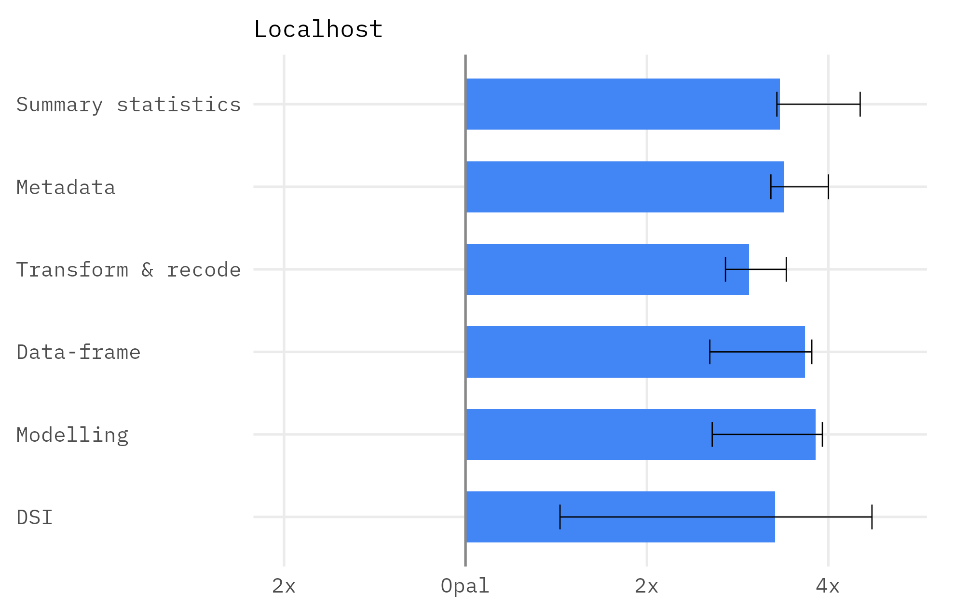
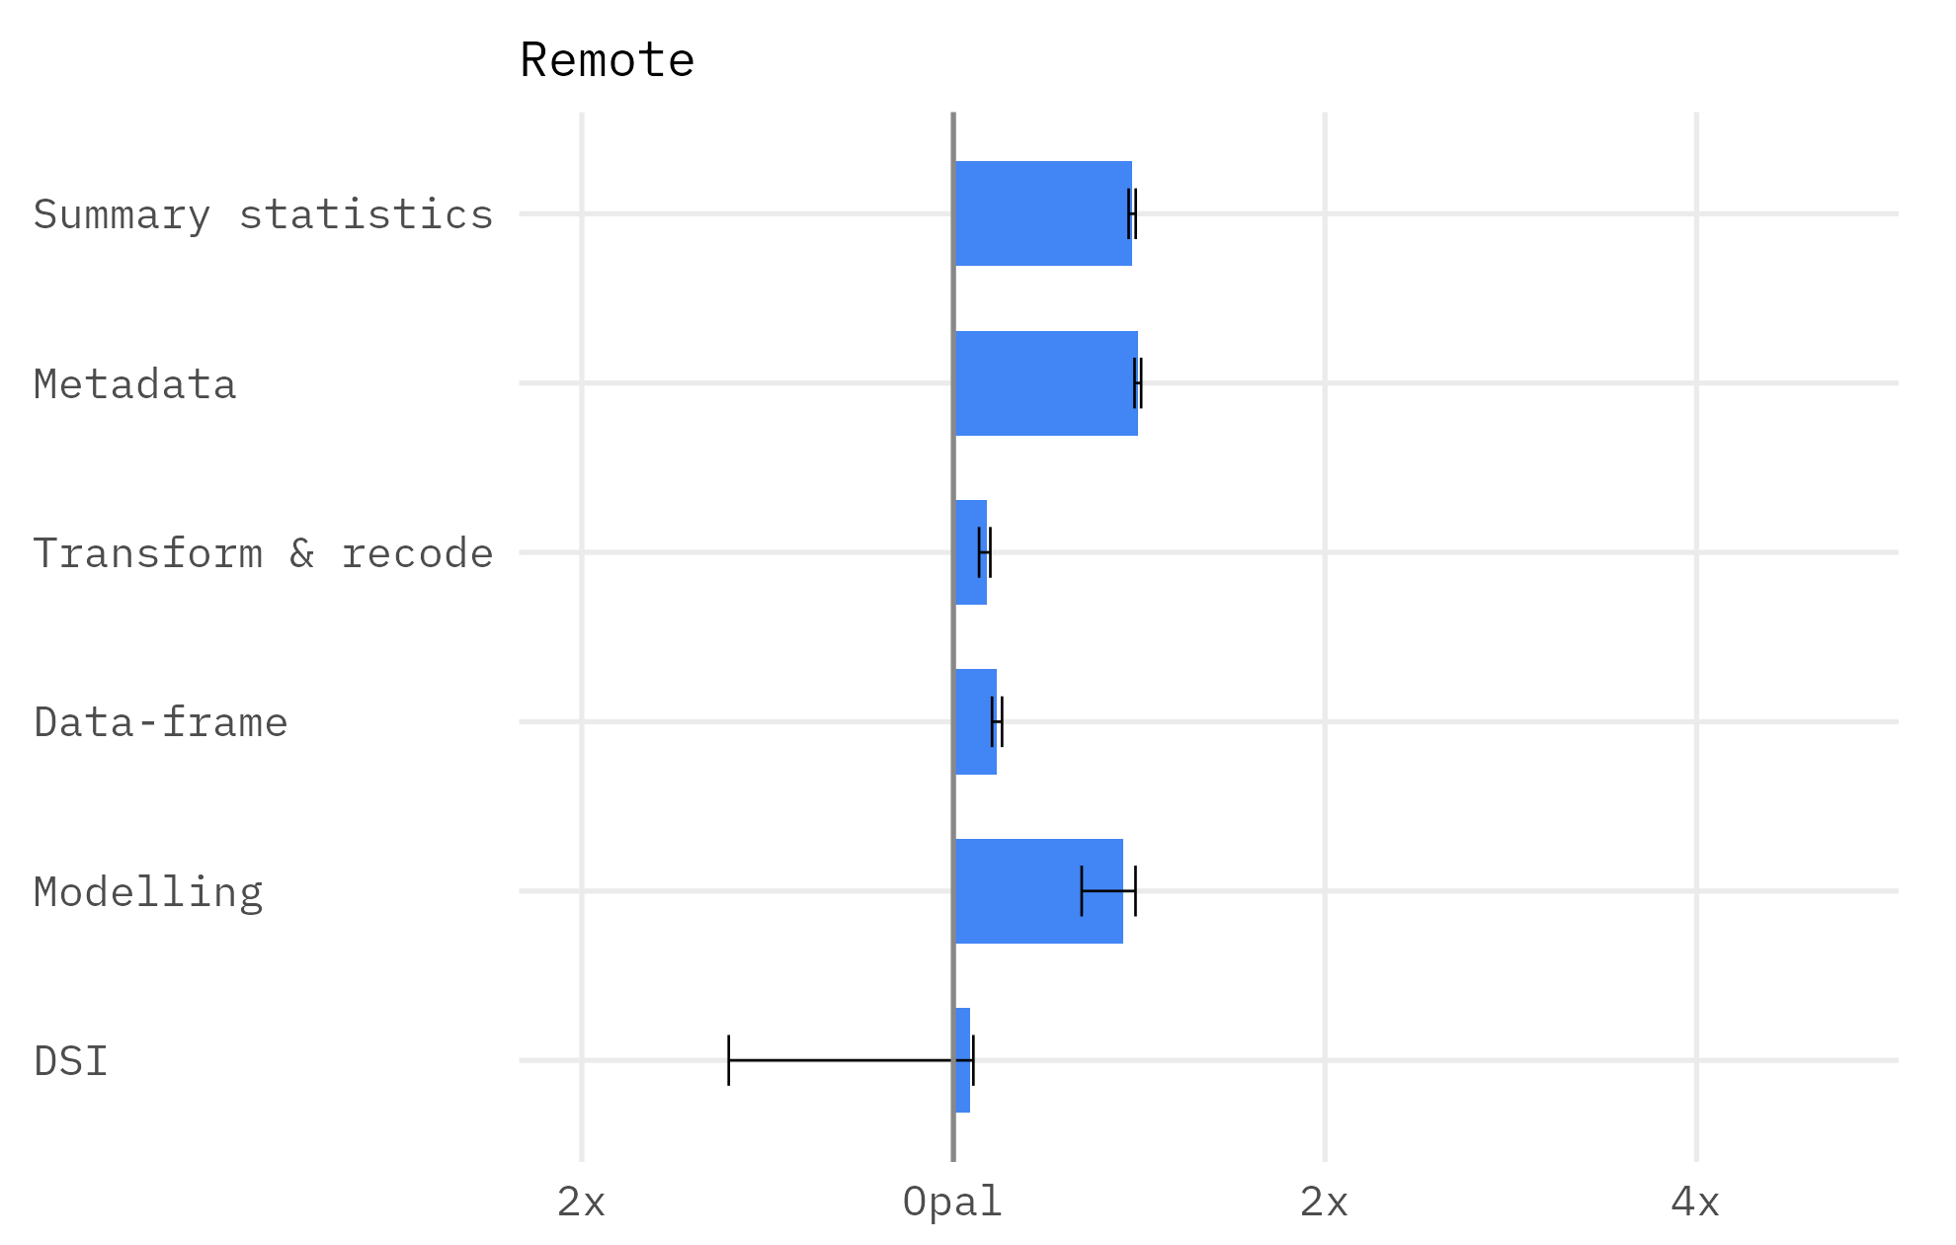
Speed
Armadillo speed vs Opal

Slide 14
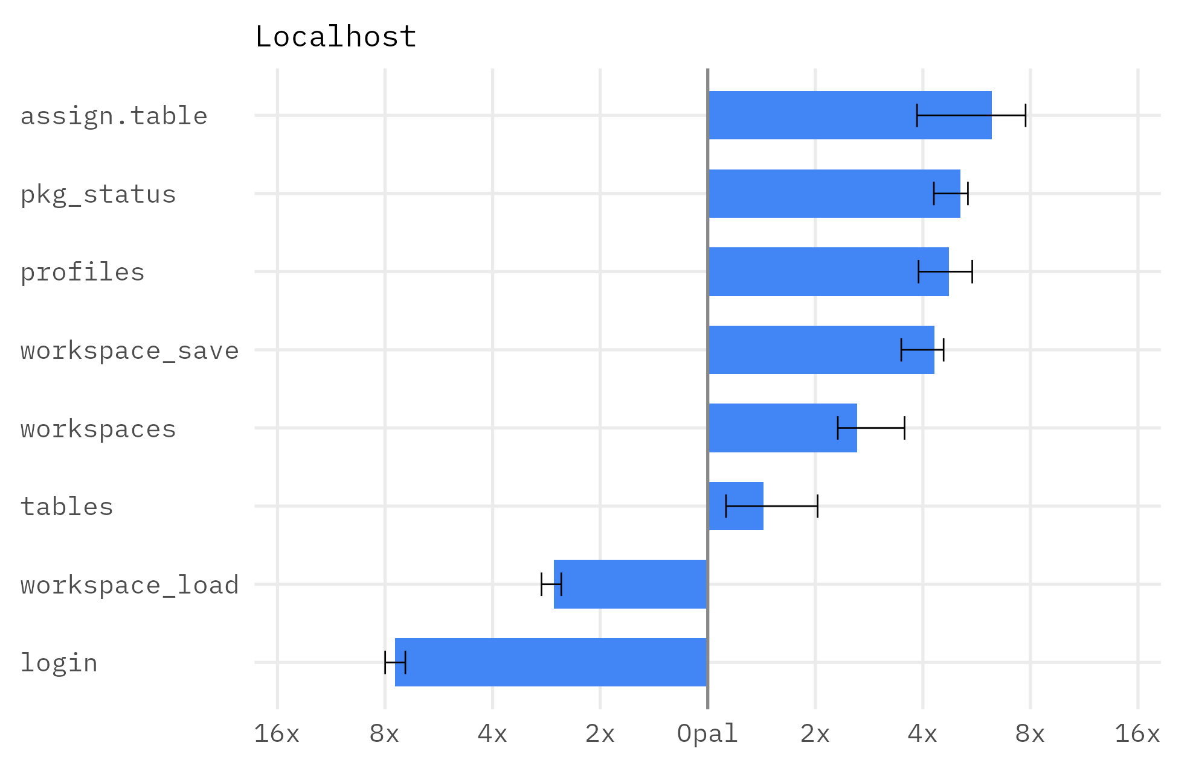
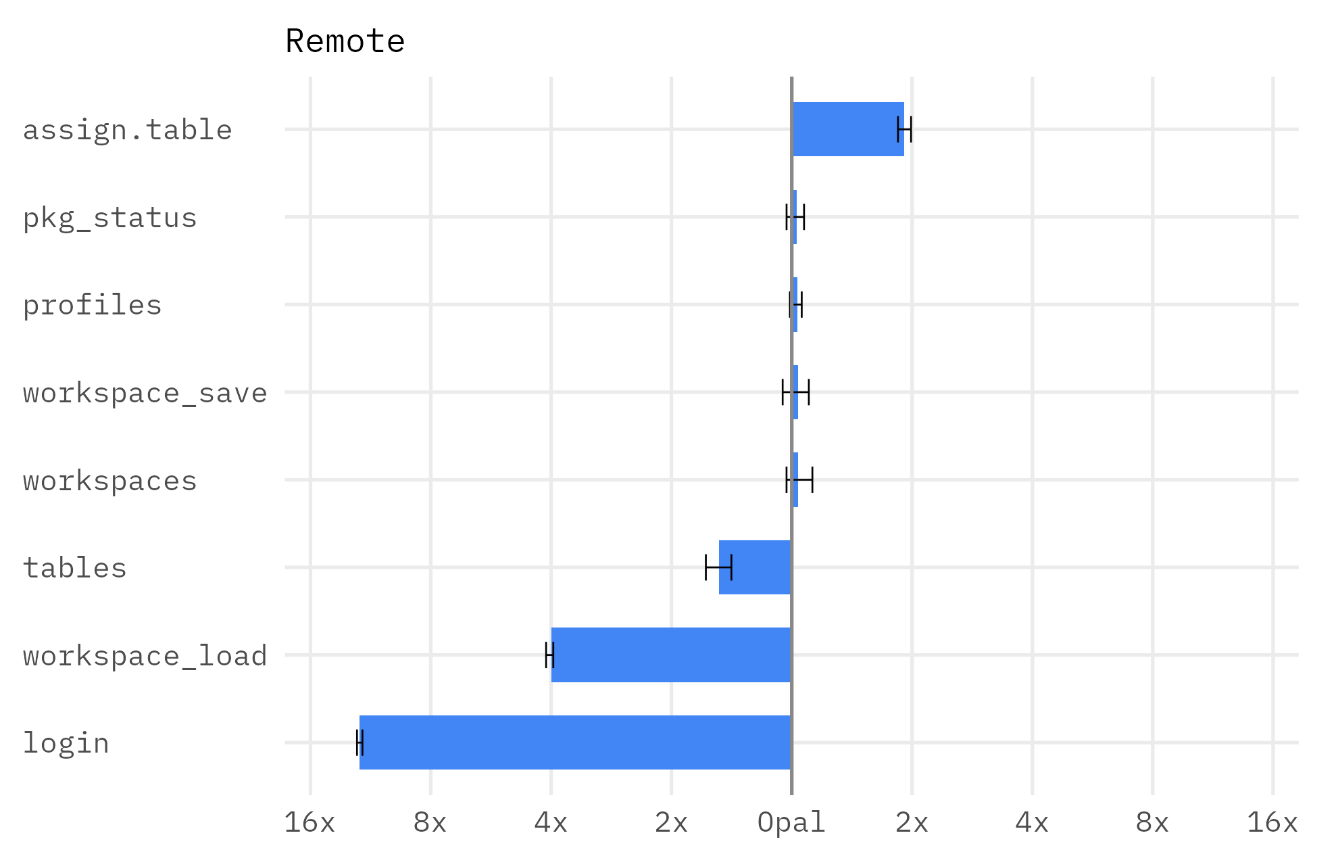
Speed
DSI variance

Slide 15
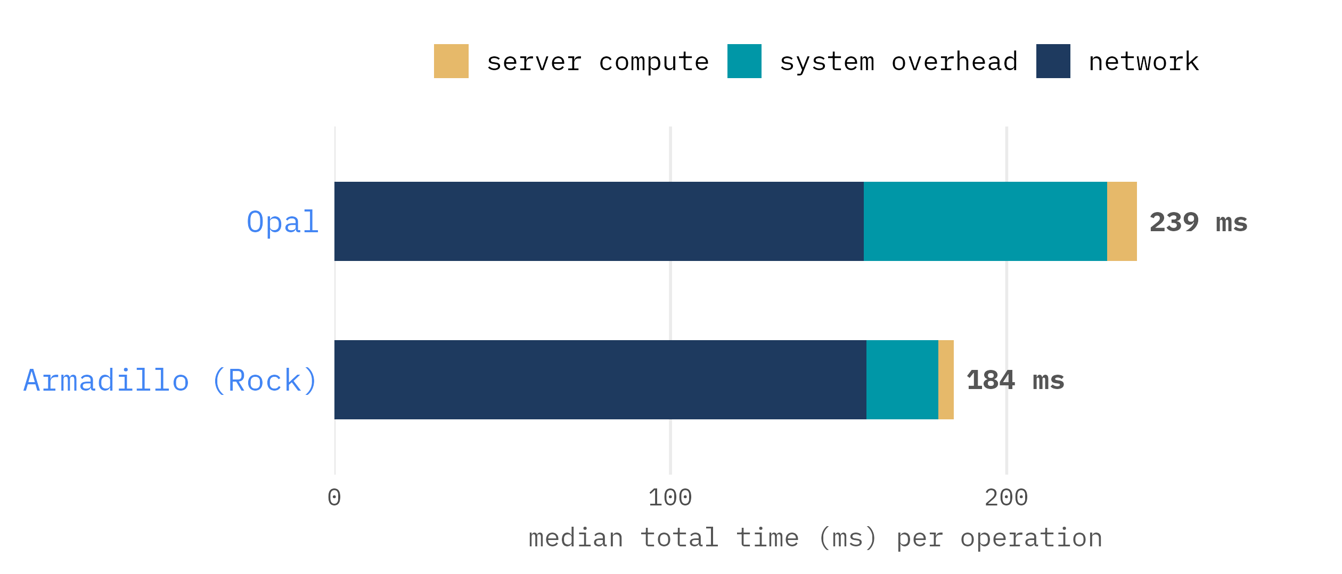
Speed
Where is Armadillo faster?

Slide 16
Conclusions

Slide 17
Conclusions
Armadillo is faster than Opal — locally ~3× ; remotely ~1.2×
Deployment is dominated by network latency (~160 ms, shared) — so Armadillo's comparative advantage diminishes when deployed
We should improve the few operations where Armadillo did worse — login and workspace_load
We can confidently say that Armadillo is quicker and more light-weight

Slide 18
Feedback
Open questions
Anything else worth measuring?
Do we want to put these figures in the docs/website?

