Slide 1
cuGeo
A CUDA Geolocation Implementation
Tim Cardenuto
timcardenuto@gmail.com

Slide 2
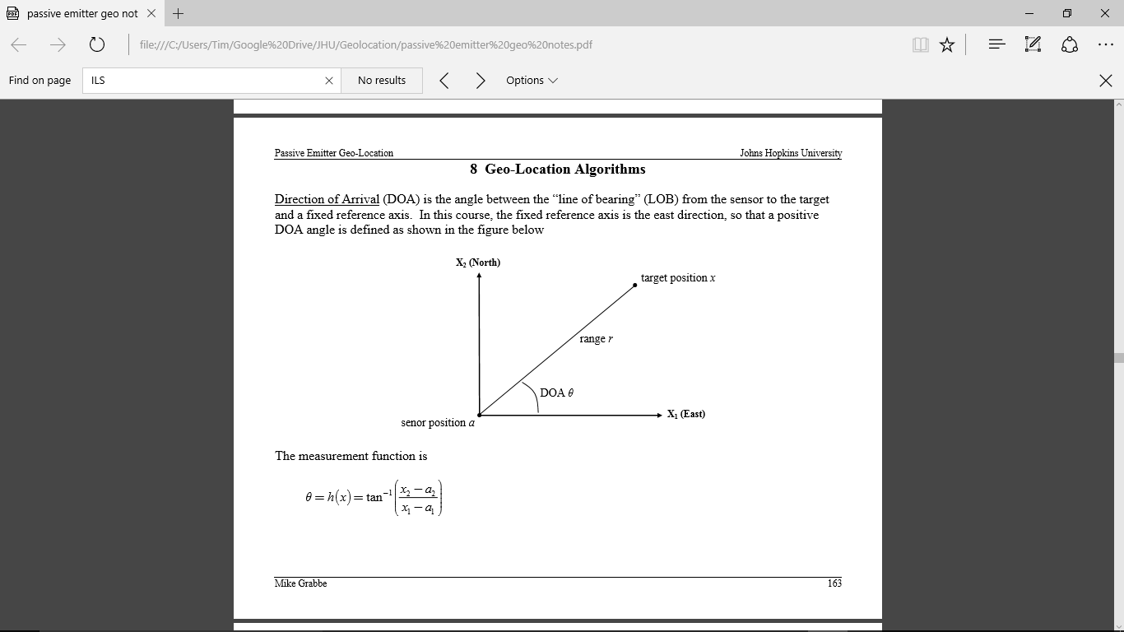

Direction of Arrival (DOA)
$h\left(x\right)=θ=\tan^{−1}\left(\frac{x_{2}− a_{2}}{x_{1}− a_{1}}\right)$
$H= \frac{∂h}{∂x} =\frac{1}{{\left[{(x−a)}^{T}(x−a)\right]}^{1/2}}∗\left[−\sin\left(h\right) cos(h)\right]$
$σ$ = sensor measurement standard deviation
Figure from Michael Grabbe’s class notes for Johns Hopkins University EN 525.744 Passive Emitter Geo-Location

Slide 3
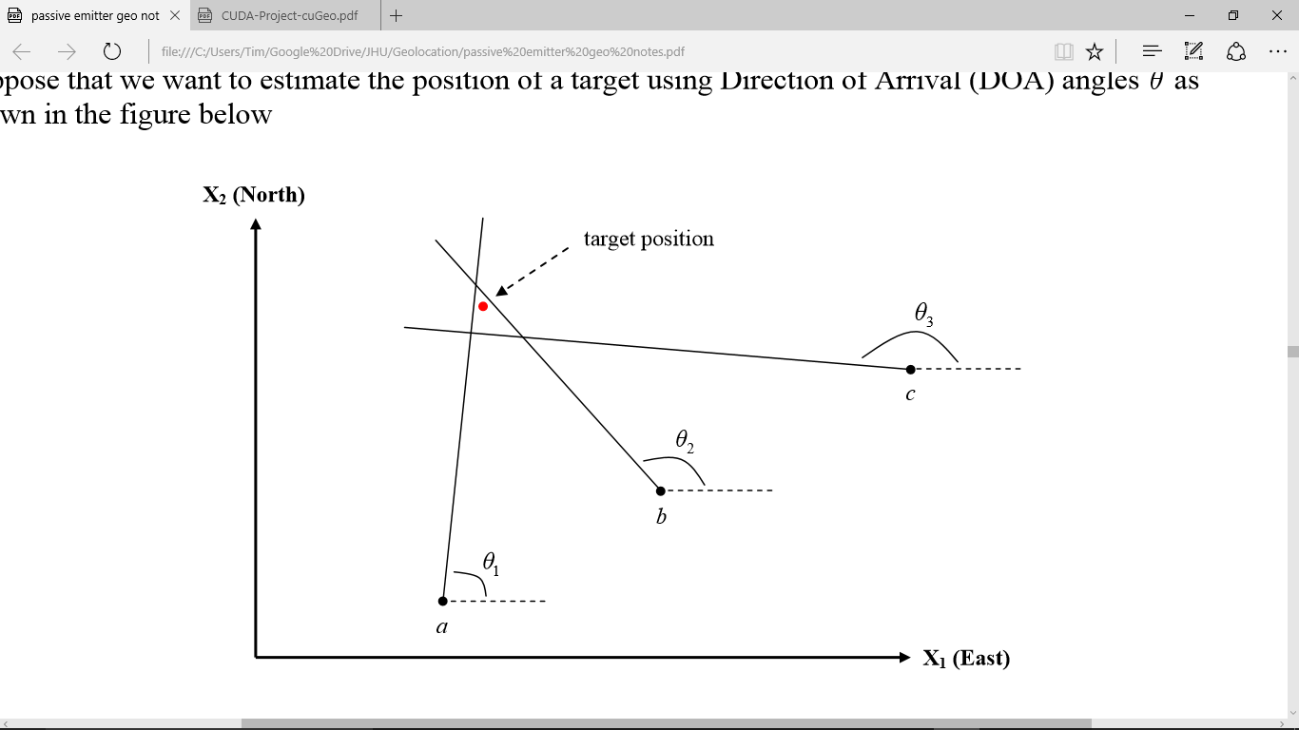

Iterated Least Squares (ILS)
$h\left({\hat{x}}_{old}\right)$
$H=\frac{∂h}{∂x}({\hat{x}}_{old})$
$P={[H^{T}R^{−1}H]}^{−1}$
${\hat{x}}_{new}={\hat{x}}_{old}+PH^{T}R^{−1}(z−h\left({\hat{x}}_{old}\right))$
${\hat{x}}_{old}={\hat{x}}_{new}$
$if (\left\|{\hat{x}}_{new}− {\hat{x}}_{old}\right\|< ε) then repeat$
Where
$n$ is the number of measurements
$z$ is a $n x 1$ vector of the actual measurements
$h$ and $H$ are models defined previously, in matrix form
$R \text{is} \text{an} n x n \text{identity} \text{matrix} \text{of} \text{each} \text{measurement} \text{variance}\text{ (}σ^{2}\text{)}$
$ε$ is a convergence value that determines when the estimator is done
Figure from Michael Grabbe’s class notes for Johns Hopkins University EN 525.744 Passive Emitter Geo-Location

Slide 4
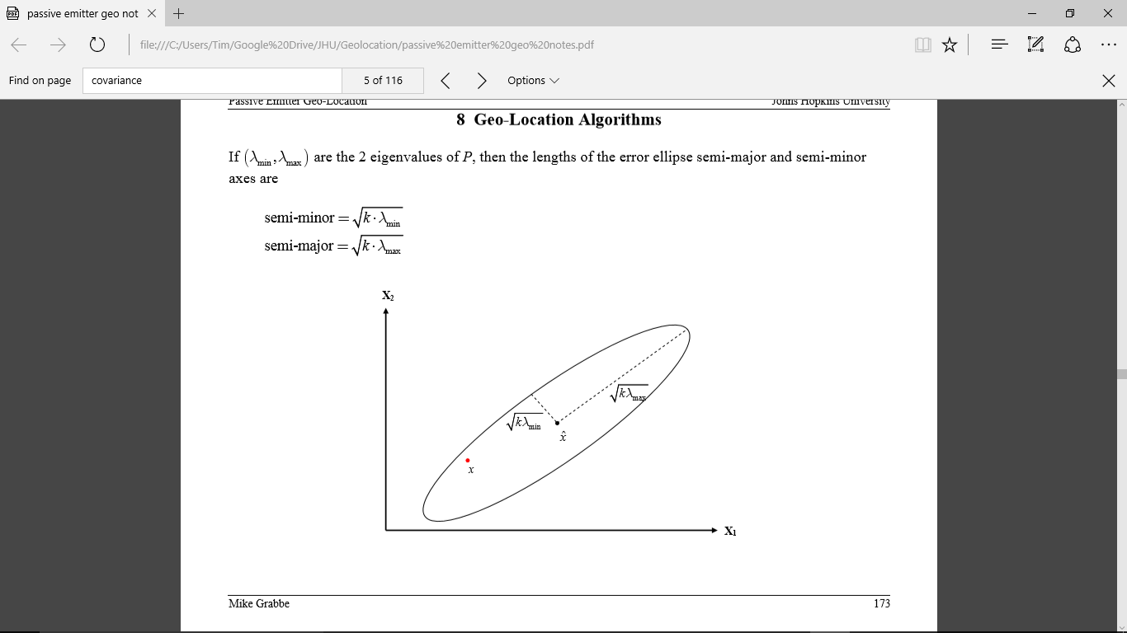

Error Ellipse Probability (EEP)
$k=5.9915$ for 95% containment
$semiminor= \sqrt{k∗λ_{min}}$
$semimajor= \sqrt{k∗λ_{max}}$
Where
$λ_{min}$ and $λ_{max}$ are the minimum and maximum eigenvalues of $P$
$k$ is the critical value from a chi-squared distribution for a given containment probability
Orientation of the ellipse is based on the eigenvectors
Figure from Michael Grabbe’s class notes for Johns Hopkins University EN 525.744 Passive Emitter Geo-Location

Slide 5
checkCmdArgs()
program options read using getopt_long
h(x)
cuGeo
H
checkDeviceProperties()
Query CUDA device properties
inv(R)
H’ * inv(R)
generateScenario()
Read ‘file’ argument for scenario data, generate random data (not implemented), or use default data
H’ * inv(R) * H
Test Increasing # of measurements
P = inv(H’ * inv(R) * H)
cpuGeolocation()
Compute C++ geolocation location estimate and error ellipse
P * H’
P * H’ * inv(R)
generateScenario()
Same as before.
(z-h)
cudaGeolocation()
Compute CUDA geolocation location estimate and error ellipse
xhat = xhat + P * H’ * inv(R) * (z-h)
Test memory type
Test block/thread distribution
eig(P)
Write report, benchmark files
Plot data in Python
semimajor, semiminor

Slide 6
cuGeo CUDA Kernels
4 custom kernels
parameterPrediction
covariancePrediction
subtract
semiMajMin
cuBLAS
cublasSgemm
cublasSgetrfBatched & cublasSgetriBatched
cuSolver
cusolverDnSgesvd_bufferSize & cusolverDnSgesvd
h(x)
H
(z-h)
semimajor, semiminor
H’ * inv(R)
H’ * inv(R) * H
P * H’
P * H’ * inv(R)
P * H’ * inv(R) * (z-h)
P = inv(H’ * inv(R) * H)
eig(P)

Slide 7
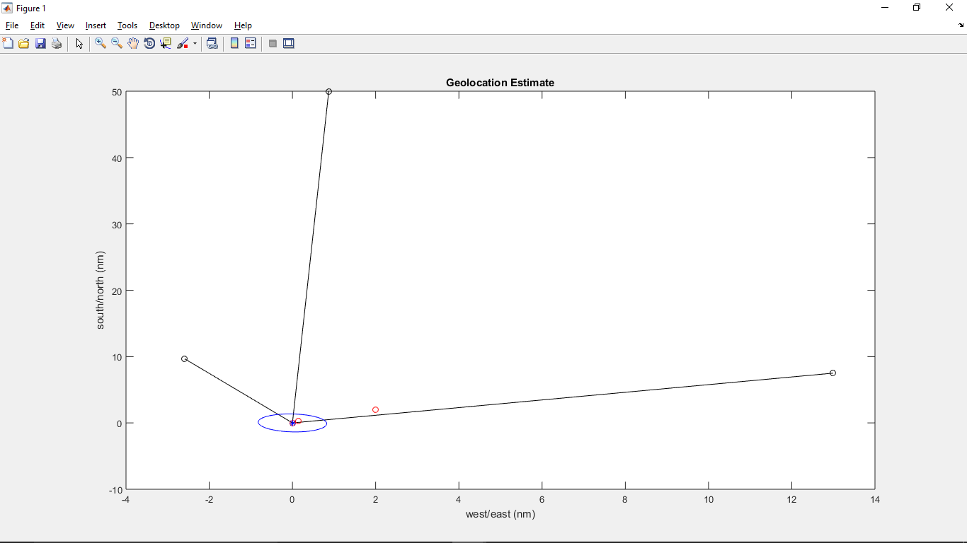
Validated Results
First iteration output in meters:
xhatnew = 1242.92
1000.70
semimajor = 1953.59
semiminor = 465.13

Slide 8
Benchmarks
./cuGEO –-measurements 15000 --benchmark
C++ is fast for low numbers of measurements, < 1ms for <= 1,000 DOA’s
Benefit when >6,000 measurements?
Crashes around ~25,000 measurements, memory or scalability problem

Slide 9
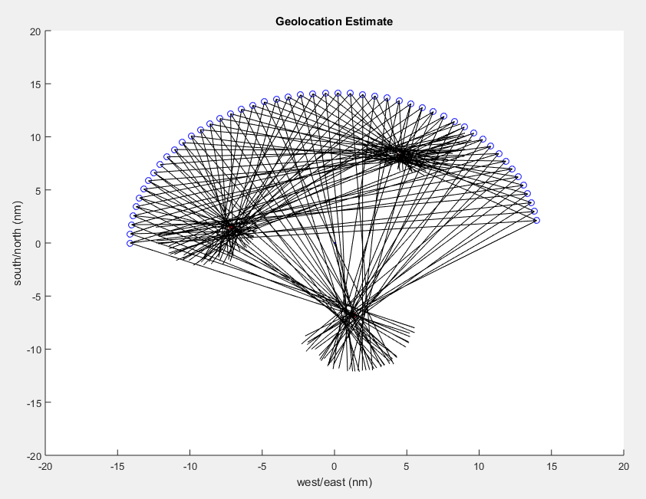
Realistic Geolocation Scenarios
Multiple targets
Moving targets
Multiple sensors
Flight patterns
Different measurement errors
Outlier measurements
Non-flat world model (WGS84)

Slide 10
Future Work
Fix scalability/memory problem
Fix algorithm boundary problems
Add CUDA streams for simultaneous/asynchronous operations
Ingest/generate full simulated scenarios
Add visual component, live data plots
Modify algorithm to use more realistic scenarios

