Slide 1
Smart Study planner
CAPSTONE PROJECT
Presented By:
1. Thimothy John-Seshadripuram Degree College-BCA

Slide 2
OUTLINE
Problem Statement (Should not include solution)
System Development Approach (Technology Used)
Algorithm & Deployment (Step by Step Procedure)
Result
Conclusion
Future Scope(Optional)
References

Slide 3
Problem Statement
Students often struggle to manage their study schedules effectively and track tasks.
Lack of proper organization can lead to missed deadlines, inefficient study sessions, and lower productivity.
We need a application that save all tasks locally for accessing and monitoring quickly.
Students are not having an interactive interface that tracks their progress and make them a interesting platform

Slide 4
System Approach
Front-end: HTML, CSS
Scripting: JavaScript
Data Storage: Browser Local Storage (no database required)
Visualization: Chart.js for progress charts
UI/UX Enhancements: Font Awesome icons, animations, interactive templates
Deployment: GitHub Pages / Netlify for hosting

Slide 5
Algorithm & Deployment
Product Catalog Creation: Define and organize products with images, prices, and descriptions for easy display.
Frontend Design: Create a visually appealing layout using HTML and CSS grids/cards for product presentation.
Interactive Features: Implement Add-to-Cart, Remove-from-Cart, real-time total calculation, filtering, and modal product views using JavaScript.
Testing: Ensure cross-browser compatibility and mobile responsiveness for smooth user experience.
Deployment: Publish the project online using GitHub Pages or Netlify for free and accessible hosting.

Slide 6
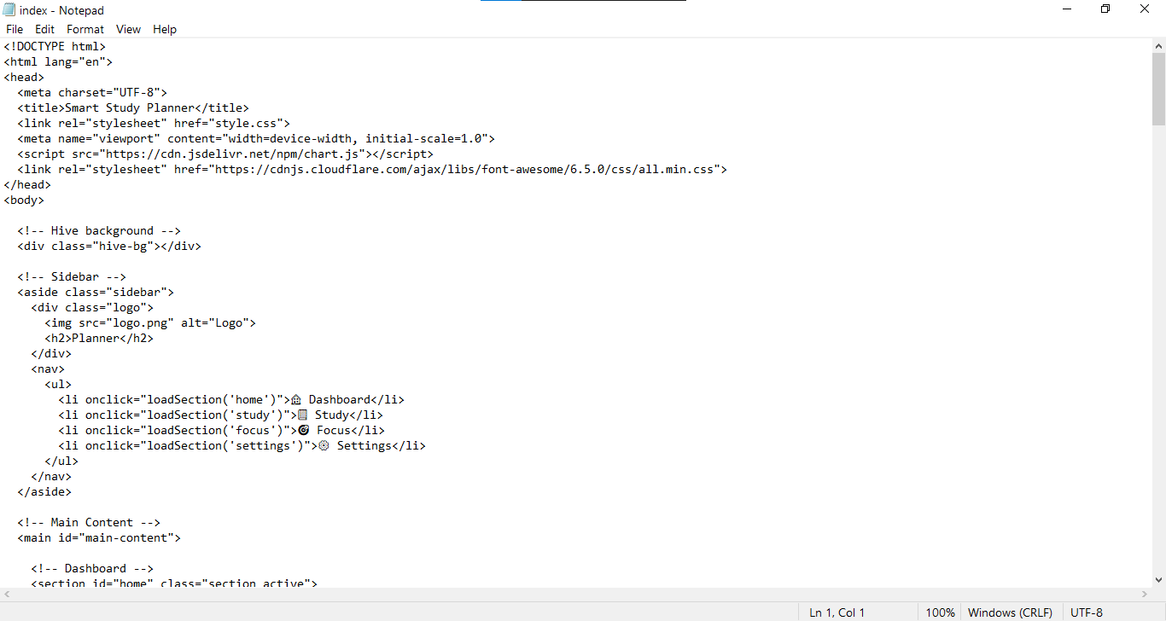
Result
Github link: https://timcoder-12.github.io/study-dashboard/
Images of code and Output:

Slide 7
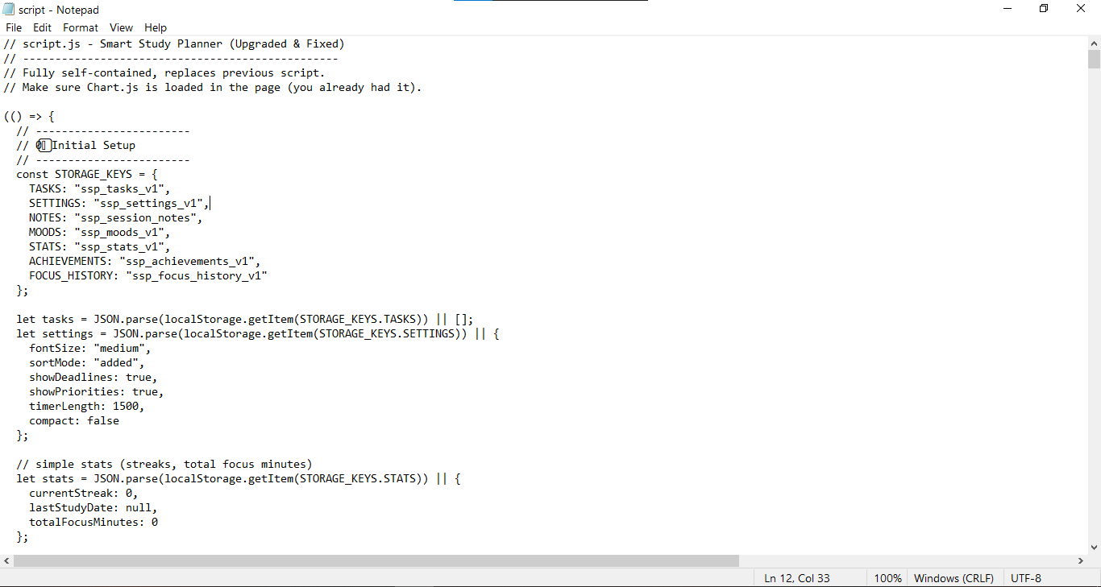
Code 2

Slide 8
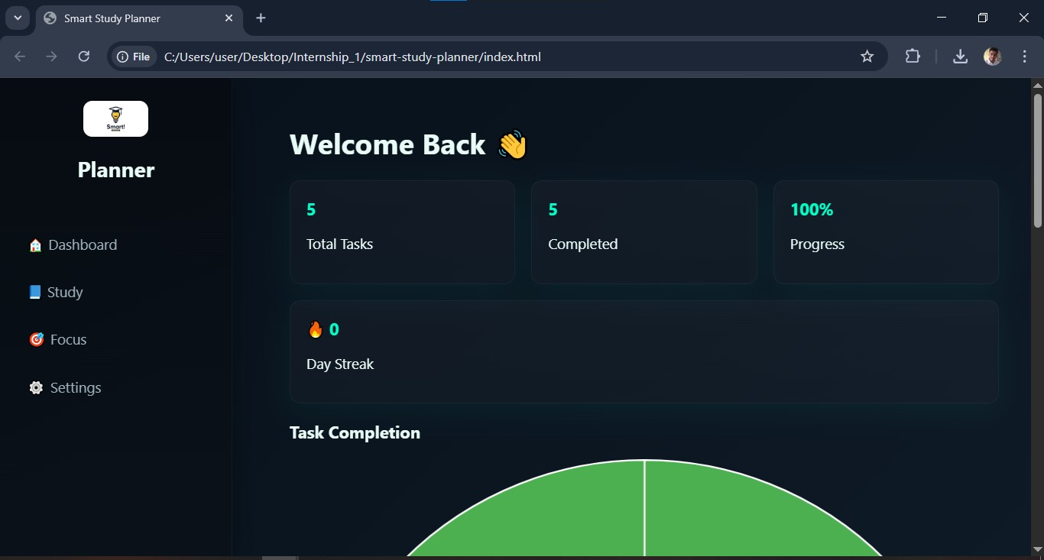
Output 1

Slide 9
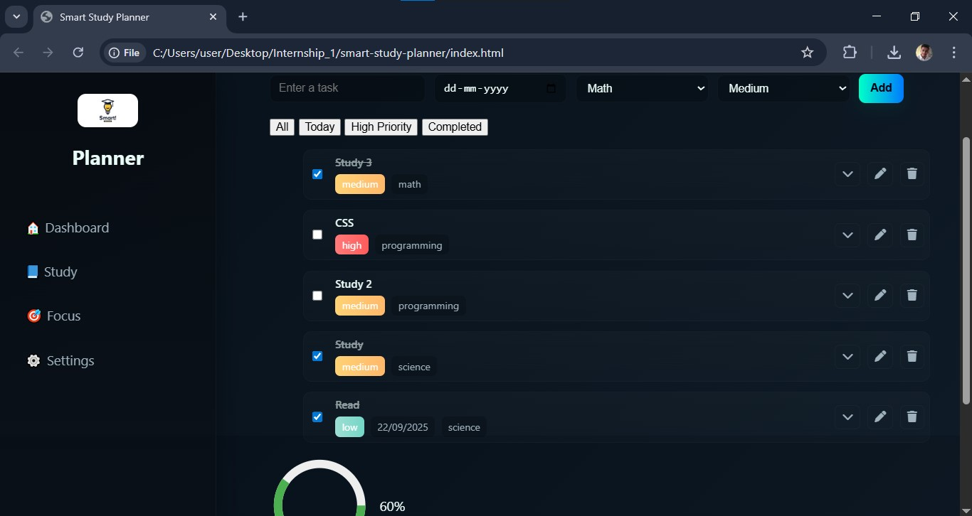
Output 2

Slide 10
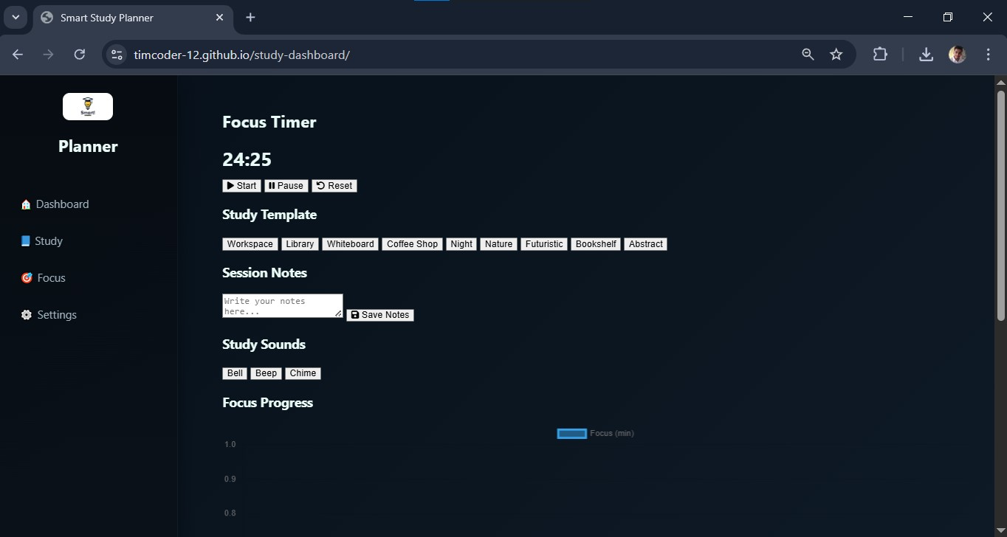
Output 3

Slide 11
Conclusion
The Smart Study Planner provides a seamless way for students to organize, manage, and track their academic tasks.
By combining interactive features, visual progress tracking, and motivational tools.
Boosts productivity and encourages disciplined study habits.

Slide 12
Future scope(Optional)
Add cloud sync to access tasks across devices.
Implement reminder notifications and email alerts.
Add AI suggestions for optimal study schedules.
Integrate analytics for long-term performance tracking.
Mobile app version for Android/iOS for better accessibility.

Slide 13
References
Chart.js Documentation: https://www.chartjs.org/
MDN Web Docs - JavaScript: https://developer.mozilla.org/en-US/docs/Web/JavaScript
HTML & CSS Tutorials - W3Schools: https://www.w3schools.com/
Netlify Documentation: https://docs.netlify.com/
GitHub Pages Documentation: https://docs.github.com/en/pages

Slide 14
THANK YOU

