Slide 1
Smart Study planner
CAPSTONE PROJECT
Presented By:
1. Thimothy John-Seshadripuram Degree College-BCA

Slide 2
OUTLINE
Problem Statement (Should not include solution)
System Development Approach (Technology Used)
Algorithm & Deployment (Step by Step Procedure)
Result
Conclusion
Future Scope(Optional)
References

Slide 3
Problem Statement
Students often struggle to manage their study schedules effectively and track tasks.
Lack of proper organization can lead to missed deadlines, inefficient study sessions, and lower productivity.
We need a application that save all tasks locally for accessing and monitoring quickly.
Students are not having an interactive interface that tracks their progress and make them a interesting platform

Slide 4
System Approach
Front-end: HTML, CSS
Scripting: JavaScript
Data Storage: Browser Local Storage (no database required)
Visualization: Chart.js for progress charts
UI/UX Enhancements: Font Awesome icons, animations, interactive templates
Deployment: GitHub Pages / Netlify for hosting

Slide 5
Front-end: HTML, CSS
HTML: Provides the structure of the study planner (tasks, goals, buttons, charts).
CSS: Styles the layout using grids, cards, and responsive design.
Role: Makes the application visually appealing, consistent, and mobile-friendly.
Key Features:
Clean layouts with sections for tasks & charts
Responsive grid system for different screen sizes
Color schemes and typography for readability

Slide 6
Scripting: JavaScript
JavaScript: Adds interactivity and functionality to the planner.
Role: Manages task creation, editing, deletion, and reminders.
Key Features:
Add/Remove tasks dynamically
Update progress in real-time
Filter and sort tasks by priority/deadline
Event listeners for buttons and inputs

Slide 7
Data Storage: Browser Local Storage (no database required)
Local Storage: Stores data in the browser itself.
Role: Ensures study goals and tasks are saved even after refreshing.
Advantages:
No database required
Fast read/write operations
Persistent across sessions on the same device
Usage in Planner: Saves tasks, user settings, and progress history.

Slide 8
Visualization (Chart.js)
Chart.js: A lightweight JavaScript library for data visualization.
Role: Shows progress and performance visually.
Key Features:
Pie charts for task completion status
Line charts for progress over time
Bar charts for subject/topic tracking
Benefit: Helps students see trends and stay motivated.

Slide 9
UI/UX Enhancements
Font Awesome Icons: Used for buttons (add, delete, edit) and navigation.
Animations: Smooth transitions for task updates, modals, and progress changes.
Interactive Templates: Different themes like Workspace, Night Owl, Coffee Shop.
Goal: Make the app engaging and user-friendly.

Slide 10
Deployment (GitHub Pages / Netlify)
GitHub Pages: Free hosting directly from your GitHub repository.
Netlify: Easy drag-and-drop deployment or Git integration.
Role: Makes the planner accessible online without paid servers.
Advantages:
Free & reliable hosting
Continuous deployment with Git updates
Supports custom domains

Slide 11
Algorithm & Deployment
Product Catalog Creation: Define and organize products with images, prices, and descriptions for easy display.
Frontend Design: Create a visually appealing layout using HTML and CSS grids/cards for product presentation.
Interactive Features: Implement Add-to-Cart, Remove-from-Cart, real-time total calculation, filtering, and modal product views using JavaScript.
Testing: Ensure cross-browser compatibility and mobile responsiveness for smooth user experience.
Deployment: Publish the project online using GitHub Pages or Netlify for free and accessible hosting.

Slide 12
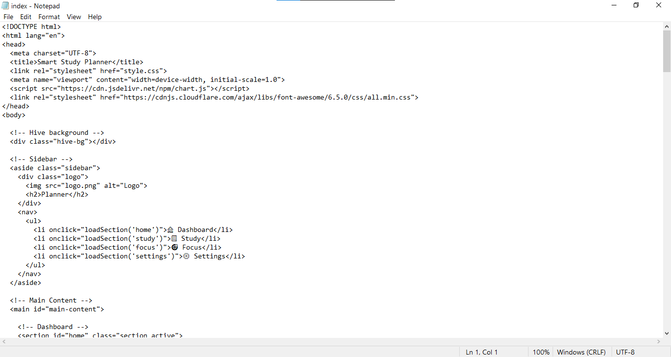
Result
Github link: https://timcoder-12.github.io/study-dashboard/
Images of code and Output:

Slide 13
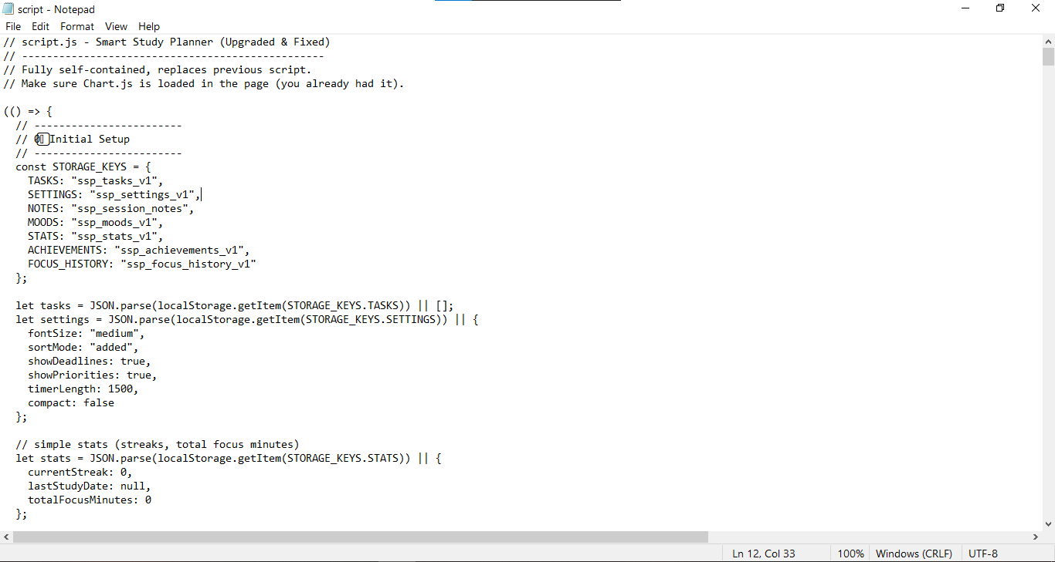
Code 2

Slide 14
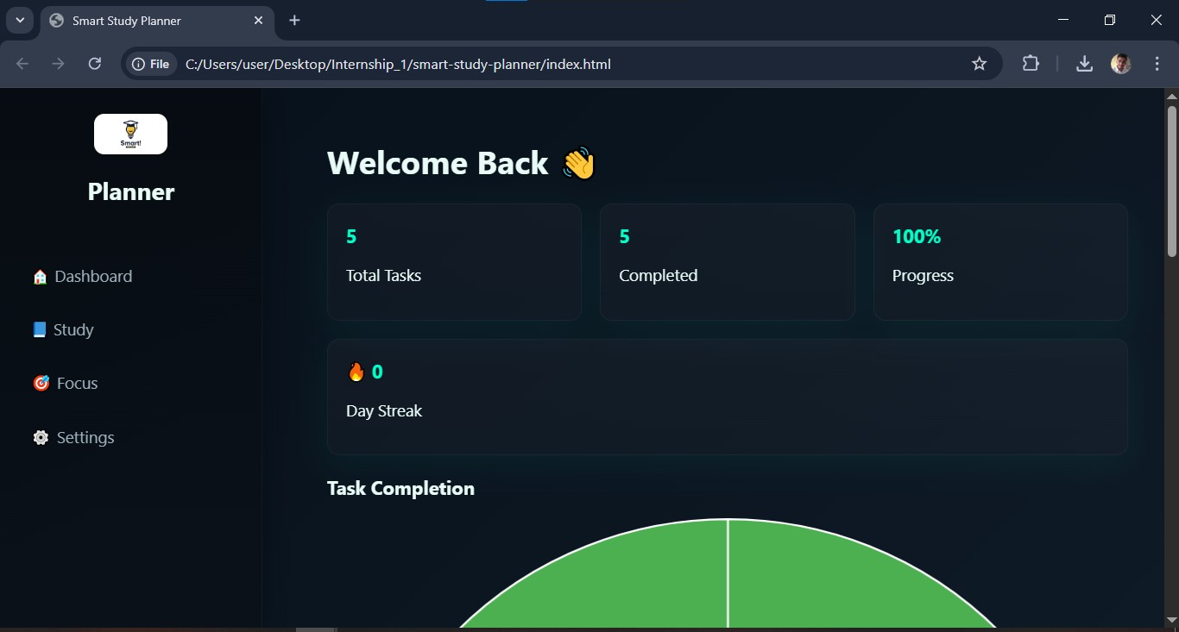
Output 1

Slide 15
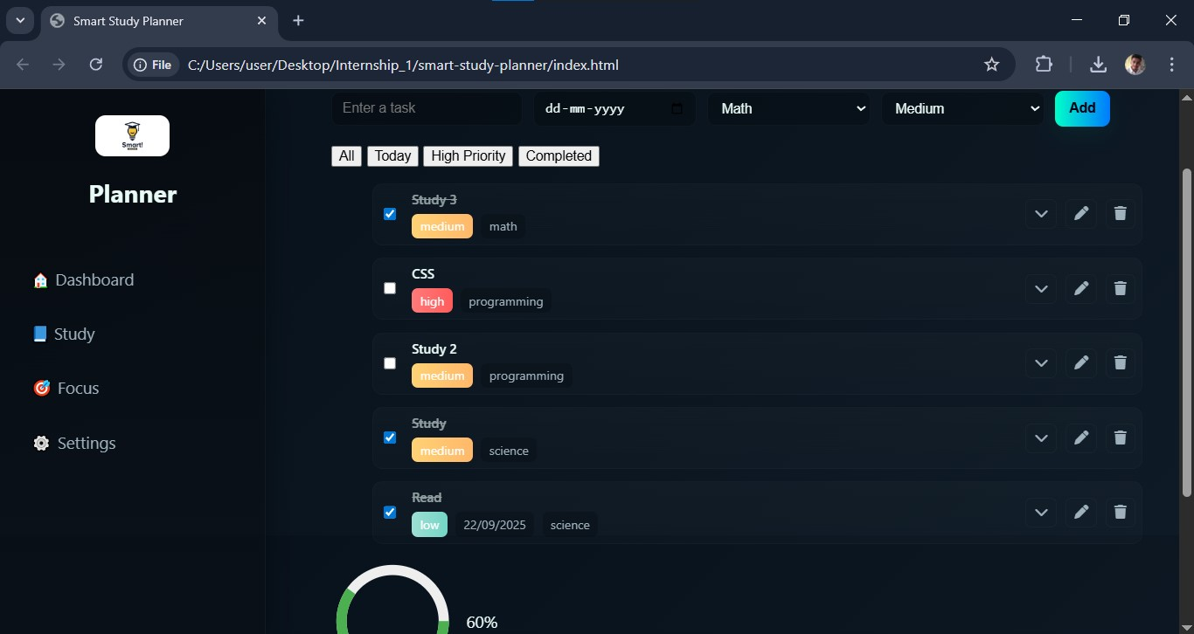
Output 2

Slide 16
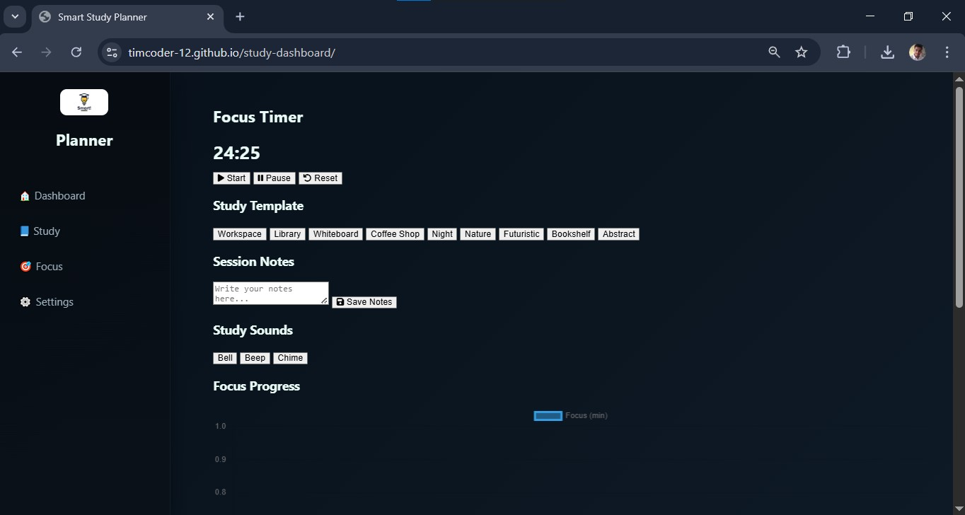
Output 3

Slide 17
Conclusion
The Smart Study Planner provides a seamless way for students to organize, manage, and track their academic tasks.
By combining interactive features, visual progress tracking, and motivational tools.
Boosts productivity and encourages disciplined study habits.

Slide 18
Future scope(Optional)
Add cloud sync to access tasks across devices.
Implement reminder notifications and email alerts.
Add AI suggestions for optimal study schedules.
Integrate analytics for long-term performance tracking.
Mobile app version for Android/iOS for better accessibility.

Slide 19
References
Chart.js Documentation: https://www.chartjs.org/
MDN Web Docs - JavaScript: https://developer.mozilla.org/en-US/docs/Web/JavaScript
HTML & CSS Tutorials - W3Schools: https://www.w3schools.com/
Netlify Documentation: https://docs.netlify.com/
GitHub Pages Documentation: https://docs.github.com/en/pages

Slide 20
THANK YOU

