Slide 1

TRYS General Architecture
communication
problem area
TRYS system
* world states: traffic situations
* individual plans: signal plan proposals for problem areas
* impact of plans: reduction of traffic excess in the problem area
* conflicts in the use of control devices produce incompatibilities between local plans
c
oordinator
a
gent
a
gent
a
gent
a
gent
- 20.000 lines of C++
- 25.000 lines of prolog

Slide 2
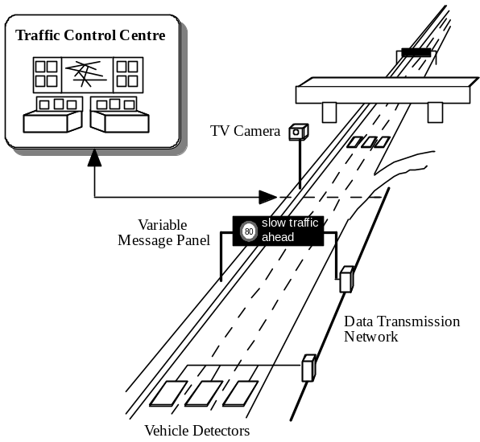
TRYS Knowledge-based Agents
Network Structure Knowledge Unit perceives the scenario data from loop detectors etc., records it, and analyses it to deduce signal information, basic traffic qualitative magnitudes (i.e. speed, occupancy, flows) and certain aggregated measures (i.e. traffic volume generated in an entrance node, spatial gradient of speed).
Scenario:
- one ring-road
- 6 adjacent motorways
- > 300 loop detectors
- 52 Variable Message Sgnals
TRYS system:
- 22 autonomous and benevolent agents
- percepcion: loop detectors and video cameras

Slide 3
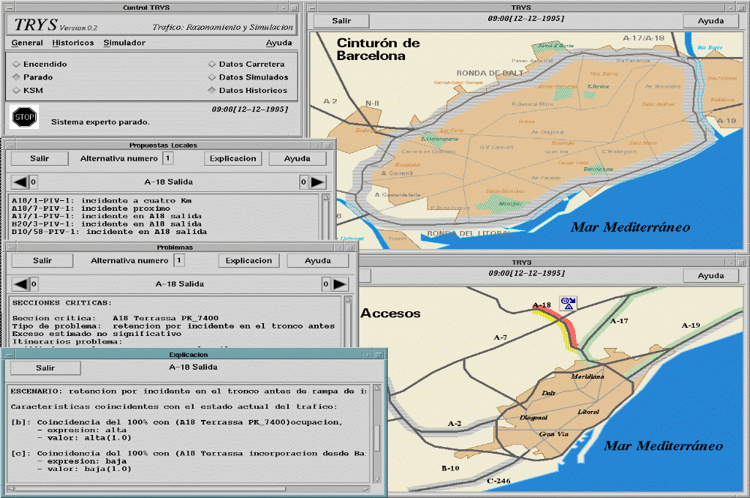
TRYS system for Barcelona

Slide 4
TRYS Knowledge-based Agents
Traffic Network
Management
...
Agent 1
Agent N
Co-
ordinator
Problems
Control Actions
Problems
Control Actions
Proposals
Agents
Proposals
Knowledge
Knowledge
Knowledge
Knowledge
Compatibility
Priority
Completion
Knowledge
Knowledge
Knowledge
Problem
Network
Control
Problem
Network
Control
Scenarios
Knowledge
Actions
Scenarios
Knowledge
Actions
Demand
Physical
Demand
Physical
Model
Structure
Model
Structure

Slide 5
TRYS Agents: Co-ordination Knowledge
Co-ordination Agent: analyses the set of control plan proposals in order to build a global proposals by coherently synthesising the local proposals into signal recommendations for the whole network
Proposals Compatibility KU
(i) physical conflicts caused by different actions on the same signal device and,
(ii) semantic incoherence between proposals which provoke undesirable effects on the traffic behaviour
Proposals Completion KU
control proposals completion with additional messages chosen from a global, strategical view.
Agents Priorities KU
Sorts agents control proposals attending to the severity of their traffic problems
Proposals Compatibility
Consistency checking
Coordination
Knowledge
Agents Priorities
Proposals selection
Integration
Proposals Completion
Completion

Slide 6
TRYSA₂ General Architecture
TRYSA₂ prototype
convert the original “benevolent” TRYS agents into autonomous agents
TRYS embeded agents produces executable local signal plans with explicity local utility value
Structural co-operation among autonomous traffic control agents
- Normative layer: permisions and prohibitions to use control devices
- Social layer: distributed search for the global signal plan that corresponds
to the bargain outcome (eficient and fair)
communication
problem area
a
gent
a
gent
a
gent
agent
- 1.000 lines of C++
- 5.000 lines of prolog
- 500 lines of Tcl/Tk

Slide 7
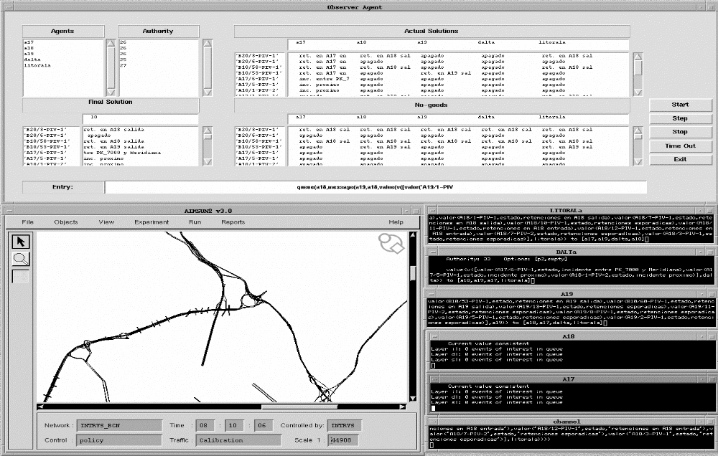
TRYSA₂ prototype

