Slide 1


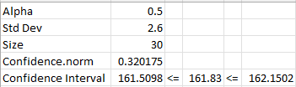
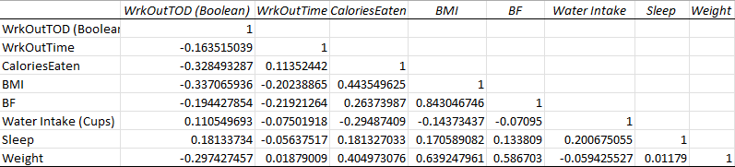
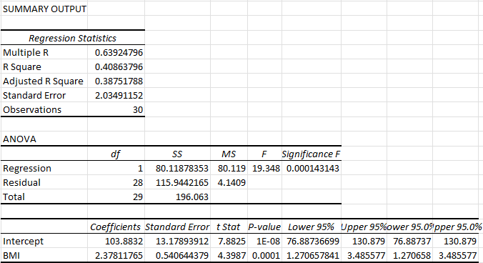
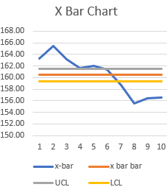
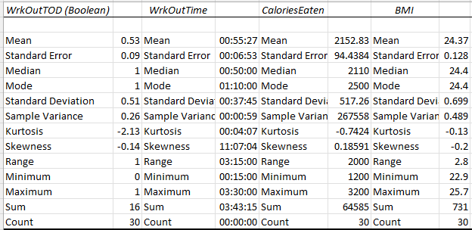
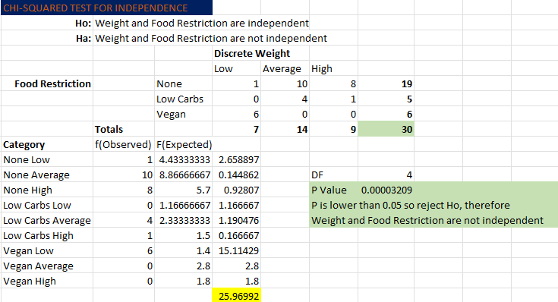
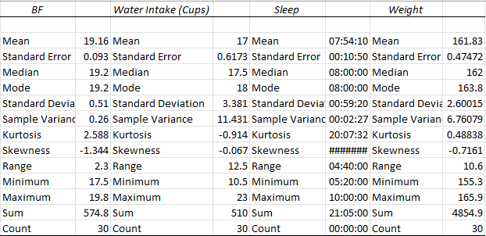
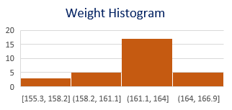
Process Improvement Project – Weight Reduction
Process owner: Tim Cordero
Key Dates --->
Team
Launch 10/21
Define
10/09/21
Measure
10/09/21-11/09/21
Analyze
11/09/21-11/23/21
Improve
11/23/21-12/5/21
Control
12/5/21-12/13/21
DEFINE
MEASURE
ANALYZE
1) Problem Statement: Bad health leads to spending more money at the grocery store, eating out from restaurants, and high health insurance bills. The bad health is caused from being in a caloric surplus and not having strict guidelines to follow for nutrition and workout plans.
2) Business Impact: To lose weight and improve overall health, I will need to be in a caloric deficit which will mean I will spend about $60 less on food each month. Improving health will also save $20 a month from CO-PAY’s due to doctor visits. In the long term, if health is improved, I can go to a cheaper health insurance plan and save an extra $200 per year.
Starting SQL: 1.9
95% confident weight will fall between 161.5 and 162.15 with current process
BMI has the strongest correlation to weight
Strongest Regression Model for Y output of Weight:
The strongest regression model for the y output of weight was a simple linear regression model with an x input of BMI. BMI also had the strongest correlation with weight out of the continuous variables which is seen in the correlation chart above as well as the Multiple R score. 40.8% of the change in weight is related to the change in BMI.
IMPROVE
Solution: As seen in the trend line as well as the Chi-Squared test for independence, the vegan food restriction has a very strong impact on weight reduction. A vegan diet was implemented to improve the weight loss process.
Weight often falls between 161-164
Target Weight:
150 pounds
Steep decline came during vegan diet and pyropilates workouts
With an n of 4, Period 8 was when the new process started. The improvement can be seen from the trend starting above the upper limit and finishing below the lower limit
CONTROL
New SQL: 2.3
Very Low P-Value between Discretized Weight variable (Low, Average, High) and categorical food restriction variable
Stick to a vegan diet or similar diet as much as possible

Slide 2
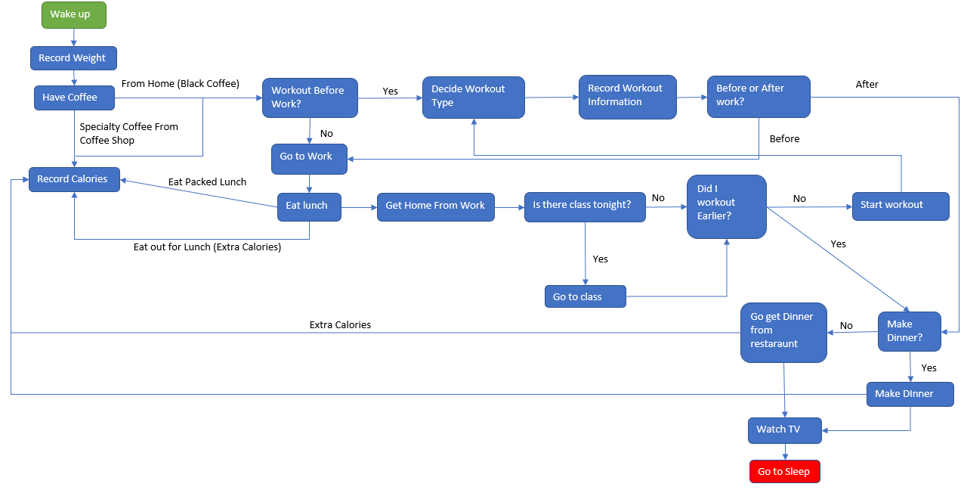
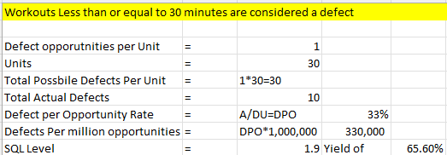
Define: 10/09/21
Process Map:
Descriptive Statistics on continuous process data
Goal: Reduce weight down to 150 pounds. If weight is at 150 pounds by the end of the control phase, the goal will be met.
Operational Definitions:
Record weight, workout, nutrition, and sleep information daily (7 days a week)
Record weight and sleep information first thing in the morning
Add up calorie intake at the end of the day
Record workout information right after workout
Do not deprive body of nutritional necessities
Record workout and sleep information only from phone tracking apps, not from memory
Process trying to improve:
The process to improve is the daily steps taken that ultimately lead to a high caloric intake and overweight health status. The first step to fix is to choose to workout more often. The last step to fix is to be diligent in recording calories each day.
SQL:

Slide 3
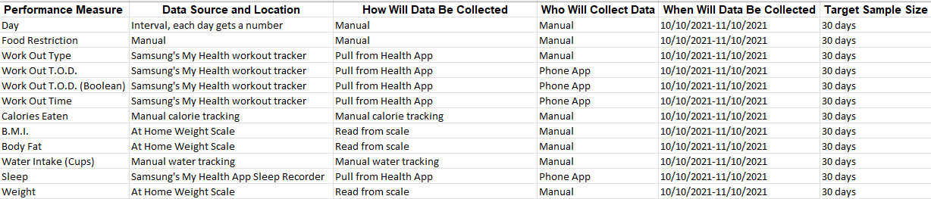

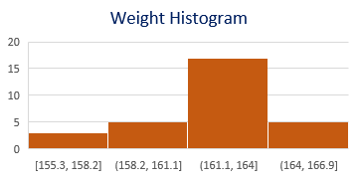
Measure: 10/09/21-11/09/21
Data Measurement Plan:
Data recorded (daily):
Weight -> Continuous
Sleep -> Continuous
Water Intake -> Continuous
Body Fat % -> Continuous
B.M.I. -> Continuous
Caloric Intake -> Continuous
Workout length -> Continuous
Workout Time of Day -> Discrete
Workout Type -> Discrete
Food Restrictions/Diet -> Discrete
Type of Data: Mix of continuous and discrete
30 records of data were collected; however, the ideal sample size is 14
More data was recorded than needed
to detect a 1-pound difference in
the population mean
Sample size was chose based on time
given for collection as well as time
needed for analysis and improvement.
All data was collected manually
Weight and sleep were recorded first thing after waking up in the morning
Workout and sleep data were collected through phone apps that automatically track sleep length and workout length/type.
Caloric intake was manually tracked by recording food labels and adding up total calories at the end of each day.
Body fat % and Body Mass Index(B.M.I.) were read from high tec scale each morning
Water intake was tracked manually by using a 1-gallon water jug
Food Restrictions were manually logged by determining if the day was spent using a low-carb or vegan diet, or no diet at all.
Measurement Error
Measurement error could have appeared in caloric intake and water intake.
Both data measurements were tracked manually and required calculations to determine total volume.
Exact measurements were hard to replicate with methods used.
Phone applications could have been used to more accurately log calorie and water intake data.

Slide 4
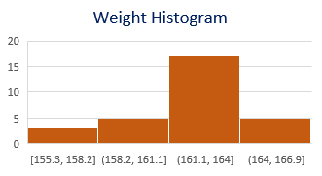
Analyze: 11/09/21-11/23/21
8 tools used: Descriptive Statistics, Histogram, Trend line, Correlation, Simple Linear Regression, Chi-Squared Test for independence, Confidence Interval, and X-Bar Control Chart.
Descriptive Statistics Histogram
As seen with the confidence Interval, the majority of weights recorded fall between 161 and 164 pounds.
-My average weight during the initial process was 161.86 with a standard deviation of 2.6 pounds, which
is 7 pounds over the 5’6 male recommendation weight of 155 pounds.
- Caloric intake averaged out to be 2152 calories per day which is 152 calories over the 2000
recommended daily caloric intake. Trend Line
Confidence Interval
A decline in weight trending started on the 17th day and took a steep drop on the 21st day
- Weight during this process will fall between 161.5 and 162.15 with a 95% confidence.

Slide 5
Analyze: 11/09/21-11/23/21
Correlation
The variable with the strongest correlation to weight is B.M.I. followed by Body Fat%.
Neither variable meets the threshold of 70% variability explanation.
Simple Linear Regression
- Since B.M.I. had the strongest correlation to weight, it was used in the simple linear
regression model. 40.8% if the change in weight is related to the change in B.M.I. Although,
p-value for B.M.I. was below 0.5, the goodness of fit did not meet the threshold and therefore
B.M.I. may not be the best input to determine weight.
Chi-Squared Test for Independence
- Since the weight attribute was originally continuous data, to use the Chi-Squared test, the data
needed to be converted into categorical data. Categories of Low, Average, and High were used. The two variables being compared for independence were weight and Food Restrictions of vegan, low carb, or no restriction. The hypothesis statements can be seen above, which say that if there is no sufficient evidence that the variables are related, then then they are independent and vice-versa. The variables were tested and determined that they are not independent of each other. The p-value is well below the threshold of 0.05, and therefore food restriction can be used as trusted input to determine weight.
X-Bar Chart
- An n of 4 was used for this x-bar control chart. 10 Periods each with 4 days of recorded weights were used as well. The first 3 periods were above the upper control limit, whereas the last 4 periods were below the lower control limit which means the chart is out of control. As seen in other charts, weight did reduce during the duration of the process tracking.

Slide 6
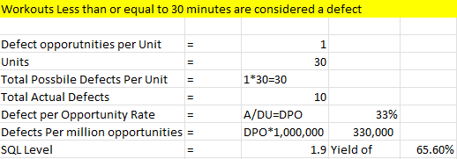
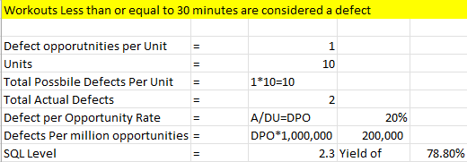
Analyze: 11/09/21-11/23/21
Old Process Sigma Quality Level
New Process Sigma Quality Level
Start Process improved!

Slide 7

Improve: 11/23/21-12/5/21
Solution for new process:
Stick to vegan diet and continue workout, sleep, and water intake processes.
Did Process Improve?
Yes, in the control chart, period 8 was the start of the new process which shows a dramatic drop below the lower control limit.
The line then flattens and remains well below the lower control limit.
New process takeaways:
Workout, sleep, and water intake processes may not have been the problem with the overall process.
Instead, nutrition and caloric intake have a much greater effect on the process to reduce weight.
A vegan diet leads to buying less snacks and eating out at restaurants less which saved nearly $70 a month.

Slide 8
Control: 12/5/21-12/13/21
New Process SQL:
2.3
Sticking to a vegan diet will likely be challenging for me,
as an individual who enjoys meat and dairy products.
To “hold the gains”, it may be beneficial to stick to a vegan diet for
periods of a time, such as sticking to a vegan diet on weekdays.
Another recommendation could be to incorporate more vegan friendly foods into my old process of nutrition.
The next round of improvements could build off the discovery made in the current rounds of improvements of holding a vegan diet. It would be useful to pinpoint another impactful input to the weight reduction process and analyze how to use that input to reduce the output of weight. Such as keeping workouts to a length of greater than 45 minutes for example.

