Slide 1
Symmetry Operations
Rotations and Translations
Tim Rose

Slide 2
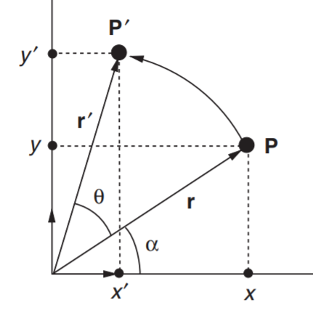
Say you want to rotate a point P (x,y) to the point P’ (x’,y’) by rotating ccw about the z axis; how do you do it mathematically?

Slide 3
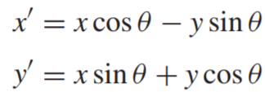
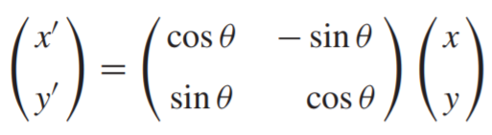
Say you want to rotate a point P (x,y) to the point P’ (x’,y’) by rotating ccw about the z axis; how do you do it mathematically?
From geometry,
In matrix form,

Slide 4
Write a python function that accepts an angle and returns a rotation matrix as a 2x2 numpy array.
What is the rotation matrix when the angle is π/6?
Note: the rotation axis is the z axis and the matrix rotates in the ccw direction).
Rotation matrices are referred to as D
D

Slide 5
Let P be (1, 0). What is P’ when the rotation angle is π/6? What is P’ when the angle is π/3? Do these calculations by hand.
Note: the rotation axis is the z axis and the matrix rotates in the ccw direction).

Slide 6
Write a python function that accepts an angle, and a numpy array (x,y), and outputs a numpy array (x’,y’).
Let P be (1, 0). Plot P and P’ when the rotation angle is π/6. Now plot P and P’ when the angle is π/3.
Note: the rotation axis is the z axis and the matrix rotates in the ccw direction).

Slide 7
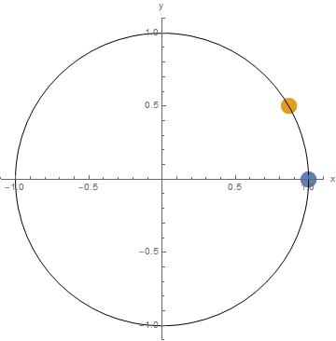
It should look like this for the π/6 case

Slide 8
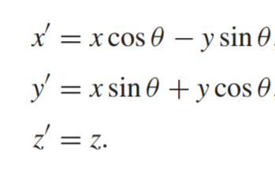
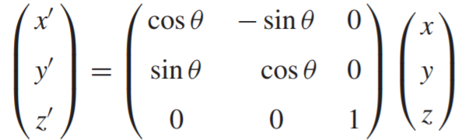
In 3D, the previous rotations could be represented like this:
Write a function that produces a 3D rotation matrix about the z axis.
Write a python function that accepts an angle, and a numpy array (x,y,z), and outputs a numpy array (x’,y’,z’).
Let P be (1, 0, 0). Plot P and P’ when the rotation angle is π/6. Now plot P and P’ when the angle is π/3.
Note: the rotation axis is the z axis and the matrix rotates in the ccw direction).
D

Slide 9
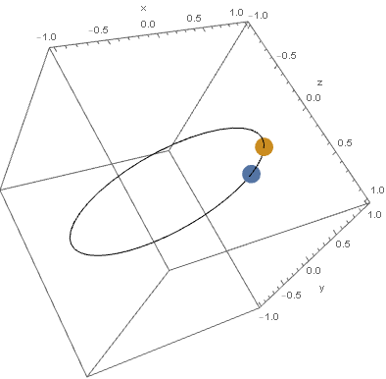
It should look like this for the π/6 case

Slide 10
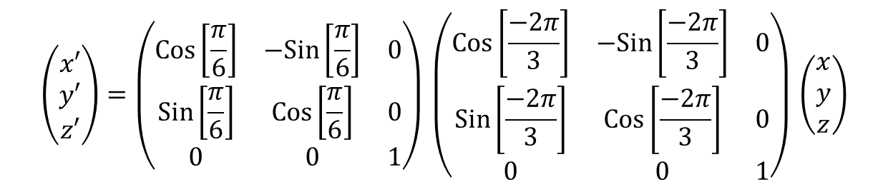
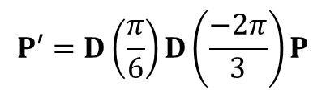

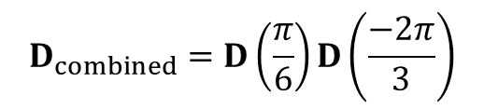
You may perform sequential symmetry operations by simply multiplying two or more matrices (each corresponds to a symmetry operation) together
For example, to rotate a point by -2π/3 and then by π/6 can be accomplished by the following:
$$\left(\begin{matrix}x′ \\ y′ \\ z′\end{matrix}\right)=\left(\begin{matrix}Cos\left[\frac{π}{6}\right] & −Sin\left[\frac{π}{6}\right] & 0 \\ Sin\left[\frac{π}{6}\right] & Cos\left[\frac{π}{6}\right] & 0 \\ 0 & 0 & 1\end{matrix}\right)⁢\left(\begin{matrix}Cos\left[\frac{−2⁢π}{3}\right] & −Sin\left[\frac{−2⁢π}{3}\right] & 0 \\ Sin\left[\frac{−2⁢π}{3}\right] & Cos\left[\frac{−2⁢π}{3}\right] & 0 \\ 0 & 0 & 1\end{matrix}\right)⁢\left(\begin{matrix}x \\ y \\ z\end{matrix}\right)$$
We could denote this as follows:
$$P′=D\left(\frac{π}{6}\right)⁢D\left(\frac{−2⁢π}{3}\right)⁢P$$
When applying more than one symmetry operation, it will become quite handy to combine them into one matrix. Thus we are looking for:
$$D_{combined}=D\left(\frac{π}{6}\right)⁢D\left(\frac{−2⁢π}{3}\right)$$
So that we can write:
$$P′=D_{combined}⁢P$$

Slide 11

Simplifying yields:
$$D_{combined}=D\left(\frac{−π}{2}\right)$$
Write a function that will take a list of symmetry operation matrices (in this case, rotation matrices) and returns the combined symmetry operation matrix.
Verify that rotating a point by π/6 and then by -2π/3 with a combined matrix gives the same result as rotating by –π/2 by testing out your function.

Slide 12
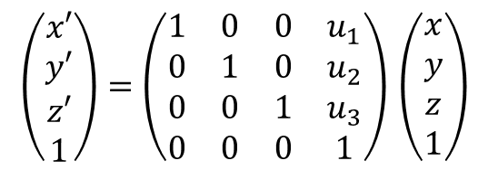
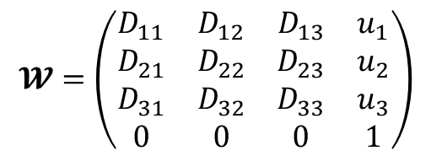

Points can be translated by matrix multiplication which will be very handy. To translate a point by t = ($u_{1}$ $u_{2}$ $u_{3}$) (in other words, $u_{1}$ in the x direction, $u_{2}$ in y direction, and $u_{3}$ in the z direction), use the following formula:
$$\left(\begin{matrix}x′ \\ y′ \\ z′ \\ 1\end{matrix}\right)=\left(\begin{matrix}1 & 0 & 0 & u_{1} \\ 0 & 1 & 0 & u_{2} \\ 0 & 0 & 1 & u_{3} \\ 0 & 0 & 0 & 1\end{matrix}\right)⁢\left(\begin{matrix}x \\ y \\ z \\ 1\end{matrix}\right)$$
Seitz matrix:
$$𝓦=\left(D|t\right)$$
Note that the upper-left 9 positions are the D rotation matrix with the t translation vector as well as some 0’s and 1’s (which are always there) appended:
$$𝓦=\left(\begin{matrix}D_{11} & D_{12} & D_{13} & u_{1} \\ D_{21} & D_{22} & D_{23} & u_{2} \\ D_{31} & D_{32} & D_{33} & u_{3} \\ 0 & 0 & 0 & 1\end{matrix}\right)$$
Note: This will rotate, then translate.
Write a function that takes in a rotation matrix and a translation vector and outputs a Seitz matrix.
Use the Seitz matrix to rotate by π/4 radians and then translate P = (1, -1, 2) with t = (0, 1, -2) to produce P’. What are the coordinates of P’?
Plot P and P’

Slide 13
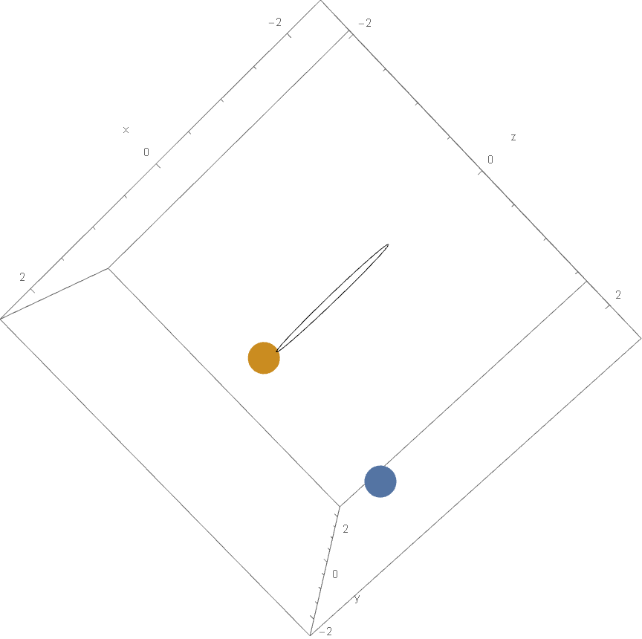
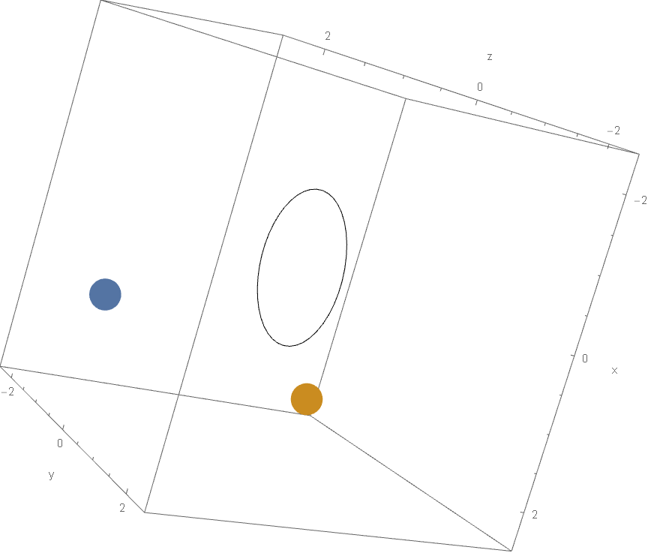
It should look like this (these are just two views of the same figure)

Slide 14
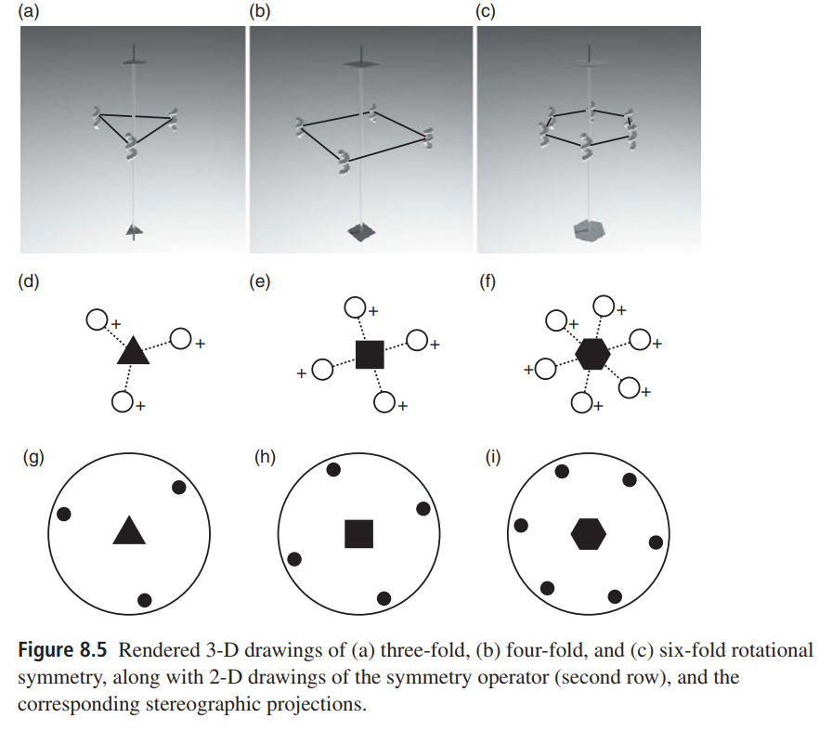
A rotation is n-fold if its angle is given by 2π/n.
n must be an integer > 0.
Denote an n-fold rotation about the c axis by the value of n
Denote an n-fold rotation about the [uvw] axis by n[uvw]
For example, a 3-fold rotation is a rotation of 2π/3 radians. A 6[010] is a π/3 rotation about the [010] axis.

Slide 15
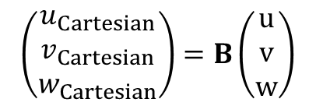
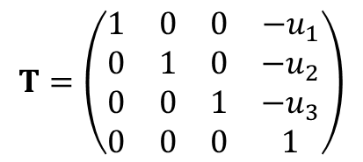
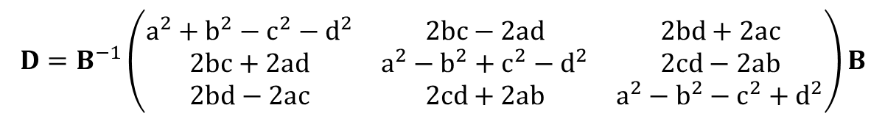
To rotate a point, P = (x, y, z), about an arbitrary axis, [uvw], with axis origin coordinates, (u₁,u₂,u₃), and with all of the aforementioned coordinates in terms of an arbitrary basis, B:
1. Compute the matrix that will translate P such that it’s coordinates are relative to the base of [uvw] rather than (0,0,0):
$$T=\left(\begin{matrix}1 & 0 & 0 & −u_{1} \\ 0 & 1 & 0 & −u_{2} \\ 0 & 0 & 1 & −u_{3} \\ 0 & 0 & 0 & 1\end{matrix}\right)$$
2. Convert [uvw] to be in terms of a Cartesian basis:
$$\left(\begin{matrix}u_{Cartesian} \\ v_{Cartesian} \\ w_{Cartesian}\end{matrix}\right)=B\left(\begin{matrix}u \\ v \\ w\end{matrix}\right)$$
3. Then, compute the D rotation matrix using the following equations:
$$a=Cos\left[\frac{θ}{2}\right],b=Sin\left[\frac{θ}{2}\right]⁢u_{Cartesian},c=Sin\left[\frac{θ}{2}\right]⁢v_{Cartesian},d=Sin\left[\frac{θ}{2}\right]⁢w_{Cartesian}$$
$$D=B^{−1}⁢\left(\begin{matrix}a^{2}+b^{2}−c^{2}−d^{2} & 2⁢b⁢c−2⁢a⁢d & 2⁢b⁢d+2⁢a⁢c \\ 2⁢b⁢c+2⁢a⁢d & a^{2}−b^{2}+c^{2}−d^{2} & 2⁢c⁢d−2⁢a⁢b \\ 2⁢b⁢d−2⁢a⁢c & 2⁢c⁢d+2⁢a⁢b & a^{2}−b^{2}−c^{2}+d^{2}\end{matrix}\right)⁢B$$

Slide 16
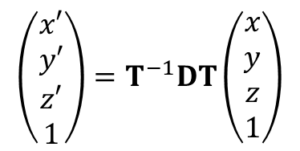
4. Append the necessary 1’s and 0’s so that all matrices and vectors are compatible with multiplication of the translation matrix.
5. Obtain the coordinates, P’ = (x’, y’, z’), (in basis B) that result from carrying out the rotation:
$$\left(\begin{matrix}x′ \\ y′ \\ z′ \\ 1\end{matrix}\right)=T^{−1}⁢D⁢T⁢\left(\begin{matrix}x \\ y \\ z \\ 1\end{matrix}\right)$$

Slide 17
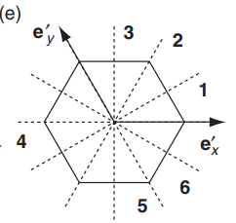
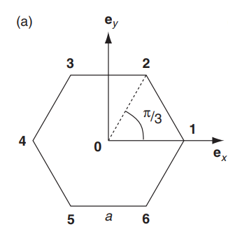
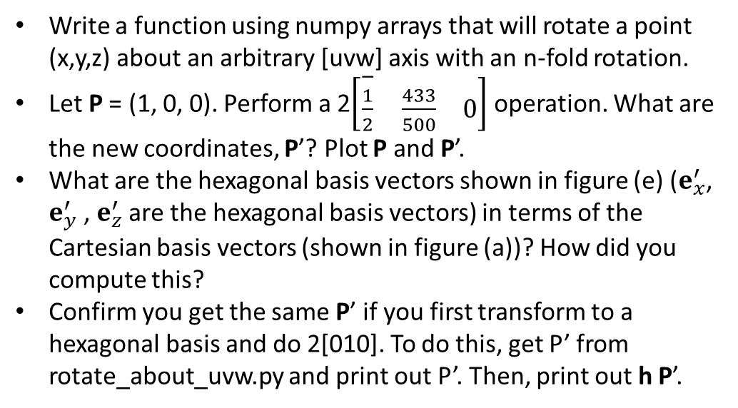
Write a function using numpy arrays that will rotate a point (x,y,z) about an arbitrary [uvw] axis with an n-fold rotation.
Let P = (1, 0, 0). Perform a 2$\left[\begin{matrix}\overset{−}{\frac{1}{2}} & \frac{433}{500} & 0\end{matrix}\right]$ operation. What are the new coordinates, P’? Plot P and P’.
What are the hexagonal basis vectors shown in figure (e) ($e_{x}^{′}$, $e_{y}^{′}$ , $e_{z}^{′}$ are the hexagonal basis vectors) in terms of the Cartesian basis vectors (shown in figure (a))? How did you compute this?
Confirm you get the same P’ if you first transform to a hexagonal basis and do 2[010]. To do this, get P’ from rotate_about_uvw.py and print out P’. Then, print out h P’.

Slide 18
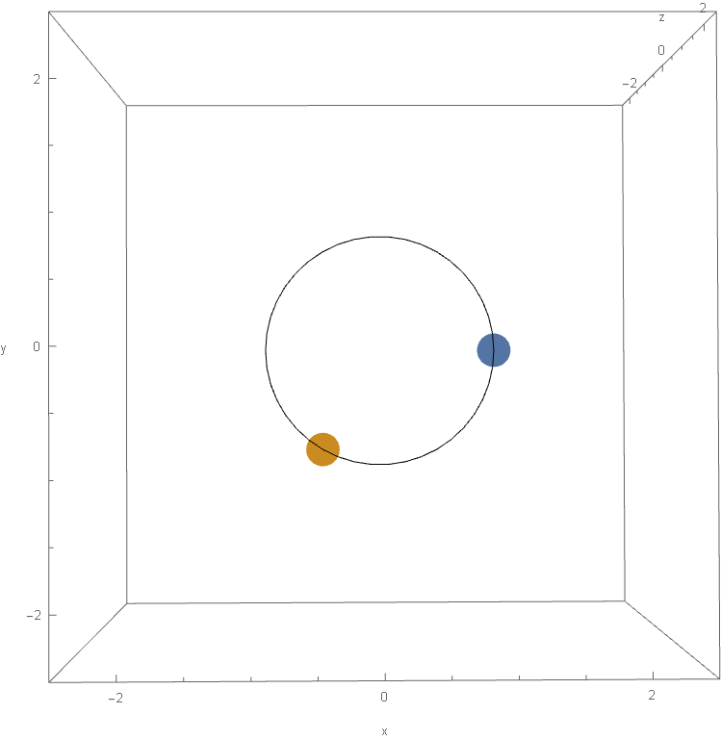
It should look like this

Slide 19
Molecules are a collection of points. The following is the set of coordinates for Target 1:
13
O 4.8879 1.50351 8.11716
C 4.07993 1.83254 9.19492
H 4.61252 2.13227 10.08853
C 2.78532 1.7067 8.80033
C 1.2652 1.72874 8.88109
H 0.81892 2.71714 9.05173
H 0.81671 1.00174 9.57354
C 1.26325 1.26612 7.36577
H 0.81071 1.99203 6.67495
H 0.81885 0.27653 7.19702
C 2.78353 1.29198 7.44134
C 4.07727 1.17141 7.04223
H 4.60838 0.87506 6.14658
atom 4.88790 1.50351 8.11716 O
atom 4.07993 1.83254 9.19492 C
atom 4.61252 2.13227 10.08853 H
atom 2.78532 1.70670 8.80033 C
atom 1.26520 1.72874 8.88109 C
atom 0.81892 2.71714 9.05173 H
atom 0.81671 1.00174 9.57354 H
atom 1.26325 1.26612 7.36577 C
atom 0.81071 1.99203 6.67495 H
atom 0.81885 0.27653 7.19702 H
atom 2.78353 1.29198 7.44134 C
atom 4.07727 1.17141 7.04223 C
atom 4.60838 0.87506 6.14658 H
geometry.in
.xyz
Write a function that will apply any number of sequential rotation operations to Target 1 about an arbitrary axis (all about the same axis) and plot the before and after molecules in Vesta or Mercury.

Slide 20
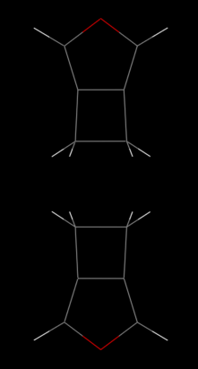
It should look like this for 2[001]

