Slide 1
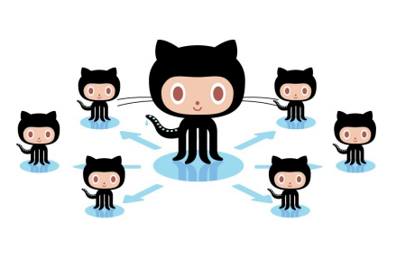
Git basics
2019

Slide 2
What is Version/Source Control?
Manages file sharing for Concurrent Development
Keeps track of changes with Version Control

Slide 3

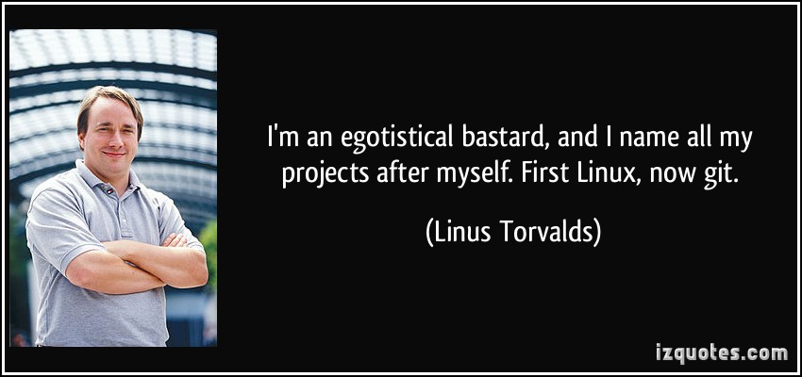
Git is a versioning control system:
Allows you to have a ‘history’ of changes in your code, text or any other type of file
Decentralized versioning (compared to older centralized way of versioning)
Everyone working on a git project has a copy containing the full history of the project.

Slide 4
The End
When I say I hate CVS with a passion, I have to also say that if there are any SVN [Subversion] users in the audience, you might want to leave. Because my hatred of CVS has meant that I see Subversion as being the most pointless project ever started. The slogan of Subversion for a while was "CVS done right", or something like that, and if you start with that kind of slogan, there's nowhere you can go. There is no way to do CVS right.
--Linus Torvalds, as quoted in Wikipedia

Slide 5

So why should I use git?!

Slide 6
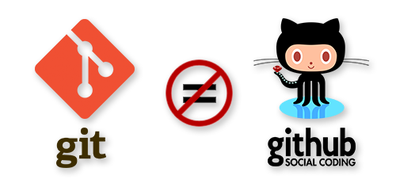
Let’s get this over with
We’ll explain later

Slide 7
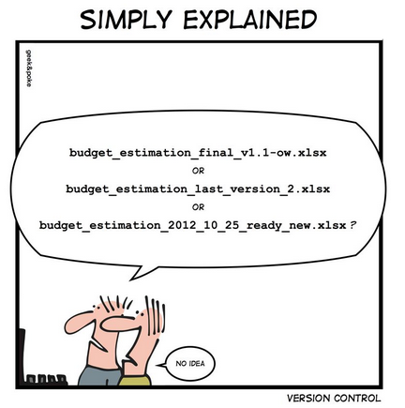
So why should I use git?!
Even when working alone on a project!
Undo changes (“lifelong ctrl-z”) or simply revert back to older version
Complete history of all changes: see how the project looked like on a certain day
Handy for bug fixes or when you forgot to write down your logs
Documents why you changed something (by using commit information)
I use it for all my projects (coding, writing, blogging, parenting, etc)

Slide 8
So why should I use git?!
When working alone:
No need to make backups/zips every time you wrote epic code
Have a history of everything you wrote, changed, deleted
Try stuff and revert if it didn’t work out

Slide 9
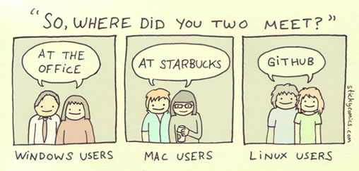
So why should I use git?!
In team [next year]:
Solve conflicts in code
Work together on same files. Git will most of the time merge them automagically
Work on different branched, independent of each other, for example: a branch per feature

Slide 10
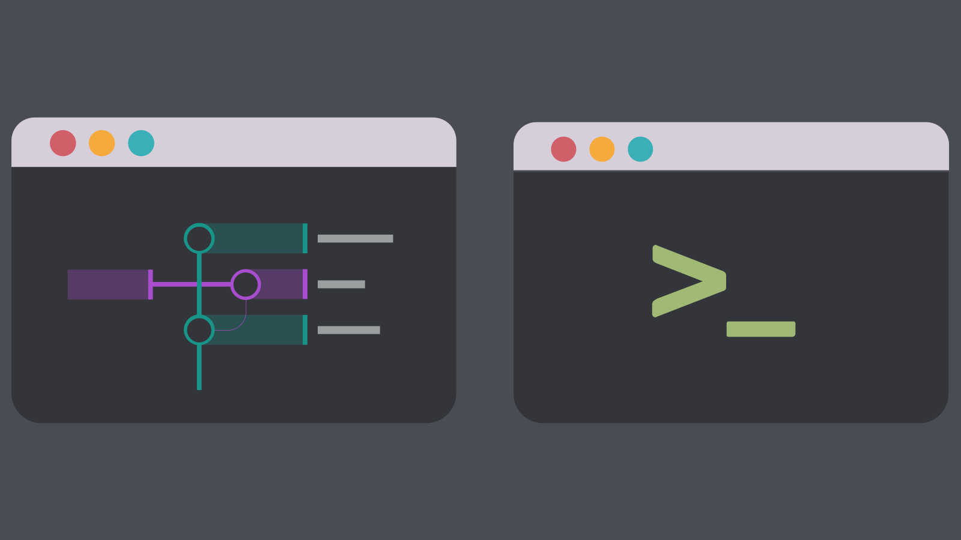
CLI vs GUI
At the bottom there’s (almost) allways GIT cli

Slide 11
Git CLI
Learn the commands!
Not everything van be done through GUI-tools
Install from: https://git-scm.com/downloads

Slide 12
Git GUI
Many IDE’s have now built-in Git-tools (VS, Android Studio, etc.)
Dedicated git-gui tools exist (and are becoming very powerfull)
Gitkraken
SmartGit
Fork
Etc.

Slide 13
Git essentials

Slide 14

Init
Initializes git in current folder
Needs to happen 1 time (obviously)

Slide 15
Commits
Initial commit
Second commit
A snapshot of your project at a given time
A commit save the changes relative to previous commit
Third commit
Fourth commit
In a nutshell, you will use git add to start tracking new files and also to stage changes to already tracked files, then git status and git diff to see what has been modified and staged and finally git committo record your snapshot into your history. This will be the basic workflow that you use most of the time.

Slide 16
3 States of a File in Git
Modified • Staged • Committed
working directory
staging area
git directory (repository)
check out the project
stage files
commit

Slide 17
File Status Lifecycle
untracked
unmodified
modified
staged
edit the file
add the file
stage the file
remove the file

Slide 18
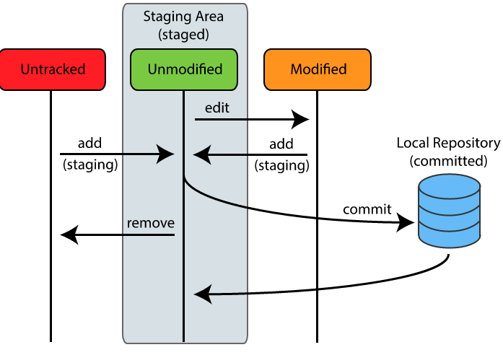
All together:

Slide 19
Some Commands
Getting a Repository
git init
Commits
git add
git commit
Getting information
git help
git status
git diff
git log
git show

Slide 20
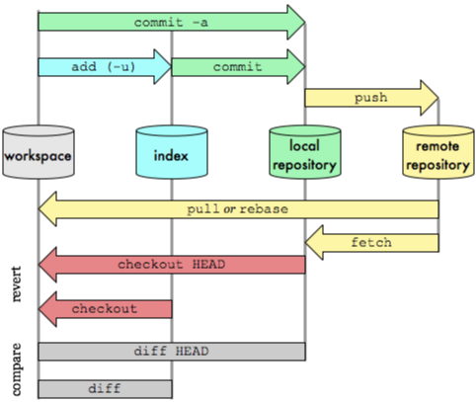
A “simple” Git workflow

Slide 21

Focus this year
Next year

Slide 22

So what is Github then?
GitHub is a website where you can store a copy of your Git “reposistory” (i.e. your project)
GitHub allows easy-to-use collaboration
GitHub has additional team tools such as wikis, issue management, forking, pull requests etc.

Slide 23
Git and github

Slide 24
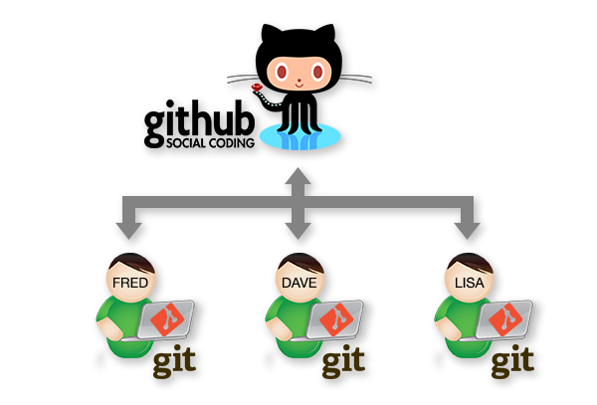
Git and github
Github is one (albeit most popular) cloudprovider on which to collaborate “talking git”
Alternatives to github also exist of course:
Gitlab
BitBucket
SourceForge
Etc.

Slide 25

Focus this year
Next year

Slide 26
And why then use GitHub

Slide 27
Now what?
Learn yourself: http://try.github.io/levels/1/challenges/1
& https://www.codecademy.com/learn/learn-git
Great tutorial: http://marklodato.github.io/visual-git-guide/index-en.html
More early start info:
https://help.github.com/articles/good-resources-for-learning-git-and-github/
https://help.github.com/
http://rogerdudler.github.com/git-guide/
http://gitimmersion.com
https://guides.github.com/activities/hello-world/

Slide 28
Git in VS

Slide 29
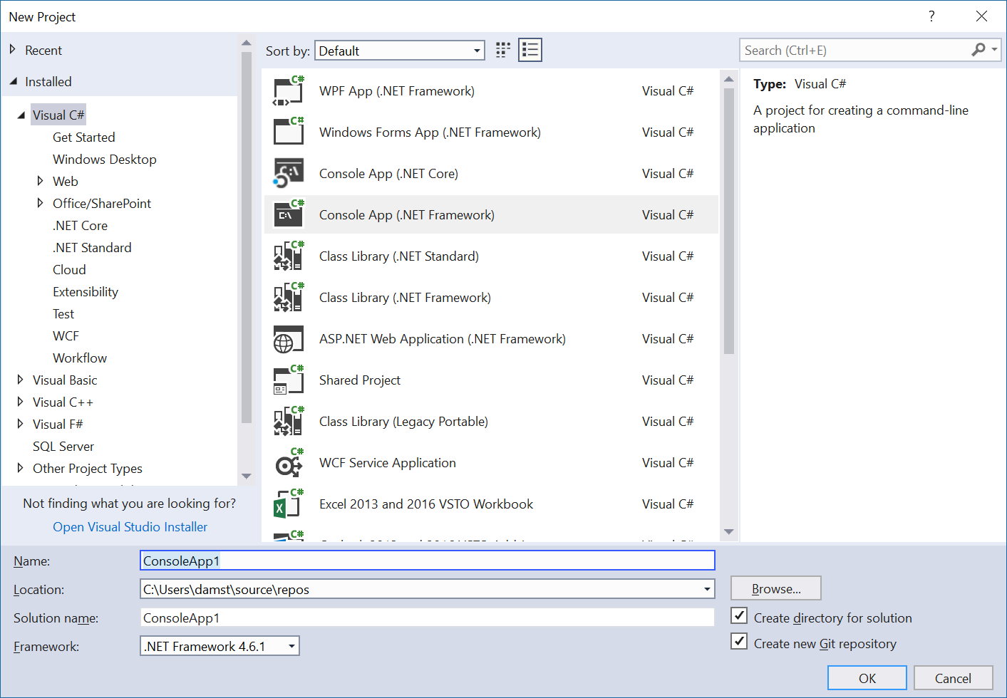
This might also be:

Slide 30
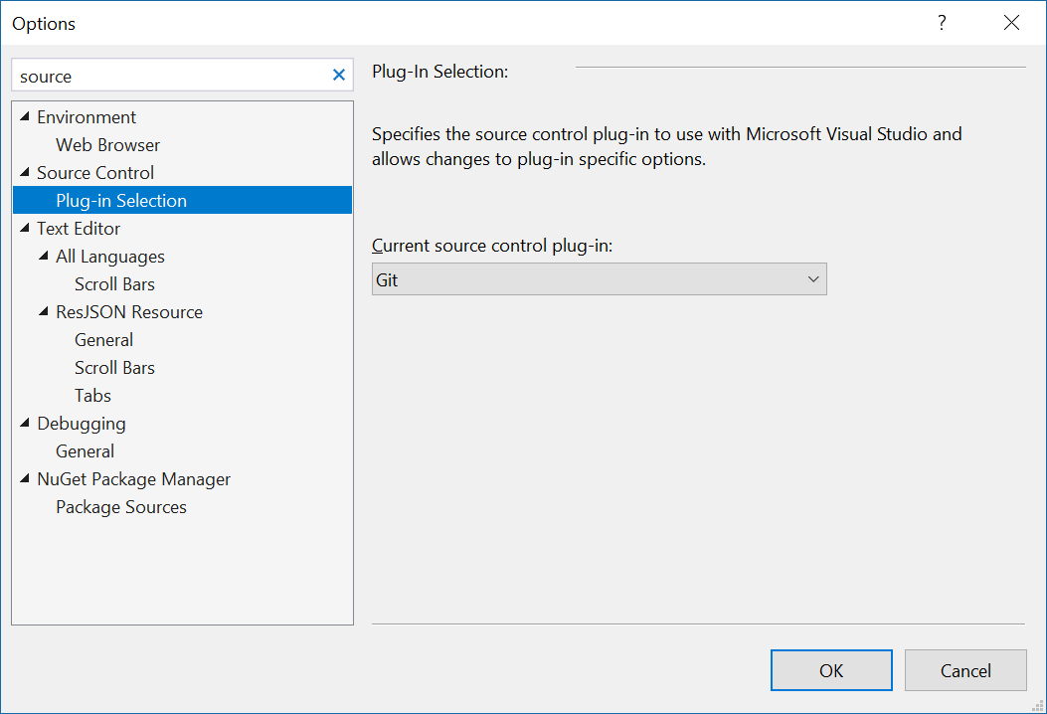
Make git default

Slide 31
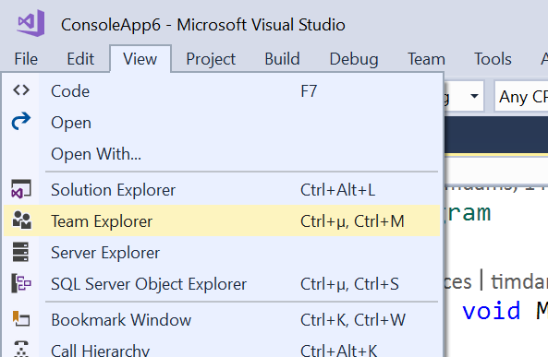
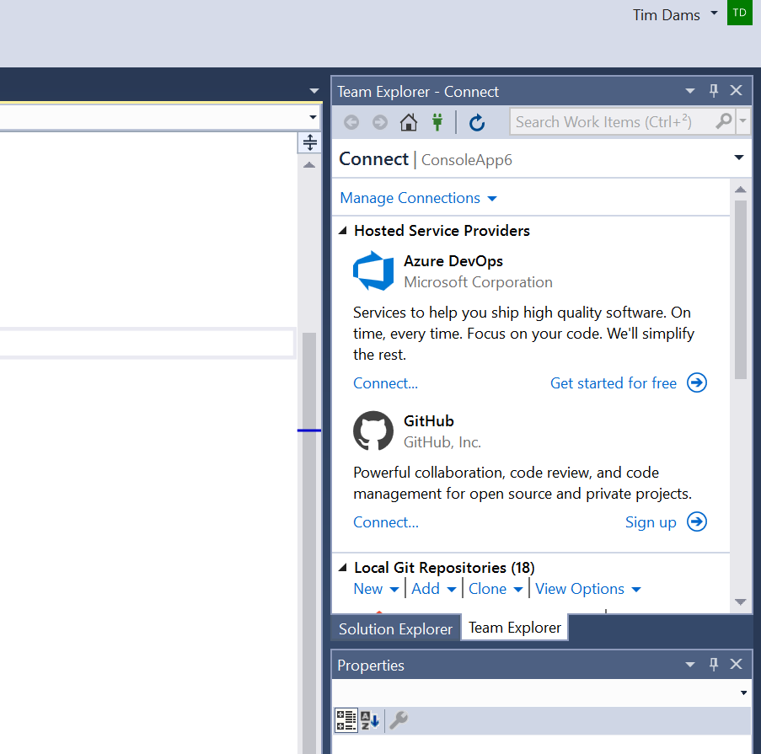
Team explorer window = portal to git

Slide 32
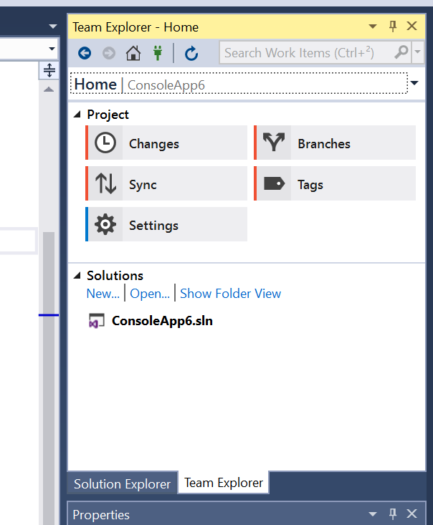
Click home in Team explorer

Slide 33
Changes== focus this semester

Slide 34
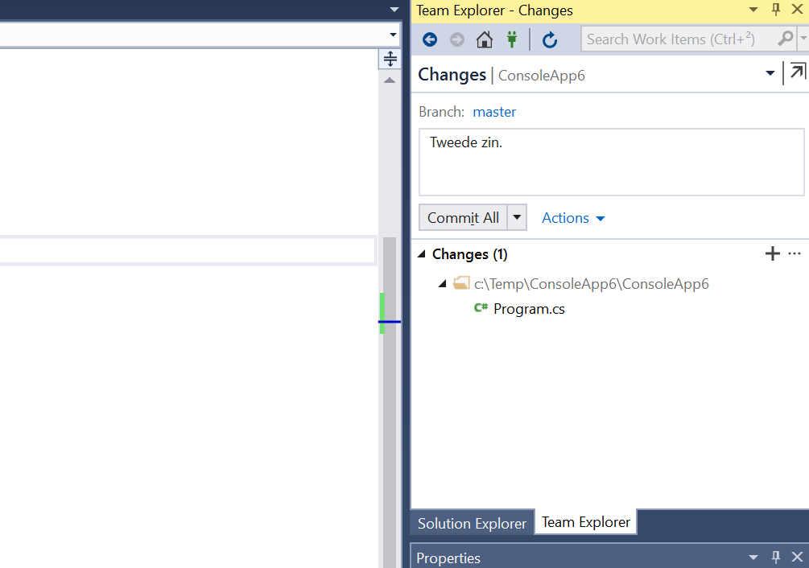
Everytime you build or safe code:
Chagnes will be shown. You can then make commit (but don’t have to of course)
Makes sure your commit messages are clear

Slide 35
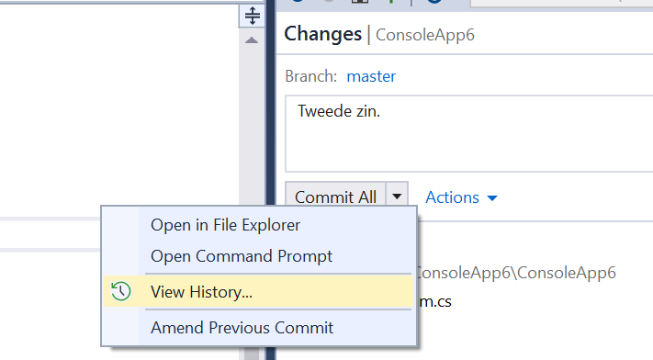
Show history
Click actions-> Show history

Slide 36
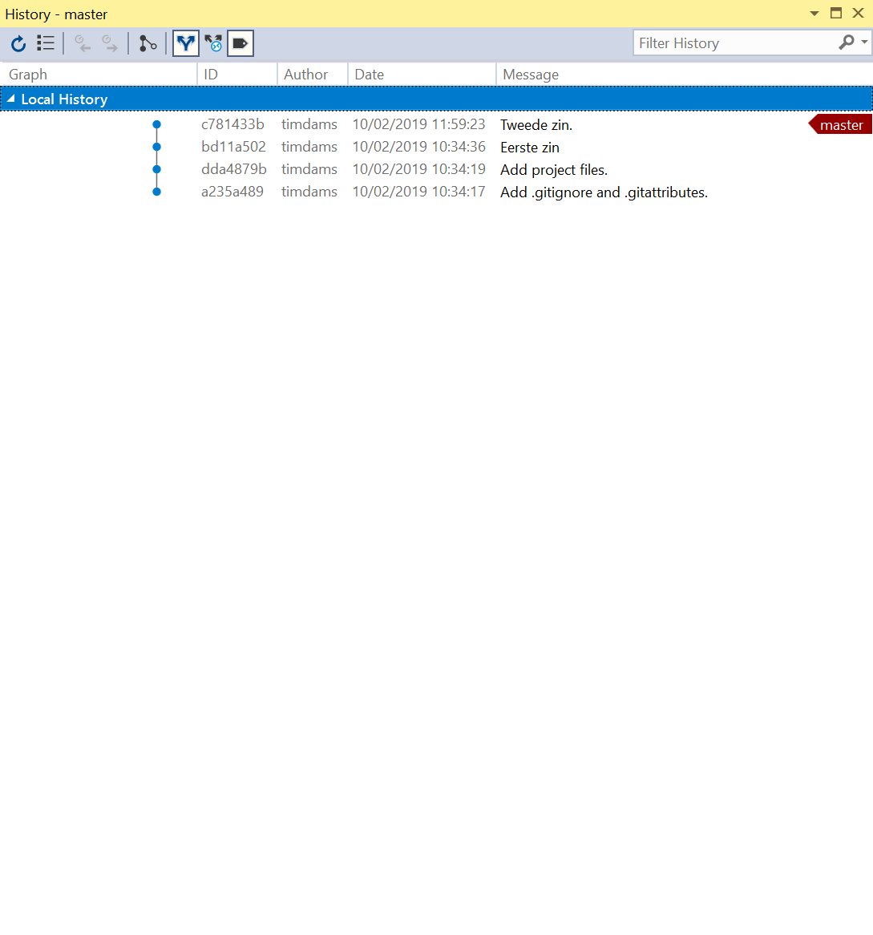
History
Master=where we are at the moment
Doubleclick any commit and use team explorer to see changes per file

Slide 37
Refresh history
Sometimes this view is not up to date, remember to refresh

Slide 38

Rollback
Always be sure that you REALLY wan’t to undo stuff you made
Later you will learn how to keep safe your changes so you don’t lose them forever

Slide 39
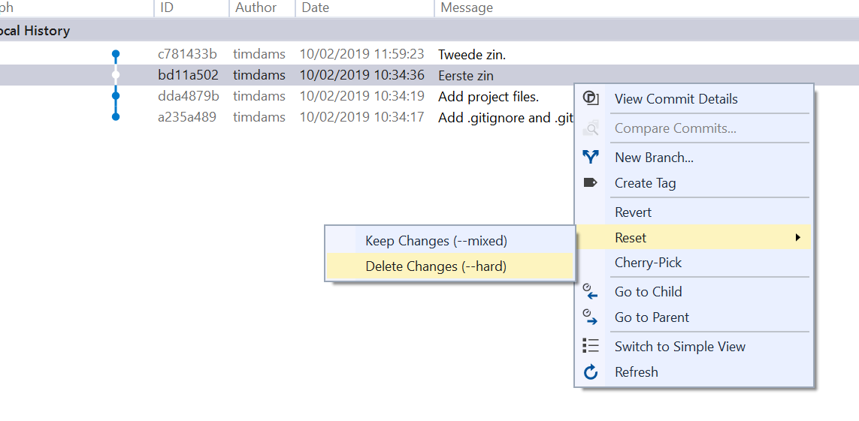
Reset == hardcore undo
Rightclick any commit in history:
Reset with keep changes: everything that is now in your code will be kept
Usefull if you just want to lose some commits but keep the changes you made
Reset with delete changes: real rollback to that current point (lose everything you did afterwards)
Usefull if you screwed up or tried something and failed

Slide 40
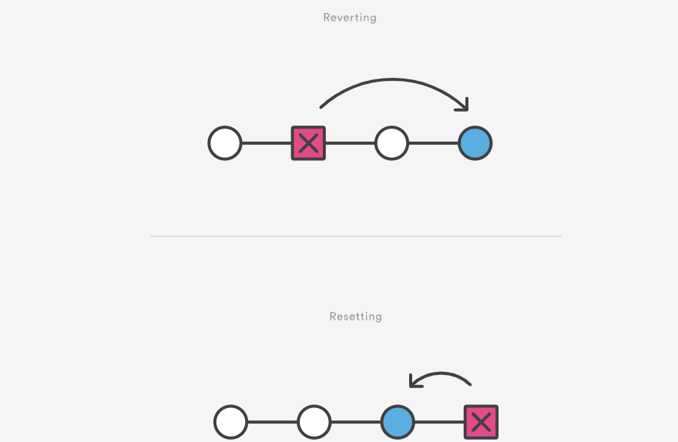
Revert== how it should be done
But you will need to learn conflict resolving
So for now, go with reset.
Just know that you lose your commits , which is never nice
https://www.atlassian.com/git/tutorials/undoing-changes/git-revert

Slide 41
Git commands

Slide 42
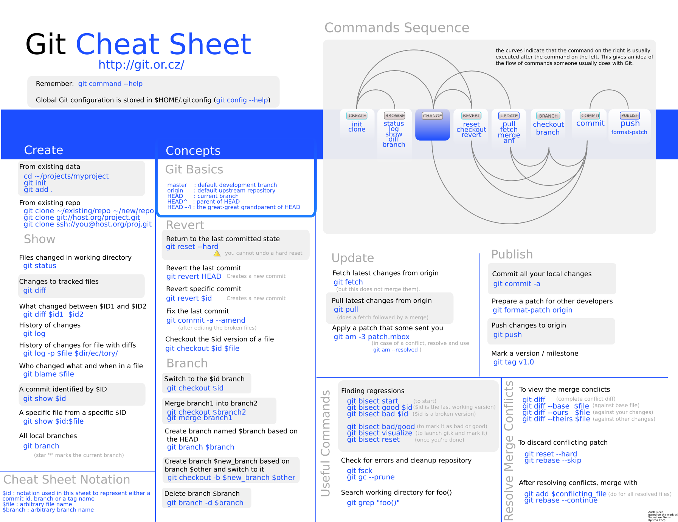
All commands
Good cheatsheet: https://hallcweb.jlab.org/wiki/images/1/1f/Git-cheat-sheet-large.png

Slide 43
Basic Commands - git
git – view all commands
$ git

Slide 44
Basic Commands - Init
Init - create an empty new repository
$ git init

Slide 45
Basic Commands - Status
Status - show differences between what has been committed and HEAD
$ git status

Slide 46
Basic Commands - Add
Add – add files to the stage
$ git add foo.info

Slide 47
Basic Commands - Commit
Commit – stores contents of the index in a commit along with a message
$ git commit –m “Added foo.info”

Slide 48
Basic Commands - Log
Log– view previous commits
$ git log

Slide 49
Basic Commands - Checkout
Checkout = checkout branches or previous commits
$ git checkout coolfeaturebranch
$ git checkout 1c899fed6ed

Slide 50
Exercise

Slide 51
Practice
$ mkdir test
$ cd test
$ git init .
$ git status
1. Create a new directory
2. Move inside the new directory
3. Initialize the new directory as a git repository
4. Show the current status of the repository

Slide 52
Practice
$ notepad hello.txt
Type “Hello World” then save and exit
$ git status
git shows hello.txt as “untracked”
Untracked files are files which are in the current directory but are not under version control!

Slide 53
Practice
$ git add hello.txt
$ git commit -m “Add hello.txt”
$ git status
$ git log
1. Add hello.txt to version control
2. Commit changes in current repository (-m tells git to save a “commit message” with this commit)
3. Show status of repository
4. Show the commit log (a sort of history)

Slide 54
Practice
“Ammend” the last commit, telling git who you are:
$ git commit --ammend --author=”Tim dams<tim.dams@ap.be>”

Slide 55
Meer info
Slides gemaakt door
Tim Dams (ziescherp.be), AP Hogeschool opleidingen elektronica-ict en toegepaste informatica
Sommige slides gebaseerd of gekopieerd van slidedecks van:
Programmeren in C# door Douglas Bell en Mike Parr (vert. Kris Hermans)
Microsoft Visual C# 2015: An Introduction to Object-Oriented Programming door Joyce Farrell
E.a.
Slides mogen aangepast worden, op voorwaarde dat deze slide steeds achteraan de slidedeck staat.

