Slide 1
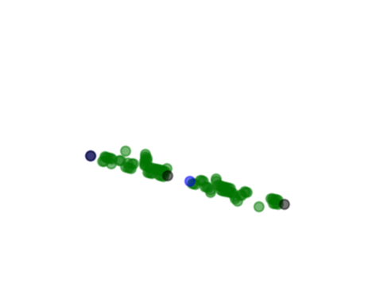
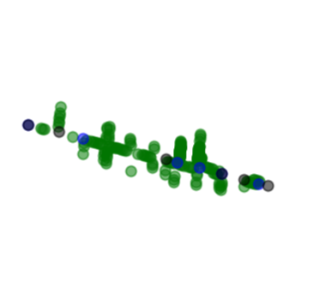
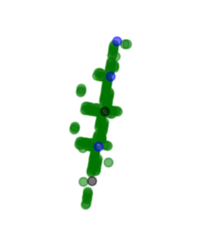

Stockton St.
Montgomery
Geary St.
Leavenworth St.
=Parking Spot

Slide 2
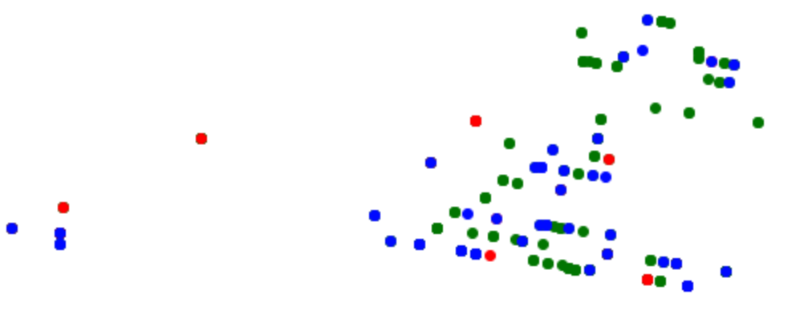
CORRECT
FALSE NEGATIVE
FALSE POSITIVE

Slide 3
Parking Meter
Data
~1.7 M
Survey
Data
~1100
Sensor
Data
~7.2 M
Machine Learning Models
Random Forest
Gradient Boosting
yelp
Business Data
27,000 Businesses
City/
neighborhood
Data

Slide 4
Street Block
Biz
Biz
Midpoint GPS
Parking Spaces
Biz
Biz
Yelp Search Radius 0.3 Miles

Slide 5
Hour Vector
8AM | 0.767641 | 5.132293 | 0.000000 | 0.000000 | 0.000000 | 0.767641
9AM | 0.422613 | 0.695313 | 0.170192 | 0.619389 | 2.468002 | 0.422613
10AM | 0.290599 | 0.000000 | 0.865879 | 1.432246 | 0.00000 | 0.290599
… | … | … | … | … | … | …
92 Unique Blocks
Parking Data by Block
 | Sun | Mon | Tues | …
8AM | ? | 5 | 0
9AM | 4 | 2 | 3
10AM | ? | 1 | 2
… |  |  |  | …
NMF
Factorization
Sun | 0.390742 | 0.064191 | 0.045707 | 0.942902 | 1.389276 | 0.390742
Mon | .504981 | 0.789013 | 0.808024 | 0.000000 | 0.001499 | .504981
Tues | 0.161121 | 0.780706 | 1.199212 | 0.025455 | 0.802949 | 0.161121
… | … | … | … | … | … | …
Day of Week Vector

