Slide 1
Predicting Movie Genres based on IMDB Descriptions
Sebastian Pinter, Daniel Chudý, Filip Faber, Tim Dirr np.nan
194.093 Natural Language Processing and Information Extraction 2024/25
TU Wien, Austria

Slide 2
Agenda
The Task
Data
Baseline
Identified Issues
Improvements & Results
Further Work

Slide 3
Genre Prediction
Predict movie genres based on textual description
Text Classification
Multilabel
Hard Task! Based on this: “A Pink/Roman porno with a yakuza character or two” Predict this: [“Action”, “Crime”]

Slide 4
Data
IMDB movie dataset containing genres (ground truth), textual movie plot descriptions and imdb-id
~190k rows, varying description lengths
some rows with no description
lots of rows where description is cut of
(“This movie talks about the ….”)
some nonsense plot descriptions
(“Add a plot”), (“plot unknown”), (“under wraps”)
heavy class imbalance

Slide 5
Basic preprocessing
We removed nonsense description by pattern matching Still, lots of missing and incomplete description
→ crawl IMDB database
Lemmatization
Notes:
some incomplete descriptions remained, not all were crawled lemmatization -> stanza pipeline with (tokenize, lemma, pos)

Slide 6
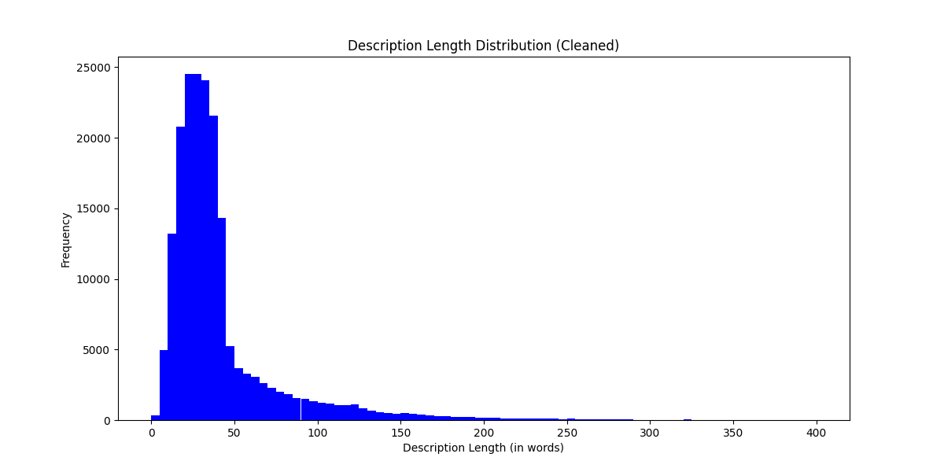
Data - Description Length

Slide 7
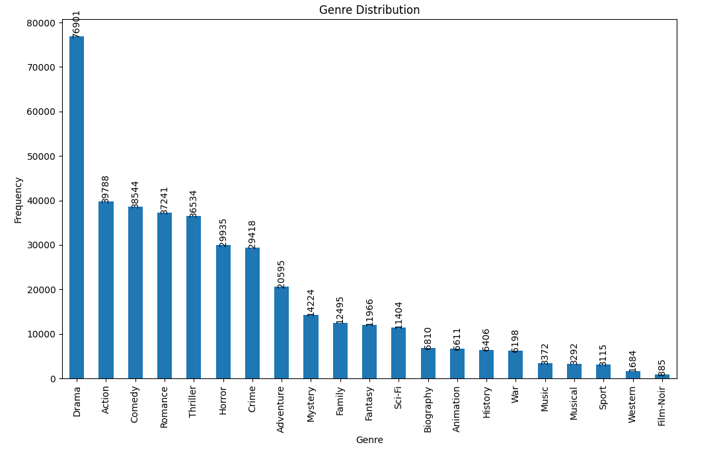
Data - Genre Distribution

Slide 8
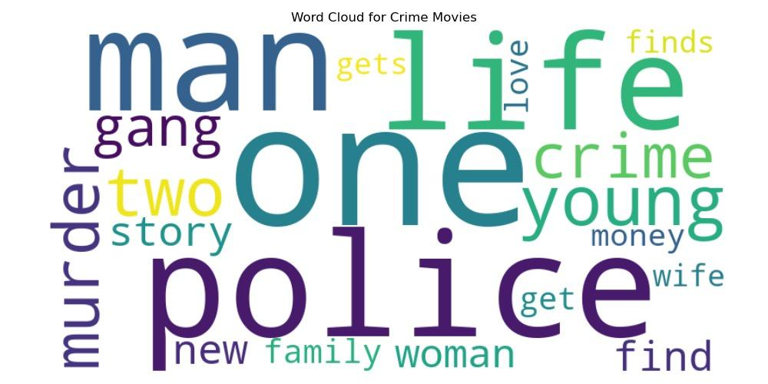
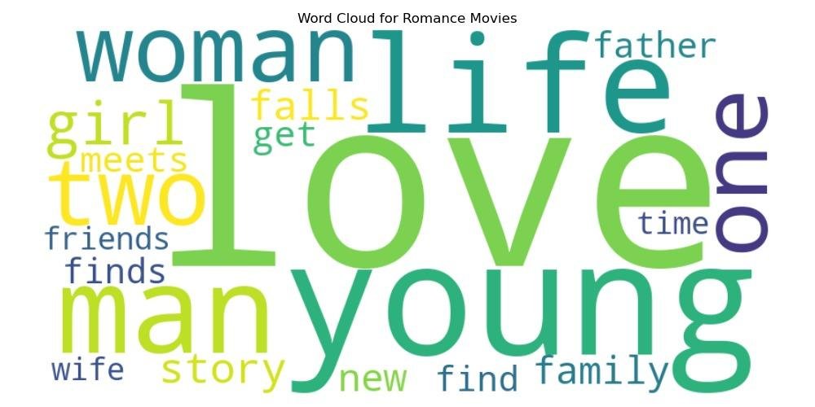
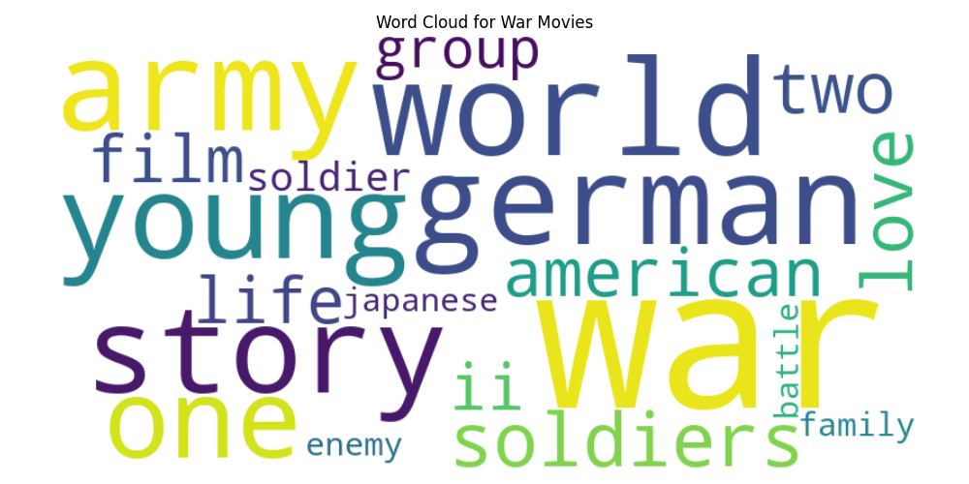
Data - Word Clouds
Notes:
Change Next

Slide 9
BREAK: SWITCH FROM A TO B

Slide 10
Baseline - Models
Text Modelling:
Bag Of Words: Count / Tf-Idf
Classifier:
Multilabel Classifier -> Training one clf per class
Logistic Regression, KNN, Decision Tree, ...
Keeping it simple!

Slide 11
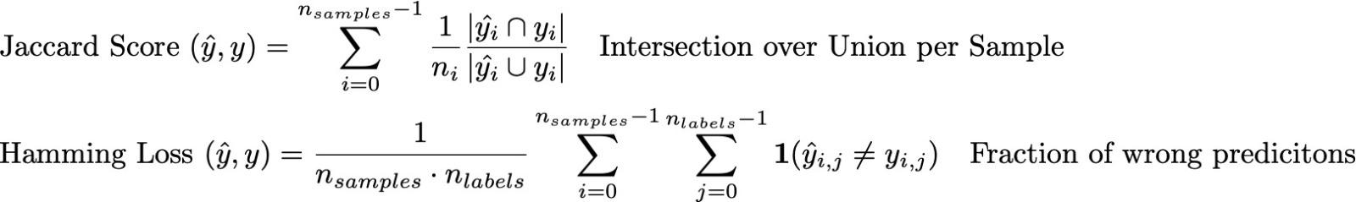
Baseline - Metrics
CLF | BoW | Jaccard | Hamming | Prec. | Recall | at-least-1 | at-least-2
LReg | Count | 0.29 | 0.09 | 0.47 | 0.35 | 0.57 | 0.14
LReg | Tf-Idf | 0.33 | 0.09 | 0.52 | 0.38 | 0.62 | 0.16

Slide 12
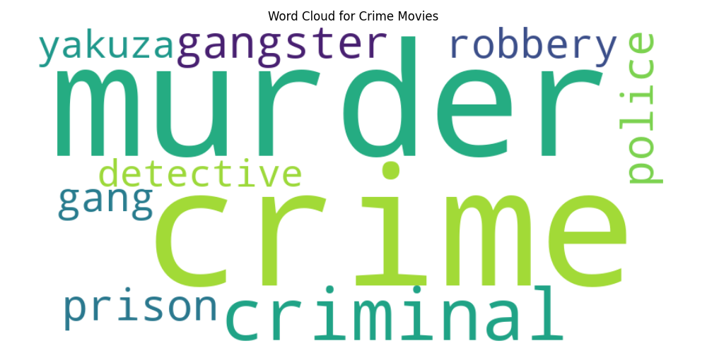
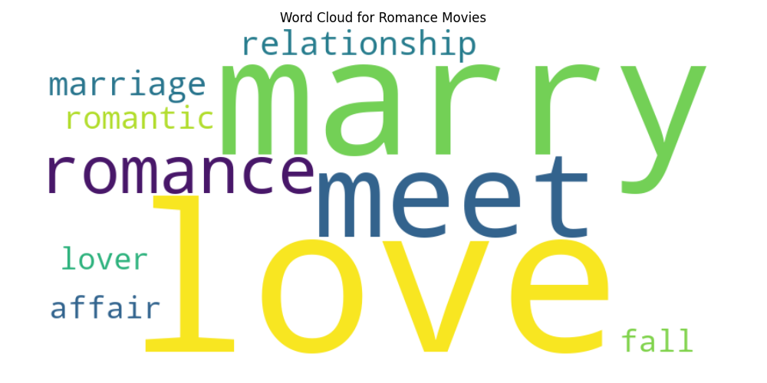
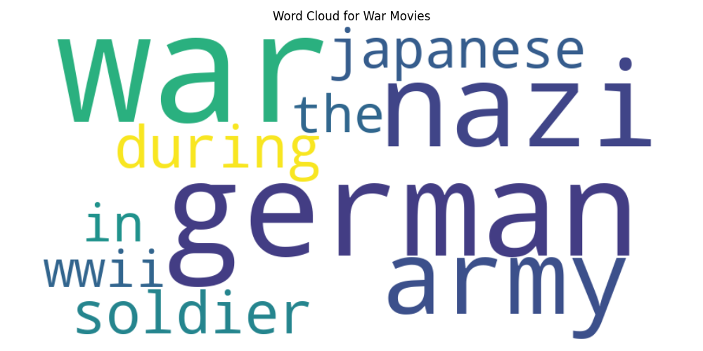
Feature Importance
Notes:
log-reg model looks for certain keywords, human also would associate this with the genre; we have already ok-ish baseline that is understandable and interpretable, also, compared to other word cloud, it is NOT the most common words
Change Next

Slide 13
BREAK: SWITCH FROM B TO DANIEL

Slide 14
Deep Learning Model
DistilBERT (40% faster)
dataset of 17k rows (0.8/0.1/0.1 split).
3 epochs
probability threshold (0.4 … 0.5)
Notes:
threshold under 0.5 resulted in both better recall and precision, lower was a prec/rec trade-off

Slide 15
DL vs. LogReg
Metric | DL model | LogReg
Jaccard | 0.42 | 0.38
Hamming Loss | 0.09 | 0.10
Accuracy | 0.14 | ----
Precision | 0.63 | 0.55
Recall | 0.50 | 0.42
At Least One | 0.80 | 0.69
At Least Two | 0.25 | 0.16
Focal loss
BCEWithLogitsLoss
class weights
Notes:
Focal loss was better overall, while BCEWithLogitLoss with class weights with values inversely to frequency

Slide 16
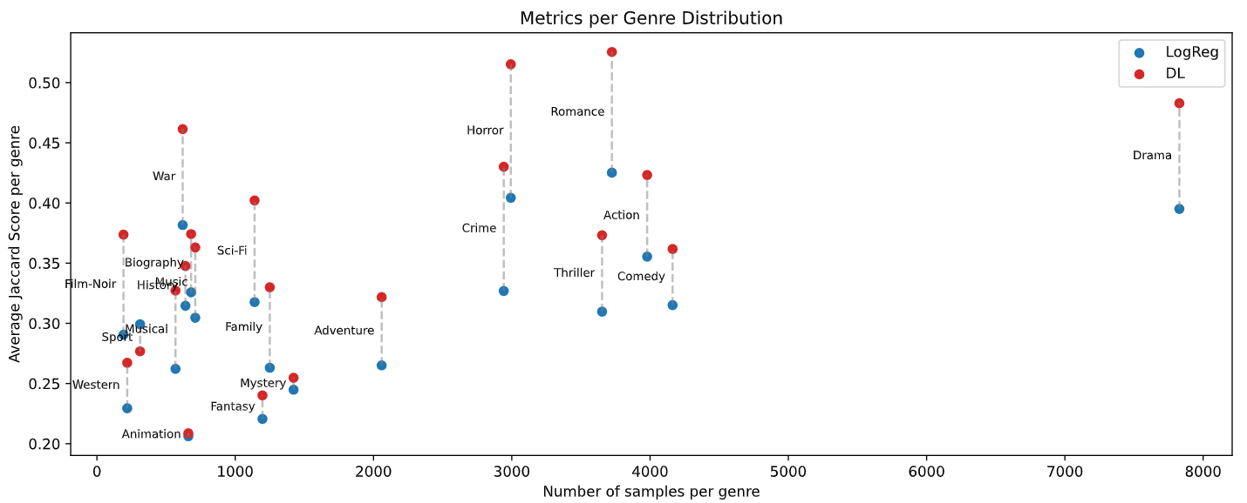
DL vs. LogReg
Notes:
The metrics get better across the board, but the distribution doesnt change
Change Next

Slide 17
BREAK: SWITCH FROM DANIEL TO B

Slide 18
Identified Issues

Slide 19
Issue - Movies without genre
There are Movies without genre???
Predict-at-least-1 Mechanic
Force the MultiLabelClassifier to always predict at least one Genre, even if it has low confidence

Slide 20
Issue - Genre Imbalance

Slide 21
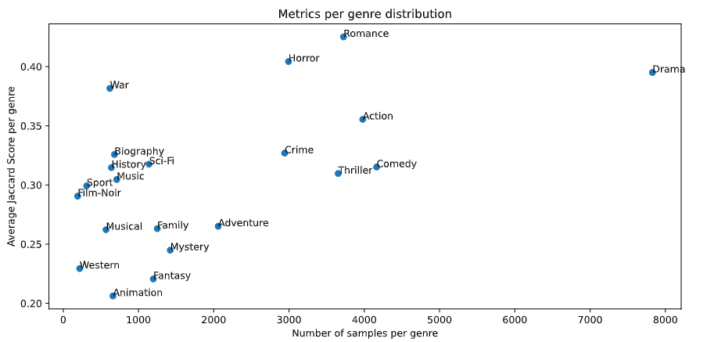
Metric / Genre-Distribution
Notes:
40% of rows include labels

Slide 22
If nothing then drama
"Trackhouse: Get Ready chronicles the launch of one of NASCAR's newest organizations."
Labels: ['Sport']
Predicted: ['Drama']
"The story of the highwayman and folk hero, Juraj Janosik."
Labels: ['Animation']
Predicted: ['Drama']

Slide 23
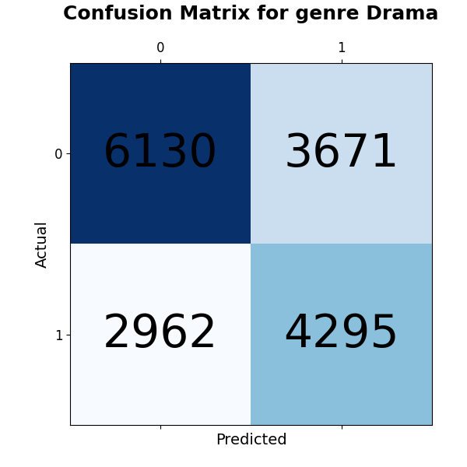
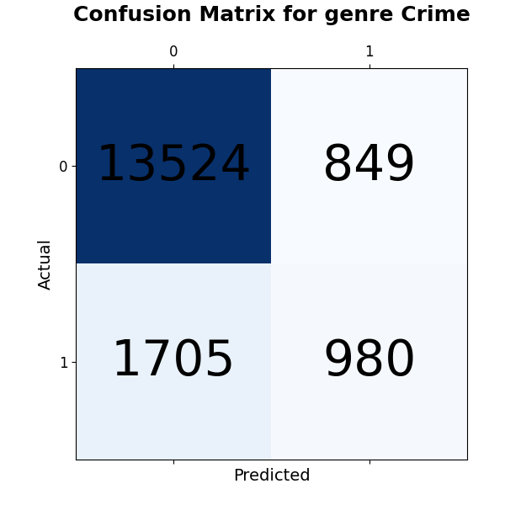
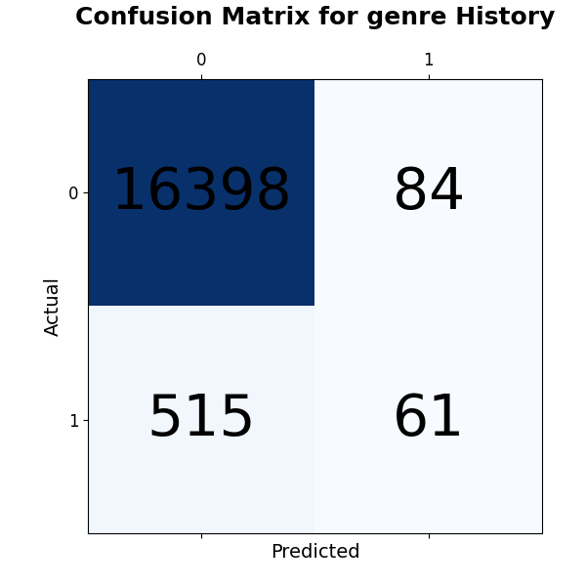
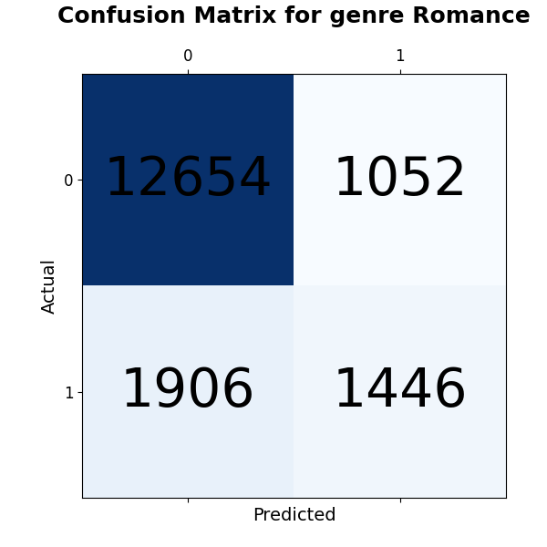
Confusion Matrix Drama
Many False Positives for Drama!
Notes:
Change Next

Slide 24
BREAK: SWITCH FROM B TO DANIEL

Slide 25
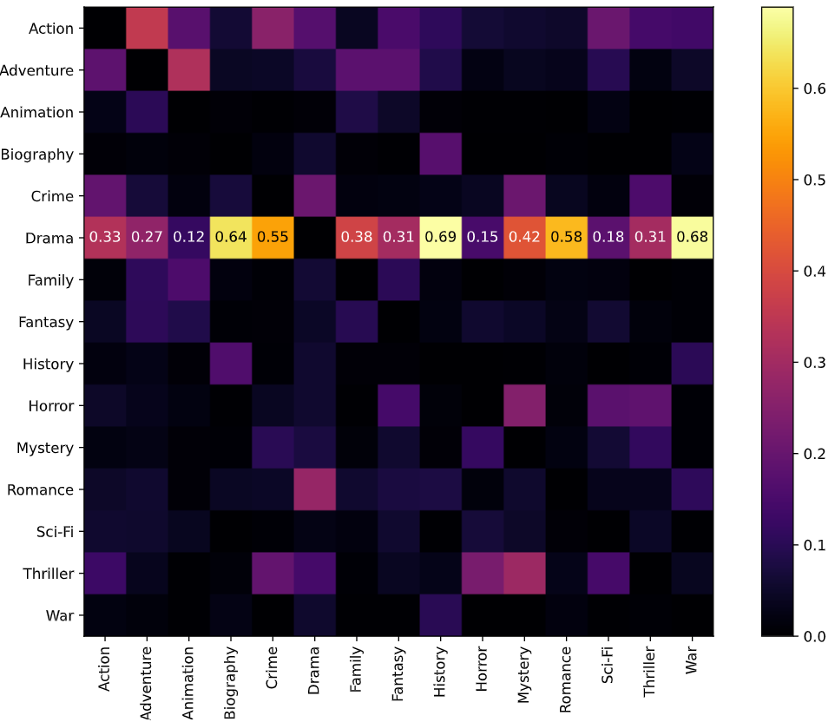
Genre co-occurrence matrix
History 0.69
War 0.68
Biography 0.64
Animation 0.12
Notes:
Low-support genres have high co-occurence with drama

Slide 26
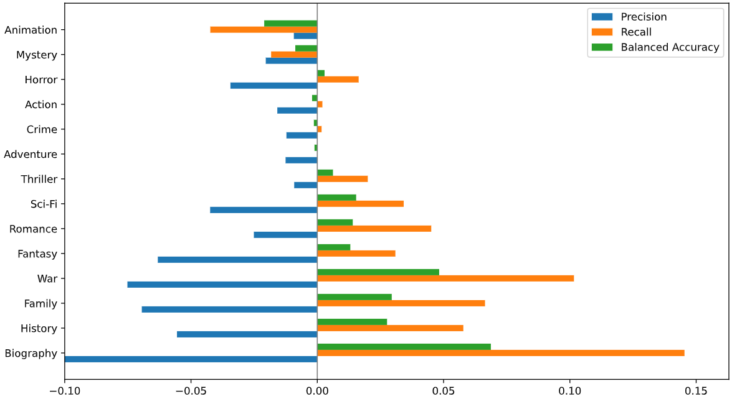
Metric differences DL (NoDrama - Orig)
Worse
Improved

Slide 27
Feature Importances and Tf-idf vectors
[2.50, 2.11, 1.90, …. , -1.37, -1.43, -1.75]
[1.00, 0.98, 0.96, …. , -0.92, -0.95, -1.00]
normalisation

Slide 28
Feature Importances - Similarity to Drama
Genre | Cosine Similarity
War | 0.36
Biography | 0.35
History | 0.32
Crime | 0.30
… | …
Animation | -0.25
Horror | -0.52
Genre | Euclidean Distance
Biography | 6.957
War | 7.432
Crime | 7.834
History | 8.485
… | …
Mystery | 10.528
Horror | 10.930
Notes:
Euclidean distance is also important, magnitude of the feature importance vectors could also be relevant, e.g. when a feature has a higher importance number it probably means its more imporant for the genre

Slide 29
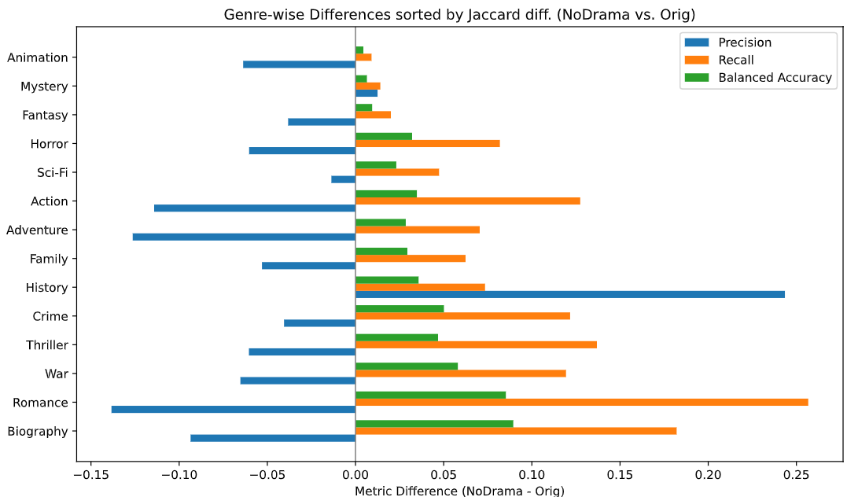
Feature Importances - Similarity to Drama
Genre | Euclidean Distance
Biography | 6.957
War | 7.432
Crime | 7.834
History | 8.485
… | …
Mystery | 10.528
Horror | 10.930

Slide 30
Tf-idf vectors - Similarity to Drama
Daniel plot
Genre | Cosine Similarity
History | 0.8818
Crime | 0.8645
War | 0.8452
Biography | 0.809
… | …
Horror | 0.6279
Animation | 0.5010

Slide 31
Removing Drama - Changes in Predictions
Both co-occurrence with Drama and Support of genres matter
Low-support high co-occurrence see the biggest changes
Similarities of Feat. Importances and Tf-idf vectors confirms this
BUT!!!
Notes:
Change Next All of the changes in the LogReg, are seen only because our predict-at-least-1 function and that Drama only co-occurs (it has no rows of its own) and how MultiOutputClassifier puts together the individual LogReg models => that if we adjusted the predict-at-least1 function to not predict the Drama label, we would see the same results with Drama still present in the Dataset.

Slide 32
BREAK: SWITCH FROM DANIEL TO C

Slide 33
Pruning Descriptions
We assume there are different “types” of descriptions.
Some actually describe content
“Anny works in a cigar shop. Wholesaler Willmann fancy Anny and hire her as her ….”
Some are “Meta”-Descriptions
“The life of queen victoria”
“An epic italian film, ‘Quo Vadis’ influenced many later works”
Some contain author information at the end e.g.
“... lawyer who has robbed him. [Synopsis from BIOSCOPE …]”
Pruning Descriptions

Slide 34
Oversampling
MultiLabelClassifier trains individual Classifiers (e.g. LogReg)
Ratio between positive and negative samples very unbalanced
(much more negative then positive samples)
Oversampling
SMOTE for Oversampling (generating new samples)
Decided on a ratio of #pos_samples = 0.5 * #neg_samples

Slide 35
Experiments
Predict at least one (!)
Address class imbalance
Pruning description
Dropping “meta” descriptions (e.g. “starring, produced by, directed by”)
Removing weird chars (e.g. “, “ “, -, “-,)
Less Drama (?)
Remove low-support genres
Increase classifier probabilities based on frequently occurring words per genre (Hard-coded)

Slide 36
Results
CLF | Improvements | Jaccard | Hamming | Prec. | Recall | at-least-1
LReg | Baseline | 0.333 | 0.088 | 0.521 | 0.385 | 0.623
LReg | AL1 | 0.377 | 0.088 | 0.613 | 0.428 | 0.700
LReg | AL1,P | 0.378 | 0.088 | 0.608 | 0.430 | 0.716
LReg | AL1,O | 0.378 | 0.096 | 0.554 | 0.487 | 0.753
LReg | AL1,P,O,C | 0.382 | 0.116 | 0.487 | 0.604 | 0.843
DL | - | 0.423 | 0.086 | 0.621 | 0.504 | 0.785
AL1=Predict-at-least-1 O=Oversampling C=Balanced Class Weights P=Prune
All LReg Models trained with lemmatized descriptions and tf-idf

Slide 37
Further Works
Include titles and/or reviews of movies
More sophisticated description analysis
More sophisticated text modeling?
Include information on Genre description
Apply insights from removing Drama to the predict_at_least_1 function

Slide 38
Future Works: Adding the Title
"Lance Hayward, a silent movie star, appears as various characters, killing quite a handful of unfortunates, using various weapons."
Labels: ['Horror']
Predicted: ['Action']
Note: The title ("Terror Night") would provide the missing Horror signal.

Slide 39
Did you extract your information?
Yes? Good
No?
QUESTION!?

