Slide 1
Agenda
Running NRS/RCT Meta-analysis in R
Overview of Models to run
Subgroup-analysis
Down-weighting
Bias adjustment
Three-level models

Slide 2
Running NRS/RCT Meta-analysis in R
Step 1: Attach all necessary packages (provided in code) before proceeding further.
Step 2: Load data
Indicators for design type
Variance inflation
Bias adjustment
Step 3 (not shown): Data cleaning, initial visualizations
Step 4: Run analysis

Slide 3
Models to run
Subgroup analysis
Variance inflation with and without bias adjustment
Frequentist three-level models
Bayesian three-level models

Slide 4
Hands-on Exercise

Slide 5
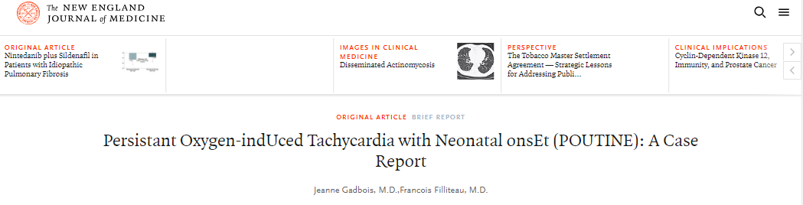
Background
Persistent Oxygen-indUced Tachycardia with Neonatal onsEt (POUTINE), is a life-threatening illness with highest prevalence in Canada and North-Eastern United States, first diagnosed in 1957 in Fernand Lachance of Warick, Quebec.

Slide 6
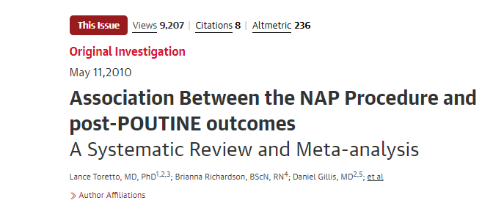
Background
In 2010, a meta-analysis published in JAMA combined the results of three landmark trials and established the efficacy of a surgical treatment for neonates diagnosed with POUTINE.
Authors reported a clinically meaningful but not statistically significant increase in neurodevelopmental impairment at 18 months corrected age.

Slide 7
Background
Since 2010 NAP has become standard care in many hospitals
Ten non-randomized studies of varying quality have visited this question since 2010. All used propensity score matching to derive odds ratios.
Two matched on all relevant prognostic variables
Three matched on most prognostic variables
Five matched on limited prognostic variables
Your hospital has asked you to provide an updated meta-analysis combining the original RCTs with new randomized studies to assess whether the risk of neurodevelopmental impairment is a concern

Slide 8
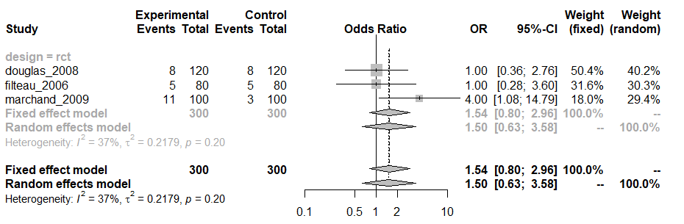
RCTs Only

Slide 9
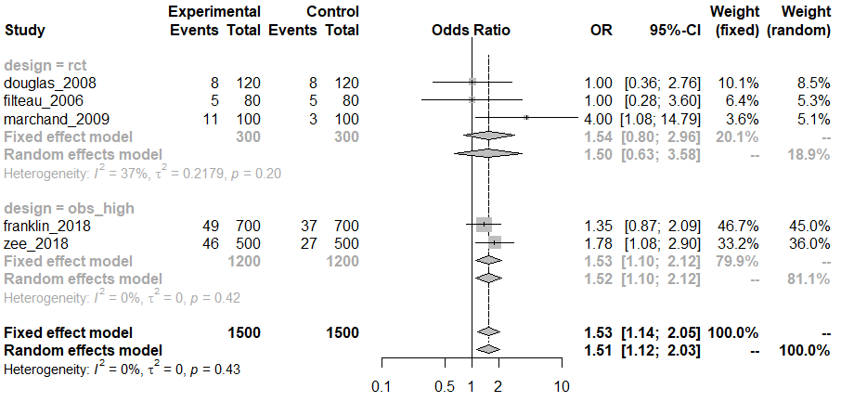
RCTs + High Quality NRS

Slide 10
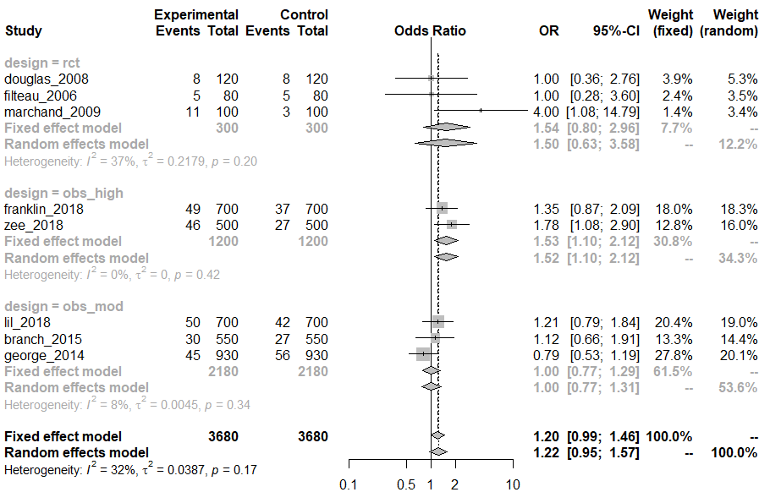
RCTs + High and Moderate Quality NRS

Slide 11
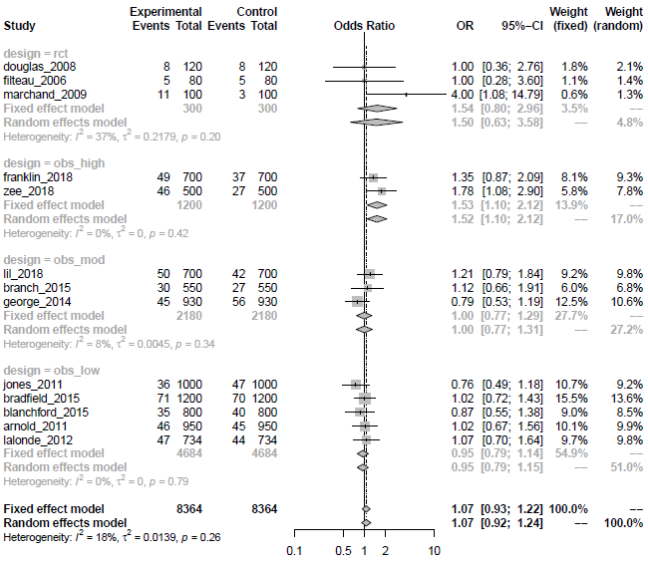
All Studies

Slide 12
Hands-on Time

Slide 13
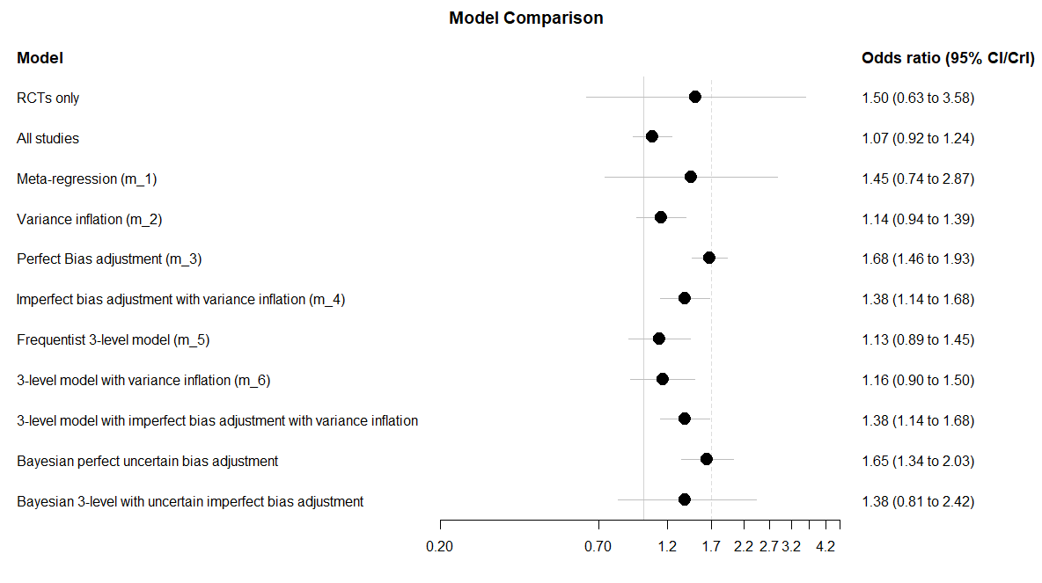
Summary Forest Plot

Slide 14
Summary Forest Plot

Slide 15
Summary Forest Plot

Slide 16
Summary Forest Plot

Slide 17
Summary Forest Plot

Slide 18
Summary Forest Plot

Slide 19
Summary Forest Plot

Slide 20
Operating Characteristics of Frequentist Models
Scenario | Ratio of Odds Ratios | Coverage | Power | Alpha
RCTs only | 1.06 | 0.97 | 0.26 | 0.03
RCTs + NRShigh | 0.95 | 0.95 | 0.75 | 0.05
RCTS + NRSmod | 0.82 | 0.61 | 0.82 | 0.29
RCTS + NRSlow | 0.65 | 0.002 | 0.07 | 0.99
Meta-regression | 1.04 | 0.96 | 0.28 | 0.04
Variance Inflation | 0.78 | 0.46 | 0.72 | 0.36
Bias adjustment (perfect) | 1.00 | 0.96 | 1 | 0.03
Variance Inflation + Bias (imperfect) | 0.90 | 0.91 | 0.98 | 0.04
3-level model (Frequentist) | 0.72 | 0.55 | 0.03 | 0.44
3-level model + Variance Inflation | 0.78 | 0.59 | 0.42 | 0.29
3-level model + Variance Inflation + Bias (imperfect) | 0.90 | 0.92 | 0.96 | 0.04

Slide 21
Discussion
What modeling approach would you use and why?
How might your decision rule differ from accept/reject based on p-value?

