Slide 1
Agenda
Software overview and installation
Running NRS/RCT Meta-analysis in R
Overview of WinBUGS code
Down-weighting
Bias adjustment
Three-level models
Hands on application using three-level models

Slide 2
Software overview
R
Open-source statistical software
Comes with basic functionality but most of the power comes from user-written packages which are downloaded from a central repository (CRAN)
R Studio
Integrated Development Environment for R. Makes day to day use of R more straightforward/user friendly.
JAGS
Allows for Bayesian analysis across platforms using language similar to WinBUGS.

Slide 3
Installation of R and R Studio
Download R from http://cran.us.r-project.org/
Click on “Download R for Windows”
Click on “base”
Click on “Download R 3.X.X for Windows”
Install R. Leave all default settings in the installation options.
Download RStudio from https://www.rstudio.com/products/rstudio/download/
Select “Rstudio 1.X.XXX – Windows Vista/7/8/10”
Install R Studio. Choose default installation options.

Slide 4
Installation of JAGS
Download JAGS from https://sourceforge.net/projects/mcmc-jags/files/
Click on Download latest version and install

Slide 5
Running NRS/RCT Meta-analysis in R
Step 1: Attach all necessary packages (provided in code) before proceeding further.
Step 2: Load data
Indicators for design type
Variance inflation
Bias adjustment
Step 3 (not shown): Data cleaning, initial visualizations
Step 4: Run analysis

Slide 6
Overview of JAGS Code

Slide 7
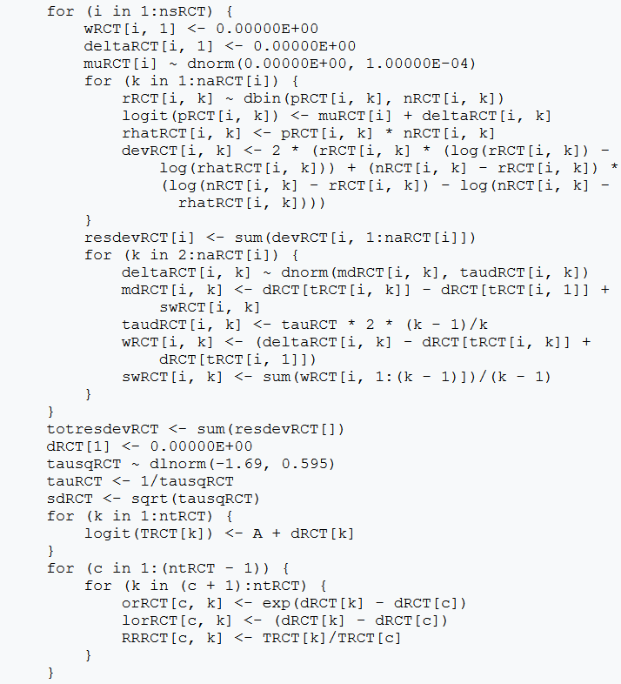
Basic Meta-Analysis Code

Slide 8
Basic Meta-Analysis Code
Linear predictor

Slide 9
Basic Meta-Analysis Code
Random effect

Slide 10
Basic Meta-Analysis Code
Absolute effects

Slide 11
Basic Meta-Analysis Code
Odds ratios and Relative Risks

Slide 12
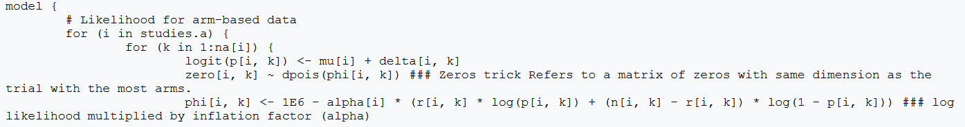
Variance Inflation (option 1)
Multiply the likelihood by an inflation factor (aka “power prior”)
Bit of work to implement (see below, “zeroes trick”) but straightforward interpretation (down weighting trial by x%)

Slide 13

Variance Inflation (option 2)
Multiply the variance of the random effect by an inflation factor
Used in three level models, reduces the amount that a group of studies contribute to overall estimate but not exactly a one to one reduction

Slide 14


Bias Adjustment
Deterministic
Uncertain
No variance inflation required

Slide 15
Hands-on Exercise

Slide 16
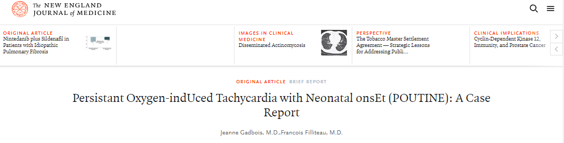
Background
Persistent Oxygen-indUced Tachycardia with Neonatal onsEt (POUTINE), is a life-threatening illness with highest prevalence in Canada and North-Eastern United States, first diagnosed in 1957 in Fernand Lachance of Warick, Quebec.

Slide 17
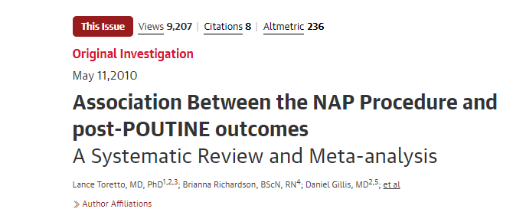
Background
In 2010, a meta-analysis combining the results of three pivotal trials established the efficacy of a surgical treatment for neonates diagnosed with POUTINE was published in JAMA
Authors reported a clinically meaningful but not statistically significant increase in severe Sepsis

Slide 18
Background
Since 2010 NAP has become standard care in many hospitals
Four recent non-randomized studies have suggested the sepsis risk may be more serious than originally thought
Your hospital has asked you to provide an updated meta-analysis combining the original RCTs with new randomized studies to assess whether the sepsis risk is a concern

Slide 19
Overview of Files

