Slide 1
Seven-Eleven Japan
James R. Bradley

Slide 2
Topics
HW questions
7-11 analytics applications
Faster is better
Developing analytics competence
7-11 analytics that we will cover in the MSBA Program
Supply Chain Management (time permitting)

Slide 3
7-11 Analytics Applications
Application:
Methodology:
Benefit:
Application:
Methodology:
Benefit:
Application:
Methodology:
Benefit:

Slide 4
7-11 Analytics Applications
Application:
Methodology:
Benefit:
Application:
Methodology:
Benefit:
Application:
Methodology:
Benefit:

Slide 5
7-11 Analytics Applications
Application:
Methodology:
Benefit:
Application:
Methodology:
Benefit:
Application:
Methodology:
Benefit:

Slide 6
7-11 Analytics Applications
Application:
Methodology:
Benefit:
Application:
Methodology:
Benefit:
Application:
Methodology:
Benefit:

Slide 7
7-11 Analytics Applications
Application:
Methodology:
Benefit:
Application:
Methodology:
Benefit:
Application:
Methodology:
Benefit:

Slide 8
Optimization & Algorithms
Which suppliers have the best locations for an SDC?
Which locations to put on a milk run form an SDC?
What is the best sequence to deliver?
Traveling Salesperson Problem
In Optimization and Heuristic Algorithms

Slide 9

Optimization & Algorithms
Consolidating Supplier
Other Suppliers

Slide 10
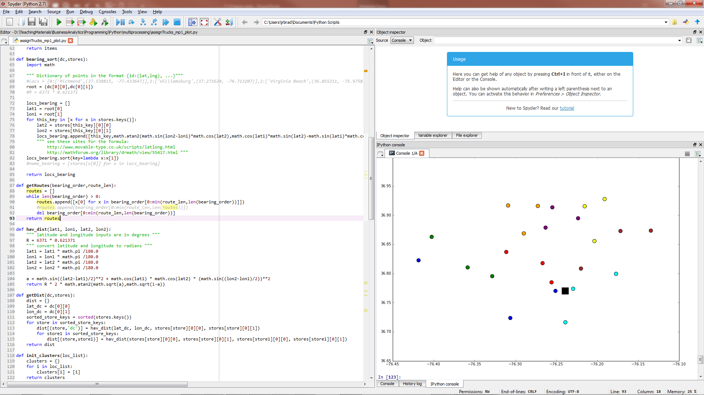
Optimization & Algorithms

Slide 11
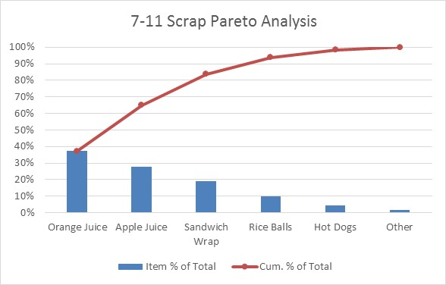
Pareto Rule (80/20 Rule)
Scrap analysis
Best items for register hot keys
Identify best selling products at various times in the day
In this course

Slide 12
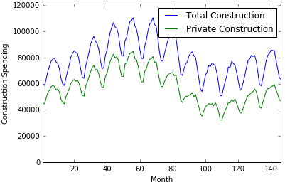
Sales Analysis
Analyze product sales rate over time and devise algorithm for product replacement
Intermediate Probability & Statistics
Time Series Analysis
Stochastic processes

Slide 13
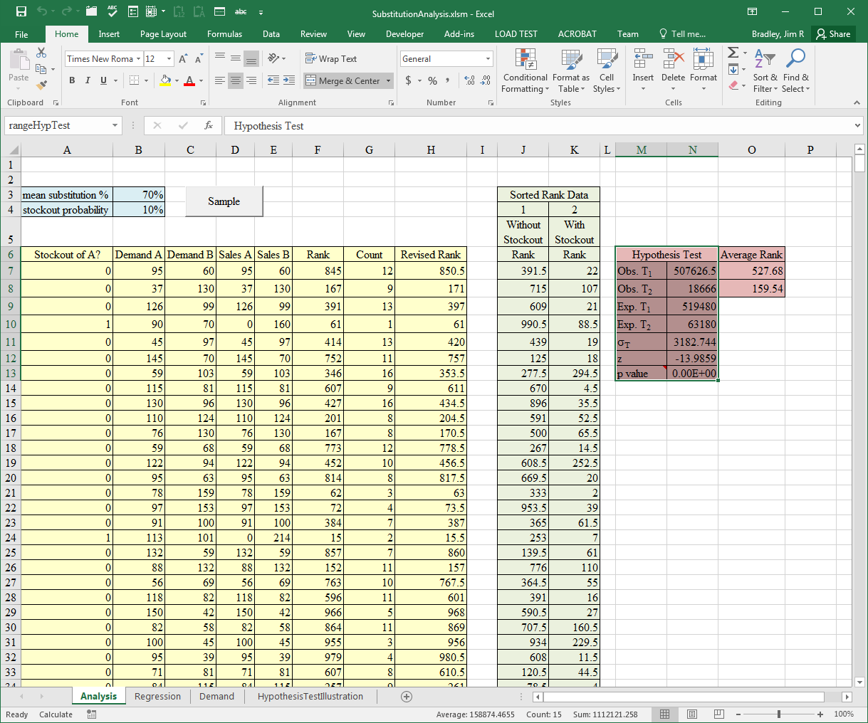
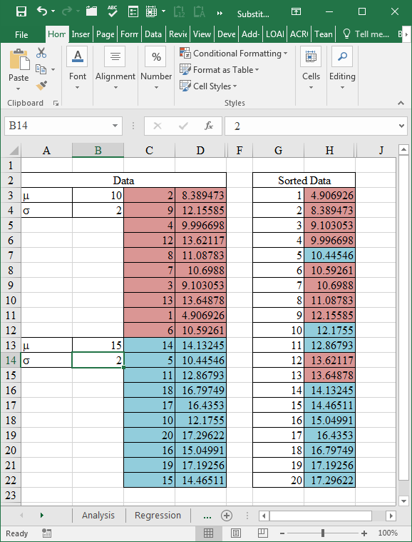
Hypothesis Tests
Identify substitute goods
Intermediate Probability & Statistics
Nonparametric hypothesis tests

Slide 14
Regression
Forecasting
Store success likelihood
In Machine Learning 1
Dependent variables
What you are trying to predict, e.g., sales
Independent variables, Features
What might be correlated with the dependent variables
Concerts, weather, day of the week, etc.

Slide 15
Collaborative Filtering
Applications
Recommendation Engines
Netflix, Amazon, etc.
Market Basket Analysis
Items to put next to each other to increase sales
Methods
Bayes Theorem, Nearest Neighbor, Cosine Similarity, Cluster Analysis, Association Rule Analysis , Linear Algebra techniques
In Machine Learning 1 & 2, Intermediate Probability & Statistics courses

Slide 16
How Does Faster Help?
Example

Slide 17
How Does Faster Help?
Example

Slide 18
How Does Faster Help?
Example

Slide 19
Analytics Excellence
How long to develop business analytics competence?
Data first, or Questions first?

Slide 20
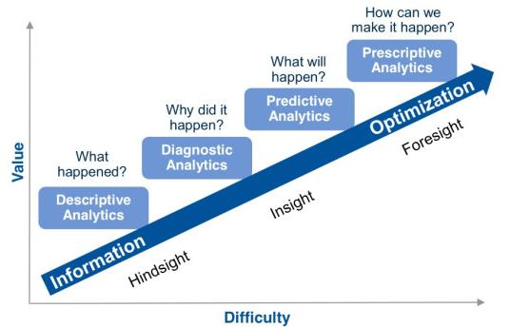
Maturity Matrices
http://www.rosebt.com/blog/descriptive-diagnostic-predictive-prescriptive-analytics

Slide 21
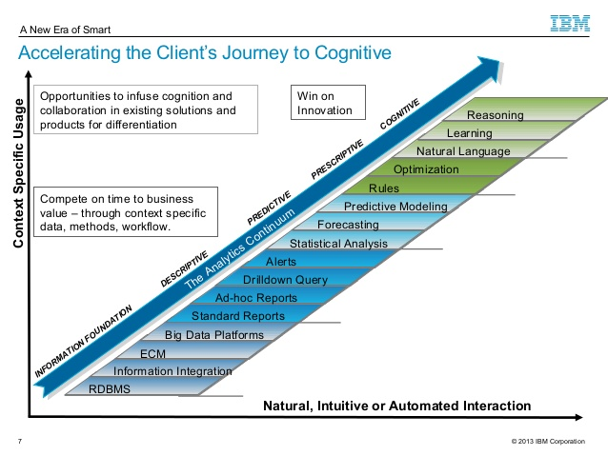
Maturity Matrices
http://www.slideshare.net/ibmsverige/gene-villeneuve-moving-from-descriptive-to -cognitive-analytics

Slide 22
Supply Chain Context

Slide 23
Supply Chain Themes in 7-11 Japan
Reducing lead times
Reducing uncertainty of arrival times
Agility/flexibility
Small Delivery Quantities
Collaboration
Logistics strategy

Slide 24
Reducing Lead Times
Reduced replenishment lead time
Receiving at some stores takes days
Benefits
Reduced labor hours
Inventory available for sale sooner
Tactics
Rolling gondolas each destined for a different category area within the store (6)
Could quickly roll gondola to area to unload goods
Store layouts standardized to category level
Gondolas with common contents can be loaded more easily at the distribution center

Slide 25
Reducing Lead Times
Reduced replenishment lead time
Lead time of receiving
Orders received at stores with Scanner Terminals (6)
Drivers left store before orders were checked
Enabled by accurate shipments
Receipt picked up by next driver (9)
Lead time of ordering
Electronic ordering with EOS (5)
Orders reached vendors in 2 to 3 hours (6)

Slide 26
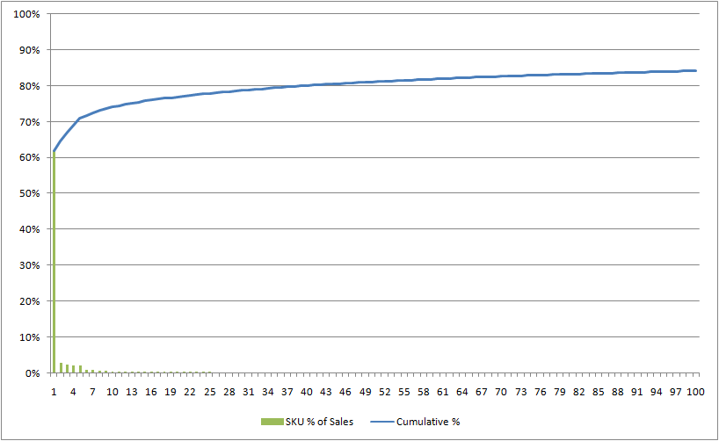
Reducing Lead Times
Tactics
Sales registers with 120 special keys for fast checkout
3,000 stock keeping units (SKUs) carried in each store (2)
Pareto Rule, 80/20 rule
A small percentage of the products with account for a large percentage of the revenues

Slide 27
Reducing Uncertainty
Benefits
Reduced safety stock, fewer stockouts, more sales
Tactics
Trucks left DC at precise times (8)
To avoid traffic congestion
Fewer stops by trucks reduces opportunity to get held up and put off schedule
Not room for multiple trucks at stores in Tokyo
Dominant Opening Strategy (DOS) put stores in close proximity for more efficient milk runs and reduced chance of encountering congestion

Slide 28
Small Delivery Quantities
Milk runs
Full truck, multiple stops
Efficient delivery of smaller batches
Good Milk Run
Bad Milk Run
Distribution Center/Supplier
7-11 Retail Stores

Slide 29
Small Delivery Quantities
Other Benefits of small delivery quantities
Less inventory, less leftovers/spoilage
Better freshness image
Higher margins
Room for different product needs by customers throughout the day
Small backrooms, if any, in stores

Slide 30
Flexibility/Agility
Benefits
Freshness, profitable product offering, fewer leftovers/scrap, convenience, …
Tactics (Short Term)
Daily changes in product offerings
Small Delivery Quantities
Changed product selection daily based on change in weather forecast (6)
For example, milk containers
Implies data analysis to forecast based on conditions
Moved items around store for convenience at different times of the day (6)

Slide 31
Flexibility/Agility
Tactics (Medium Term)
Changed product selection depending on how products were selling (6)
Supported by IT system
Shrinking product life cycles

Slide 32
Collaboration
Point-of-sale data sent back up the supply chain to manufacturers
Multi-link visibility/sharing of POS data
Joint delivery program with suppliers (7)
Used supplier distribution center as a consolidation point for multiple suppliers
Also better for suppliers (more efficient routes)
From 70 deliveries/day in 1976 to 10 in 2003
Delivery cost reduced by 67%
Greater assortment, smaller shipping quantities

Slide 33
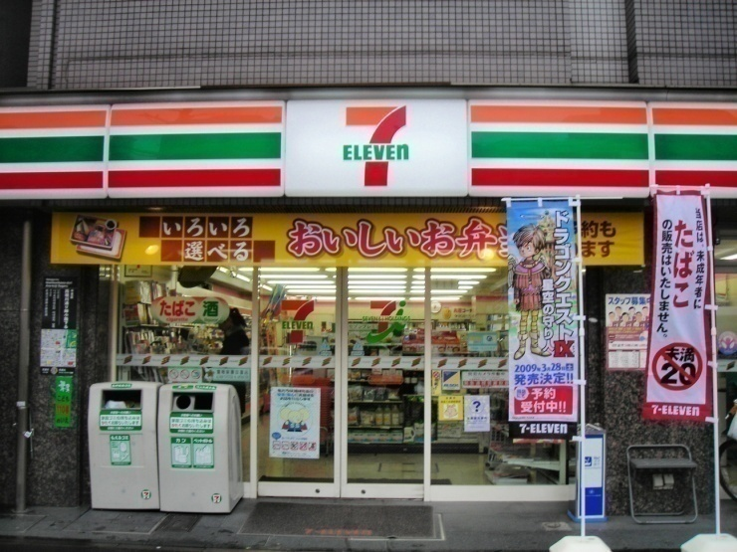
Logistics Network
Consolidating Supplier
Other Suppliers
http://obustamante.files.wordpress.com/2009/02/fscn0449.jpg

Slide 34
Collaboration
New product development with suppliers
Aided by IT system and data analysis
New business idea development
Online shopping for pickup at neighborhood 7-11 stores—clicks and mortar
Product example: books
Each company had its role to play
7-11 provided local distribution
Other companies provided products, software

Slide 35
Conclusions
IT supported other initiatives
IT/data analysis are a competitive weapon for 7-11
Better Decisions
Better Forecasts
Less Inventory
Less Missed Demand
Lead Time Reduction
Data Analysis
Collaboration
Lead Time Reduction
Data Analysis
Transactional IT
Information Technology

Slide 36
Conclusions
Fit: tactics vs. tactics, tactics vs. context
Supply chain tactics reinforce one another
Supply chain tactics fit business strategy
Customer desires
Freshness
Right products (short and long term)
Contextual Constraints
Small stores
Traffic congestion
Supply chain cost
Reduce uncertainty, lead time, and batch sizes
Increased revenue
Lower inventory and scrap cost

Slide 37
7-11 Japan Situation
Note how 7-11 actions fit the situation
Japan’s city environment
Densely populated, customers lived near stores
69% visits 7-11 stores 2+ times per week
Short and shrinking product lives
Small stores
Perishable products
Overall performance
55 inventory turns versus 7 for Wal-Mart
High growth, most profitable Japan retail chain
Very successful company 1976 - 2004

Slide 38
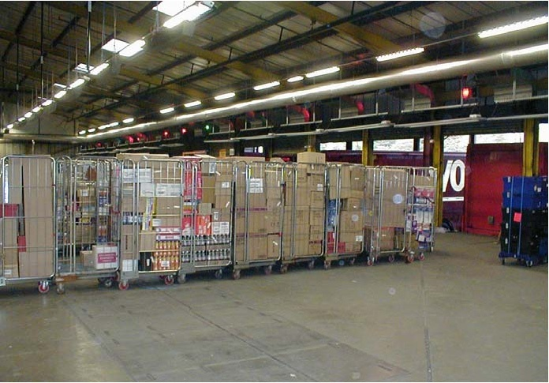
Gondolas
Back

Slide 39
Other Maturity Matrices

Slide 40
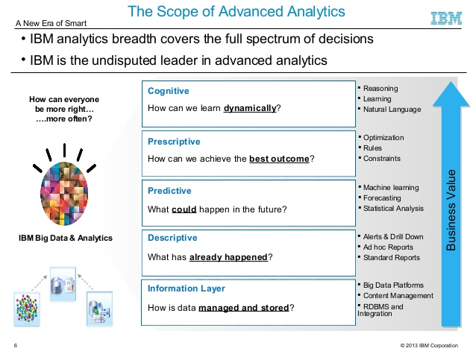
Maturity Matrices

Slide 41
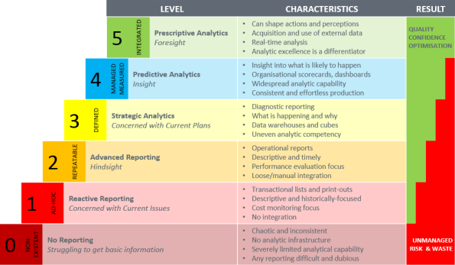
Maturity Matrices
www.xelocity.net

Slide 42
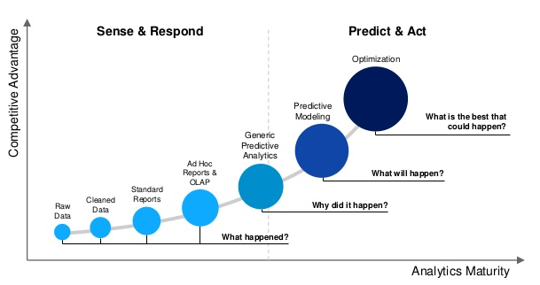
Maturity Matrices
www.miprofs.com

Slide 43
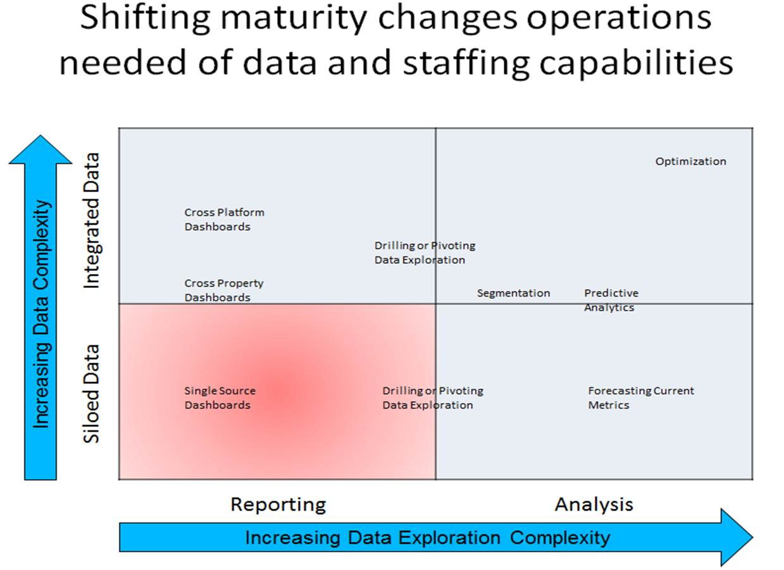
Maturity Matrices
semphonic.blogs.com

Slide 44
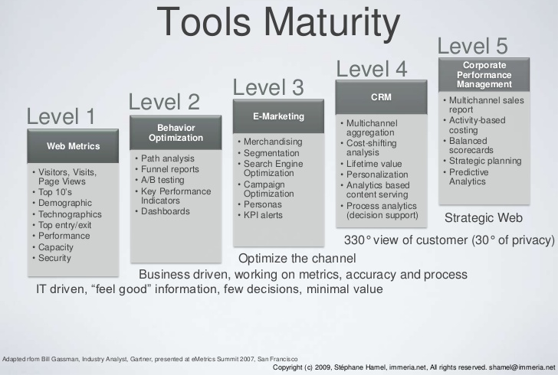
Maturity Matrices
www.slideshare.net

Slide 45
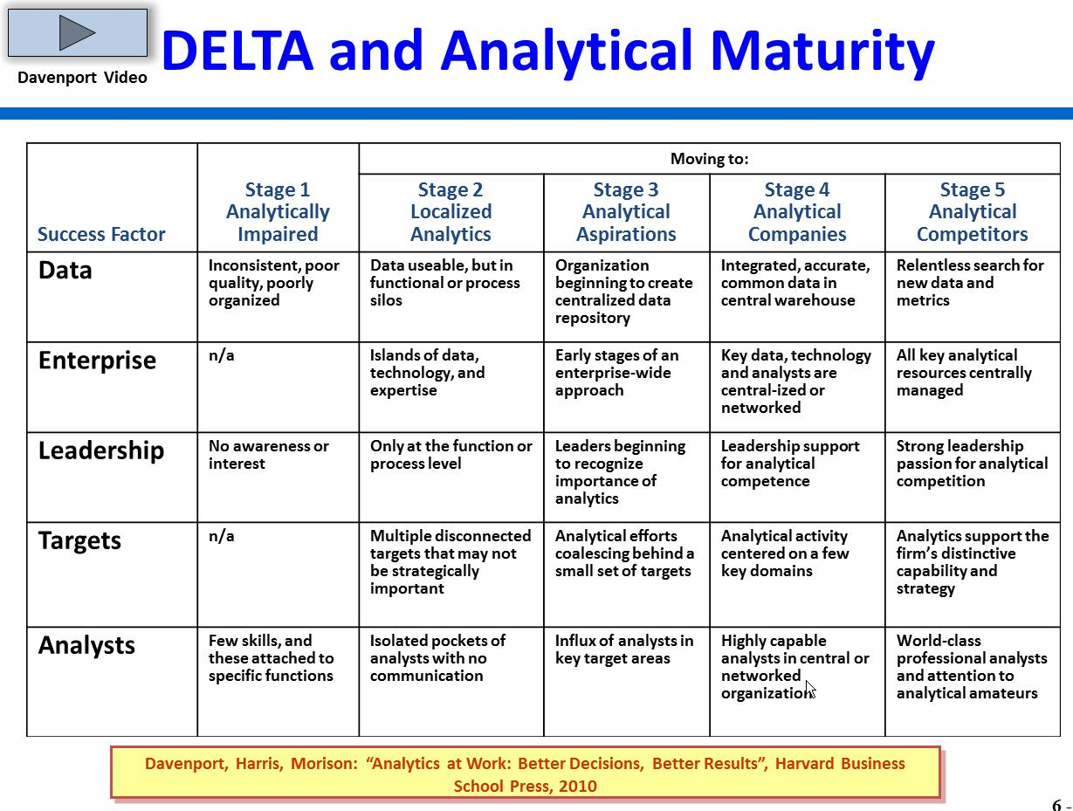
Maturity Matrices
Source: souterconsulting.eu

