Slide 1
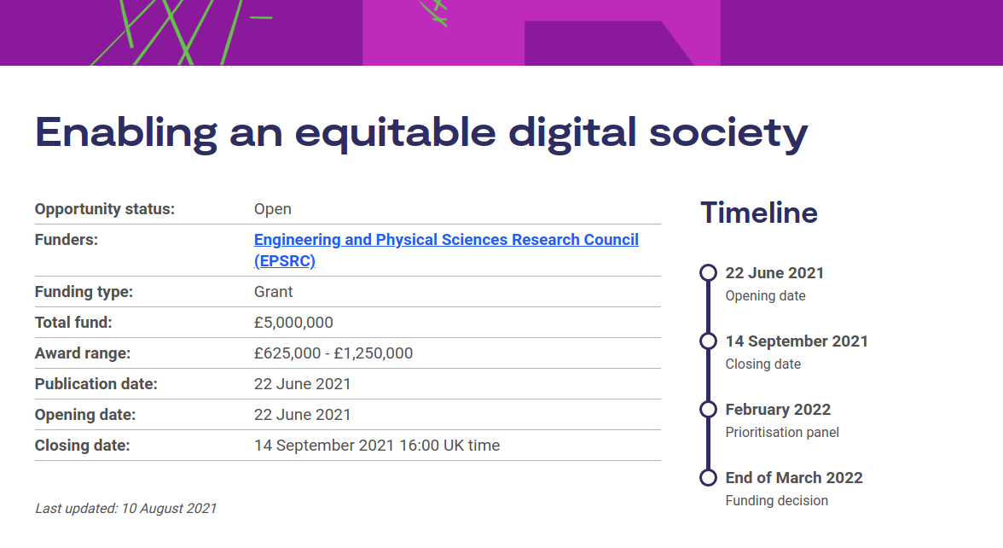

Slide 2
Call Purpose
Apply for funding to explore and develop human-centred digital technologies and services that enable an equitable society.

Slide 3
Proposal Team requirements
researchers from at least two disciplines across the EPSRC, ESRC and AHRC portfolio
at least one early-career researcher at lecturer level as principal or co-investigator
at least one researcher co-investigator at postdoctoral level.

Slide 4
Size of call
Max. award: £625,000 – £1,250,000 (of total fund of £5 million) at 80% Fec

Slide 5
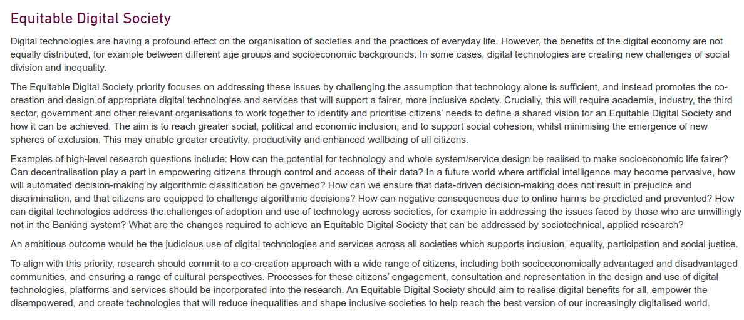

Slide 6
Initial analysis of fit
An interdisciplinary area that maps onto our existing disparate activities in Digital Education, because of the role that digital education has in creating an equitable society (e.g. for Low,Middle-Income Countries) –
but perhaps this is not what the call-writers were anticipating.
The call covers things we probably want to do anyway (e.g. Tim D, Joe with remote labs and interactives, Tim F/Jen social justice/fairness elements )
The call provides an opportunity to coalesce and formalise our activities across Colleges.
This could map nicely onto a longer term activity/relationship at EU, rather than just being a one-shot deal for a single call (but predicting the future is hard)

Slide 7
Do we jump this year?
There are four weeks left
Many of use heavily committed on operational matters over the last 18 months, with ongoing matters to attend to
What theme might it be next year, if there is one?

Slide 8
Last year’s call
Digital Economy: Sustainable Digital Society
“This call focuses on environmental sustainability. It is recognised that social and economic sustainability are interconnected with environmental sustainability, therefore exploration of these aspects of sustainability is acceptable and welcomed, provided environmental sustainability is the primary focus.” (Closed 1 October 2020)

Slide 9
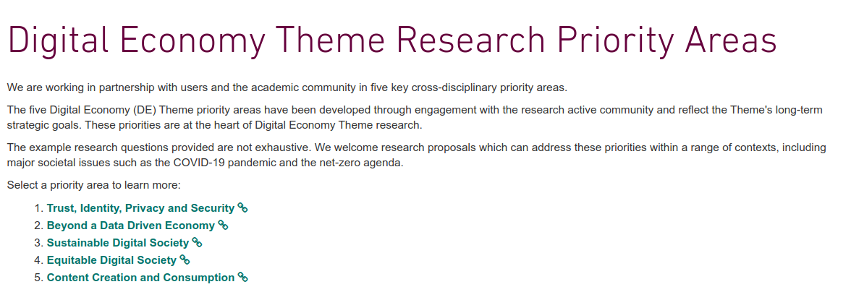
Possible themes for next year?
2015
2020
2021
2016
https://epsrc.ukri.org/files/funding/calls/2015/tipsintentstosubmit/
https://epsrc.ukri.org/files/funding/calls/2016/content-creation-and-consumption-in-the-digital-economy/

Slide 10
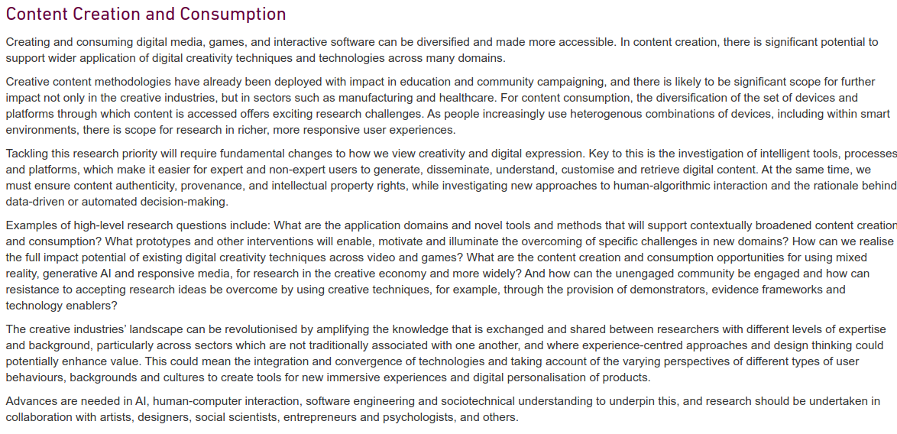

Slide 11
