Slide 1

Time Series Analysis project Fitbit data
Nicole Garza
Jason Dunn
Chad Hackney
25 Apr 19

Slide 2
Assumptions about person
Likely an employee, and not a fitbit research study participant
Why? Extremely incomplete food log
Safe to assume a research study would require a more complete food log from study participants, with daily input requirements
Most likely male
Due to average daily calories burned (3,401)
Note: fitbit automatically populates 2,145 cals burned per day, if device left inactive (ie “not worn”)
Again, this implies male fitbit owner
Began out of shape, became healthier over this time
Initially inactive and became more active over time
Conclusion derived from increases in average daily calories burned, daily steps, and daily minutes of activity, and a decrease of inactive time

Slide 3
Four Prophet models
Calories Burned
Steps
Minutes Active (all active categories summed)
Minutes Sedentary

Slide 4
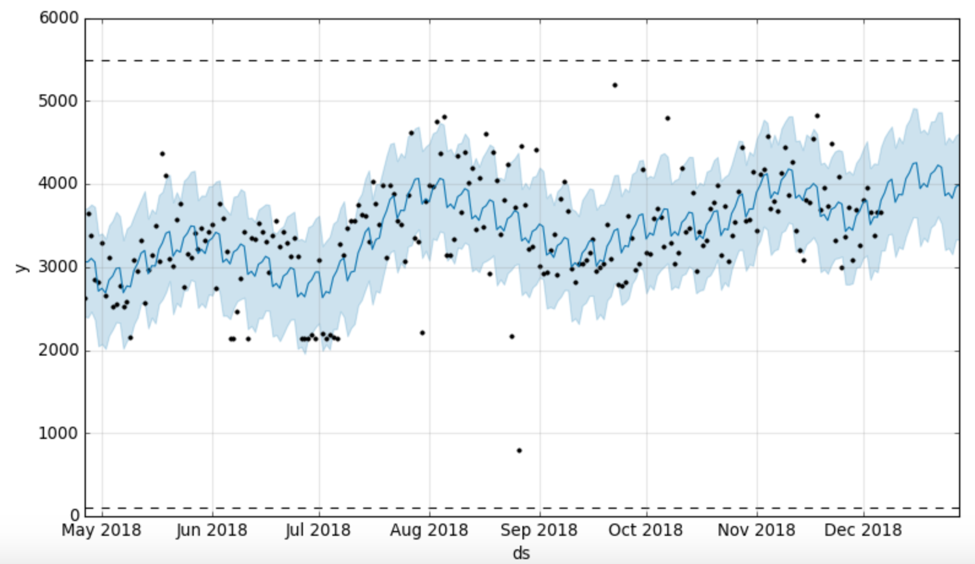
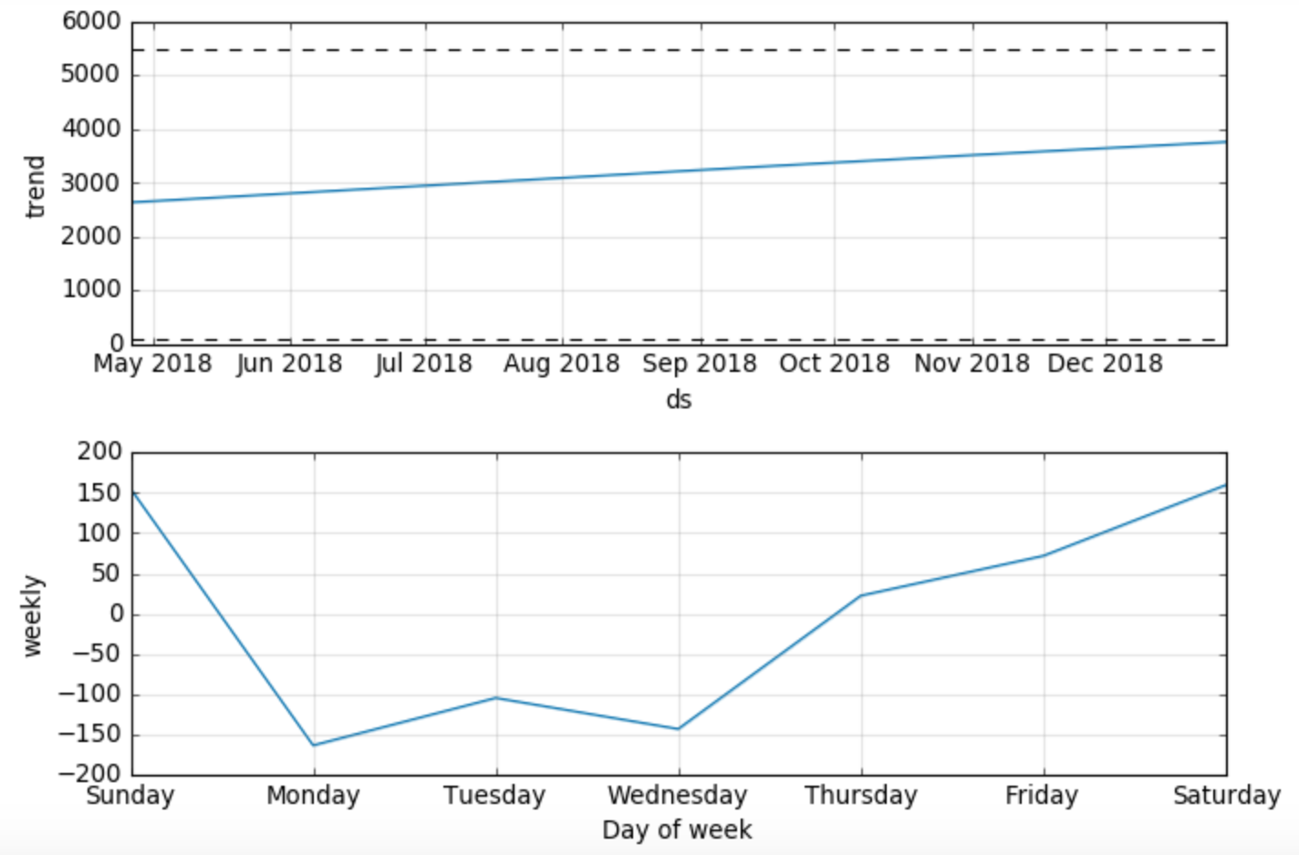
Calories Burned

Slide 5
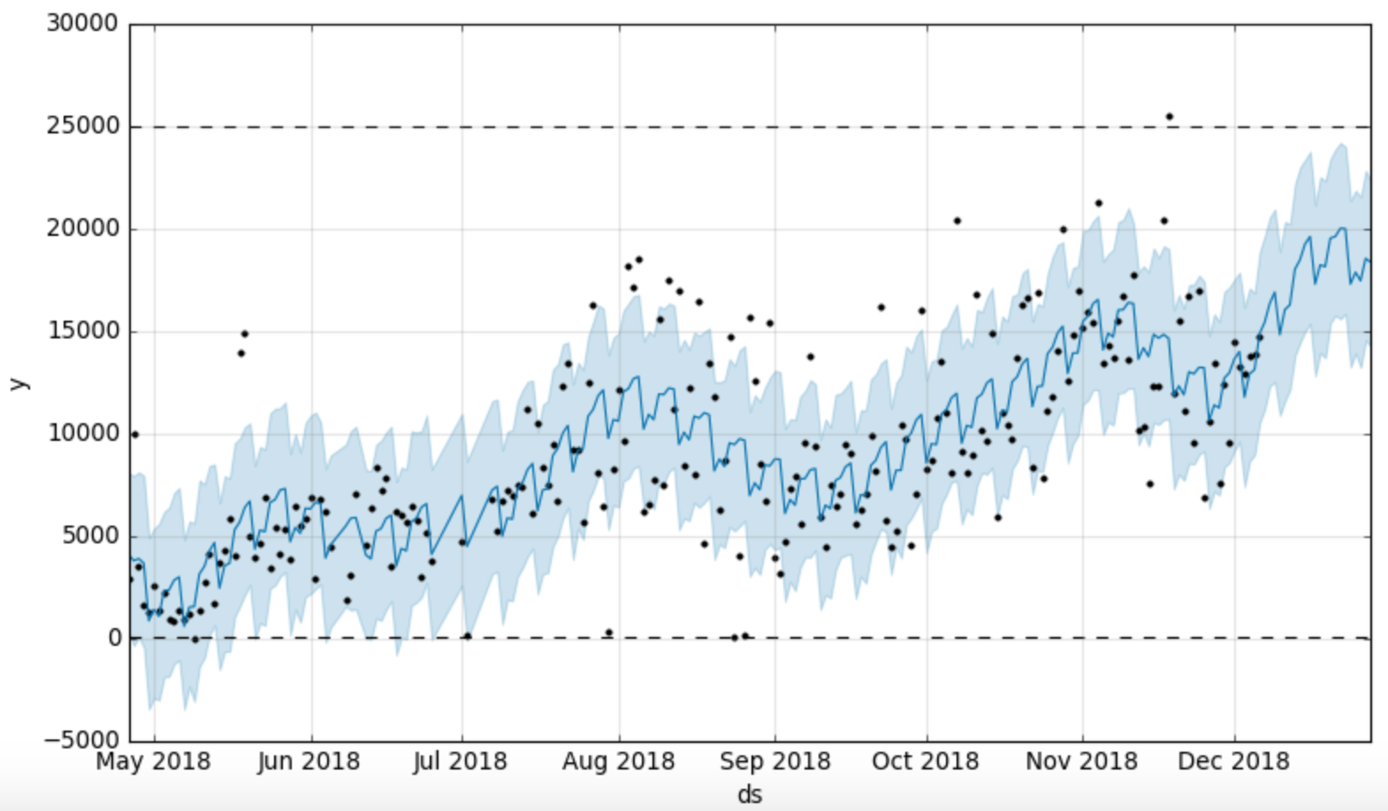
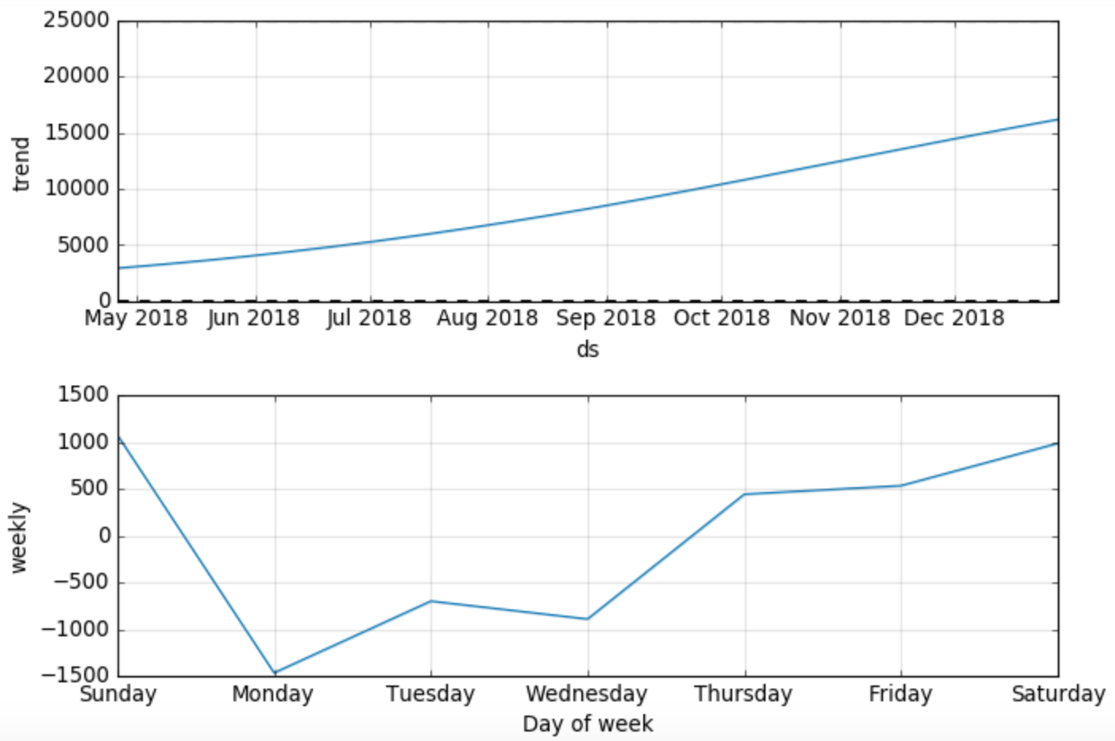
Steps

Slide 6
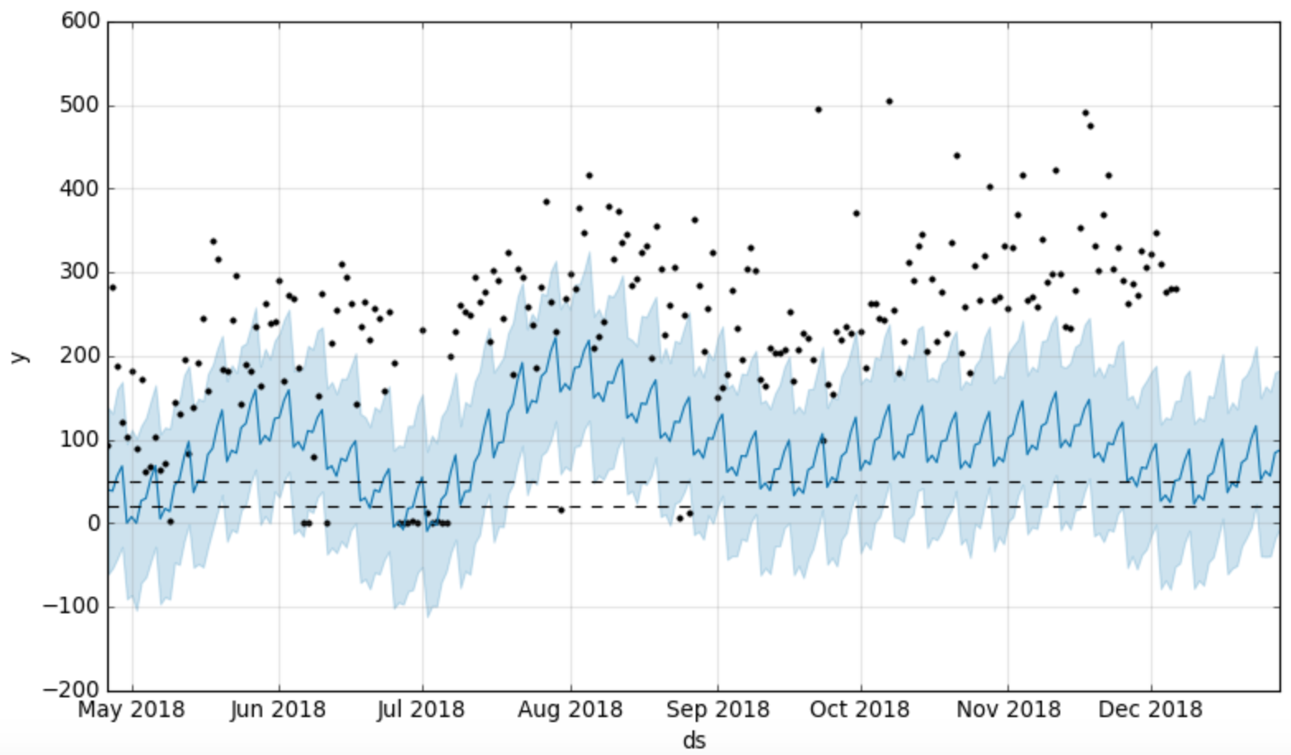
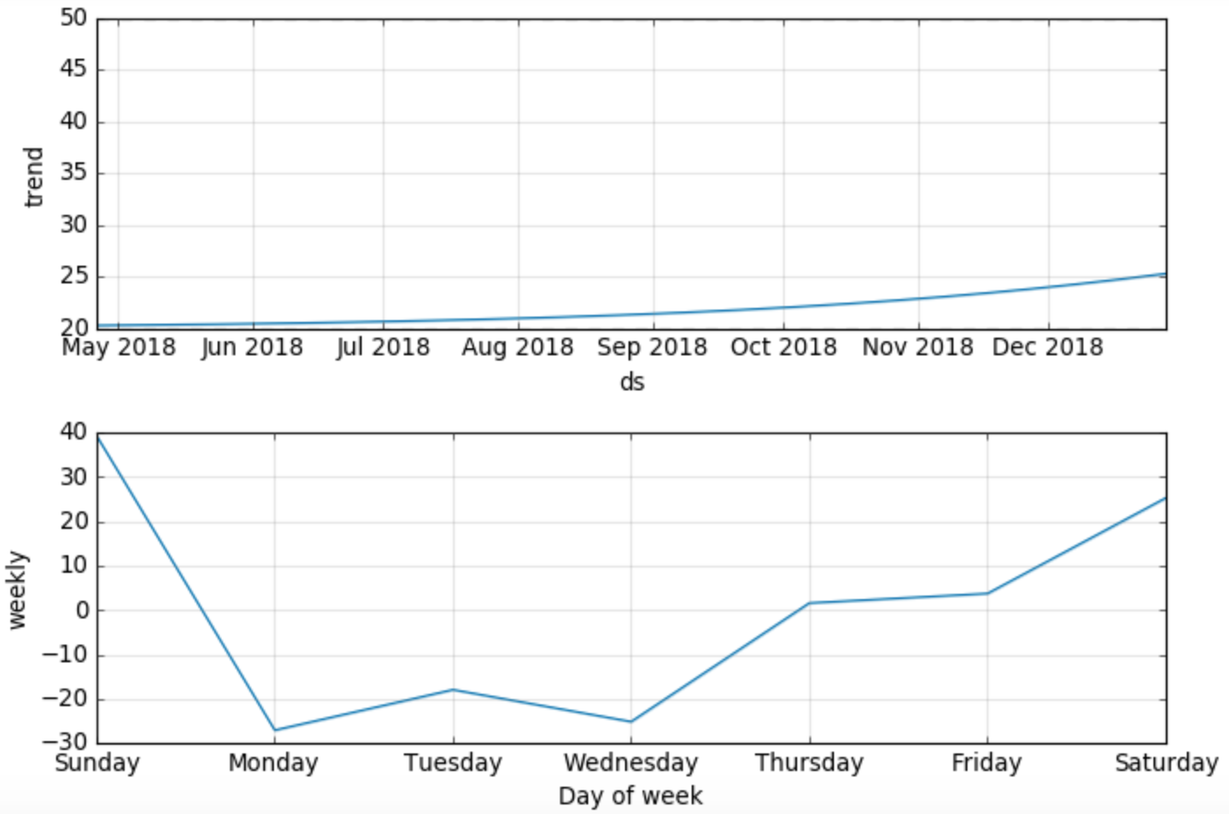
Minutes Active (combined)

Slide 7
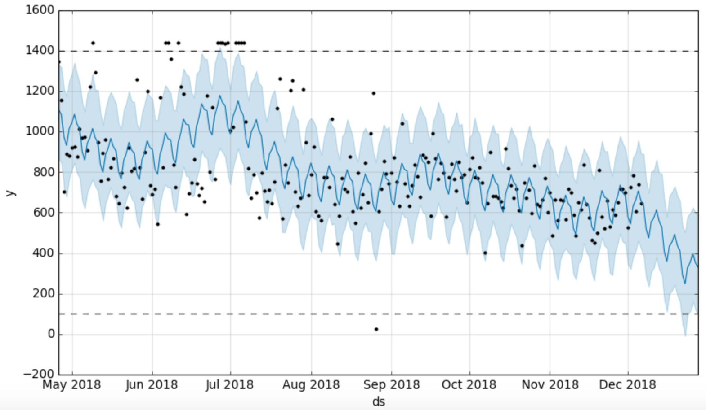
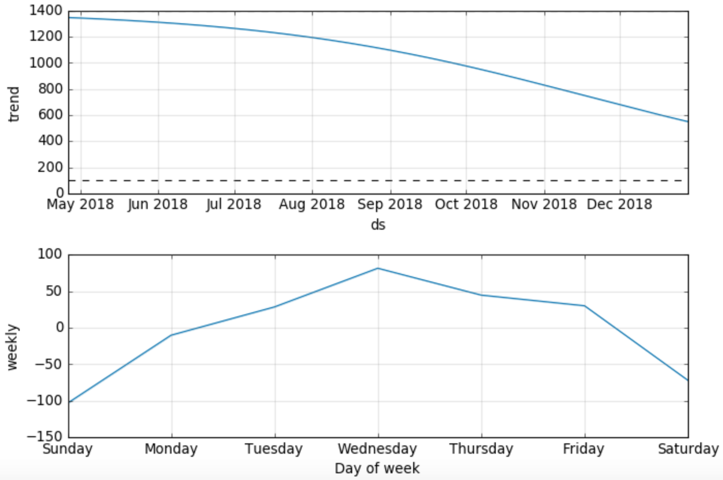
Minutes Sedentary

Slide 8
Weekly views

Slide 9

Calories Burned
Steps

Slide 10
Minutes Active (combined)
Minutes Sedentary

