Slide 1

Time Series Analysis project Fitbit data
Nicole Garza
Jason Dunn
Chad Hackney
25 Apr 19

Slide 2
Assumptions about person
Likely an employee, and not a fitbit research study participant
Why? Extremely incomplete food log
Most likely male
Due to average daily calories burned (3,401)
Note: fitbit automatically populates 2,145 cals burned per day, if device left inactive (ie “not worn”)
Began out of shape, became healthier over this time
Initially inactive and became more active over time

Slide 3
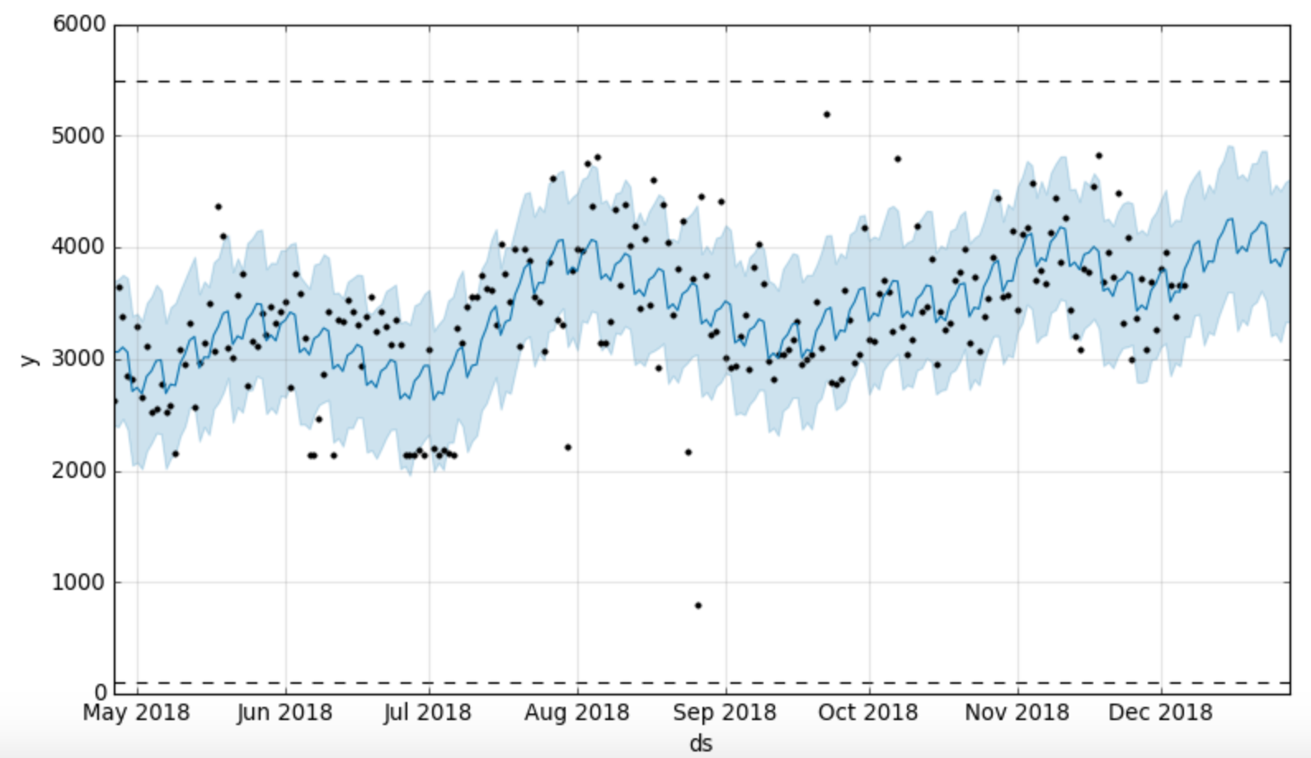
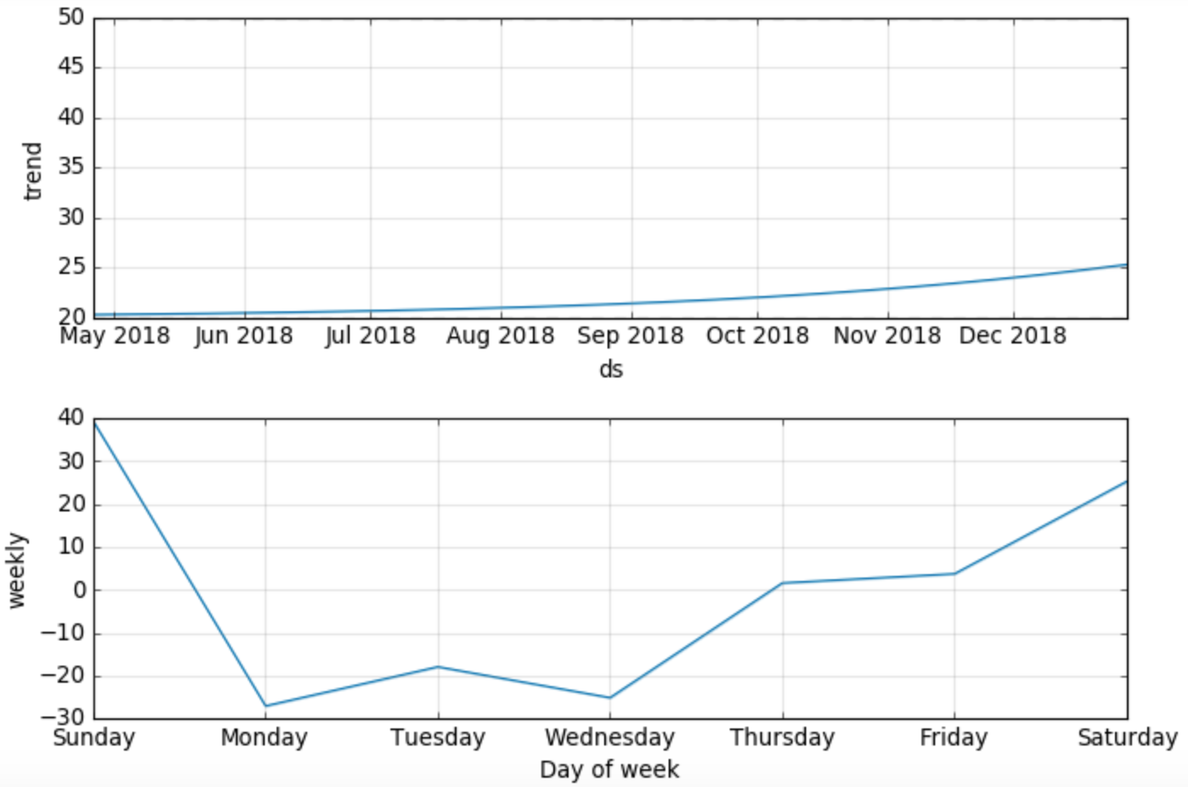
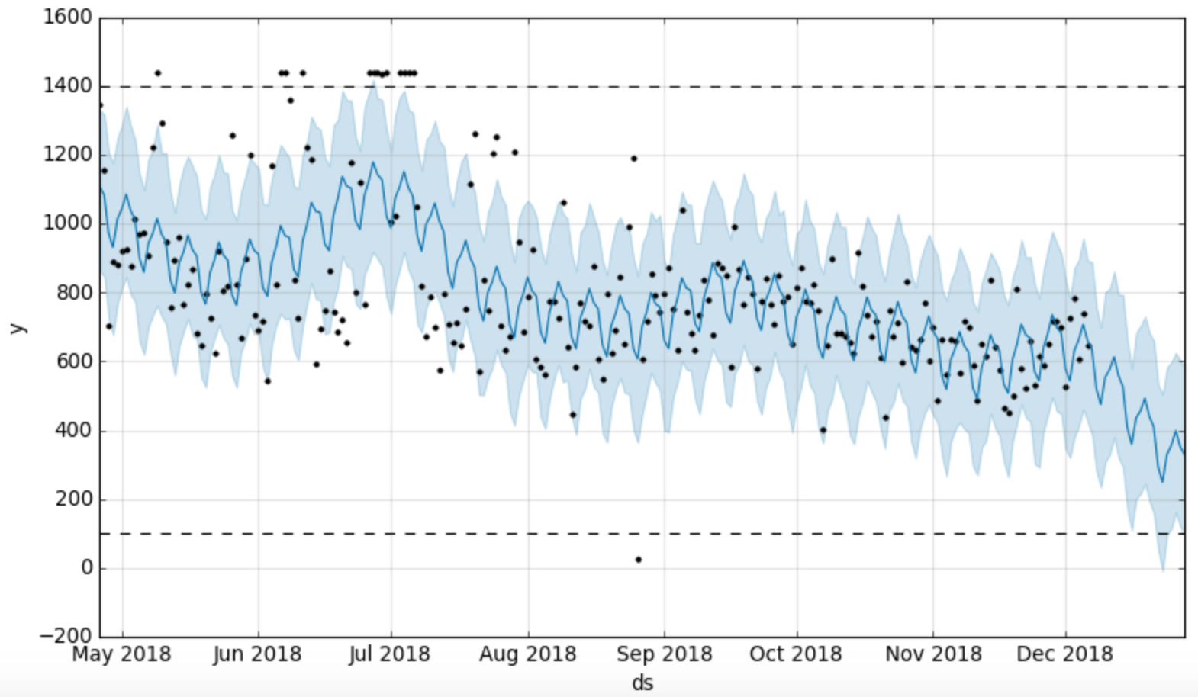
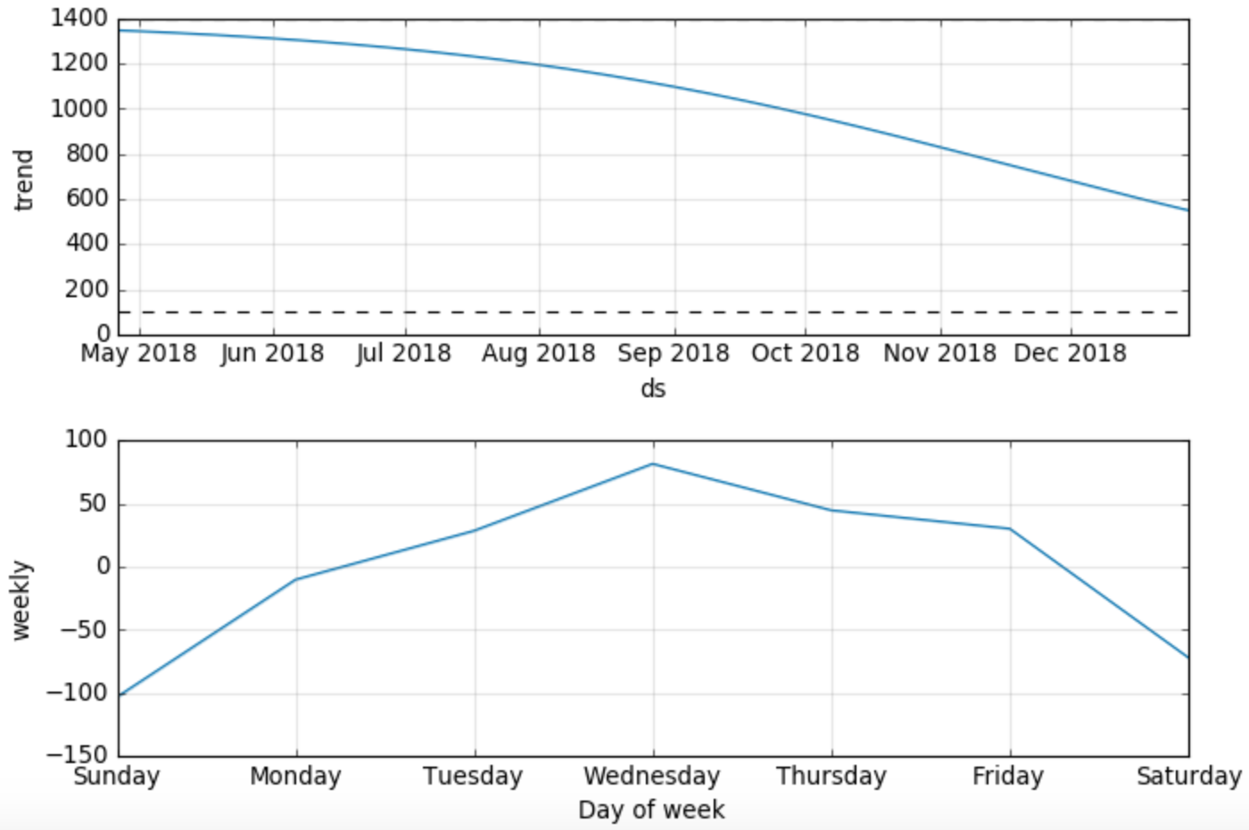
Calories Burned
Prophet Model Observations
Minutes Active
Calories
4018 avg cals
Missing 2 weeks
Date
Minutes Sedentary
Minutes Sedentary
Minutes
Date

