Slide 1

Time Series Analysis project Fitbit data
Slides under construction
Will finish Wed night.
Nicole Garza
Jason Dunn
Chad Hackney
25 Apr 19

Slide 2
Assumptions about person
Likely an employee, and not a fitbit research study participant
Why? Extremely incomplete food log
It would be safe to assume a fitbit study would require a more complete food of participants, with daily input requirements
Also more likely male
Due to average daily calories burned (3,401)
Note: fitbit automatically populates 2,145 cals burned per day, if device left inactive (ie “not worn”)
Initially inactive and became more active over time
Due to average daily calories burned, daily steps, and daily minutes of activity and inactivity
Slides under construction
Will finish Wed night.

Slide 3
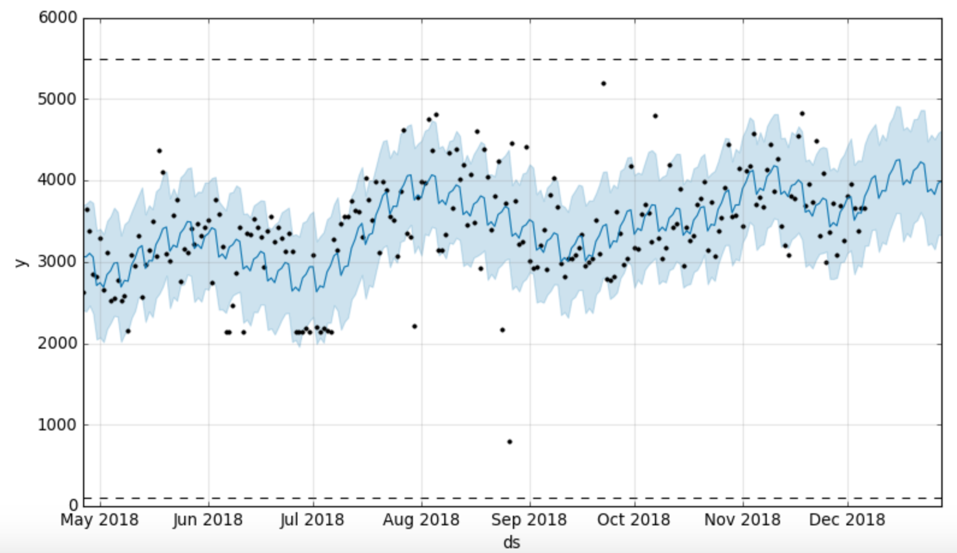
Calories_burned
Slides under construction
Will finish Wed night.

Slide 4
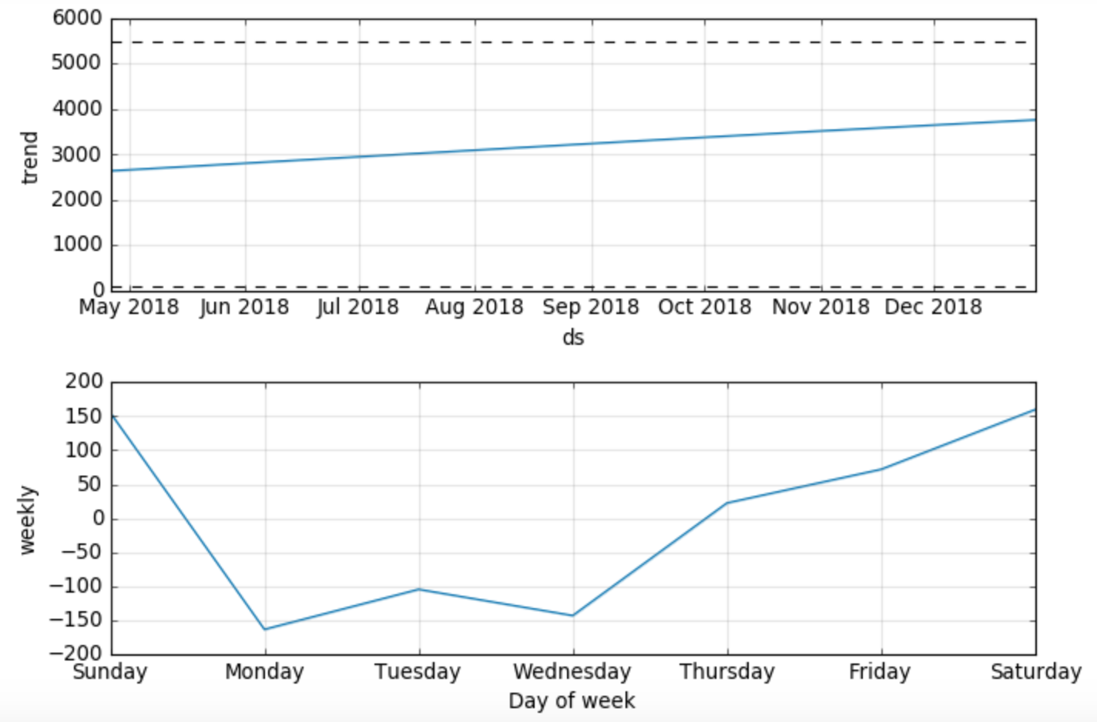
Calories_burned
Slides under construction
Will finish Wed night.

Slide 5
Calories_burned
Slides under construction
Will finish Wed night.

Slide 6
Calories_burned
Slides under construction
Will finish Wed night.

