Slide 1
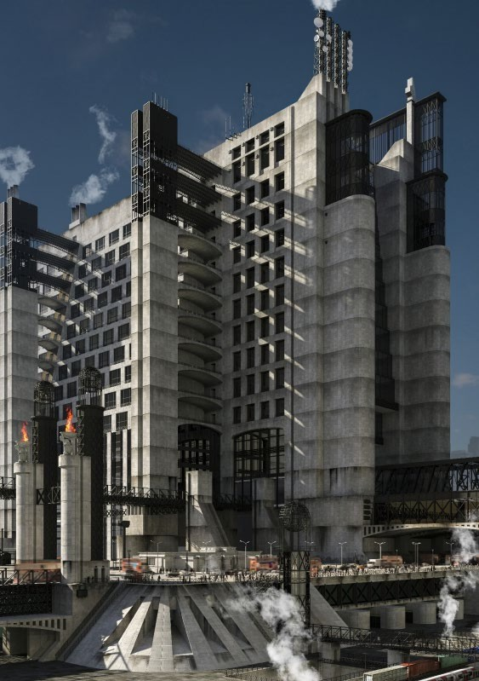

The Exploration of Buildings through 3D Modeling
Alessio Mezzina
Course: VISUALISATION SPECIAL ISSUES
Professor: Jacopo Spinelli

Slide 2
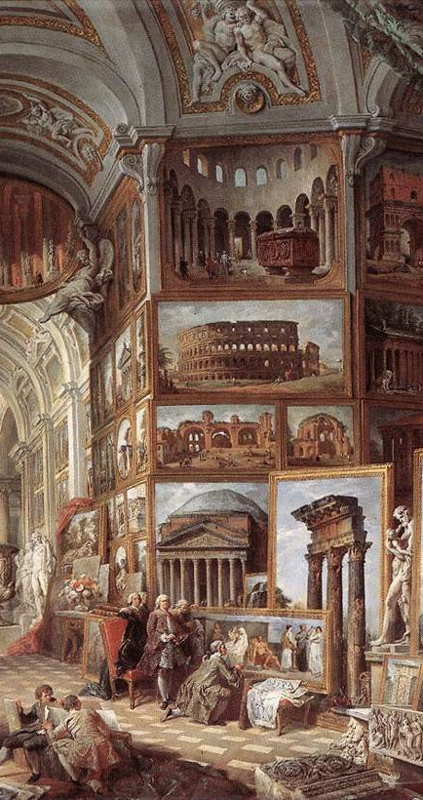
Selected Building
Relatore
2023-10-30 10:24:15
--------------------------------------------
Classicismo tardo barocco: G. P. Pannini assembla i canoni delle rovine e delle sculture romane in una vasta e immaginaria galleria (1756).
Pacifere, “Planche 40”
"The 'Pacifère' was a theoretical architectural project for a funeral palace, this project is renowned for its
neoclassical aesthetics and bold geometric forms
Maison d'un Commis, “Planche 42”
"Maison d'un Commis" translates to "House of a Clerk" in English, is a particular project is known for its unique and innovative architectural design especially in terms of its practical and functional aspects. An emphasis should
also be placed on the garden, which could prove to be a particularly intriguing modeling subject.
Fragmente des Propylées de Paris, “Planche 87”
"Fragmente des Propylées de Paris" cloud be translates to "Fragments of the Propylaea of Paris", These fragments likely represent parts of the Propylaea, which was a monumental gateway in ancient Greek architecture

Slide 3
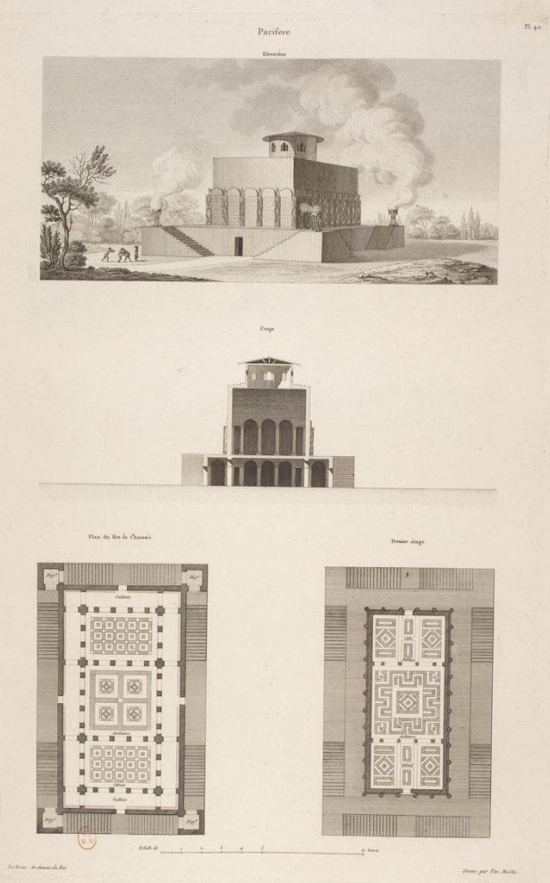
Geometries and Exterior
Pacifere, “Planche 40”
The Pacifère exhibits a very rigid and austere structure from the exterior, and also a strong sense of symmetry. Concerning the external spaces, there isn't much to emphasize except for the building's location (outside a city). This is particularly significant because the building is intended to serve a funerary function. Its placement outside the city is integral to the design, as funerary purposes often require quiet and secluded settings, and the location contributes to creating a suitable atmosphere for this purpose.
Internal spaces
Discussing the internal spaces, 'Pacifère' stands out as the most complex structure, featuring exceptionally high internal intricacy, both in terms of functionality and aesthetics, given the nature of the building.

Slide 4
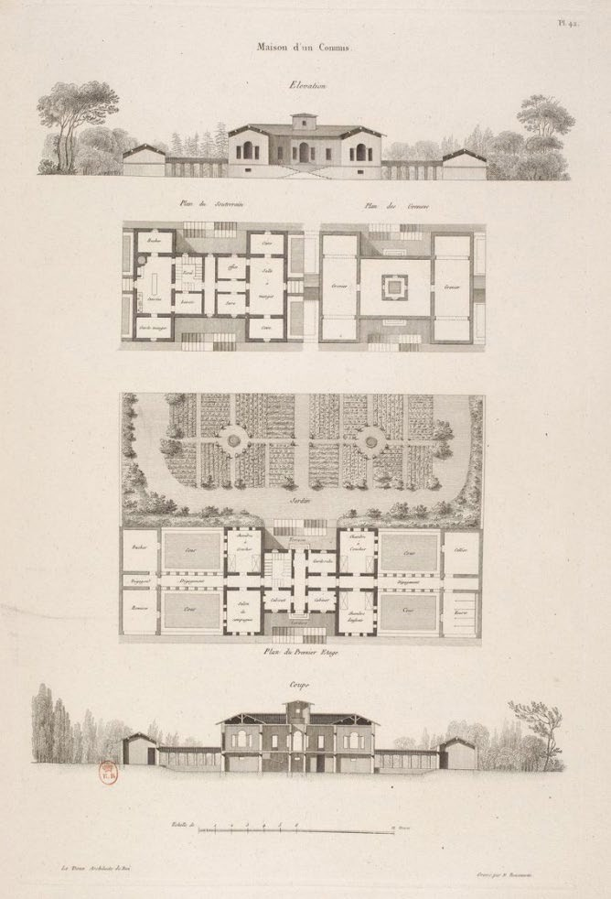
Geometries and Exterior
Maison d'un Commis, “Planche 42”
From a geometric and external space perspective is the remarkable symmetry, which warrants in-depth analysis both in terms of aesthetics and functionality:
In terms of geometry, the house exhibits a highly symmetrical appearance, that makes this house particularly intriguing, and, when it comes to the
external spaces of these three projects, 'Maison d'un Commis' stands out as the most captivating. It demonstrates how the garden is seamlessly integrated as an integral part of the house
Internal spaces
maintains a sense of internal symmetry, making it compelling to explore its functional aspects.

Slide 5
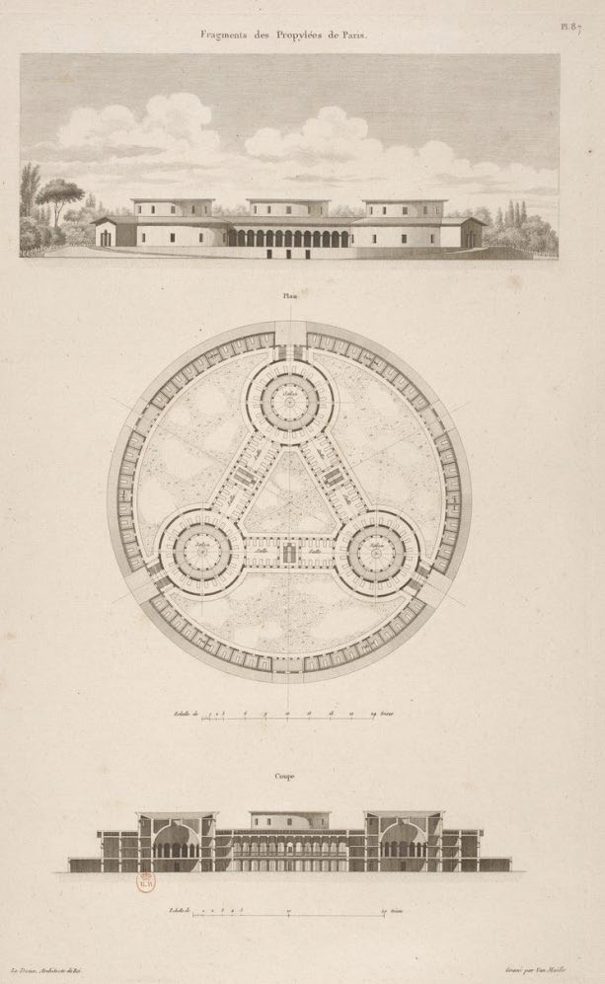
Geometries and Exterior
Fragmente des Propylées de Paris, “Planche 87”
Regarding 'Fragmente des Propylées de Paris,' we can observe it as a kind of monument. Among the three considered projects, it is notably the most geometrically intricate and complex. It incorporates various geometric shapes and features numerous arches. Despite the building's complexity, it maintains a strong sense of symmetry. However, the exact positioning of the building is not entirely clear, as the Propylaea in ancient Greek architecture served as monumental gateways. They functioned as partitions, separating the secular and religious parts of a city.
Internal spaces
Does not provide a clear internal configuration. However, we can identify three main halls (within the circles) and three primary corridors connecting them, forming an inscribed triangle within a larger external circle.

Slide 6
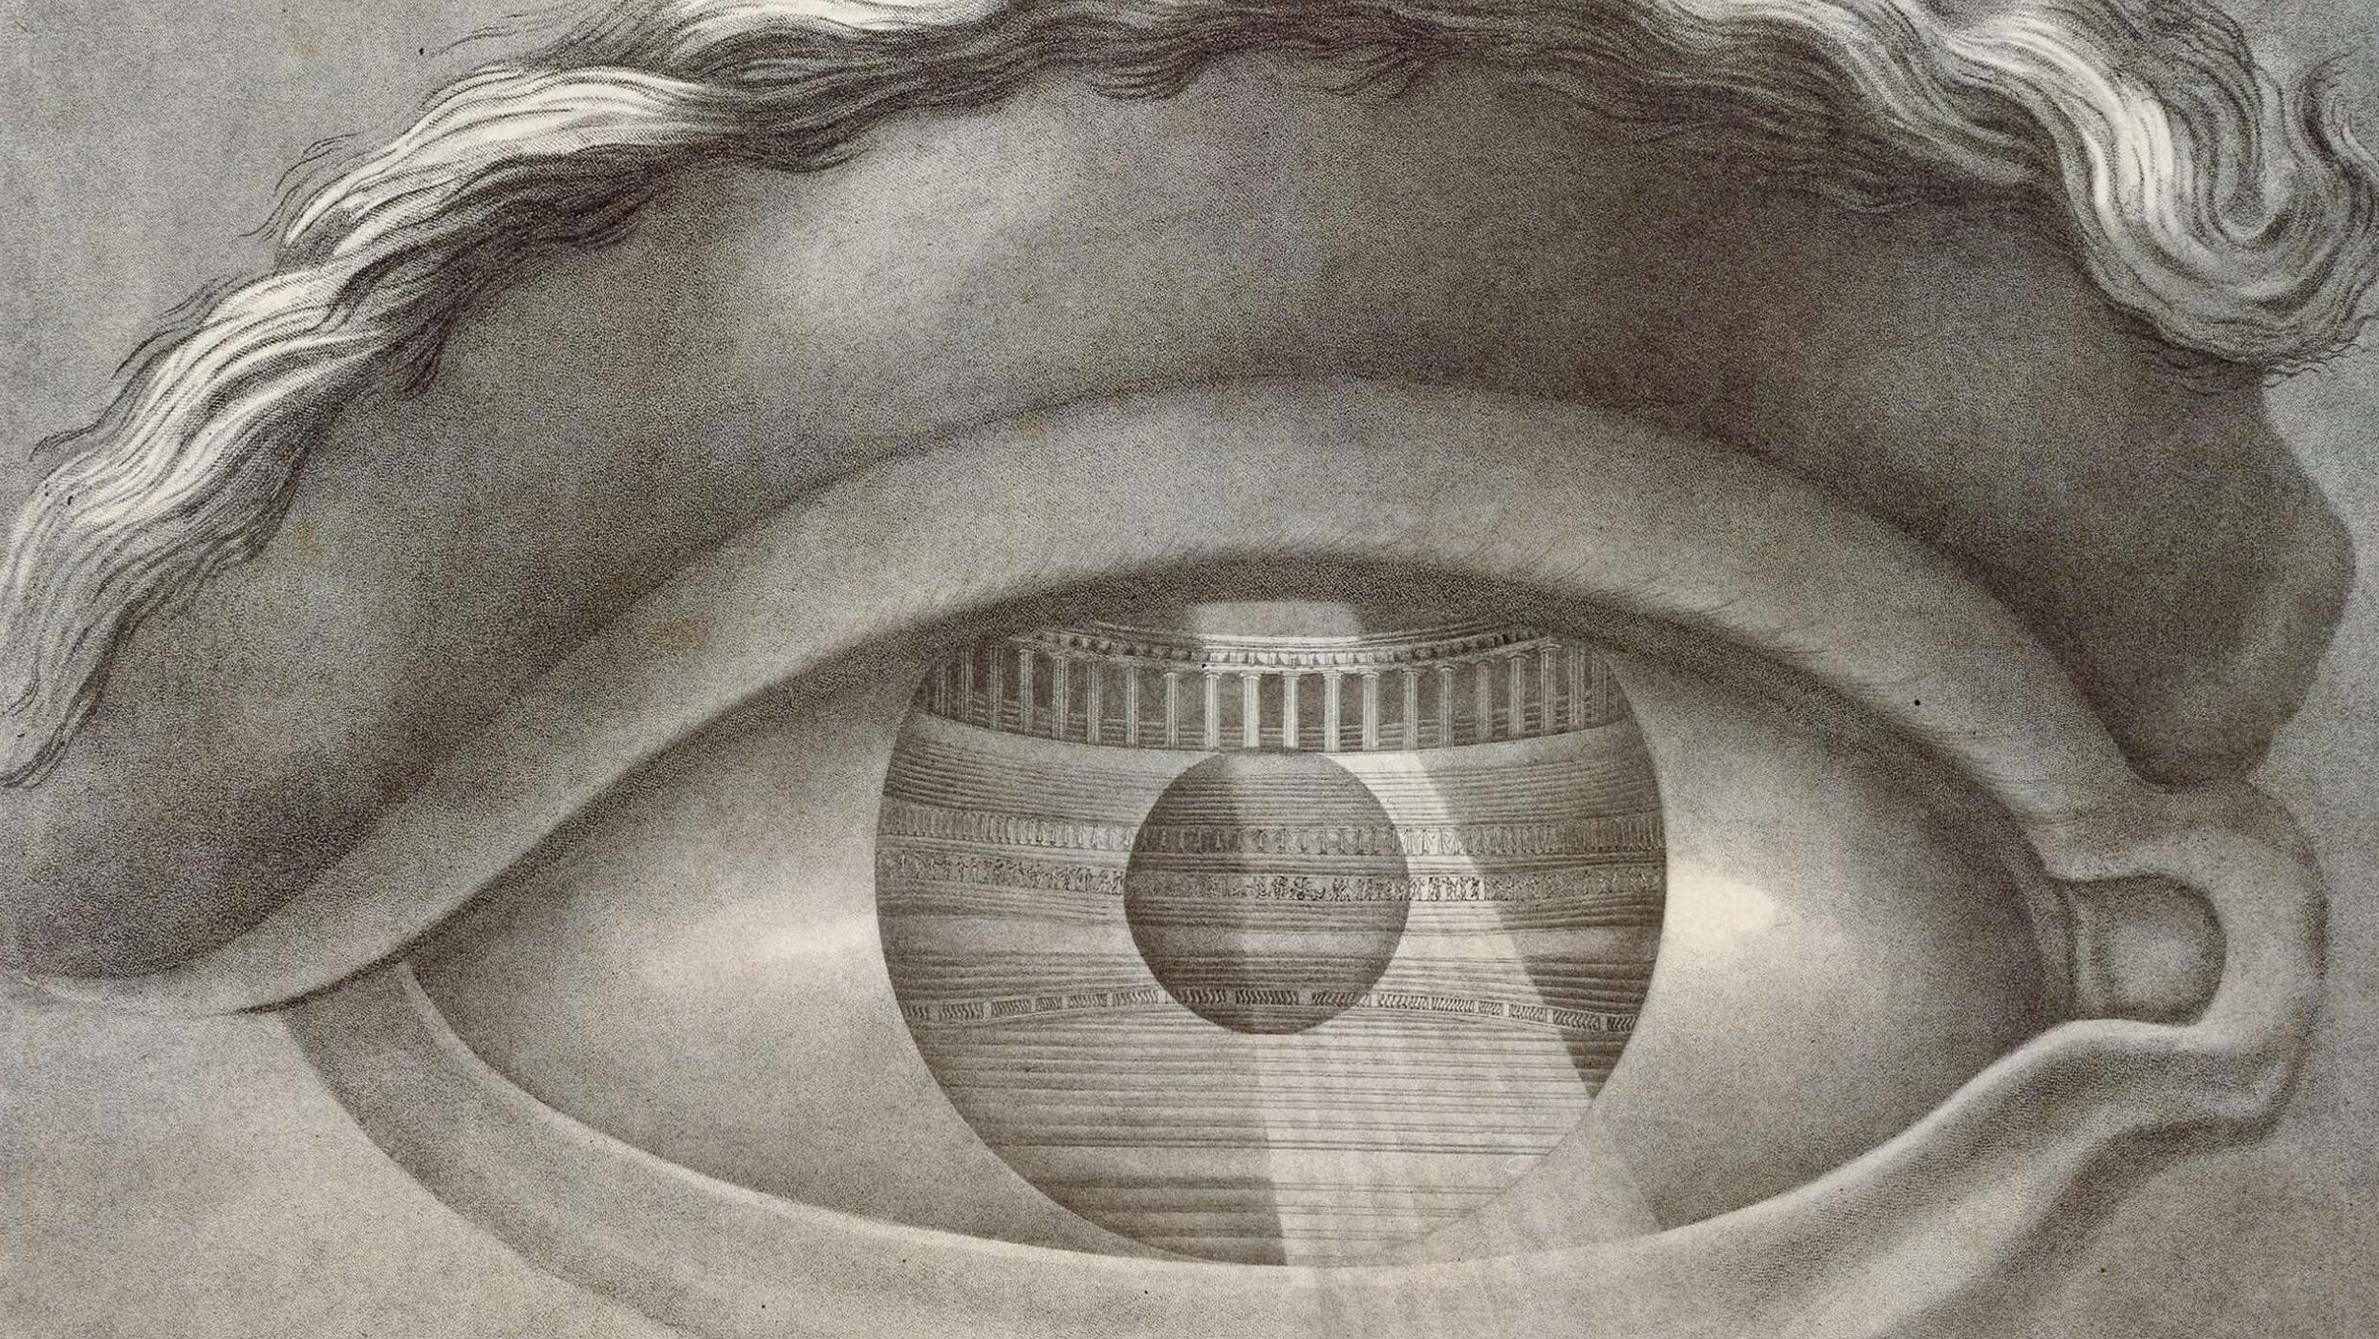
Conclusion:
What Struck Me Most About the 3 Buildings?
Pacifere
Captivates with its intricate internal, blurring the lines between functionality and aesthetics.
Maison d'un Commis.
Impresses with its internal symmetry and external spaces, offering a glimpse into its functional elegance.
Fragmente des Propylées de Paris
Intrigues with its elusive internal composition, revealing a unique arrangement of three primary halls and corridors, as well as the intriguing purpose this structure may have served.

