Slide 1
Bob Moritz
Global Chairman, PricewaterhouseCoopers International Limited
2nd term until June 2024:
Timing for engagement is not bad, as he still has 18 months to go.
New business year starts in Juli (budget allocation!).
Global initiatives:
Setup Managed Services ( we would call it BPO )
Digitalisation of the Auditing Business

Slide 2
Important to know: Structure PwC
PwC is the brand under which the member firms of PricewaterhouseCoopers International Limited (PwCIL) operate and provide professional services. Together, these firms form the PwC network. ‘PwC’ is often used to refer either to individual firms within the PwC network or to several or all of them collectively.
In many parts of the world, accounting firms are required by law to be locally owned and independent. Although regulatory attitudes on this issue are changing, PwC member firms do not and cannot currently operate as a corporate multinational. The PwC network is not a global partnership, a single firm, or a multinational corporation.
For these reasons, the PwC network consists of firms which are separate legal entities. The firms that make up the network are committed to working together to provide quality service offerings for clients throughout the world. Firms in the PwC network are members in, or have other connections to, PricewaterhouseCoopers International Limited (PwCIL), an English private company limited by guarantee. PwCIL does not practise accountancy or provide services to clients. Rather its purpose is to facilitate coordination between member firms in the PwC network. Focusing on key areas such as strategy, brand, and risk and quality, the Network Leadership Team and Board of PwCIL develop and implement policies and initiatives to achieve a common and coordinated approach among individual firms where appropriate. Member firms of PwCIL can use the PwC name and the resources and methodologies of the PwC network are made available to them. In addition, member firms may request the resources of other member firms and/or secure the provision of professional services by other member firms and/or other entities. In return, member firms agree to abide by certain common policies and to maintain the standards of the PwC network as put forward by PwCIL.
The PwC network is not one international partnership and PwC member firms are not otherwise legal partners with each other. Many of the member firms have legally registered names which contain “PricewaterhouseCoopers”, however there is no ownership by PwCIL. A member firm cannot act as agent of PwCIL or any other member firm, cannot obligate PwCIL or any other member firm, and is liable only for its own acts or omissions and not those of PwCIL or any other member firm. Similarly, PwCIL cannot act as an agent of any member firm, cannot obligate any member firm, and is liable only for its own acts or omissions.
Source: https://www.pwc.com/gx/en/about/corporate-governance/network-structure.html

Slide 3
Example: German PwC representation
All member firms / local legal entities have an own strategy and are driven by a board and Technical Leadership Team (TLT).
Underneath the local (e.g. german representation) we see several smaller entities / partner areas ( approx. 600 Partners – which are the shareholders).
Such partner act as „own companies“, but underlay the guidance of the local / legal entity.
The partner drives the success/profit of its resp. unit. The partner has invested in the unit and participates heavily in its result. ( Bonus based on Equity share/Company Performance and Individuell Performance
Therefore no big / limited appetite of partners to invest / kick off a new technology project, these are direct costs and have impact on the result of the unit and partner‘s income.

Slide 4
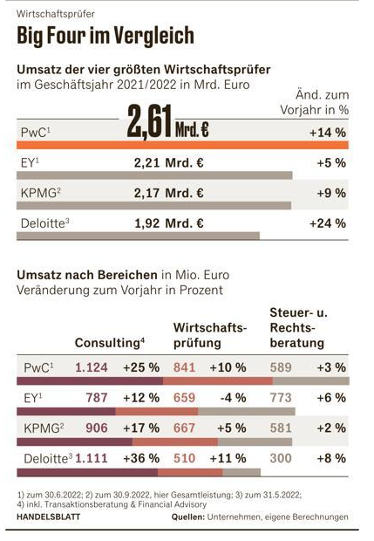
Revenue Stream German PwC representation
The german representation has 3 revenue streams:
Advisory 44 %
Auditing 33 %
Tax Consultancy 23 %
German revenue stream is representative for other countries.
Auditing market is a stable, non growing market. Market growth can only by done via price dumping / agressive pricing. Revenue growth via yearly rate adjustments. All 10 years companies need a new auditor (by law) – periodic rotation of audit mandates.
PwC provides „bodies“ during audit – there is no interest to reduce bodies /billable work as this would reduce auditing revenue.
PwC is very restricted to provide advice/software to direct customers / C1 / Auditing customers by law ( SEC )
Source: https://www.pwc.com/gx/en/about/corporate-governance/network-structure.html

Slide 5
Considerations
ML Ops Platform
many companies are using models for their Business Processes around finance (i.e. Hypatos for AP )
What does the usage of models mean for the auditing business ?
How will the future auditing business look like?
Post mortem corrections vs preventive / predictive actions ( kind of new Advisory service )
Systems like Hypatos will generate bookkeeping transactions based on historical data (i.e. transactions, WBS elements, depreciation)
Fraud prevention: prevent internal / external fraud (i.e. expenses, subcontractors, suspicious payments/transactions).
Quality assurance / recommendations
Operational bookkeeping (i.e. chart of account, Tax, COPA, depreciations)
Revenue recognition based on unstructured data, contracts
Aggregation
consideration end to end ecosystem
each single transaction ( internal / external systems) need to be validated towards correctness

Slide 6
Considerations
Recruiting / HR issue
PwC is not been seen as a technology company (‚dusty image‘ as tax / audit company), they are strugling to find good tech employees.

Slide 7
How can we raise interest?
How to motivate a Partner?
Different interests per partner level (Junior, …, Senior)
Partner
Reduce costs, raise revenue, market growth
Usage ML Ops platform
Automation: less ressources / work needed per auditing mandate

