Slide 1

Application of Regular Expressions in Network Data Acquisition
Speaker：Yang chen
Hong yi tian
Members：Zhao jun
Wang zhi hao
Cao jin yu

Slide 2
Background of the problrm：
The bangumi in October is on,the Cinderella who loves quadratic element wants to know how hot bilibili's plays are, but as a programmer, she doesn't bother to click her mouse one by one, so she prepares to use programs to crawl the data on the web page. By reading the paper, she learned that one can use the urlread function to get the content of a Web page.
fullURL = 'https://www.bilibili.com/ranking/bangumi/13/1/3/';
aim = urlread(fullURL);
But she don’t know how to get data from the web page source code. Could you please help her to solve this problem?

Slide 3
Here is part of web page
<li class="rank-item"><div class="num">1</div><div class="content"><div class="img"><a href="//bangumi.bilibili.com/anime/25510" target="_blank"><div class="lazy-img cover"><img alt="刀剑神域 Alicization" src=""></div></a><!----></div><div class="info"><a href="//bangumi.bilibili.com/anime/25510" target="_blank" class="title">刀剑神域 Alicization</a><div class="bangumi-info">
连载中，更新至第
<span class="bangumi-num">1</span> 话</div><!----><div class="detail"><span class="data-box"><i class="b-icon view"></i>32.6万</span><span class="data-box"><i class="fav"></i>221.8万</span></div><div class="pts"><div>8111250</div>综合得分
</div></div><!----></div></li></a>
Do you feel confused when you look at it?
So how do you extract valid information, which is the separation of the JS (JAVASRIPT) statement from the required data, she came up with the regular expression.

Slide 4
So how do we use regular expressions to crawl webpage data?
First, let's first understand what a regular expression is.

Slide 5
What Is a Regular Expression?
A regular expression is a string of characters that defines a certain pattern. You normally use a regular expression to search text for a group of words that matches the pattern.

Slide 6
After knowing what is a regular expression ， Let me introduce the following sections.
Steps for Building Expressions
Part of a regular expression
the model of Regular expression
Regular expression matching function
Data cleaning and saving

Slide 7
Steps for Building Expressions
1 Identify unique patterns in the string
This entails breaking up the string you want to search for into groups of like character types. These character types could be a series of lowercase letters,a dollar sign followed by three numbers and then a decimal point, etc.
2 Express each pattern as a regular expression
Use the metacharacters and operators described in this documentation to express each segment of your search string as a regular expression. Then combine these expression segments into the single expression to use in the search.
3 Call the appropriate search function
Pass the string you want to parse to one of the search functions, such as regexp or regexpi, or to the string replacement function, regexprep.

Slide 8
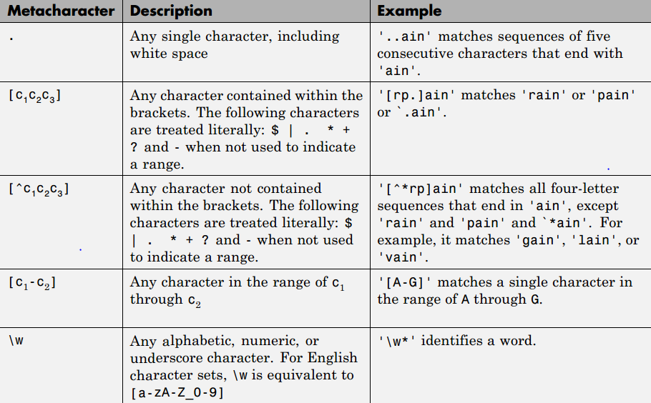
The most commonly used Part of a regular expression
Metacharacters

Slide 9
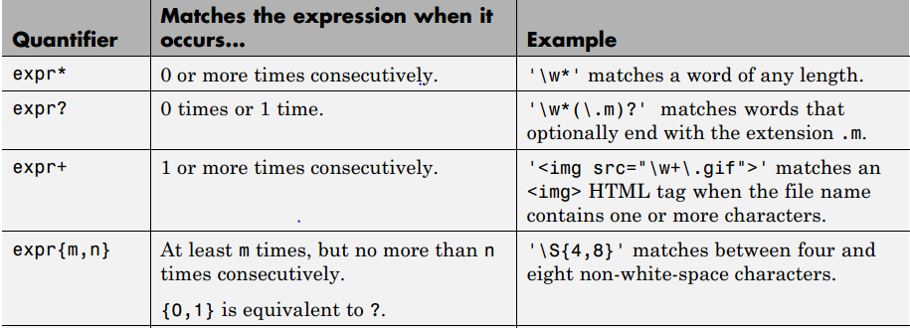
Quantifiers

Slide 10
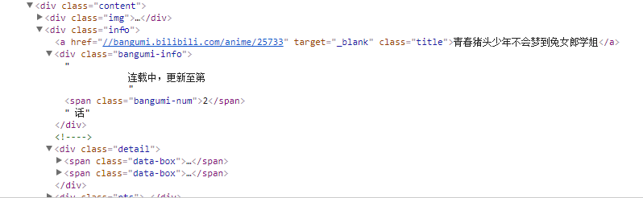
An example of how to use it in a real Web page

Slide 11
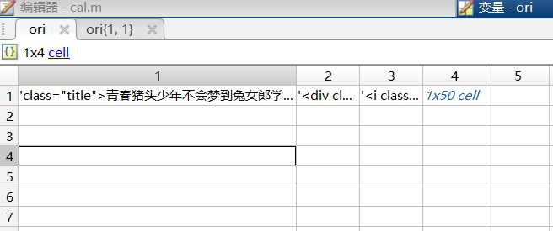
So what do we get when we run the code in a similar example？
We have written such a line of code that leads to the following (note that there is no. + here？).
expr={'class="title">.+</a>';
'<div class="bangumi-info">.+</span>';
'<i class="fav"></i>.+</span>';
'<div>[0-9]+</div>';
};
There's too much to match!

Slide 12
Patterns of regular expressions: positive and negative expressions
Mode
Lazy expression：match as many characters as possible.
exprq
Greedy expression：match as few characters as necessary
exprq？

Slide 13
Now that we've covered the regular expression pattern, let's take a look at an improved piece of code
This leads to the following code (note the. + followed by?, which is a negative expression)
expr={'class="title">.+?</a>';
'<div class="bangumi-info">.+?</span>';
'<i class="fav"></i>.+?</span>';
'<div>[0-9]+</div>';
};
expr1='>.*<‘;
result：
class="title">青春猪头少年不会梦到兔女郎学姐</a>
<div class="bangumi-info">连载中，更新至第
<span class="bangumi-num">2</span>
<i class="fav"></i>128.3万</span>
<div>1735423</div>

Slide 14
Matching function of regular expression:
regexp,regexpi,regexprep
regexp:Match regular expression (case sensitive)
regexpi: Match regular expression (case insensitive)
regexprep: Replace text using regular expression
The difference between them
>>str = 'bat cat can car coat court CUT ct CAT-scan’;
expression = 'c[aeiou]+t’;
replace = 'replace’;
startIndex = regexp(str,expression)
startIndex1 = regexpi(str,expression)
newStr = regexprep(str,expression,replace)
>>startIndex =
5 17
startIndex1 =
5 17 28 35
newStr =
bat replace can car replace court CUT ct CAT-scan

Slide 15
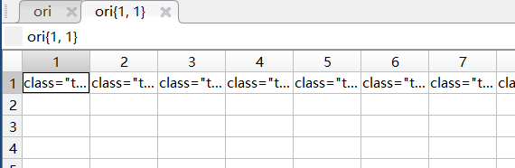
Let's take a look at an example of using a matching function.
To elicit this code
for i=1:4
ori{i}=regexp(aim,expr{i},'match');
end
At this point, you can see the results by looking at the ori1 variable, but not intuitively enough

Slide 16
Data cleaning and saving
Now we have extracted the part that contains the required data, but now the data is not "pure" enough. Because that's what they are now.
class="title">青春猪头少年不会梦到兔女郎学姐</a>
<div class="bangumi-info"> 连载中，更新至第 <span class="bangumi-num">2</span>
<i class="fav"></i>128.3万</span>
<div>1735423</div>
So what should we do ，Continue to use regular expressions, of course!

Slide 17
We can write this code easily from the previous study.
name=regexp(ori{1,1},'>.+?<','match');%番剧名称
gx=regexp(ori{1,2},'>[0-9]+<','match');%更新到第几话
np=regexp(ori{1,3},'i>.+?<','match');%追番人数
hot=regexp(ori{1,4},'>[0-9]+<','match');%热度
class="title">青春猪头少年不会梦到兔女郎学姐</a>
<div class="bangumi-info"> 连载中，更新至第 <span class="bangumi-num">2</span>
<i class="fav"></i>128.3万</span>
<div>1735423</div>
>青春猪头少年不会梦到兔女郎学姐<
>2<
i>128.3万<
>1735423<

Slide 18
Data cleaning and saving
Now that the data is still in memory, we should save it. Save the filename with the current time
now
Current date and time as serial date number
t = now returns the current date and time as a serial date number. A serial date number represents the whole and fractional number of days from a fixed, preset date (January 0, 0000).
But that's not enough, because now returns a number, which isn't intuitive enough for humans, so we can use the datestr function.
Datestr
The datestr function creates a character array that displays one or more points in time. However, the best way to represent points in time is by using the datetime data type.
>> datestr(now)
ans =
14-Oct-2018 15:05:49
At this point we get a nice filename, but on windows you can't include: in the filename, so replace the: with another character with the previously mentioned regexprep function, as shown below
filename = [regexprep(datestr(now),':','_'),'.xlsx'];

Slide 19


Data cleaning and saving
We use the xlswrite function to write the data to the excel file. Let's first take a look at the function prototype
xlswrite(filename,A) writes matrix A to the first worksheet in the Microsoft® Excel® spreadsheet workbook filename starting at cell A1.
xlswrite(filename,A,sheet,xlRange) writes to the specified worksheet and range.

Slide 20
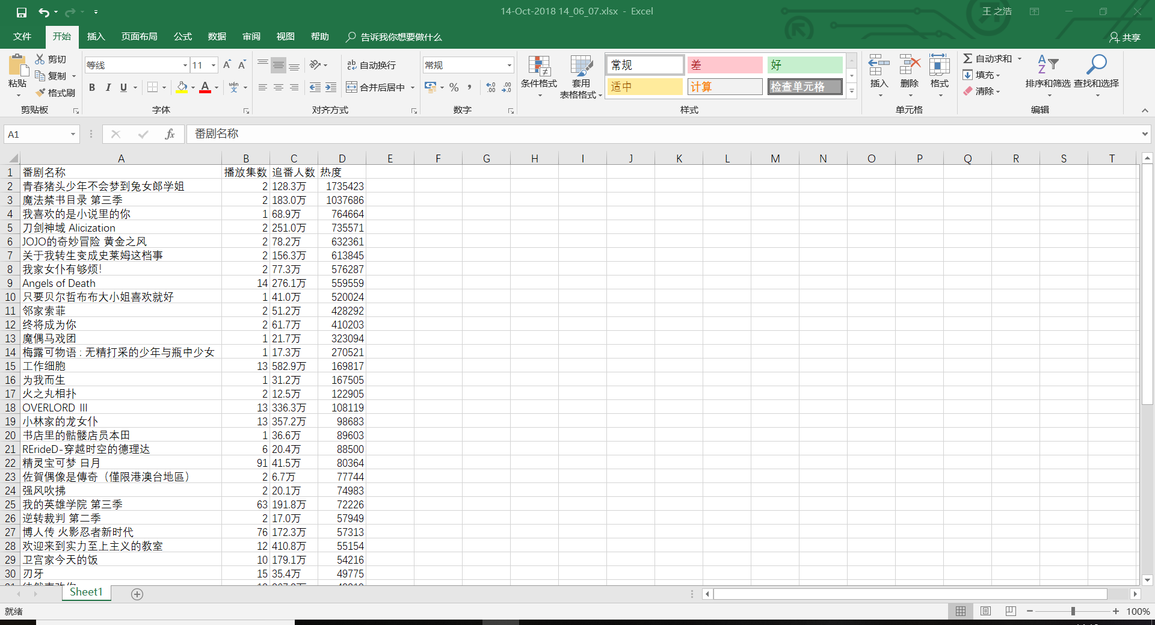

Slide 21
Thank you
If you are interested in this, you can visit this URL below
https://github.com/timelessnaive/matlab_re

