Slide 1
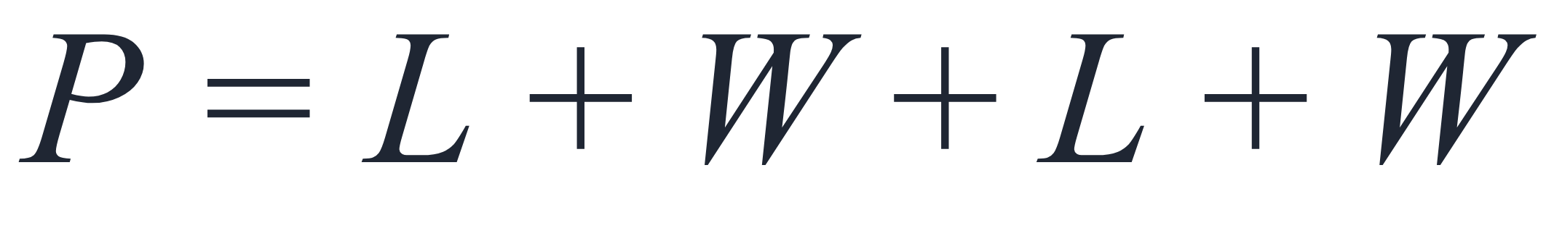
SECTION 1.1 · EXAMPLE 13
Simplifying a Formula
A rectangle with length L and width W has a perimeter P given by P = L + W + L + W. Simplify this expression.
OpenStax College Algebra 2e · CC BY 4.0

Slide 2
SECTION 1.1 · EXAMPLE 13
Simplifying a Formula
A rectangle with length L and width W has a perimeter P given by P = L + W + L + W. Simplify this expression.
OpenStax College Algebra 2e · CC BY 4.0

Slide 3
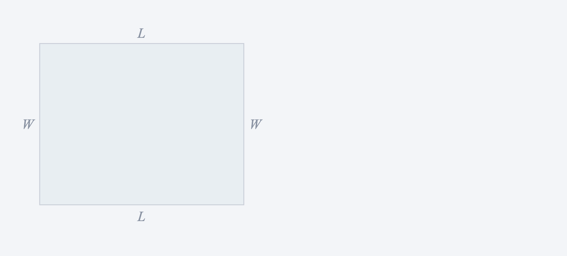
A rectangle with length L and width W has a perimeter P given by P = L + W + L + W. Simplify this expression.

Slide 4
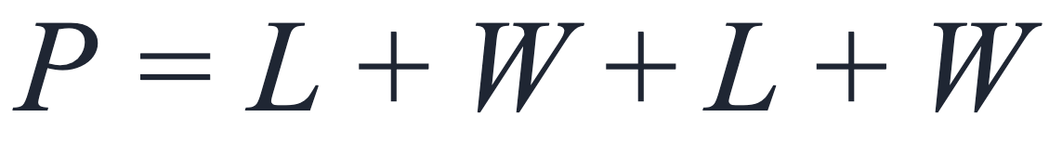
A rectangle with length L and width W has a perimeter P given by P = L + W + L + W. Simplify this expression.

Slide 5
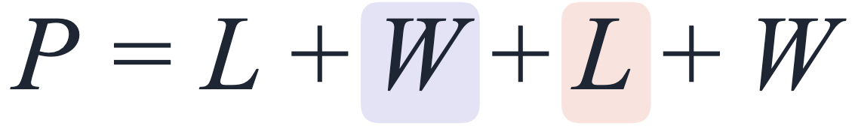
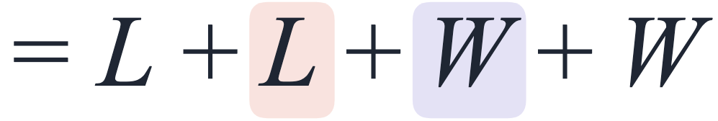
A rectangle with length L and width W has a perimeter P given by P = L + W + L + W. Simplify this expression.
Commutative property of addition.

Slide 6
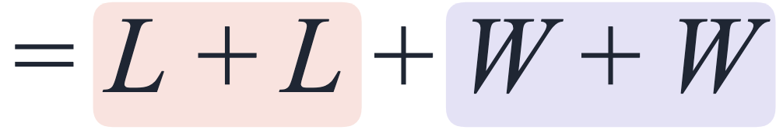
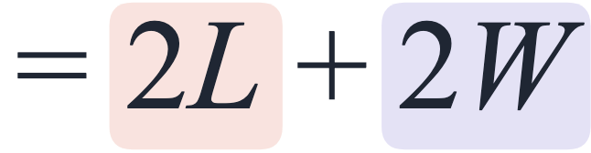
A rectangle with length L and width W has a perimeter P given by P = L + W + L + W. Simplify this expression.
Commutative property of addition.
Simplify.

Slide 7
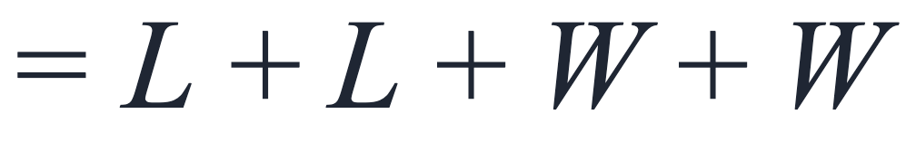
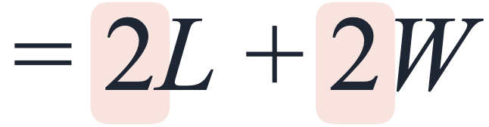
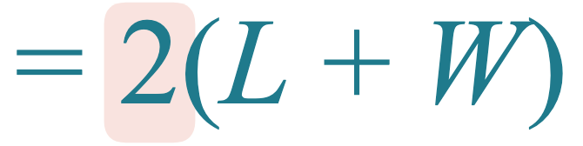
A rectangle with length L and width W has a perimeter P given by P = L + W + L + W. Simplify this expression.
Commutative property of addition.
Simplify.
Distributive property.

