Slide 1
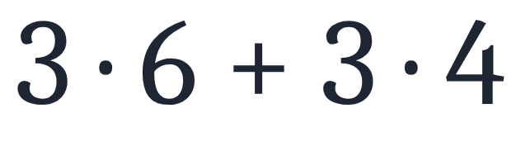
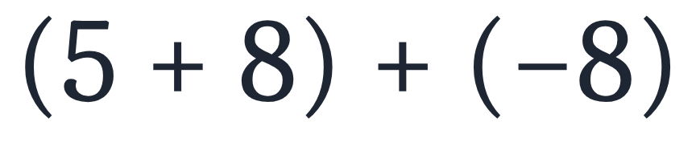
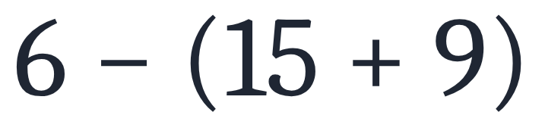
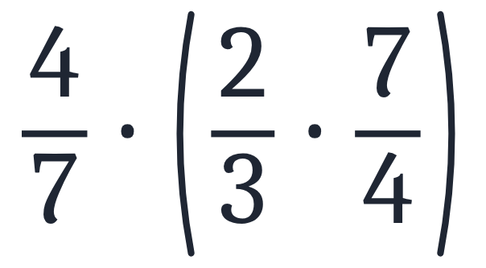
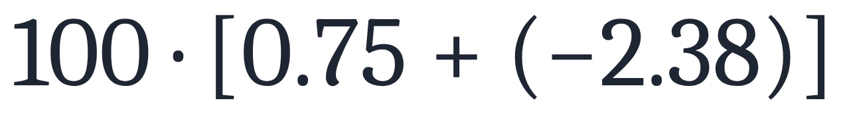
SECTION 1.1 · EXAMPLE 7
Using Properties of Real Numbers
Use the properties of real numbers to rewrite and simplify each expression. State which properties apply.
a
b
c
d
e
OpenStax College Algebra 2e · CC BY 4.0

Slide 2
SECTION 1.1 · EXAMPLE 7
Using Properties of Real Numbers
Use the properties of real numbers to rewrite and simplify each expression. State which properties apply.
a
b
c
d
e
OpenStax College Algebra 2e · CC BY 4.0

Slide 3
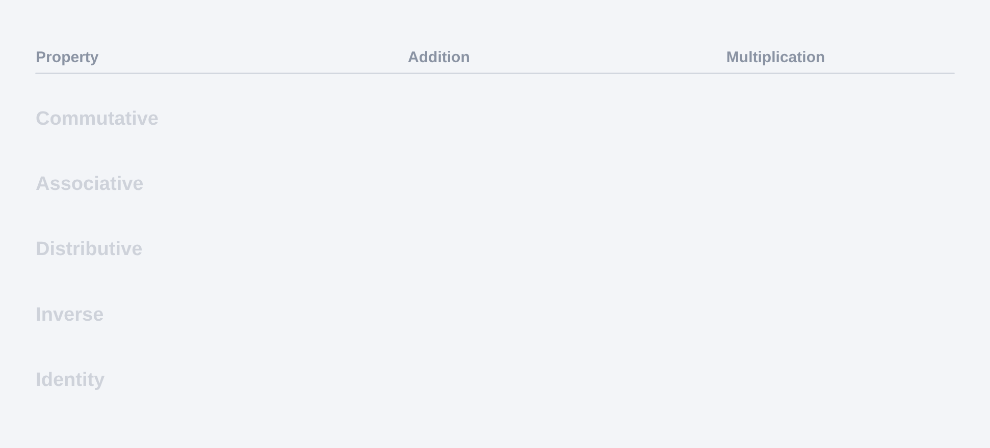
Use the properties of real numbers to rewrite and simplify each expression. State which properties apply.

Slide 4
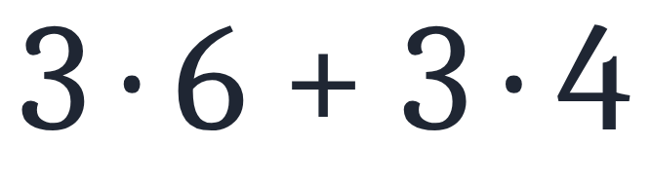
Use the properties of real numbers to rewrite and simplify each expression. State which properties apply.
a

Slide 5
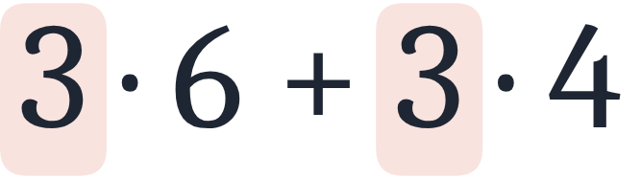
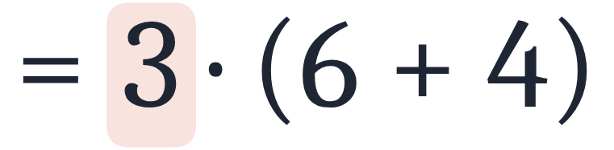
Use the properties of real numbers to rewrite and simplify each expression. State which properties apply.
a
Distributive property.

Slide 6
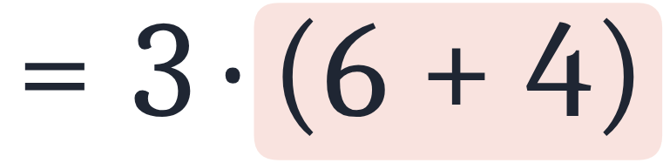
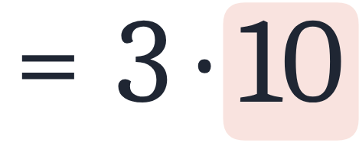
Use the properties of real numbers to rewrite and simplify each expression. State which properties apply.
a
Distributive property.
Simplify.

Slide 7
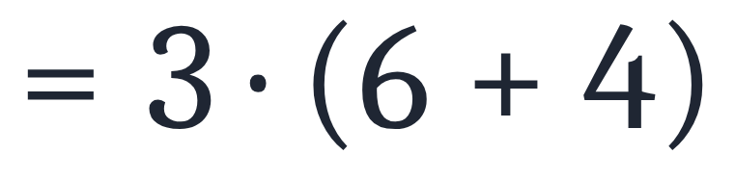
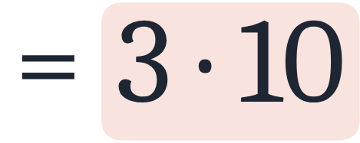
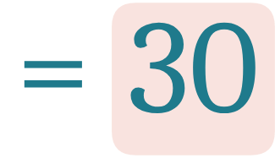
Use the properties of real numbers to rewrite and simplify each expression. State which properties apply.
a
Distributive property.
Simplify.
Simplify.

Slide 8
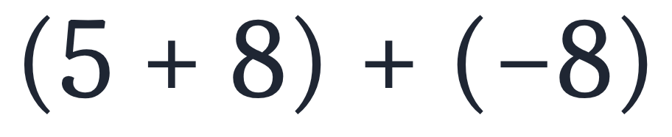
Use the properties of real numbers to rewrite and simplify each expression. State which properties apply.
b

Slide 9
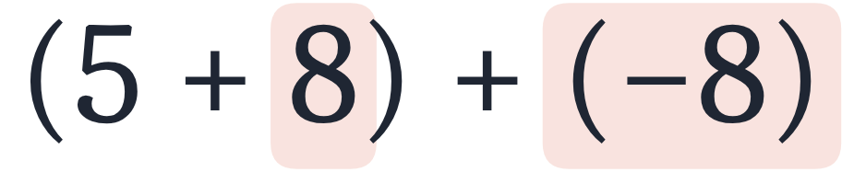
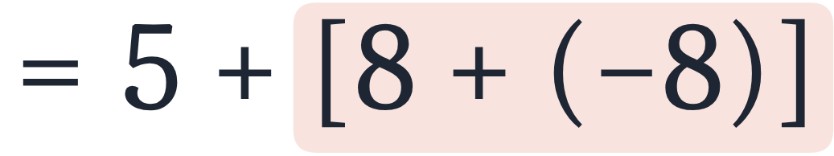
Use the properties of real numbers to rewrite and simplify each expression. State which properties apply.
b
Associative property of addition.

Slide 10
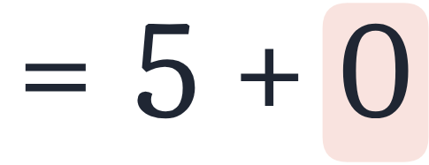
Use the properties of real numbers to rewrite and simplify each expression. State which properties apply.
b
Associative property of addition.
Inverse property of addition.

Slide 11
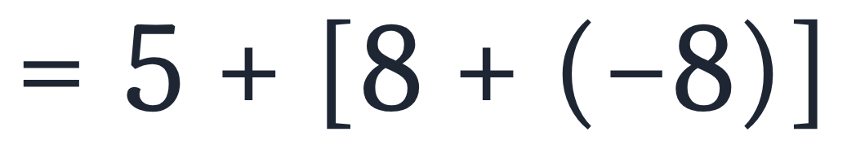
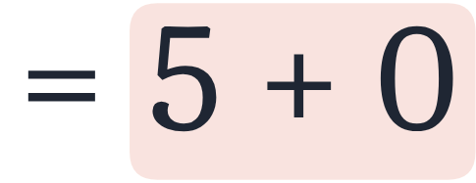
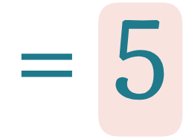
Use the properties of real numbers to rewrite and simplify each expression. State which properties apply.
b
Associative property of addition.
Inverse property of addition.
Identity property of addition.

Slide 12
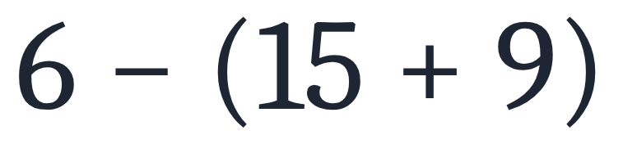
Use the properties of real numbers to rewrite and simplify each expression. State which properties apply.
c

Slide 13
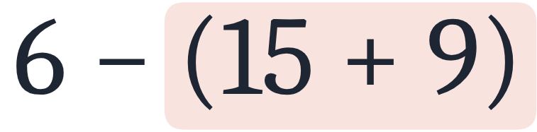
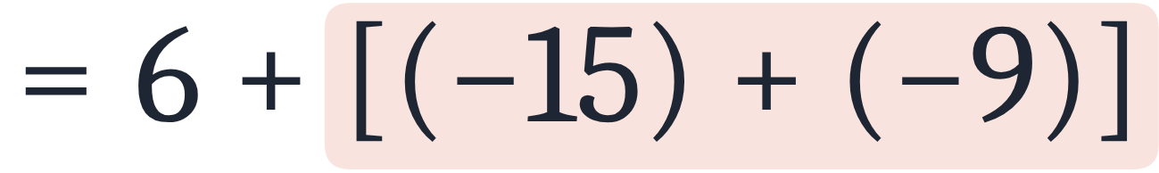
Use the properties of real numbers to rewrite and simplify each expression. State which properties apply.
c
Distributive property.

Slide 14
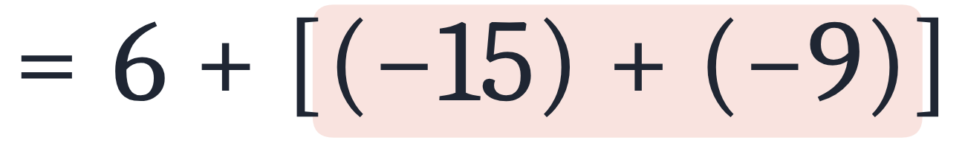
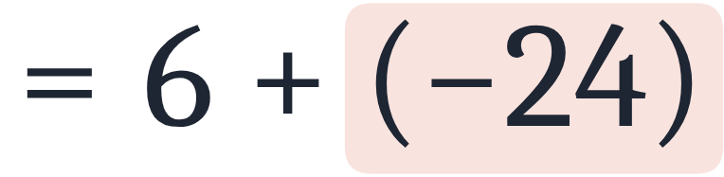
Use the properties of real numbers to rewrite and simplify each expression. State which properties apply.
c
Distributive property.
Simplify.

Slide 15
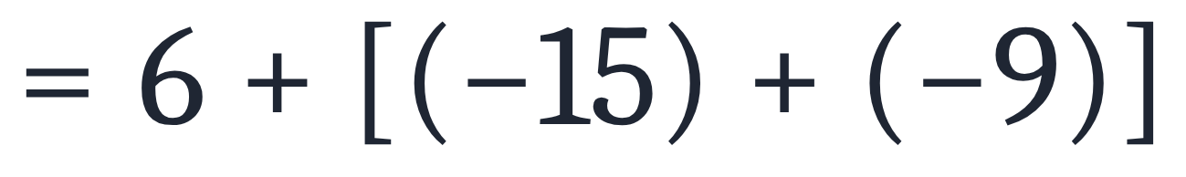
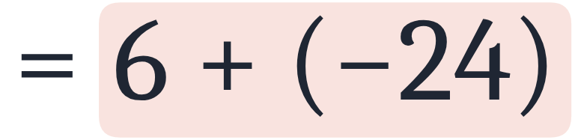
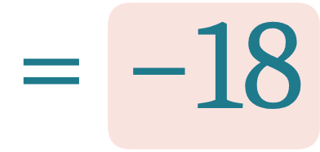
Use the properties of real numbers to rewrite and simplify each expression. State which properties apply.
c
Distributive property.
Simplify.
Simplify.

Slide 16
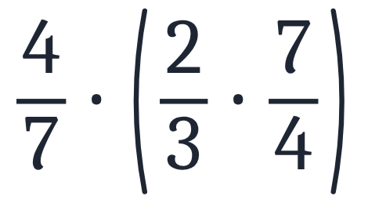
Use the properties of real numbers to rewrite and simplify each expression. State which properties apply.
d

Slide 17
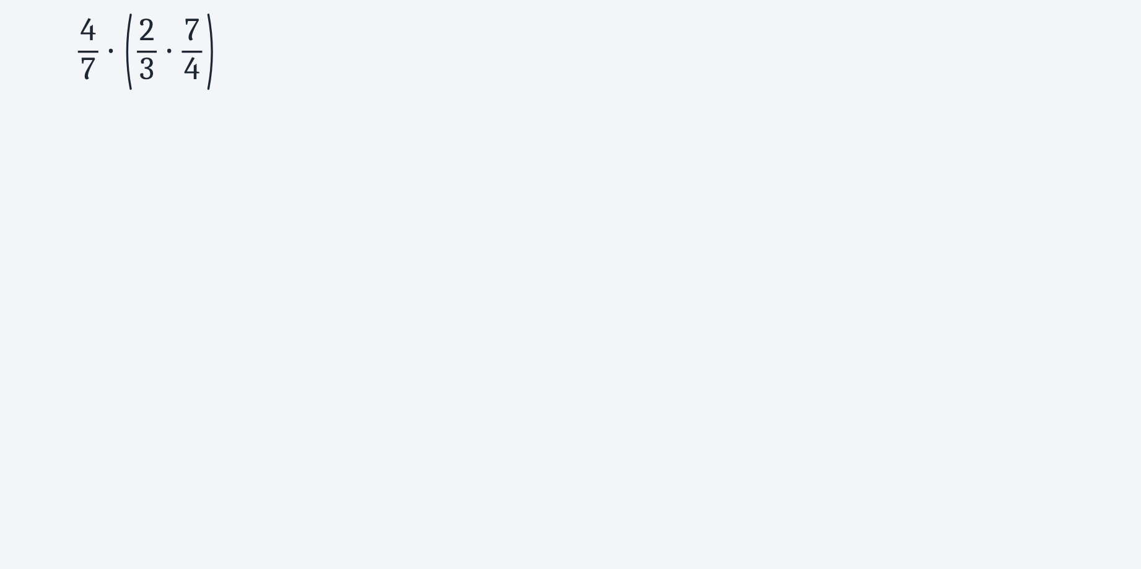
Use the properties of real numbers to rewrite and simplify each expression. State which properties apply.
d

Slide 18
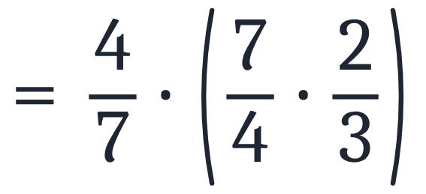
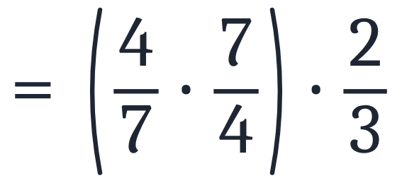
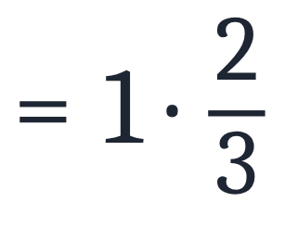
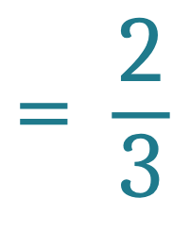
Use the properties of real numbers to rewrite and simplify each expression. State which properties apply.
d
Commutative property of multiplication.
Associative property of multiplication.
Inverse property of multiplication.
Identity property of multiplication.

Slide 19
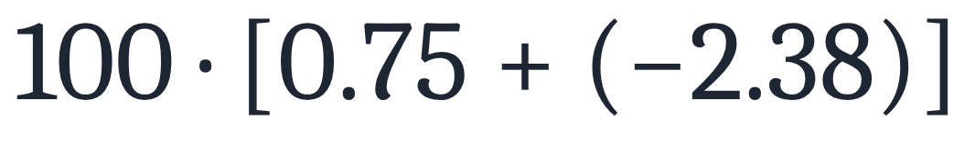
Use the properties of real numbers to rewrite and simplify each expression. State which properties apply.
e

Slide 20
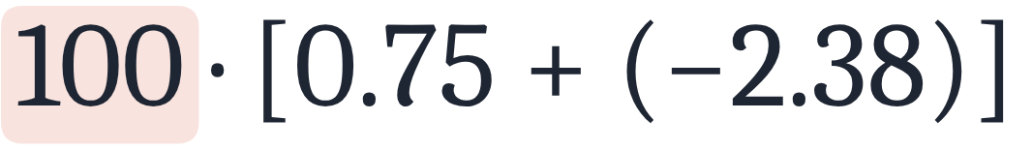
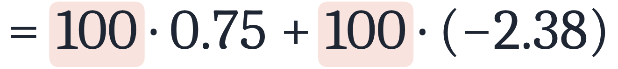
Use the properties of real numbers to rewrite and simplify each expression. State which properties apply.
e
Distributive property.

Slide 21
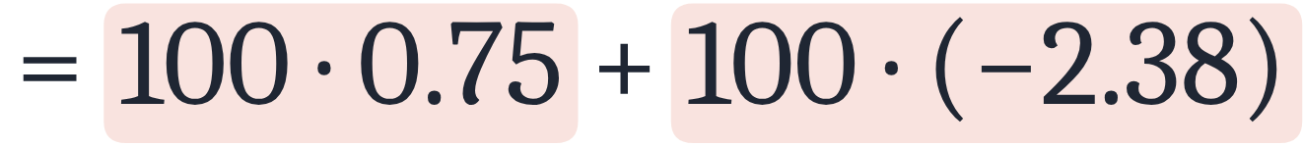
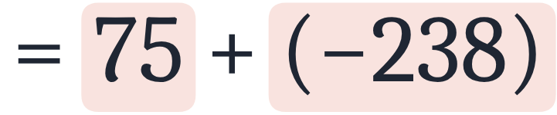
Use the properties of real numbers to rewrite and simplify each expression. State which properties apply.
e
Distributive property.
Simplify.

Slide 22
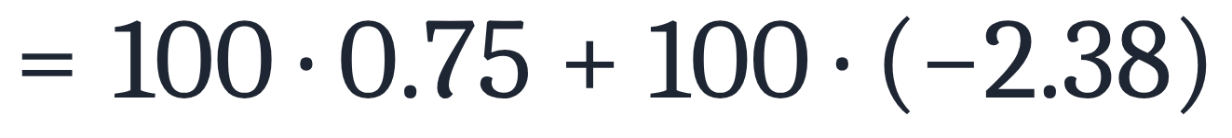
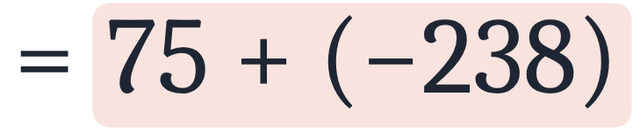
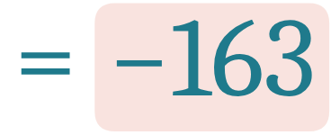
Use the properties of real numbers to rewrite and simplify each expression. State which properties apply.
e
Distributive property.
Simplify.
Simplify.

Slide 23
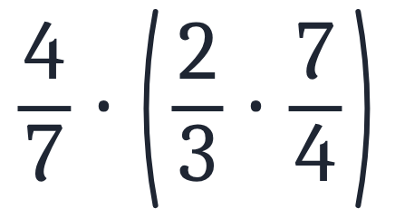
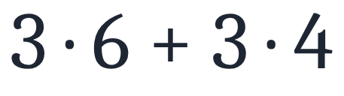
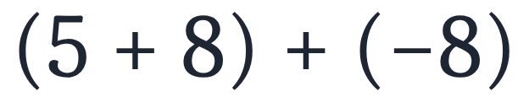
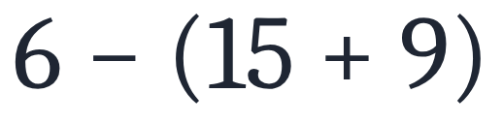
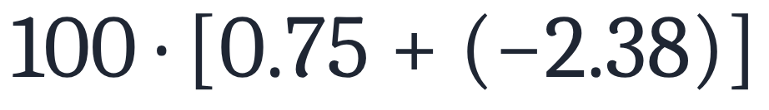



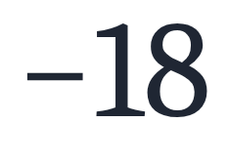
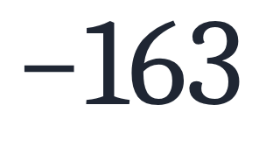
Using Properties of Real Numbers
Use the properties of real numbers to rewrite and simplify each expression. State which properties apply.
a
b
c
d
e
Answers
a
b
c
d
e

