Slide 1


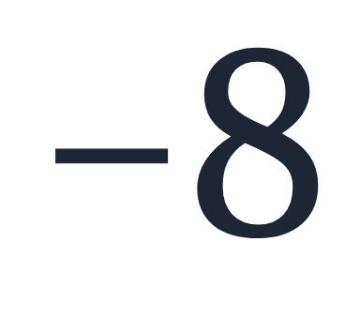
SECTION 1.1 · EXAMPLE 1
Writing Integers as Rational Numbers
Write each of the following as a rational number.
a
b
c
OpenStax College Algebra 2e · CC BY 4.0

Slide 2
SECTION 1.1 · EXAMPLE 1
Writing Integers as Rational Numbers
Write each of the following as a rational number.
a
b
c
integer
A rational number
=
integer, not 0
OpenStax College Algebra 2e · CC BY 4.0

Slide 3
SECTION 1.1 · EXAMPLE 1
Writing Integers as Rational Numbers
Write each of the following as a rational number.
a
b
c
integer
A rational number
=
integer, not 0
OpenStax College Algebra 2e · CC BY 4.0

Slide 4
Write each of the following as a rational number.
Write a fraction with the integer in the numerator and 1 in the denominator.

Slide 5

Write each of the following as a rational number.

Slide 6

Write each of the following as a rational number.
a

Slide 7
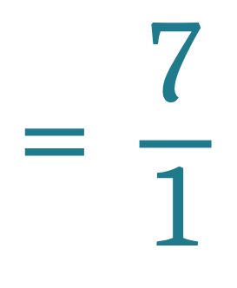
Write each of the following as a rational number.
a

Slide 8

Write each of the following as a rational number.
b

Slide 9
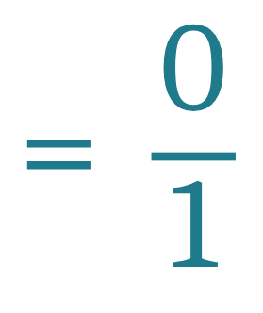
Write each of the following as a rational number.
b

Slide 10
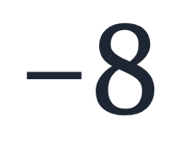
Write each of the following as a rational number.
c

Slide 11
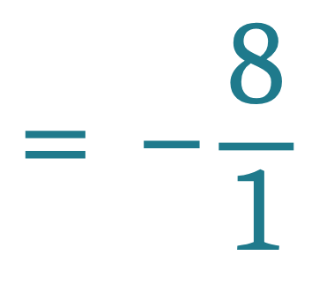
Write each of the following as a rational number.
c

Slide 12



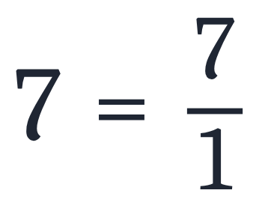
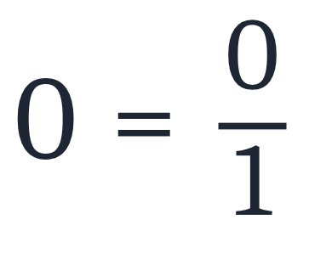
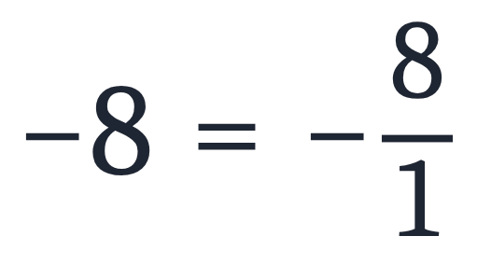
Writing Integers as Rational Numbers
Write each of the following as a rational number.
a
b
c
Answers
a
b
c
Every integer is a rational number: write it over 1.

