Slide 1

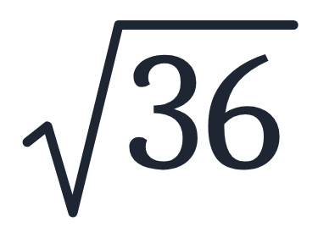
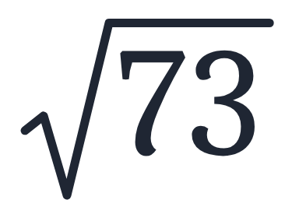
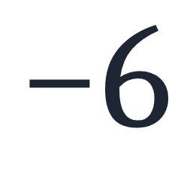
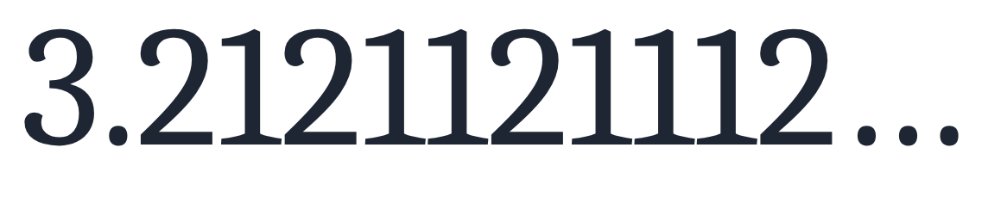
SECTION 1.1 · EXAMPLE 5
Differentiating the Sets of Numbers
Classify each number as being a natural number (N), whole number (W), integer (I), rational number (Q), and/or irrational number (Q′).
a
b
c
d
e
OpenStax College Algebra 2e · CC BY 4.0

Slide 2
SECTION 1.1 · EXAMPLE 5
Differentiating the Sets of Numbers
Classify each number as being a natural number (N), whole number (W), integer (I), rational number (Q), and/or irrational number (Q′).
a
b
c
d
e
OpenStax College Algebra 2e · CC BY 4.0

Slide 3

Classify each number as being a natural number (N), whole number (W), integer (I), rational number (Q), and/or irrational number (Q′).

Slide 4
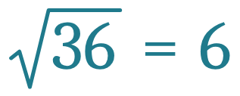
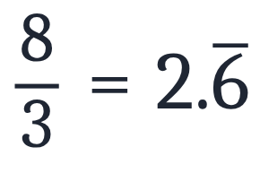
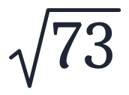
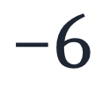

Classify each number as being a natural number (N), whole number (W), integer (I), rational number (Q), and/or irrational number (Q′).
a
Number
N
W
I
Q
Q′
✕
✕
✕
✕

Slide 5
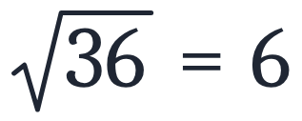
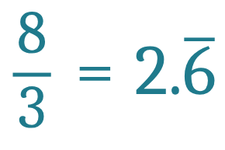
Classify each number as being a natural number (N), whole number (W), integer (I), rational number (Q), and/or irrational number (Q′).
b
Number
N
W
I
Q
Q′
✕
✕
✕
✕
✕

Slide 6
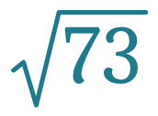
Classify each number as being a natural number (N), whole number (W), integer (I), rational number (Q), and/or irrational number (Q′).
c
Number
N
W
I
Q
Q′
✕
✕
✕
✕
✕
✕

Slide 7

Classify each number as being a natural number (N), whole number (W), integer (I), rational number (Q), and/or irrational number (Q′).
d
Number
N
W
I
Q
Q′
✕
✕
✕
✕
✕
✕
✕
✕

Slide 8

Classify each number as being a natural number (N), whole number (W), integer (I), rational number (Q), and/or irrational number (Q′).
e
Number
N
W
I
Q
Q′
✕
✕
✕
✕
✕
✕
✕
✕
✕

Slide 9
Classify each number as being a natural number (N), whole number (W), integer (I), rational number (Q), and/or irrational number (Q′).

Slide 10
Classify each number as being a natural number (N), whole number (W), integer (I), rational number (Q), and/or irrational number (Q′).
Number
N
W
I
Q
Q′
✕
✕
✕
✕
✕
✕
✕
✕
✕

