Slide 1
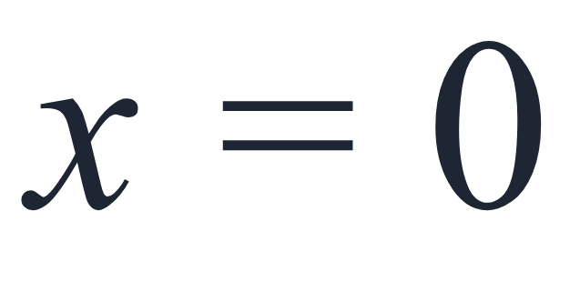
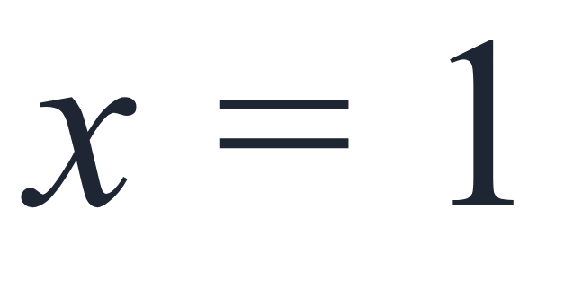
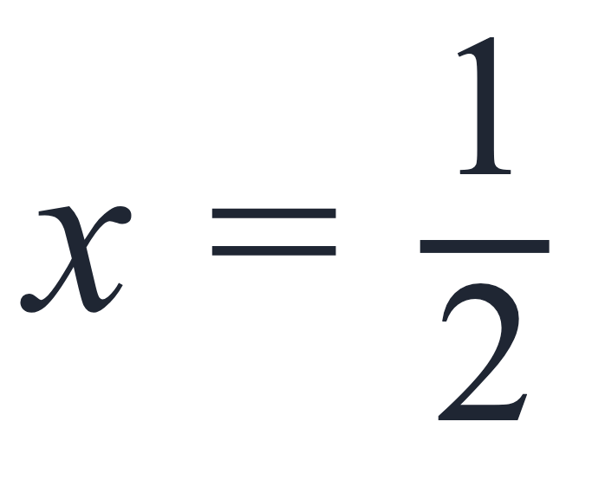
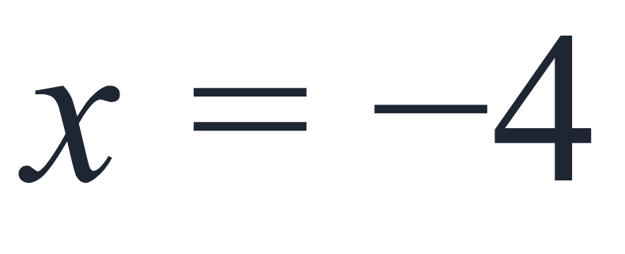
SECTION 1.1 · EXAMPLE 9
Evaluating an Algebraic Expression at Different Values
Evaluate the expression 2x − 7 for each value for x.
a
b
c
d
OpenStax College Algebra 2e · CC BY 4.0

Slide 2
SECTION 1.1 · EXAMPLE 9
Evaluating an Algebraic Expression at Different Values
Evaluate the expression 2x − 7 for each value for x.
a
b
c
d
OpenStax College Algebra 2e · CC BY 4.0

Slide 3
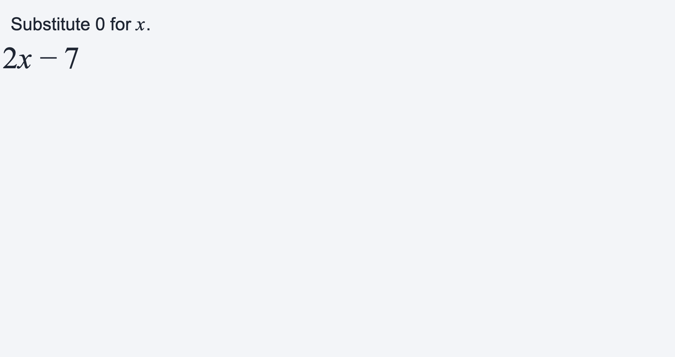
Evaluate the expression 2x − 7 for each value for x.
a

Slide 4
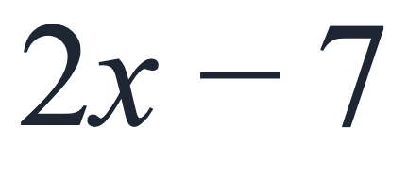
Evaluate the expression 2x − 7 for each value for x.
b
Substitute 1 for x.

Slide 5
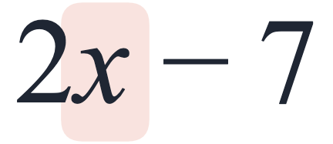
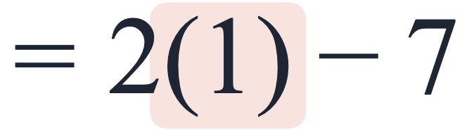
Evaluate the expression 2x − 7 for each value for x.
b
Substitute 1 for x.

Slide 6
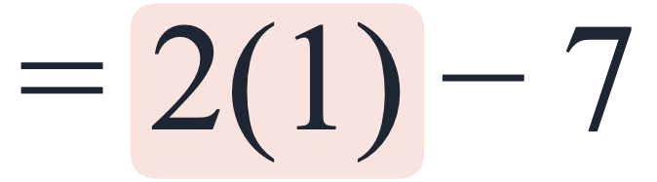
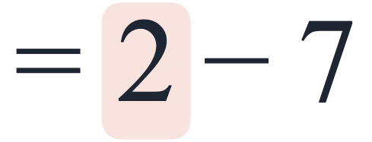
Evaluate the expression 2x − 7 for each value for x.
b
Substitute 1 for x.

Slide 7
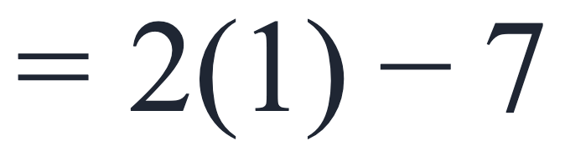
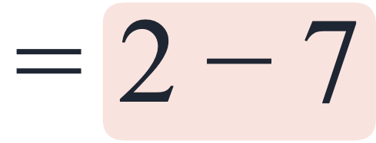
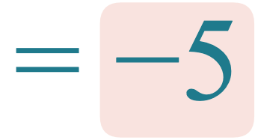
Evaluate the expression 2x − 7 for each value for x.
b
Substitute 1 for x.

Slide 8
Evaluate the expression 2x − 7 for each value for x.
c
Substitute ½ for x.

Slide 9
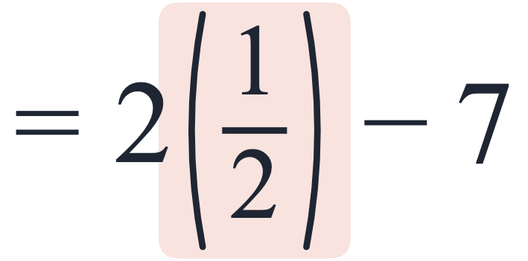
Evaluate the expression 2x − 7 for each value for x.
c
Substitute ½ for x.

Slide 10
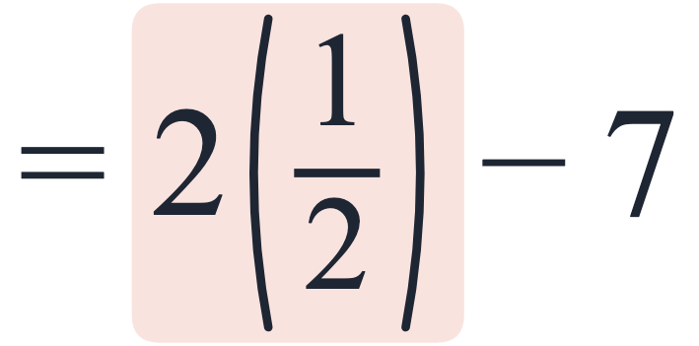
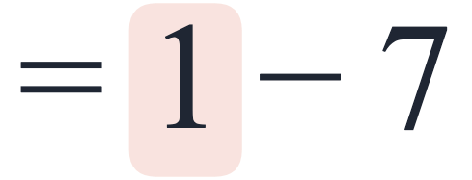
Evaluate the expression 2x − 7 for each value for x.
c
Substitute ½ for x.

Slide 11
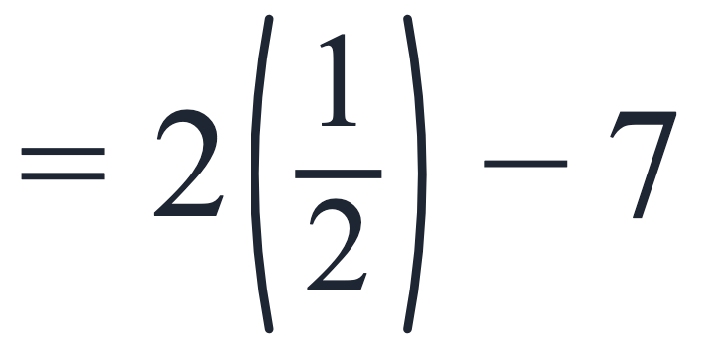
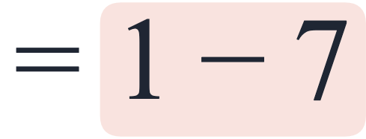
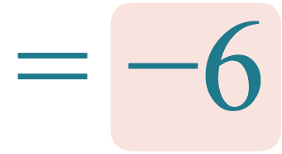
Evaluate the expression 2x − 7 for each value for x.
c
Substitute ½ for x.

Slide 12
Evaluate the expression 2x − 7 for each value for x.
d
Substitute −4 for x.

Slide 13
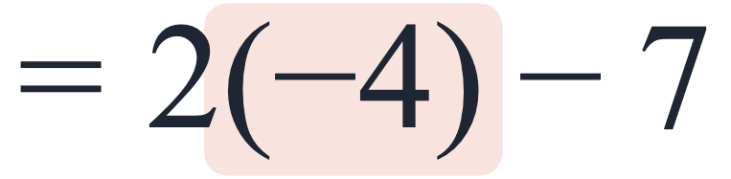
Evaluate the expression 2x − 7 for each value for x.
d
Substitute −4 for x.

Slide 14
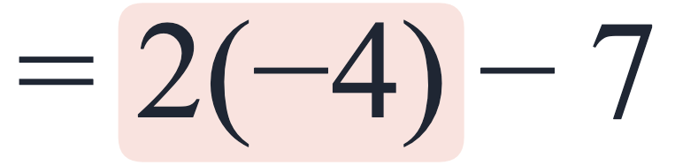
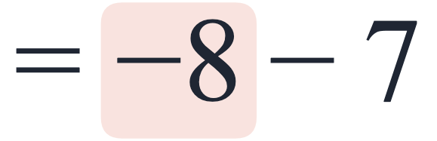
Evaluate the expression 2x − 7 for each value for x.
d
Substitute −4 for x.

Slide 15
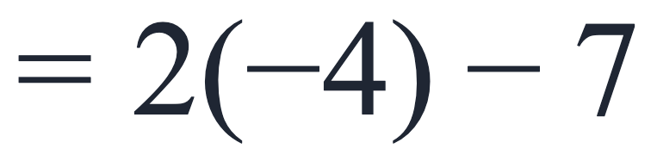
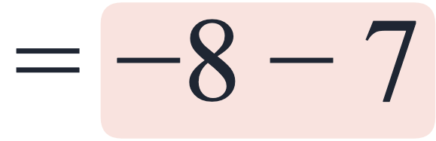
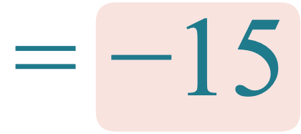
Evaluate the expression 2x − 7 for each value for x.
d
Substitute −4 for x.

Slide 16
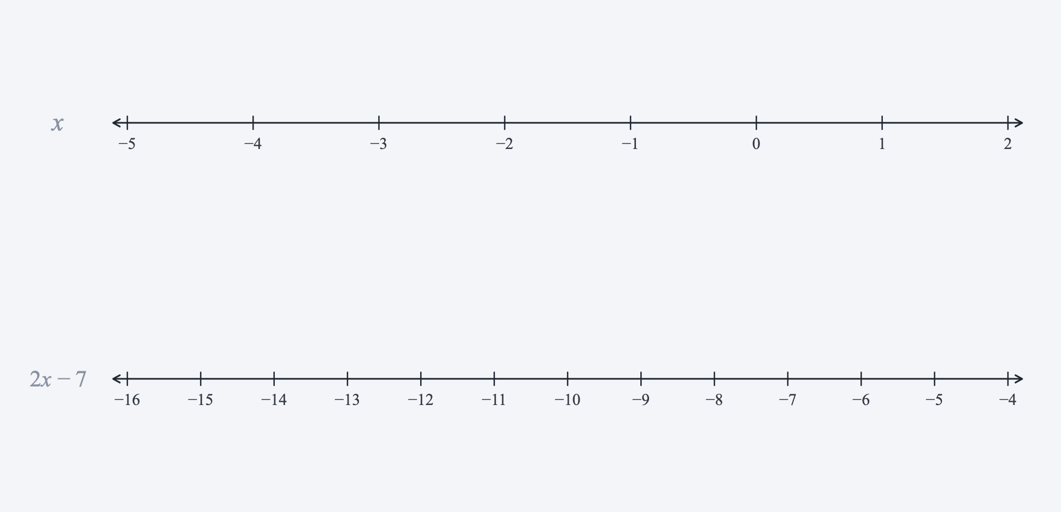
Evaluate the expression 2x − 7 for each value for x.

Slide 17
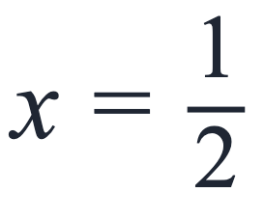
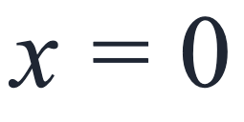
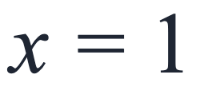

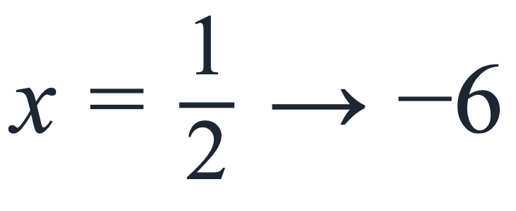
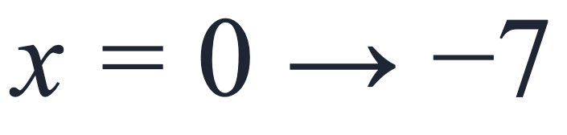
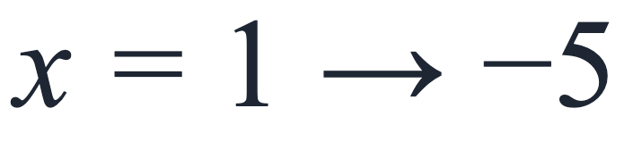
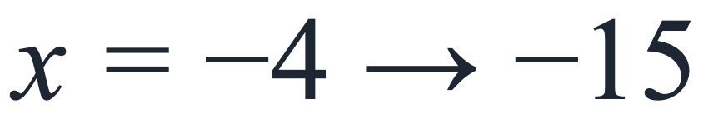
Evaluating an Algebraic Expression at Different Values
Evaluate the expression 2x − 7 for each value for x.
a
b
c
d
Answers
a
c
b
d

