Slide 1
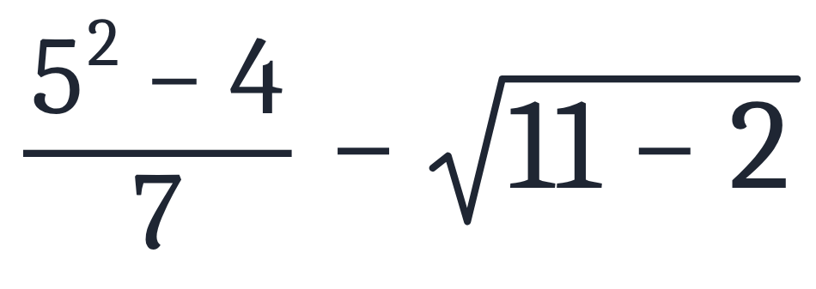
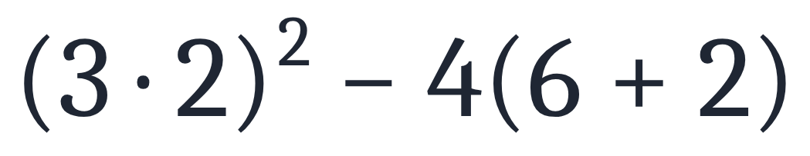
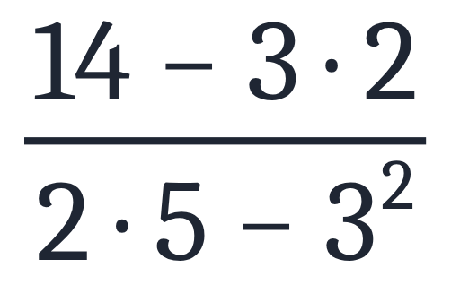
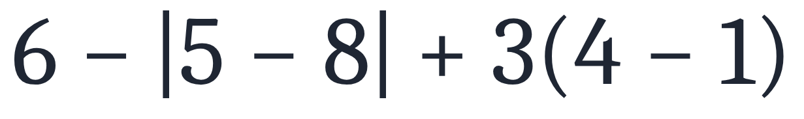
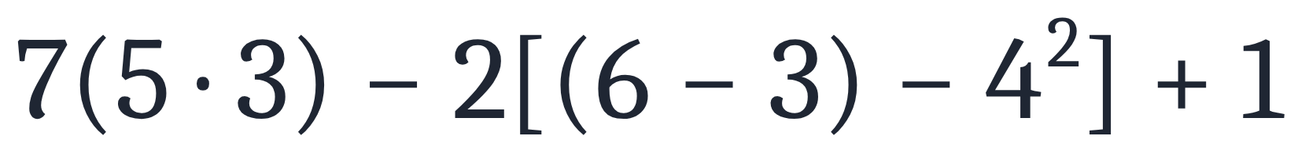
SECTION 1.1 · EXAMPLE 6
Using the Order of Operations
Use the order of operations to evaluate each of the following expressions.
a
b
c
d
e
OpenStax College Algebra 2e · CC BY 4.0

Slide 2
SECTION 1.1 · EXAMPLE 6
Using the Order of Operations
Use the order of operations to evaluate each of the following expressions.
a
b
c
d
e
OpenStax College Algebra 2e · CC BY 4.0

Slide 3
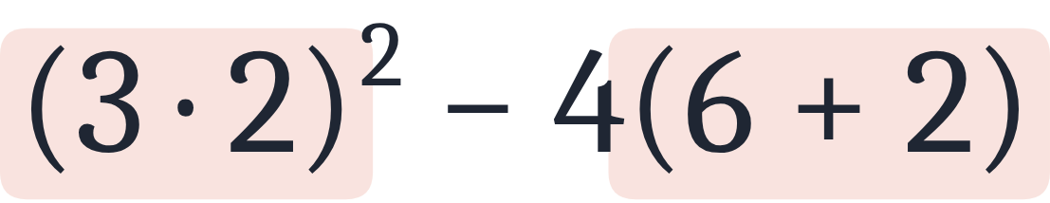
Use the order of operations to evaluate each of the following expressions.
a

Slide 4
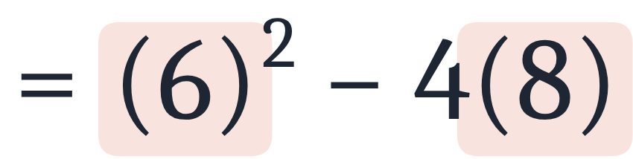
Use the order of operations to evaluate each of the following expressions.
a
Simplify parentheses.

Slide 5
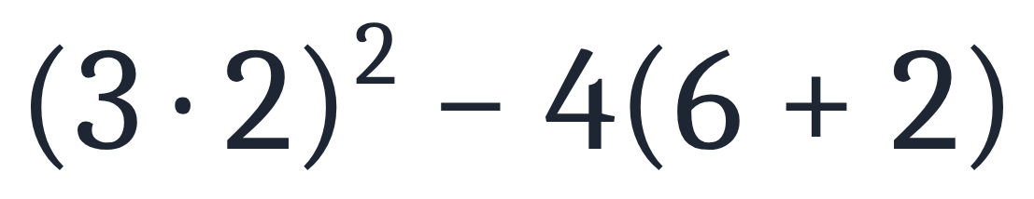
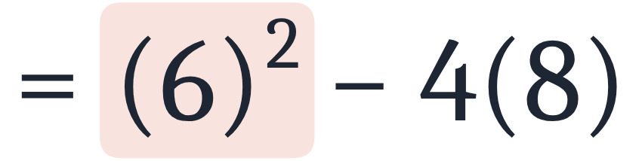
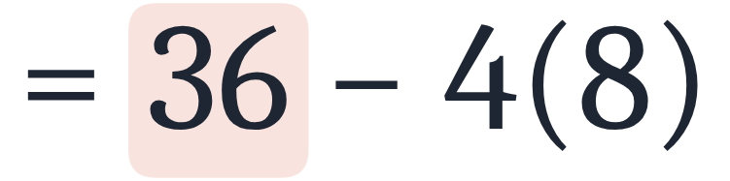
Use the order of operations to evaluate each of the following expressions.
a
Simplify parentheses.
Simplify exponent.

Slide 6
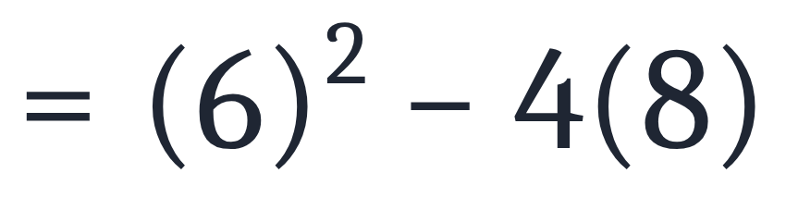
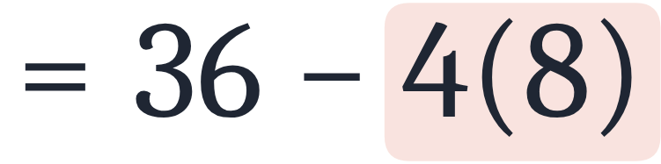
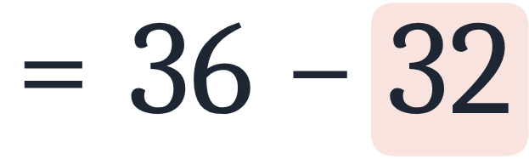
Use the order of operations to evaluate each of the following expressions.
a
Simplify parentheses.
Simplify exponent.
Simplify multiplication.

Slide 7
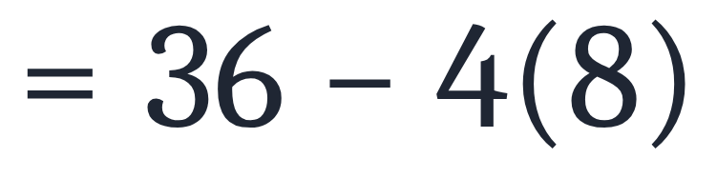
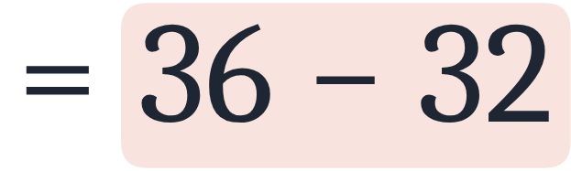
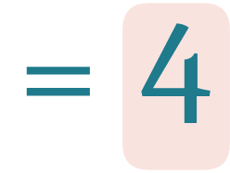
Use the order of operations to evaluate each of the following expressions.
a
Simplify parentheses.
Simplify exponent.
Simplify multiplication.
Simplify subtraction.

Slide 8
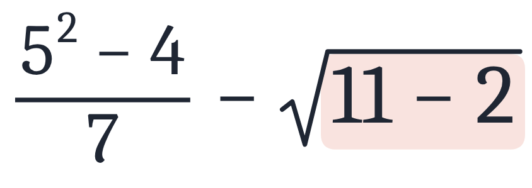
Use the order of operations to evaluate each of the following expressions.
b

Slide 9
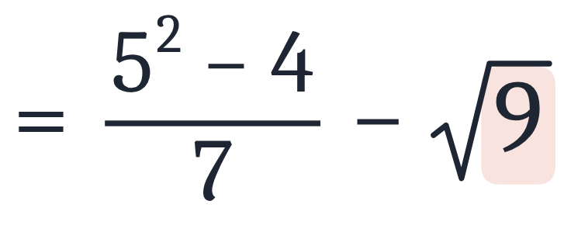
Use the order of operations to evaluate each of the following expressions.
b
Simplify grouping symbols (radical).

Slide 10
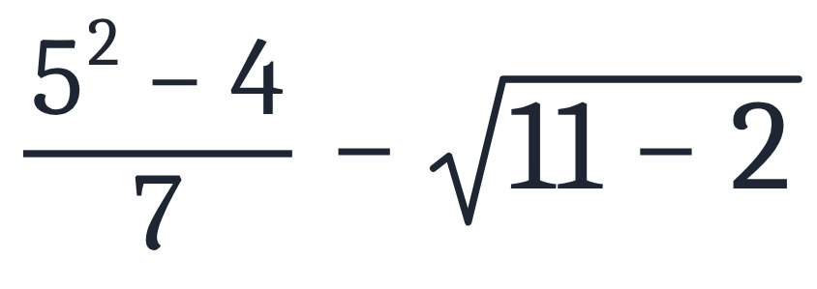
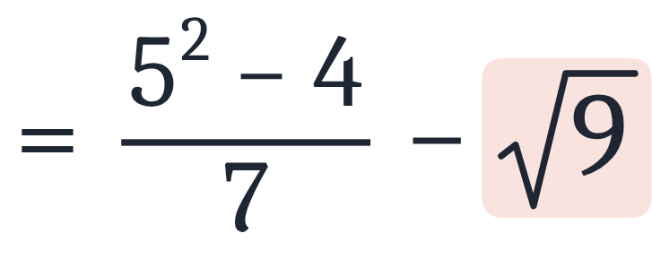
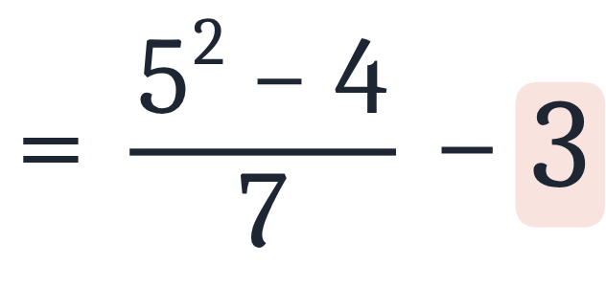
Use the order of operations to evaluate each of the following expressions.
b
Simplify grouping symbols (radical).
Simplify radical.

Slide 11
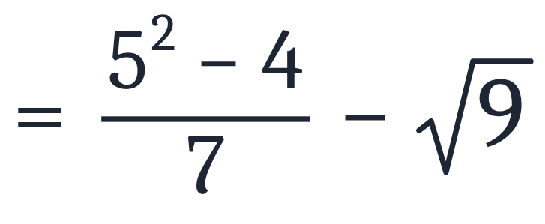
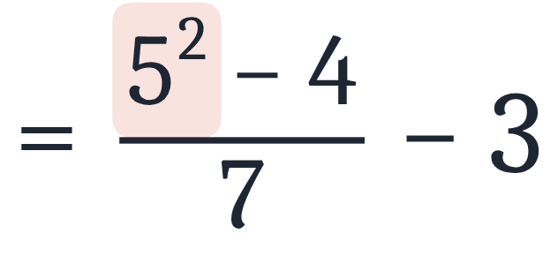
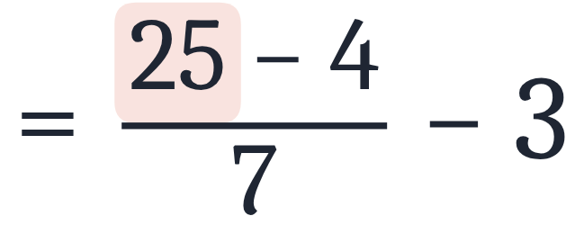
Use the order of operations to evaluate each of the following expressions.
b
Simplify grouping symbols (radical).
Simplify radical.
Simplify exponent.

Slide 12
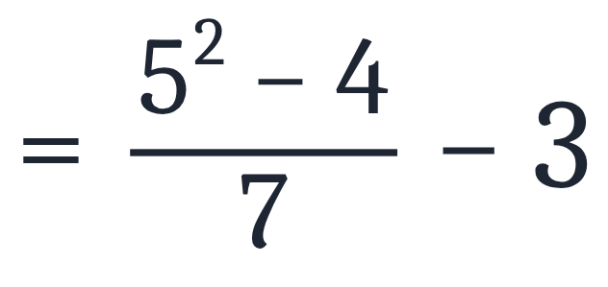
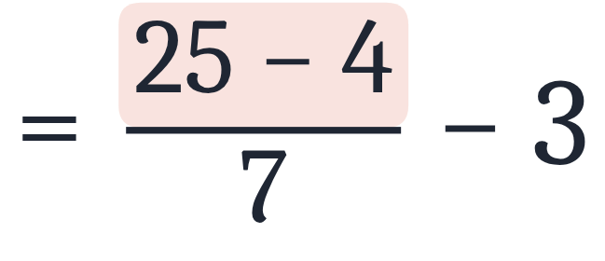
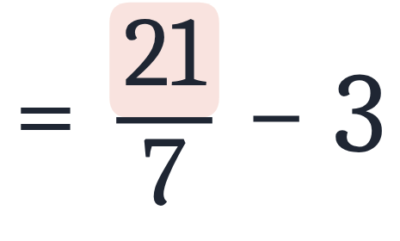
Use the order of operations to evaluate each of the following expressions.
b
Simplify grouping symbols (radical).
Simplify radical.
Simplify exponent.
Simplify subtraction in numerator.

Slide 13
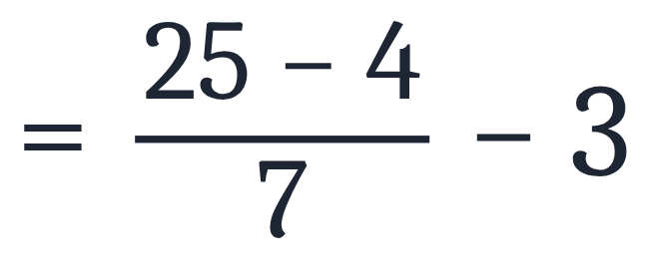
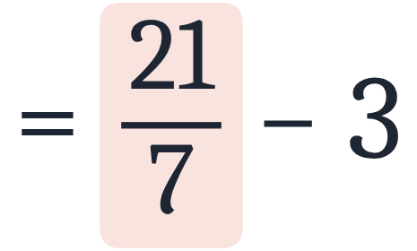
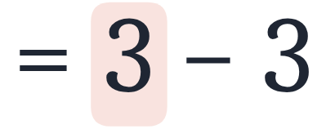
Use the order of operations to evaluate each of the following expressions.
b
Simplify grouping symbols (radical).
Simplify radical.
Simplify exponent.
Simplify subtraction in numerator.
Simplify division.

Slide 14
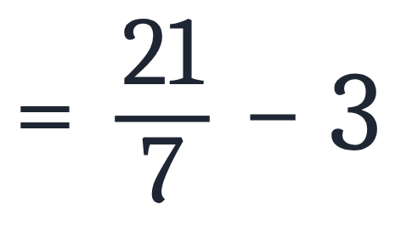
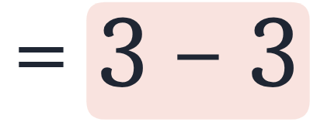
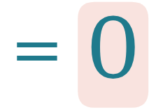
Use the order of operations to evaluate each of the following expressions.
b
Simplify grouping symbols (radical).
Simplify radical.
Simplify exponent.
Simplify subtraction in numerator.
Simplify division.
Simplify subtraction.

Slide 15
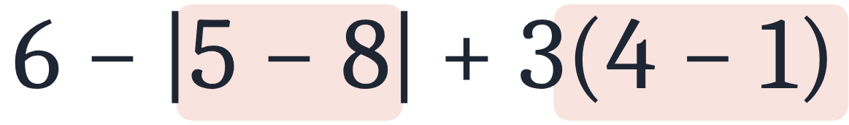
Use the order of operations to evaluate each of the following expressions.
c

Slide 16
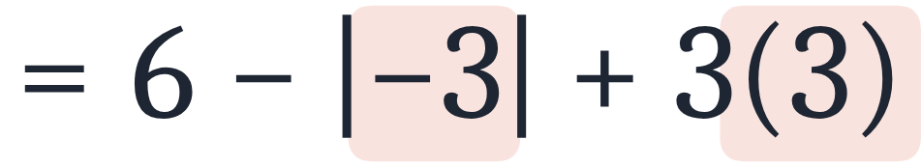
Use the order of operations to evaluate each of the following expressions.
c
Simplify inside grouping symbols.

Slide 17
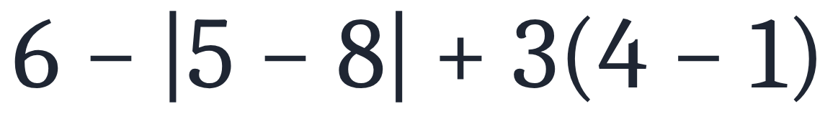
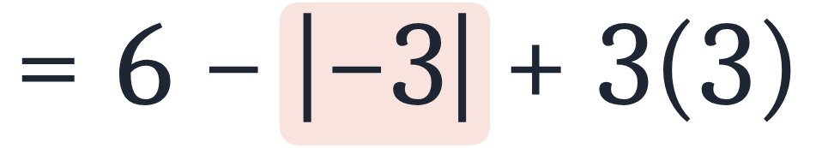
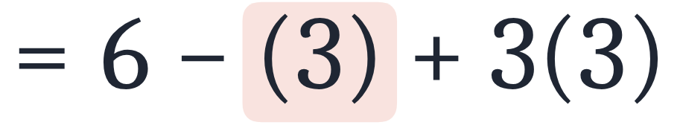
Use the order of operations to evaluate each of the following expressions.
c
Simplify inside grouping symbols.
Simplify absolute value.

Slide 18
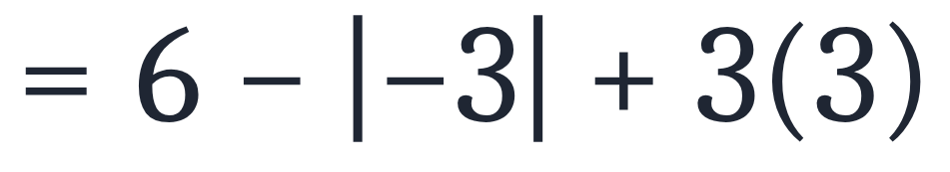
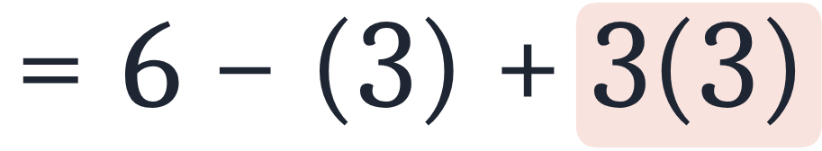
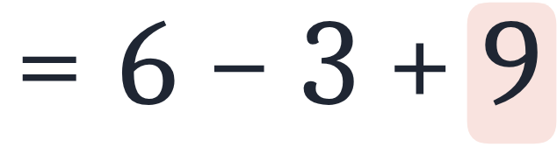
Use the order of operations to evaluate each of the following expressions.
c
Simplify inside grouping symbols.
Simplify absolute value.
Simplify multiplication.

Slide 19
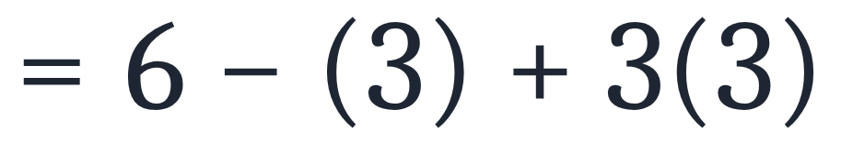
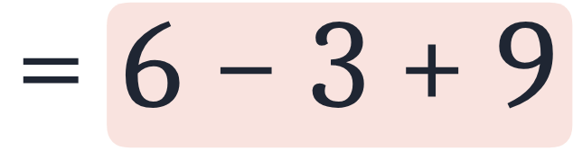
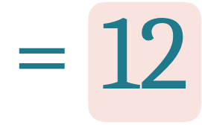
Use the order of operations to evaluate each of the following expressions.
c
Simplify inside grouping symbols.
Simplify absolute value.
Simplify multiplication.
Simplify addition.

Slide 20
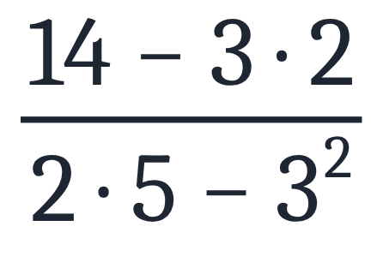
Use the order of operations to evaluate each of the following expressions.
d

Slide 21
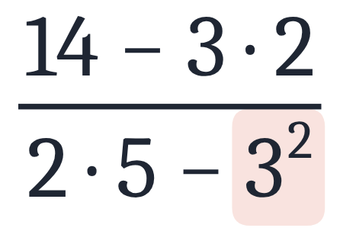
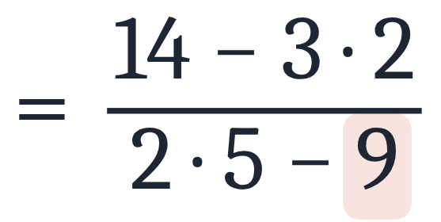
Use the order of operations to evaluate each of the following expressions.
d
Simplify exponent.

Slide 22
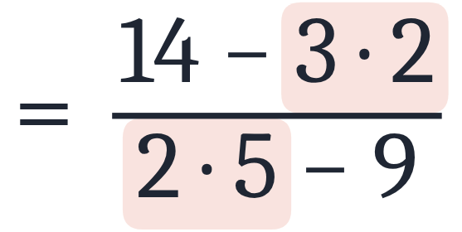
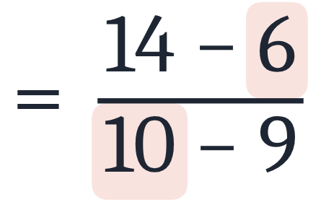
Use the order of operations to evaluate each of the following expressions.
d
Simplify exponent.
Simplify products.

Slide 23
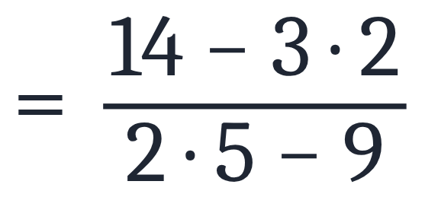


Use the order of operations to evaluate each of the following expressions.
d
Simplify exponent.
Simplify products.
Simplify differences.

Slide 24



Use the order of operations to evaluate each of the following expressions.
d
Simplify exponent.
Simplify products.
Simplify differences.
Simplify quotient.

Slide 25

Use the order of operations to evaluate each of the following expressions.
e

Slide 26

Use the order of operations to evaluate each of the following expressions.
e

Slide 27






Use the order of operations to evaluate each of the following expressions.
e
Simplify inside parentheses.
Simplify exponent.
Subtract.
Multiply.
Add.

Slide 28









Using the Order of Operations
Use the order of operations to evaluate each of the following expressions.
a
b
c
d
e
Answers
a
b
c
d
e

