Slide 1
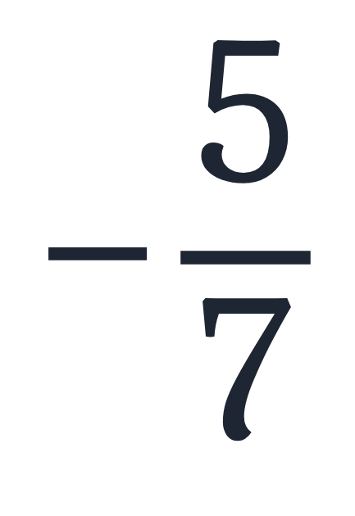

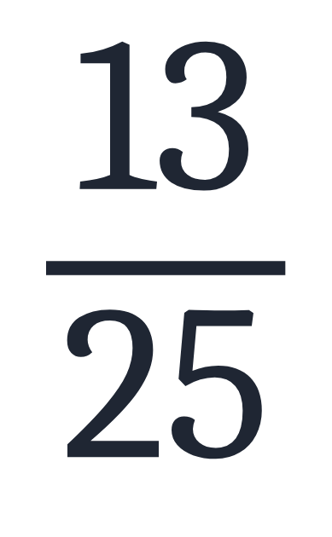
SECTION 1.1 · EXAMPLE 2
Identifying Rational Numbers
Write each of the following rational numbers as either a terminating or repeating decimal.
a
b
c
OpenStax College Algebra 2e · CC BY 4.0

Slide 2
SECTION 1.1 · EXAMPLE 2
Identifying Rational Numbers
Write each of the following rational numbers as either a terminating or repeating decimal.
a
b
c
OpenStax College Algebra 2e · CC BY 4.0

Slide 3
Write each of the following rational numbers as either a terminating or repeating decimal.
Write each fraction as a decimal by dividing the numerator by the denominator.

Slide 4

Write each of the following rational numbers as either a terminating or repeating decimal.
a

Slide 5
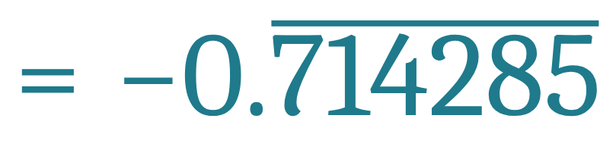
Write each of the following rational numbers as either a terminating or repeating decimal.
a
a repeating decimal

Slide 6

Write each of the following rational numbers as either a terminating or repeating decimal.
a

Slide 7

Write each of the following rational numbers as either a terminating or repeating decimal.
b

Slide 8
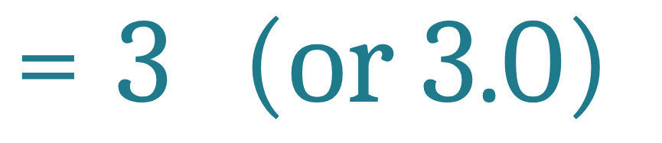
Write each of the following rational numbers as either a terminating or repeating decimal.
b
a terminating decimal

Slide 9
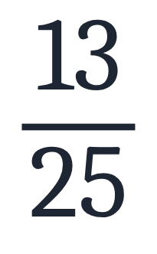
Write each of the following rational numbers as either a terminating or repeating decimal.
c

Slide 10
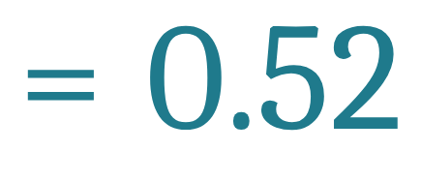
Write each of the following rational numbers as either a terminating or repeating decimal.
c
a terminating decimal

Slide 11
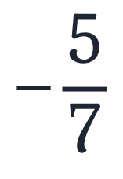

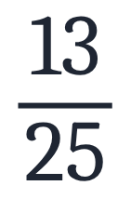
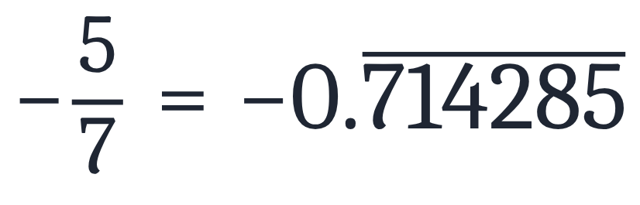
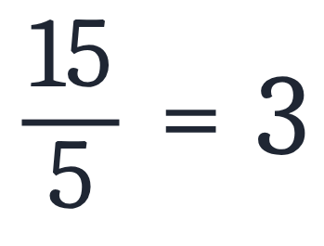
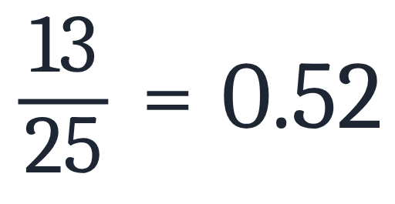
Identifying Rational Numbers
Write each of the following rational numbers as either a terminating or repeating decimal.
a
b
c
Answers
a
repeating
b
terminating
c
terminating

