Slide 1
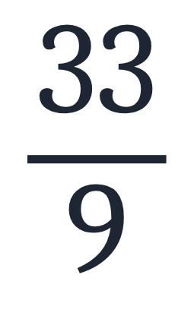
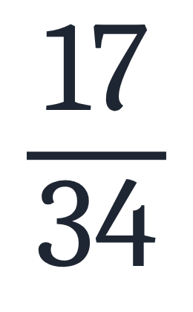
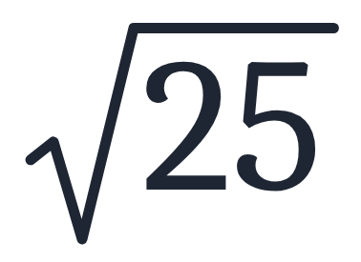
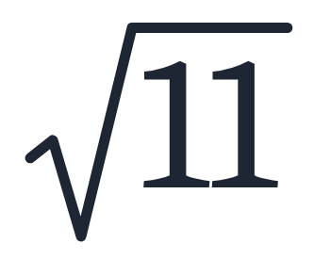
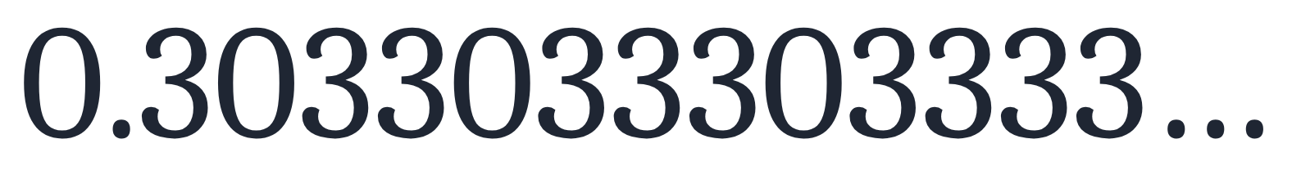
SECTION 1.1 · EXAMPLE 3
Differentiating Rational and Irrational Numbers
Determine whether each of the following numbers is rational or irrational. If it is rational, determine whether it is a terminating or repeating decimal.
a
b
c
d
e
OpenStax College Algebra 2e · CC BY 4.0

Slide 2
SECTION 1.1 · EXAMPLE 3
Differentiating Rational and Irrational Numbers
Determine whether each of the following numbers is rational or irrational. If it is rational, determine whether it is a terminating or repeating decimal.
a
b
c
d
e
OpenStax College Algebra 2e · CC BY 4.0

Slide 3
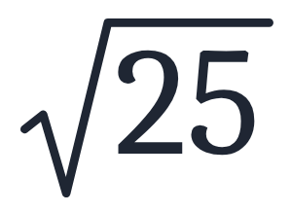
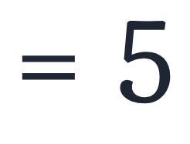
Determine whether each of the following numbers is rational or irrational. If it is rational, determine whether it is a terminating or repeating decimal.
a
Simplify.

Slide 4
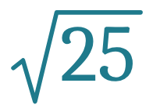
Determine whether each of the following numbers is rational or irrational. If it is rational, determine whether it is a terminating or repeating decimal.
a
Simplify.
Therefore,
is rational.

Slide 5
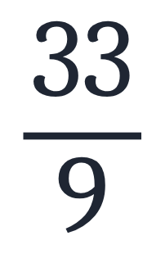
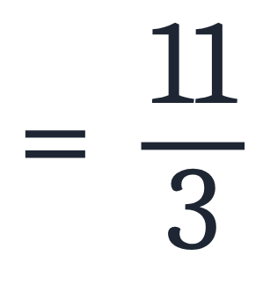
Determine whether each of the following numbers is rational or irrational. If it is rational, determine whether it is a terminating or repeating decimal.
b
Simplify.

Slide 6
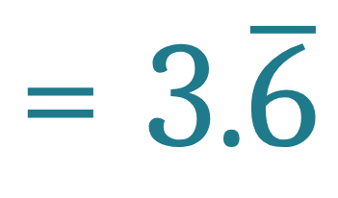
Determine whether each of the following numbers is rational or irrational. If it is rational, determine whether it is a terminating or repeating decimal.
b
Simplify.
Divide.

Slide 7
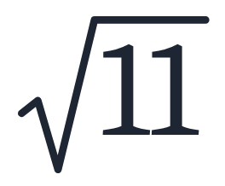
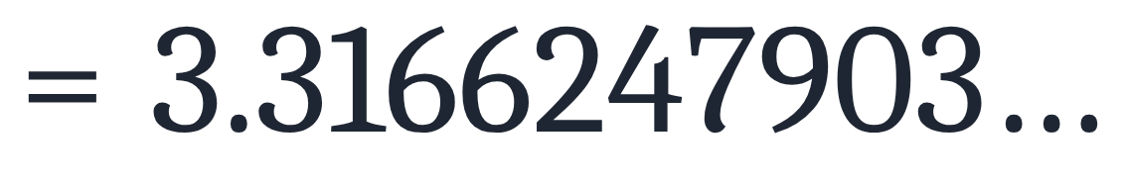
Determine whether each of the following numbers is rational or irrational. If it is rational, determine whether it is a terminating or repeating decimal.
c
never ends, never repeats

Slide 8
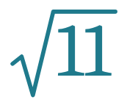
Determine whether each of the following numbers is rational or irrational. If it is rational, determine whether it is a terminating or repeating decimal.
c
never ends, never repeats
11 is not a perfect square, so
cannot be expressed as a fraction: it is
irrational.

Slide 9

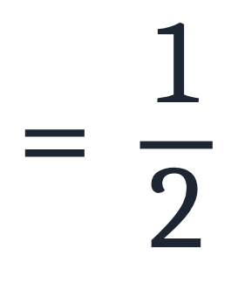
Determine whether each of the following numbers is rational or irrational. If it is rational, determine whether it is a terminating or repeating decimal.
d
Simplify.

Slide 10
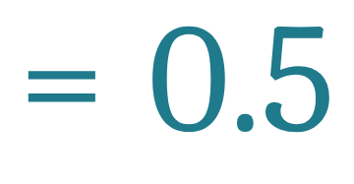
Determine whether each of the following numbers is rational or irrational. If it is rational, determine whether it is a terminating or repeating decimal.
d
Simplify.
Divide.

Slide 11
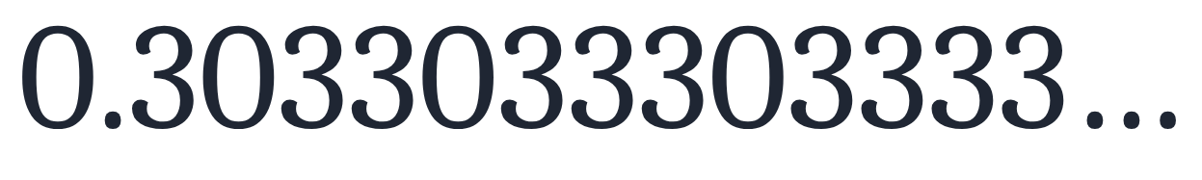

Determine whether each of the following numbers is rational or irrational. If it is rational, determine whether it is a terminating or repeating decimal.
e

Slide 12

Determine whether each of the following numbers is rational or irrational. If it is rational, determine whether it is a terminating or repeating decimal.
e

Slide 13


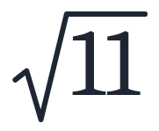
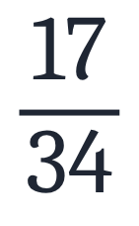
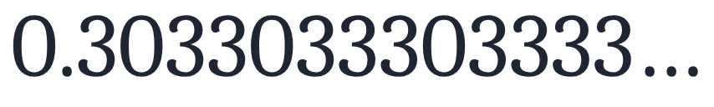
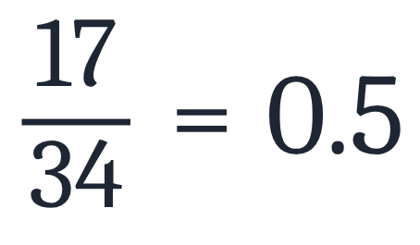
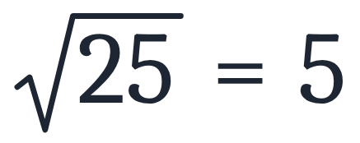
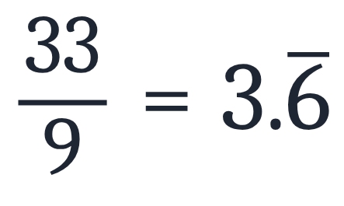
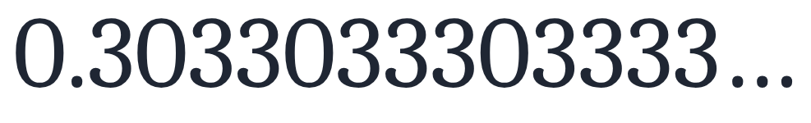
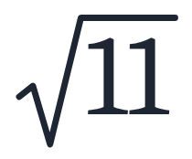
Differentiating Rational and Irrational Numbers
Determine whether each of the following numbers is rational or irrational. If it is rational, determine whether it is a terminating or repeating decimal.
a
b
c
d
e
Answers
a
rational
d
rational, terminating
b
rational, repeating
e
irrational
c
irrational

