Slide 1
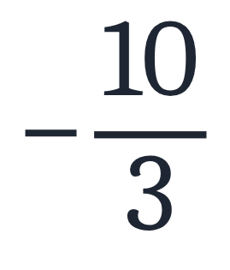
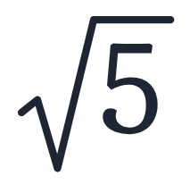
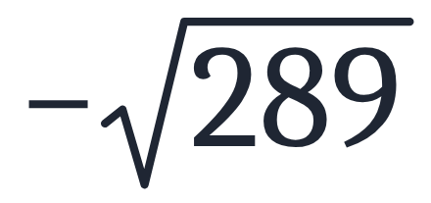
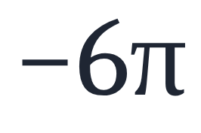
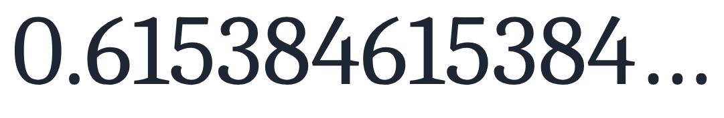
SECTION 1.1 · EXAMPLE 4
Classifying Real Numbers
Classify each number as either positive or negative and as either rational or irrational. Does the number lie to the left or the right of 0 on the number line?
a
b
c
d
e
OpenStax College Algebra 2e · CC BY 4.0

Slide 2
SECTION 1.1 · EXAMPLE 4
Classifying Real Numbers
Classify each number as either positive or negative and as either rational or irrational. Does the number lie to the left or the right of 0 on the number line?
a
b
c
d
e
OpenStax College Algebra 2e · CC BY 4.0

Slide 3
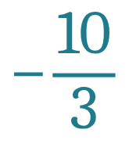

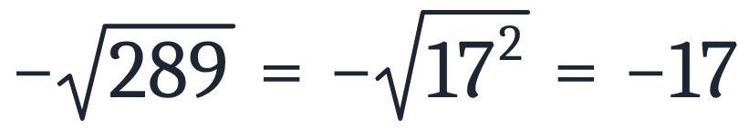
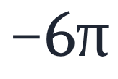
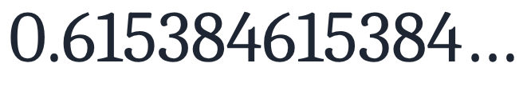
Classify each number as either positive or negative and as either rational or irrational. Does the number lie to the left or the right of 0 on the number line?
a
Number
Positive or negative
Rational or irrational
Side of 0
negative
rational
left

Slide 4
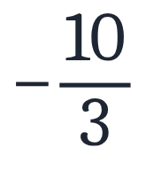

Classify each number as either positive or negative and as either rational or irrational. Does the number lie to the left or the right of 0 on the number line?
b
Number
Positive or negative
Rational or irrational
Side of 0
negative
rational
left
positive
irrational
right

Slide 5

Classify each number as either positive or negative and as either rational or irrational. Does the number lie to the left or the right of 0 on the number line?
c
Number
Positive or negative
Rational or irrational
Side of 0
negative
rational
left
positive
irrational
right
negative
rational
left

Slide 6
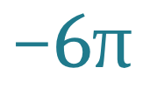
Classify each number as either positive or negative and as either rational or irrational. Does the number lie to the left or the right of 0 on the number line?
d
Number
Positive or negative
Rational or irrational
Side of 0
negative
rational
left
positive
irrational
right
negative
rational
left
negative
irrational
left

Slide 7

Classify each number as either positive or negative and as either rational or irrational. Does the number lie to the left or the right of 0 on the number line?
e
Number
Positive or negative
Rational or irrational
Side of 0
negative
rational
left
positive
irrational
right
negative
rational
left
negative
irrational
left
positive
rational
right

Slide 8

Classify each number as either positive or negative and as either rational or irrational. Does the number lie to the left or the right of 0 on the number line?

Slide 9
Classify each number as either positive or negative and as either rational or irrational. Does the number lie to the left or the right of 0 on the number line?
Number
Positive or negative
Rational or irrational
Side of 0
negative
rational
left
positive
irrational
right
negative
rational
left
negative
irrational
left
positive
rational
right

