Slide 1
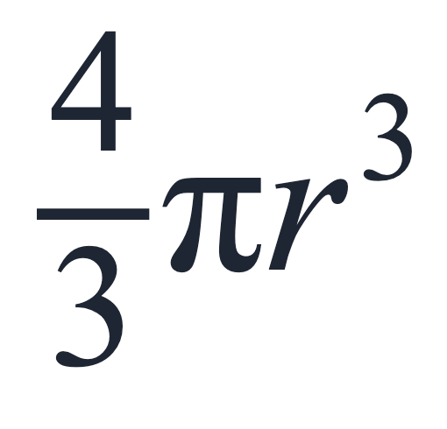
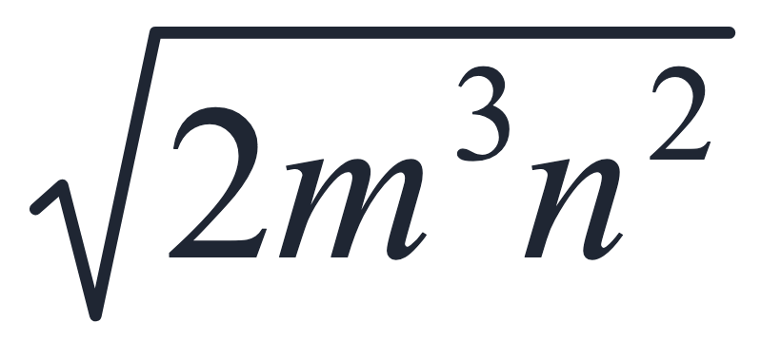
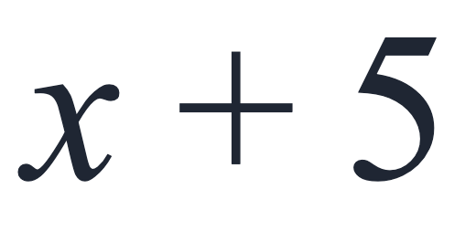
SECTION 1.1 · EXAMPLE 8
Describing Algebraic Expressions
List the constants and variables for each algebraic expression.
a
b
c
OpenStax College Algebra 2e · CC BY 4.0

Slide 2
SECTION 1.1 · EXAMPLE 8
Describing Algebraic Expressions
List the constants and variables for each algebraic expression.
a
b
c
OpenStax College Algebra 2e · CC BY 4.0

Slide 3
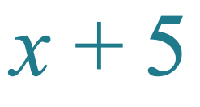




List the constants and variables for each algebraic expression.
a
Expression
Constants
Variables

Slide 4


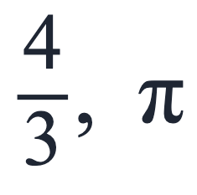

List the constants and variables for each algebraic expression.
b
Expression
Constants
Variables

Slide 5
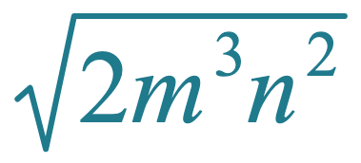

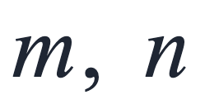
List the constants and variables for each algebraic expression.
c
Expression
Constants
Variables

Slide 6
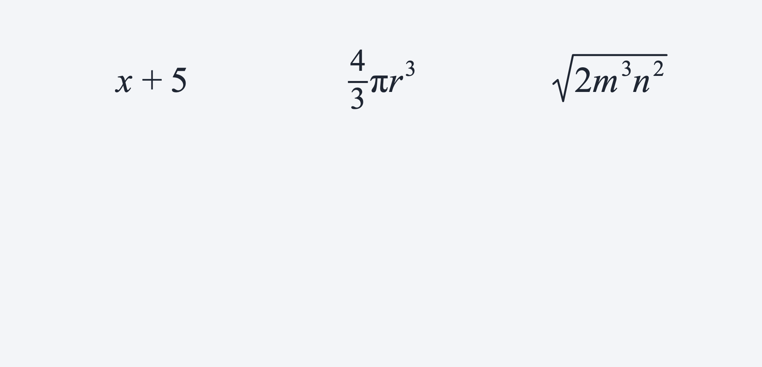
List the constants and variables for each algebraic expression.

