Slide 1
Better Designed Powerpoint with Template
using the R package officer and Powerpoint Future Forward template

Slide 2
What R Has That JS Doesn't
Survival Analysis
On a previous project, I had to do Shiny
to support survival analysis. Porting
to JavaScript would be an extremely
time consuming and difficult exercise.
Now we can access all the R tooling for
survival analysis in the browser with
webR.

Slide 3
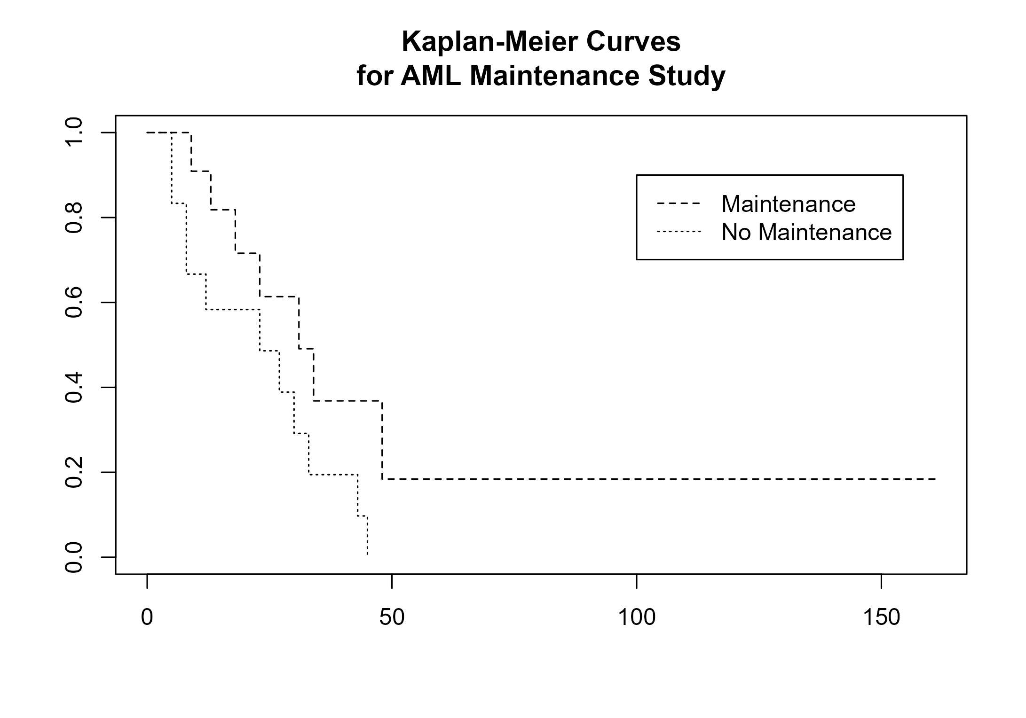
survival
using the survival package
help(plot.survfit)

Slide 4
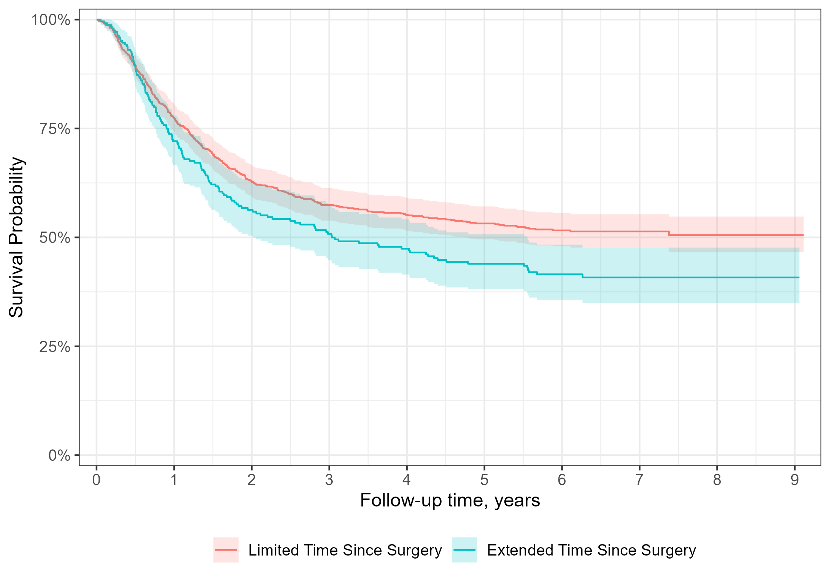
ggsurvfit
using the new ggsurvfit package
https://www.danieldsjoberg.com/ggsurvfit

Slide 5
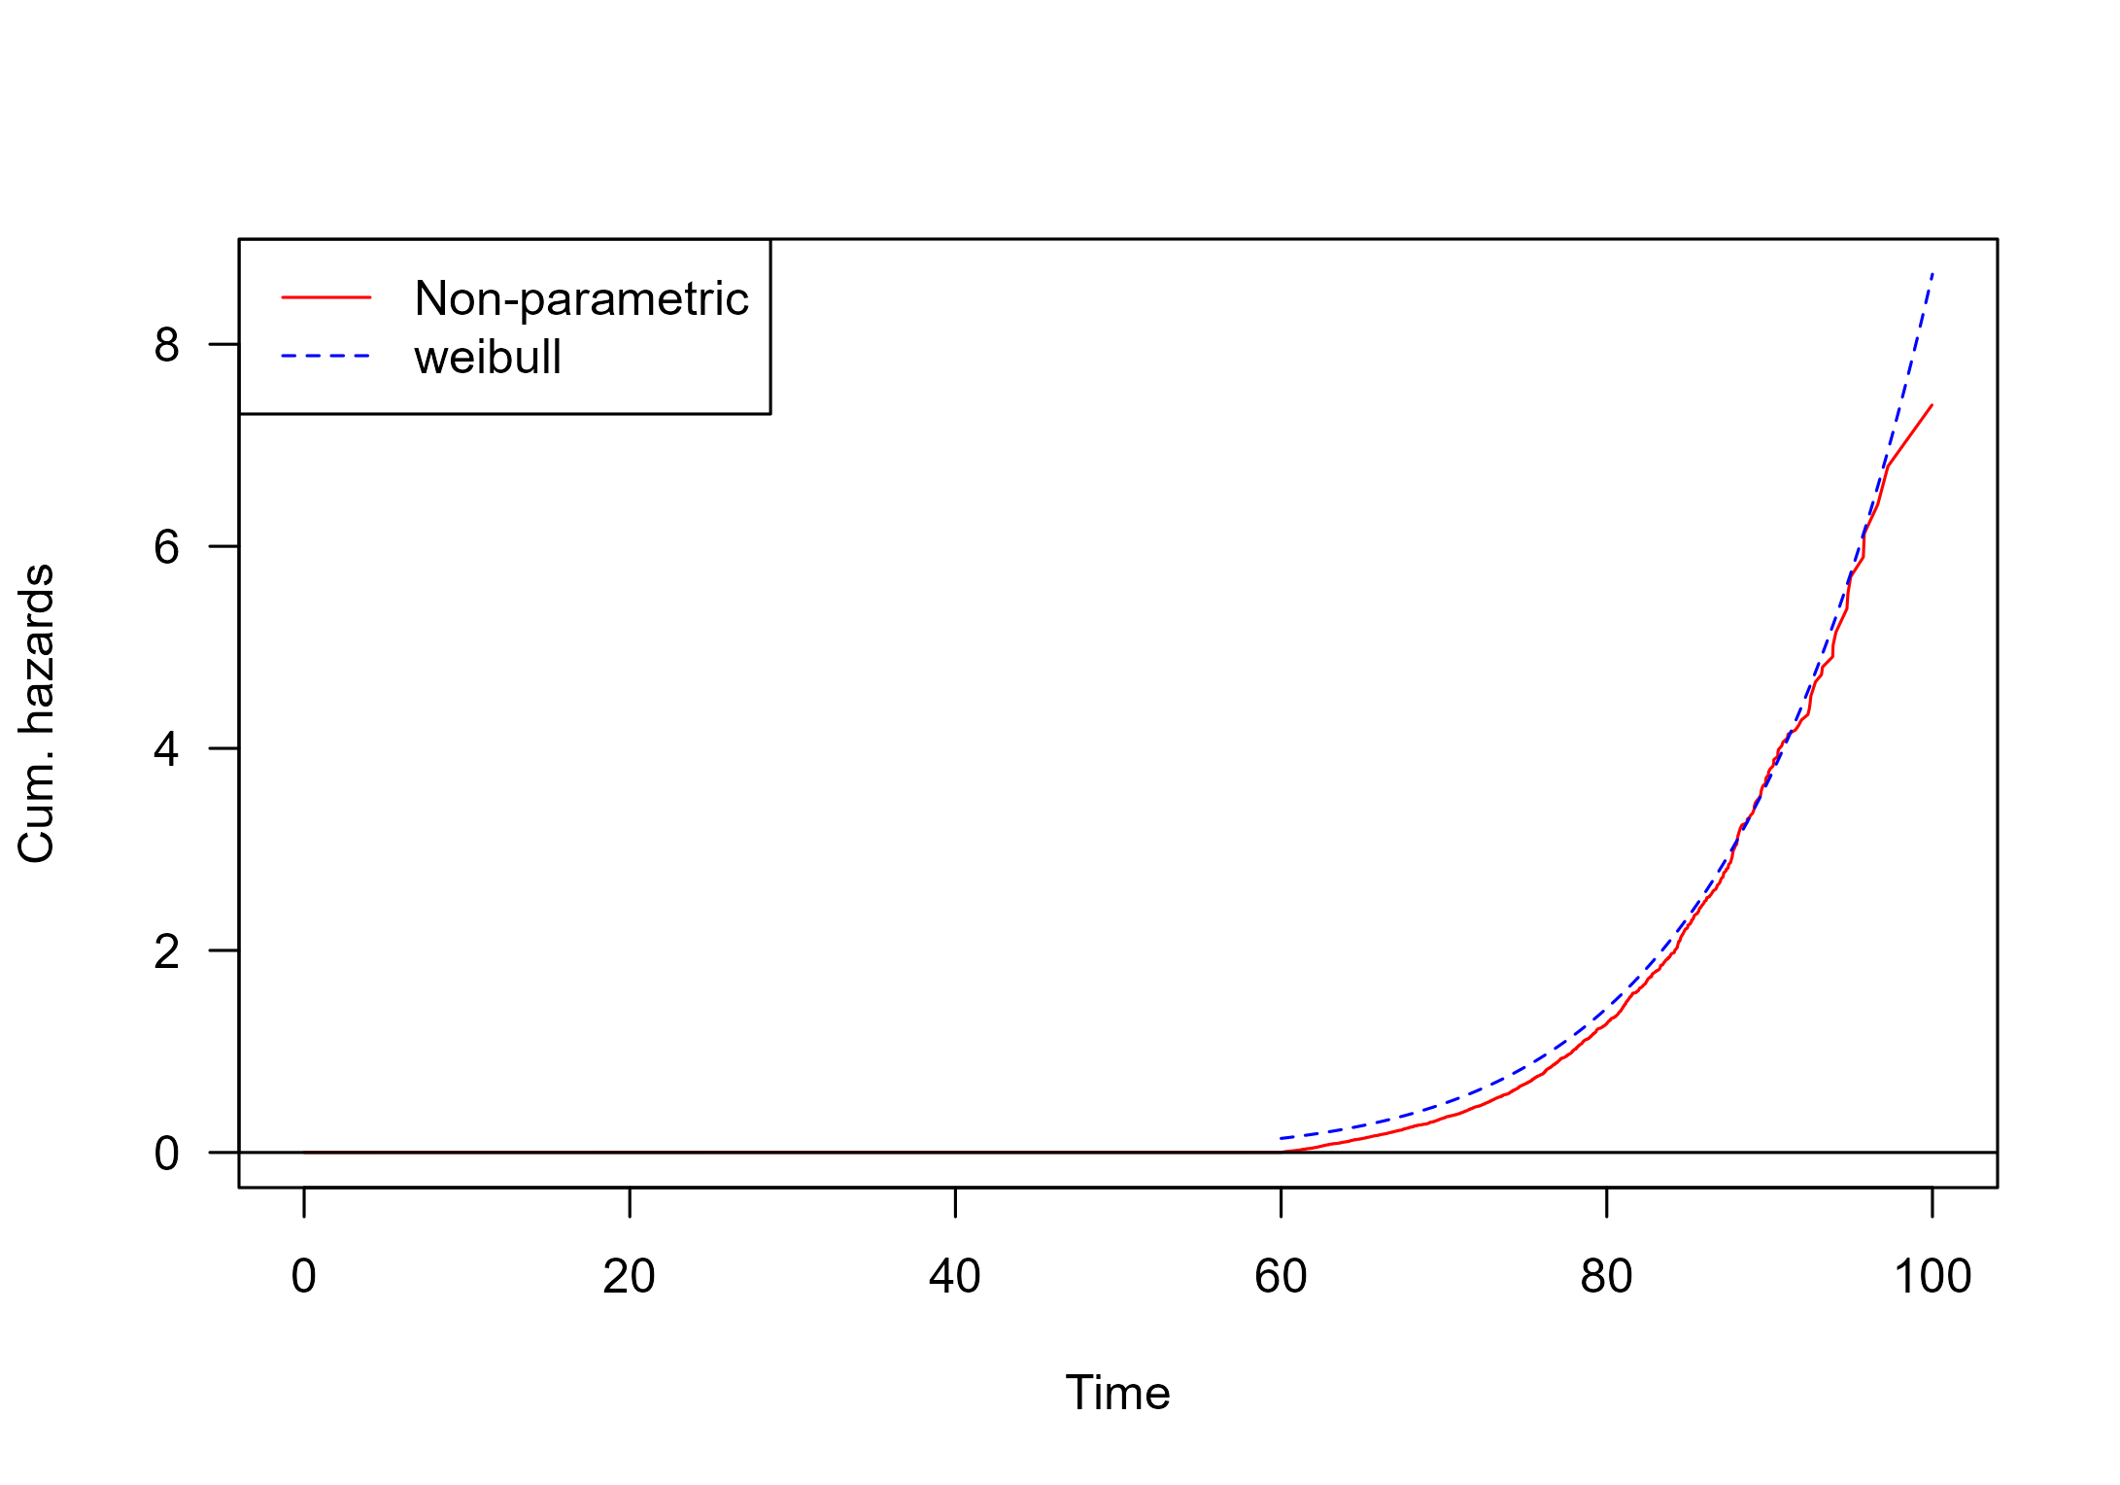
eha
using the eha package

Slide 6
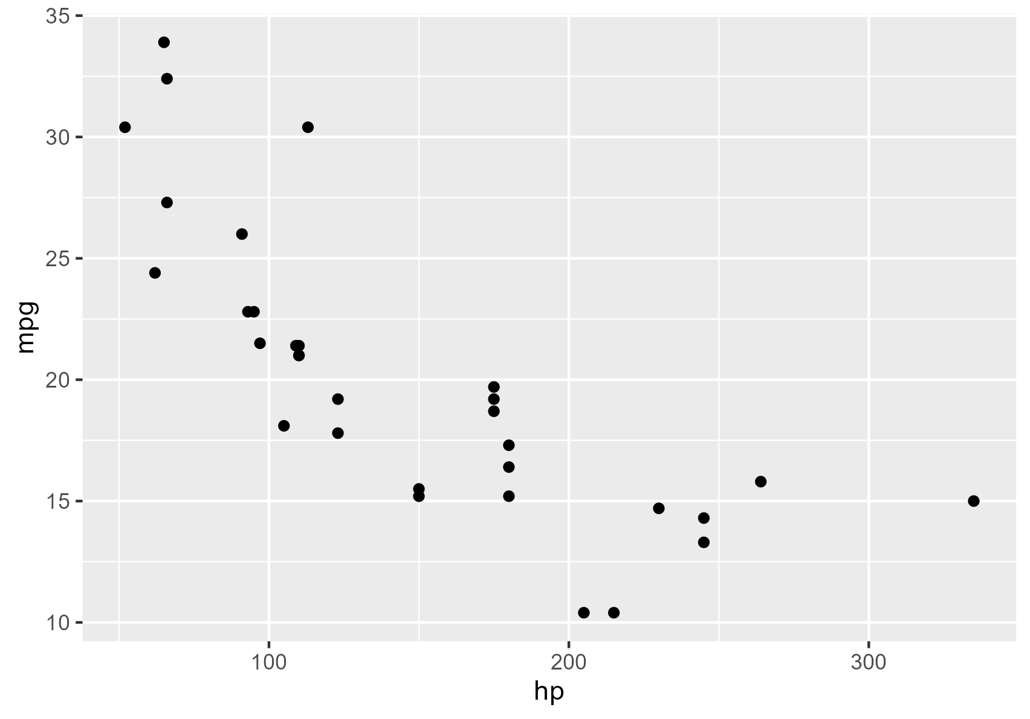
Plot with Code
Code usually isn't shown in my work Powerpoint, but we can modify the template to support.
ggplot(mtcars, aes(x=hp,y=mpg)) +
geom_point() +
theme_void()

