Slide 1
Practical Applications of Temporal and Event Reasoning
James Pustejovsky, Brandeis
Graham Katz, Osnabrück
Rob Gaizauskas, Sheffield
ESSLLI 2003
Vienna, Austria
August 25-29, 2003

Slide 2
Course Outline
Monday-
  Theoretical and Computational Motivations
  Overview of Annotation Task
  Events and Temporal Expressions
Tuesday
  Anchoring Events to Times
  Relations between Events
Wednesday
  Syntax of TimeML Tags
  Semantic Interpretations of TimeML
  Relating Annotations
  Temporal Closure
Thursday
  Automatic Identification of Expressions
  Automatic Link Construction
Friday-
  Outstanding Problems

Slide 3
Wednesday Topics
Syntax of TimeML Tags
Semantic Interpretations of TimeML
Relating Annotations
Temporal Closure

Slide 4
TimeML Syntax
Event
Timex3
Signal
MakeInstance
Tlink
Slink
Alink

Slide 5
Syntax of Event
<Event>
attributes ::= eid class
eid ::= ID
{eid ::= EventID
EventID ::= e<integer>}
class ::= 'OCCURRENCE' | 'PERCEPTION' | 'REPORTING' 'ASPECTUAL' | 'STATE' | 'I_STATE' | 'I_ACTION'

Slide 6
Syntax of MakeInstance
<MakeInstance>
attributes ::= eiid eventID tense aspect negation [modality] [signalID] [cardinality]
eiid ::= ID
{eiid ::= EventInstanceID
EventInstanceID ::= ei<integer>}
eventID ::= IDREF
{eventID ::= EventID}
tense ::= 'PAST' | 'PRESENT' | 'FUTURE' | 'NONE'
aspect ::= 'PROGRESSIVE' | 'PERFECTIVE' | 'PERFECTIVE_PROGRESSIVE' | 'NONE'
negation ::= 'true' | 'false'
{negation ::= boolean}
modality ::= CDATA
signalID ::= IDREF
{signalID ::= SignalID}
cardinality ::= CDATA

Slide 7
MakeInstance: Examples 1
(1) should have bought
should have
<EVENT eid=”e1” class=”OCCURRENCE”>
bought
</EVENT>
<MAKEINSTANCE eiid=”ei1” eventID=”e1” tense=”PAST” aspect=”PERFECTIVE” negation=”false” modality=”SHOULD”/>
(2) did not teach
did not
<EVENT eid=”e1” class=”OCCURRENCE”>
teach
</EVENT>
<MAKEINSTANCE eiid=”ei1” eventID=”e1” tense=”PRESENT” aspect=”NONE” negation=”true”/>

Slide 8
MakeInstance: Examples 2
(3) must not teach twice
must not
<EVENT eid=”e1” class=”OCCURRENCE”>
teach
</EVENT>
<SIGNAL sid=”s1”>
twice
</SIGNAL>
<MAKEINSTANCE eiid=”ei1” eventID=”e1” tense=”PRESENT” aspect=”NONE” negation=”true” modality=”MUST” signalID=”s1” cardinality=”2”/>

Slide 9
Syntax of Timex3
<Timex3>
attributes ::= tid type [functionInDocument] [beginPoint] [endPoint] [quant] [freq] [temporalFunction] (value | valueFromFunction) [mod] [anchorTimeID]
tid ::= ID
{tid ::= TimeID
TimeID ::= t<integer>}
type ::= 'DATE' | 'TIME' | 'DURATION' | 'SET'
beginPoint ::= IDREF
{beginPoint ::= TimeID}
endPoint ::= IDREF
{endPoint ::= TimeID}
quant ::= CDATA
freq ::= CDATA
{value ::= duration}
functionInDocument ::= 'CREATION_TIME' | 'EXPIRATION_TIME' | 'MODIFICATION_TIME' | 'PUBLICATION_TIME' |
'RELEASE_TIME'| 'RECEPTION_TIME' | 'NONE' {default, if absent, is 'NONE'}
temporalFunction ::= 'true' | 'false' {default, if absent, is 'false'}
{temporalFunction ::= boolean}
value ::= CDATA
{value ::= duration | dateTime | time | date | gYearMonth | gYear | gMonthDay | gDay | gMonth}
valueFromFunction ::= IDREF
{valueFromFunction ::= TemporalFunctionID
TemporalFunctionID ::= tf<integer>}
mod ::= 'BEFORE' | 'AFTER' | 'ON_OR_BEFORE' | 'ON_OR_AFTER' |'LESS_THAN' | 'MORE_THAN' |
'EQUAL_OR_LESS' | 'EQUAL_OR_MORE' | 'START' | 'MID' | 'END' | 'APPROX'
anchorTimeID ::= IDREF
{anchorTimeID ::= TimeID}

Slide 10
Timex3 Examples
(4) no more than 60 days
<TIMEX3 tid="t1" type="DURATION" value="P60D" mod="EQUAL_OR_LESS">
no more than 60 days
</TIMEX3>
(5) the dawn of 2000
<TIMEX3 tid="t2" type="DATE" value="2000" mod="START">
the dawn of 2000
</TIMEX3>

Slide 11
Temporal Functions in TimeML
(15) John taught last week.
John
<EVENT eid="e1" class="OCCURRENCE">
taught
</EVENT>
<MAKEINSTANCE eiid="ei1" eventID="e1" tense=”PAST” aspect=”NONE” negation=”false”/>
<TIMEX3 tid="t1" type="DATE" value="XXXX-WXX" temporalFunction="true" anchorTimeID="t2">
last week
</TIMEX3>
<TIMEX3 tid="t2" type="DATE" value="1996-03-27" functionInDocument="CREATION_TIME">
03-27-96
</TIMEX3>
<TLINK eventInstanceID="ei1" relatedToTime="t1" relType="IS_INCLUDED"/>

Slide 12
Syntax of Signal
<Signal>
attributes ::= sid
sid ::= ID
{sid ::= SignalID
SignalID ::= s<integer>}

Slide 13
Syntax of TLINK
<TLINK>
attributes ::= [lid] [origin] (eventInstanceID | timeID) [signalID] (relatedToEventInstance | relatedToTime) relType
lid ::= ID
{lid ::= LinkID
LinkID ::= l<integer>}
origin ::= CDATA
eventInstanceID ::= IDREF
{eventInstanceID ::= EventInstanceID}
timeID ::= IDREF
{timeID ::= TimeID}
signalID ::= IDREF
{signalID ::= SignalID}
relatedToEventInstance ::= IDREF
{relatedToEventInstance ::= EventInstanceID}
relatedToTime ::= IDREF
{relatedToTime ::= TimeID}
relType ::= 'BEFORE' | 'AFTER' | 'INCLUDES' | 'IS_INCLUDED' | 'DURING'
'SIMULTANEOUS' | 'IAFTER' | 'IBEFORE' | 'IDENTITY' |
'BEGINS' | 'ENDS' | 'BEGUN_BY' | 'ENDED_BY'

Slide 14
Syntax of SLINK
<SLINK>
attributes ::= [lid] [origin] [eventInstanceID] [signalID] subordinatedEventInstance relType
lid ::= ID
{lid ::= LinkID
LinkID ::= l<integer>}
origin ::= CDATA
eventInstanceID ::= IDREF
{eventInstanceID ::= EventInstanceID}
subordinatedEventInstance ::= IDREF
{subordinatedEventInstance ::= EventInstanceID}
signalID ::= IDREF
{signalID ::= SignalID}
relType ::= 'MODAL' | 'EVIDENTIAL' | 'NEG_EVIDENTIAL'
| 'FACTIVE' | 'COUNTER_FACTIVE'

Slide 15
Events introducing Slinks
The following EVENT classes interact with SLINK:
    1. REPORTING
    2. I_STATE
    3. I_ACTION
Verbs that introduce I_STATE EVENTs that induce SLINK:
    1. want, desire, crave, lust
    2. believe, doubt, suspect
    3. hope, aspire
    4. intend
    5. fear, hate
    6. love
    7. enjoy
    8. like
    9. know
Verbs that introduce I_ACTION EVENTs that induce SLINK:
    1. attempt, try
    2. persuade
    3. promise
    4. name
    5. swear, vow

Slide 16
Syntax of ALINK
<ALINK>
attributes ::= [lid] [origin] eventInstanceID [signalID] relatedToEventInstance relType
lid ::= ID
{lid ::= LinkID
LinkID ::= l<integer>}
origin ::= CDATA
eventInstanceID ::= ID
{eventInstanceID ::= EventInstanceID}
signalID ::= IDREF
{signalID ::= SignalID}
relatedToEventInstance ::= IDREF
{relatedToEventInstance ::= EventInstanceID}
relType ::= 'INITIATES' | 'CULMINATES' | 'TERMINATES' |
'CONTINUES' | 'REINITIATES'

Slide 17
Semantic Interpretation of TimeML

Slide 18
Goal
Annotate texts to make temporal and event information explicit:
14 Oct 2001 07:27:13 –0400 (EDT)
FIJI - A fresh
<EVENT eid=“e1”> flow </EVENT>
of lava, gas and debris erupted here on
<TIMEX3 tid=“t1” value=20011014T112713>
Saturday
</TIMEX>
<TLINK eventId=“e1” relatedToTime=“t1”>

Slide 19
What is TimeML
Defined as Markup Language
  Markup guidelines
  XML Syntax
But interpreted as a semantic representation language

Slide 20
Semantics of TimeML
Annotations can be viewed as a set of conditions on variables
  An Example:
    John
    <EVENT eid="e1“>
    taught
    </EVENT>
    <SIGNAL sid="s1">
    on
    </SIGNAL>
    <TIMEX3 tid="t2" type="DATE" value="XXXX-WXX-1">
    Monday
    </TIMEX3>
    <MAKEINSTANCE eventID="e1" eventInstanceID="ei1" class="OCCURRENCE" tense="PAST" aspect="NONE">
    <TLINK eventInstanceID="ei1" signalID="s1" relatedToTime="t2" relType="IS_INCLUDED"/>
  The TimeML says: this is true if there is an event of John teaching that is located on a Monday

Slide 21
Semantics of TimeML
We will interpret TimeML texts with respect to a class of model structures ⟨E,I,<, ⊆,τ,V⟩ where
E is the set of events
I the set of times
< is the ordering relation on time intervals
⊆ is the inclusion relation on time intervals
τ is the run-time function from E to I
V is the valuation function.
These models must satisfy a number of axioms, for example:
  ∀x,y,z ∈ I. x<y & y<z → x<z
  ∀x,y,z ∈ I.. x⊆y & y⊆z → x⊆z
  ∀w,x,y,z ∈ I.. x<y & z⊆x & w⊆y → z<w
  ∀w,x,y,z. x<y & y<z & x ⊆w & z⊆w → y⊆w

Slide 22
Semantics of TimeML:
Attribute values
TimeML defines a large number of attributes for tags.
The intended models for TimeML are models in which Val assigns appropriate denotations to these terms.
For all attributes α,
If α is an ISO-8601 term that doesn’t start with P then
Val(α) = the interval determined by the ISO notation
If α is an ISO-8601 term that start with P then
Val(α) = the set of all intervals determined by the ISO notation
If α is an an event predicate then Val(α) = the set of all events of the appropriate type
…

Slide 23
Semantics of TimeML Text
Let T be a TimeML Text,
Dom_{e}(T) = the set of event ids in T
Dom_{t}(T) = the set of time ids in T
Dom_{ei}(T) = the set of event instance ids in T
Tag(T) = the set of all tags in T
A text T is satisfied by a model M iff there are functions (that assign denotations to identifier variables)
f_{e}: Dom_{e} (T) -> Pow(E), and
f_{ei}: Dom_{ei} (T) -> E
f_{t}: Dom_{t} (T) -> I , such that
for all tags t ∈Tag(T), t is satisfied by f_{e} f_{ei} and f_{t} in M.

Slide 24
Semantics of TimeML
Text Embedding
We define satisfaction of a tag by a set of functions in a model by enumeration.
A tag t is satisfied by f_{e},f_{t}, and f_{ei} in M iff if t has the form
“<EVENT eid = α class = β pred= δ >”
then f_{e}(α) = Val(δ)
“<TIMEX3 tid = α type = DATE value= δ >”
then f_{t}(α) = Val(δ)
“<TIMEX3 tid = α type = DURATION value= δ >”
then f_{t}(α) ∈ Val(δ)
“<MAKEINSTANCE eiid = α eid = β negation=‘FALSE’ modal = ‘’>”
then f_{ei}(α) ∈ f_{e}(β)
“<MAKEINSTANCE eiid = α eid = β negation=‘TRUE’ modal = ‘’>”
then f_{ei}(α) ∉ f_{e}(β)

Slide 25
Semantics of TimeML Text
Embedding
Cont’d
“<TLINK eventInstanceID = α relatedtoTime = β relType= ‘IS_INCLUDED’>”
then τ(f_{ei}(α)) ⊆ f_{t} ( β)
“<TLINK eventInstanceID = α relatedtoEventInstance = β relType= ‘BEFORE’ >”
then τ(f_{ei}(α)) < τ(f_{ei} ( β))
“<TLINK eventInstanceID = α relatedtoTime = β relType= ‘DURING>”
then τ(f_{ei}(α)) = f_{t} ( β)

Slide 26
Semantics: Example
John
<EVENT eid="e1" class="OCCURRENCE" pred="TEACH">
taught
</EVENT>
<TIMEX3 tid="t1" type=“DURATION" value=“P20M">
20 minutes
</TIMEX3>
<SIGNAL sid="s1">
on
</SIGNAL>
<TIMEX3 tid="t2" type="DATE" value="XXXX-WXX-1">
Monday
</TIMEX3>
<MAKEINSTANCE eventID="e1" eventInstanceID="ei1" " negation=“FALSE">
<TLINK eventInstanceID="ei1" signalID="s1" relatedToTime="t2" relType="IS_INCLUDED"/>
<TLINK eventInstanceID="ei1" relatedToTime="t1" relType=“DURING"/>
Dom_{e} = {e1} Dom_{ei} = {ei1} Dom_{t} = {t1,t2}
This annotation is satisfied in M if we can find f_{e},f_{t}, and f_{ei} such that:
  f_{e}(e1) is set of teaching events,
  f_{t}(t2) is a Monday,
  f_{t}(t1) is a twenty minute interval and
  f_{ei}(ei1) ∈ (f_{e}(e1)), τ(f_{ei}(ei1)) ⊆ f_{t} (t2) and τ(f_{ei}(ei1)) =f_{t} (t1)

Slide 27
Semantics: Negation Example
John didn’t
<EVENT eid="e1" class="OCCURRENCE" pred="TEACH">
teach
</EVENT>
<SIGNAL sid="s1">
on
</SIGNAL>
<TIMEX3 tid="t2" type="DATE" value="XXXX-WXX-1">
Monday
</TIMEX3>
<MAKEINSTANCE eventID="e1" eventInstanceID="ei1" " negation=“TRUE">
<TLINK eventInstanceID="ei1" signalID="s1" relatedToTime="t2" relType=“IS-INCLUDED"/>
Dom_{e} = {e1} Dom_{ei} = {ei1} Dom_{t} = {t2}
This annotation is satisfied in M if we can find f_{e},f_{t}, and f_{ei} such that:
  f_{e}(e1) is set of teaching events,
  f_{t}(t2) is a Monday,
  and
  f_{ei}(ei1) ∉ f_{e}(e1), τ(f_{ei}(ei1)) ⊆ f_{t} (t2)

Slide 28
Semantics: Problem
“John didn’t teach on Monday”
Dom_{e} = {e1} Dom_{ei} = {ei1} Dom_{t} = {t2}
This annotation is satisfied in M if we can find f_{e},f_{t}, and f_{ei} such that:
  f_{e}(e1) is set of teaching events,
  f_{t}(t2) is a Monday,
  and
  f_{ei}(ei1) ∉ f_{e}(e1), τ(f_{ei}(ei1)) ⊆ f_{t} (t2)
(This says that there was an event of something other than teaching that was on Monday)
Unfortunately such a model might actually have an event of teaching included somewhere on a Monday
Problem: We do not have scope!
Possible Solutions: Introduce event types into the TLINK.
…

Slide 29
Issues for Semantic Annotation
Evaluating the Annotation
Annotations need do be compared semantically, not ‘syntactically’
These are equivalent
<
<
<
Before she arrived John met the girl who won the race.
<
<
Before she arrived John met the girl who won the race.

Slide 30
Issues for Semantic Annotation
But these are not:
<
<
<
Before she arrived John met the girl who won the race.
<
<
Before she arrived John met the girl who won the race.

Slide 31
Comparing Annotations
We can define in model-theoretic terms four relations that hold between TimeML texts A and B:
  A and B are equivalent if all models satisfying A satisfy B, and vice-verse.
  A subsumes annotation B iff all models satisfying B satisfy A.
  A and B are consistent iff there are models satisfying both A and B.
  A and B are inconsistent if there are no models satisfying both A and B

Slide 32
The Need for Closure

Slide 33
Closure in TERQAS
Goals
  Annotation Completeness
  The number of temporal relations is quadratic to the number of objects that are being linked temporally. A complete manual annotation is not feasible, automatic inferences are needed.
  Annotation Consistency
  Axiom application reveals inconsistencies in annotation.
  Encourage Inter-annotator agreement
  While agreement on entities like TIMEXes and Events is high (.85 F), annotators only annotate about 3-5% of all possible links. Agreement figures here (with AWB) hover around 15%.
Lesson Learned
  Discovery mechanism
    Closure generated links that came as a surprise to the annotator, they were not immediately obvious from the interfaces that were used in TERQAS.

Slide 34
Precedence
PRE1: [ x PRE y & y PRE z => x PRE z ]
----x---- ----y---- ----z----
PRE2: [ x PRE y & y SIM z => x PRE z ]
PRE3: [ x PRE y & y IDT z => x PRE z ]
----x---- ----y----
----z----
PRE4: [ x PRE y & x SIM z => z PRE y ]
PRE5: [ x PRE y & x IDT z => z PRE y ]
----x---- ----y----
----z----
PRE6: [ x PRE y & x INC z => z PRE y ]
----x---- ----y----
--z--

Slide 35
Inclusion
INC1: [ x INC y & y INC z => x INC z ]
------x------
----y----
--z--
INC2: [ x INC y & y SIM z => x INC z ]
INC3: [ x INC y & y IDT z => x INC z ]
----x----
--y--
--z--
INC4: [ x INC y & z SIM x => z INC y ]
INC5: [ x INC y & z IDT x => z INC y ]
----x----
--y--
----z----

Slide 36
Identity and Simultaneity
SIM1: [ x SIM y & y SIM z => x SIM z ]
SIM2: [ x SIM y & y IDT z => x SIM z ]
IDT1: [ x IDT y & y IDT z => x IDT z ]
----x----
----y----
----z----

Slide 37
Features of Closure in TERQAS
User prompting
Completes temporal ordering markup in a text by asking the user to fill in the holes. Based on Setzer and Gaizauskas.
Text-segmented closure
Ensures that user-prompting is linear to the size of the text rather than quadratic. Closure with user prompting and text segmented closure derives up to 70% of all possible links.
Integrated in tool
Semi-graphic annotation tool build on top of Alembic.

Slide 38
TANGO: Event Graph Closure
Implemented a more compact algorithm than the one used for the TERQAS project.
Algorithm is EVENT/TIMEX3 based rather than TLINK based.
Algorithm is based on the Warshall algorithm for graph closure.
For all event and timex3 nodes Y:
  if RelA(X,Y) and RelB(Y,Z)
  and there is an axiom RelA & RelB → RelC
  then add RelC(X,Z)

Slide 39
Complete Axiom Set
The TERQAS axiom set is incomplete. It uses TimeML relations as primitives without having a complete theory about the semantics of those relations. As a result, inconsistencies were not ruled out.
A complete axiom set is derived using the underlying semantics of TimeML relations. This ensures that the axiom set is complete.
Each Event and Timex3 is represented as an interval with a begin point and an end point. Each TimeML relation is translated into a set of precedence and/or equality statements between points-in-time.
X ==> x1 - x2
Y ==> y1 - y2
before(X,Y) ==> x2 < y1
includes(X,Y) ==> x1 < y1 & y2 < x2

Slide 40
Complete Axiom Set
Using precedence and equality relations over points in time allows us to use the properties of a partial order to automatically derive all possible axioms:
  1. Compile out all possible relations using = and < on the begin and
  end points.
  2. Create the Cartesian product of this set.
  3. For each pair, compute transitive closure, using transitivity of
  equality (=) and precedence (<) relations.
  4. Check whether derived relations between points can be translated back into a new relation between intervals.

Slide 41
Complete Axiom Set
Two TimeML relations
X before Y Y before Z
X1 x2

Slide 42
Complete Axiom Set
Translate into precedence relations on points
X before Y Y before Z
X1 x2
x1
x2
y1
y2
y1
y2
z1
z2

Slide 43
Complete Axiom Set
Collapse identical events
X before Y Y before Z
X1 x2
x1
x2
y2
y2
y1
y2
z1
z2
x1
x2
y1
y2
z1
z2

Slide 44
Complete Axiom Set
Applying transitivity of precedence relation
X before Y Y before Z
X1 x2
x1
x2
y2
y2
y1
y2
z1
z2
x1
x2
y1
y2
z1
z2

Slide 45
Complete Axiom Set
Pull out new information
X before Y Y before Z
X1 x2
x1
x2
y2
y2
y1
y2
z1
z2
x1
x2
y1
y2
z1
z2
x1
x2
z1
z2

Slide 46
Complete Axiom Set
Translate point relations back to TimeML
X before Y Y before Z
X1 x2
x1
x2
y2
y2
y1
y2
z1
z2
x1
x2
y1
y2
z1
z2
x1
x2
z1
z2
X before Z

Slide 47
Complete Axiom Set
Using precedence and equality relations over points in time allows us to use the properties of a partial order to automatically derive all possible axioms:
  1. Compile out all possible relations using = and < on the begin and
  end points.
  2. Create the Cartesian product of this set.
  3. For each pair, compute transitive closure, using transitivity of
  equality (=) and precedence (<) relations.
  4. Check whether derived relations between points can be translated back into a new relation between intervals.

Slide 48
Axioms for Closure
AXIOM 0.0
[ [x1 < y1] [x1 < y2] ]
[ [y1 < z1] [y1 < z2] [y2 < z2] [z1 < y2] ]
  ==> [x1 < z1] [x1 < z2]
IN before ended_by ibefore includes overlap_before
OUT overlap_before
NEW before ended_by ibefore includes overlap_before
AXIOM 0.1
[ [x1 < y1] [x1 < y2] ]
[ [y1 = z1] [y1 < z2] [z1 = y1] [z1 < y2] [z2 < y2] ]
  ==> [x1 < z1] [x1 < z2]
IN before ended_by ibefore includes overlap_before
OUT begun_by
NEW before ended_by ibefore includes overlap_before
AXIOM 0.3
[ [x1 < y1] [x1 < y2] ]
[ [y1 < z1] [y1 < z2] [y2 < z2] ]
  ==> [x1 < z1] [x1 < z2]
  IN before ended_by ibefore includes overlap_before
OUT before ibefore overlap_before
NEW before ended_by ibefore includes overlap_before

Slide 49
Warshall-Based
Event Closure Algorithm
e₂
e₄
e₁
e₅
e₃
The nodes are processed one by one. When node i is processed, new edges
are added in order ensure that for every path a -> i -> b (in the current
graph, not the original graph) there be an edge a -> b.

Slide 50
Closure Algorithm 2
e₂
e₄
e₁
e₅
e₃
Start anywhere in the graph. Ex: event 4.
When event 4 is processed, new edges are added from
event 1 to events 3 and 5.

Slide 51
Closure Algorithm 3
e₂
e₄
e₁
e₅
e₃
When event 5 is processed, nothing happens. When node 3
is processed, arcs must be added from 4 and 1 to 2.

Slide 52
Closure Algorithm 4
e₂
e₄
e₁
e₅
e₃
When events 1 and 2 are processed, nothing happens.

Slide 53
Closure Algorithm 5
e₂
e₄
e₁
e₅
e₃
When events 1 and 2 are processed, nothing happens.
The graph is now closed.

Slide 54
Different Annotation of Events
Distinct set of links for an article
Equivalent after closure

Slide 55
Annotation 2
e₂
e₄
e₁
e₅
e₃

Slide 56
Annotation 2 Closure
e₂
e₄
e₁
e₅
e₃

Slide 57
Annotation Comparison
Annotator 1
Annotator 2
e₂
e₄
e₂
e₄
e₁
e₁
e₅
e₅
e₃
e₃

Slide 58
The Task of Annotation

Slide 59
Alembic Workbench
Excellent named entity annotation tool
  Supports Preprocessed Entity Recognition
  Simple entity attribute editing
Extended to support TimeML
However, somewhat weak in representing links
  Difficult to add dependencies between entities (relations)
  No global view of relations possible

Slide 60
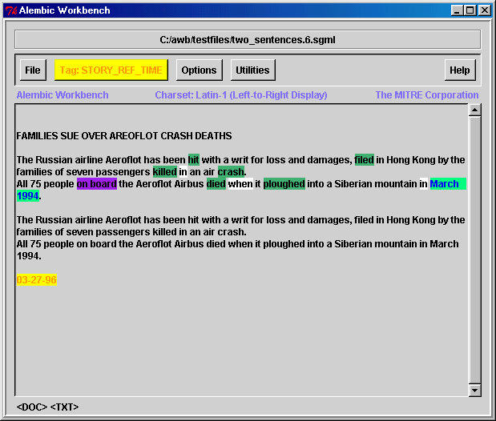
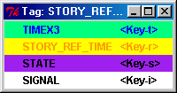
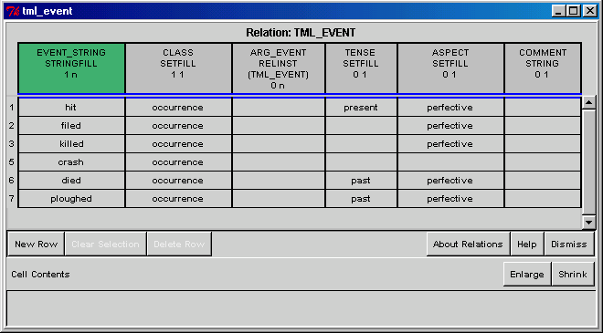
Annotation of Event, Time, State, Signal, and Story Reference Time

Slide 61
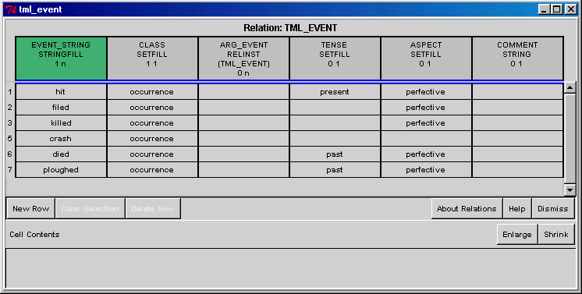
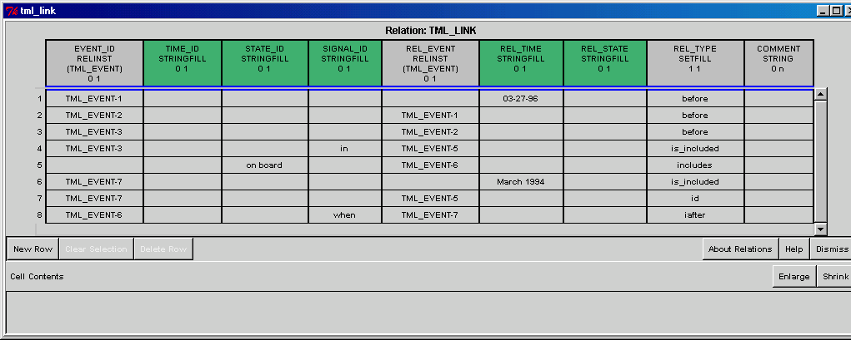
Link Annotation

Slide 62
Problems with Alembic WB in performing TimeML annotation
Within-sentence annotation:
  hard to keep track of direction and embedding of links
Within-document annotation:
  cannot see global picture of link connectivity and ordering
Text authoring metaphor
  useful for entities, but not always natural for representing links

Slide 63
TimeML Density Information
TimeML tag frequencies in
56.6K bytes (raw) dataset

Slide 64
Problems with Alembic WB in performing Dense TimeML annotation
Within-sentence annotation: hard to keep track of direction and embedding of links
Within-document annotation: cannot see global picture of link connectivity and ordering
Text authoring metaphor useful for entities, but not always natural for representing links

Slide 65
Addressing the Challenges
Density
  move away from textual annotation for links: Graphical Annotation
    Visualization helpful in any link analysis task
Speed
  use radical mixed-initiative architecture, involving massive pre-processing and interactive post-processing (temporal closure)
Relevance
  build links to other communities, by showing value (e.g., Q&A, summarization, MT)
    faster annotation

Slide 66

TANGO Participants
James Pustejovsky Brandeis University (Co-Team Lead)
Inderjeet Mani MITRE Virginia (Co-Team Lead)
Branimir Boguraev IBM, Yorktown Heights
Linda Van Guilder MITRE
Marc Verhagen Brandeis University
Andrew See Brandeis University
David Day MITRE
Bob Knippen Brandeis University
Jessica Littman Brandeis University
Luc Bélanger University of Montreal
Svetlana Symonenko University of Syracuse
Anna Rumshisky Brandeis University
Supported by

