Slide 1
zKWIC: A Web Based KWIC Tool
  Robert Irie
  irier@spawar.navy.mil
  Code 244207
  SPAWAR Systems Center San Diego

Slide 2


Introduction
Keyword in context (KWIC) tool
  Searches installed corpora for user supplied keywords and displays them in context
  Allows successive filtering with standard regular expressions
Integration of open source components
  Web application server (Zope: http://www.zope.org)
  Relational database (MySQL: http://www.mysql.com)
  Search engine (SWISH-E: http://www.swish-e.org)
  Scripting language (Python: http://www.python.org)
Note: zKWIC may function better with Internet Explorer than with Netscape Navigator on some non-Windows platforms

Slide 3

Architecture
Win32 (cygwin) and Unix platforms
Compressed corpora stored in relational database
User interface
  Searching/Filtering through web interface
Administrator usage
  Two-step uploading/indexing of corpora through shell interface
  Additional administrative functions through special web interface

Slide 4
zKWIC System Diagram
Index Files
Zope
Web Server
SWISH-E
Search Engine
User
Browser
Index
MySQL
DB
Admin
Shell
Convert
Corpus

Slide 5


User Interface
Search Interface (Web)
  Keyword entry
    Form field: Semicolon-separated keywords
    Text File: CR-separated keywords
  Single or multiple index selection (indices previously created by administrator)
  Retrieve previous results
Results Interface (Web)
  Per file display of matches, or view all matches
  Successively filter matches using regular expressions
  Sort by column (right or left context, keyword, etc.)
  Save results to database for later retrieval
  Link from keyword to file (full doc) context, with keyword highlighted

Slide 6
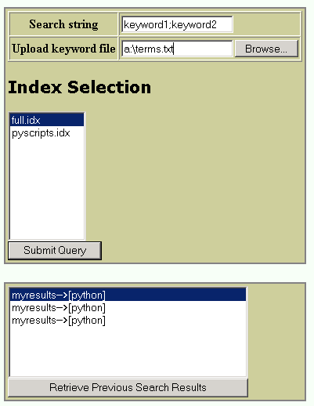
Search Interface
Manual Keyword Entry
File-based Keyword Entry
Single or Multiple Index Selection
Start Search
Previous Search Results
(name assigned by user)

Slide 7
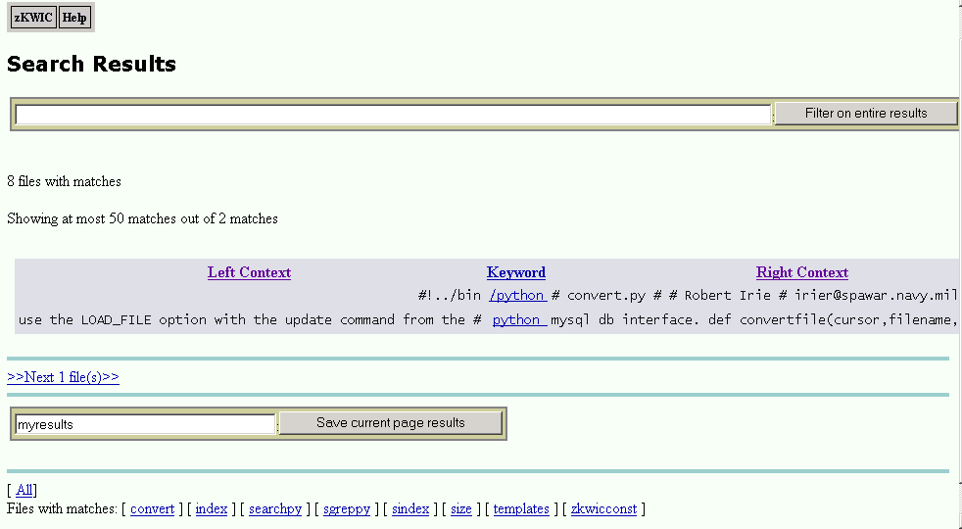
Results Interface
Menu
Regular Expression Filter
Match Summary
Save Results
Show All Matches
Matched File Display

Slide 8

Administrator Interface
Execution Directory
  (ZOPE_INSTANCE_HOME)/Extensions
Multiple Indices
  Indexbase- A unique name for each corpus (no extension)
Upload corpus (shell)
  ./convert.py [-o] [-g] [-i indexbase] [-d dir [-e ext] -r]|[file ...]
  By directory (recursively), by extension, or by file name
Index corpus (shell)
  ./index.py [incr|full|delete] [all|indexbase]
  Full: Indexes entire corpus
  Incr: Indexes only files uploaded since last full index

Slide 9
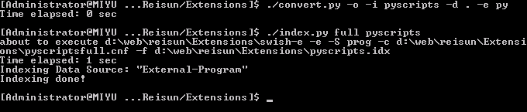
Administrator Interface (shell)
Upload all *.py files in current directory, naming corpus 'pyscripts'
Index corpus 'pyscripts', creating full index file

Slide 10
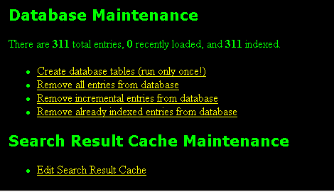
Administrator Interface (Web)
http://localhost:8080/zkwic/zkwicadmin

Slide 11
JCorporaLogger
Developed by Robert Gottlieb (gottlieb@spawar.navy.mil)
Java-based, zKWIC interoperable utility
  Shows user last set of queries made into zKWIC
  Shows user last set of indexes that were indexed (via swish-e)
JcorporaLogger installation
  logger.properties file: set up query to access table you wish to display
Usage
  Click on the Query button.
  Click on any column headers to sort the entire data set based on that column.
  Double click inside any table cell to copy information (e.g. to rerun a query in zKWIC)

Slide 12
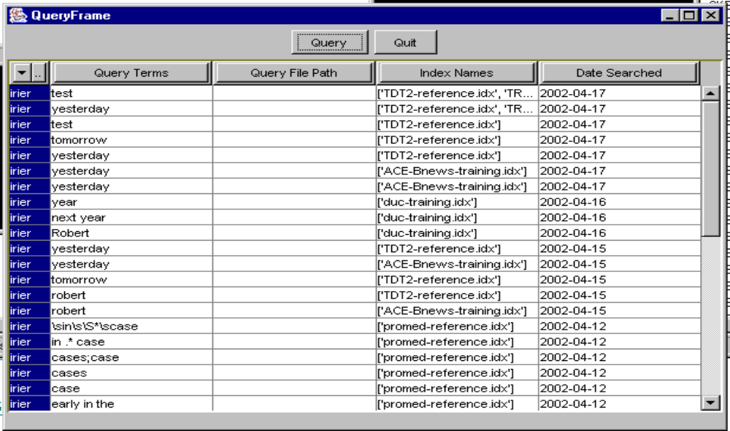
JCorporaLogger Usage
User
Query Term
Query File
Indices
Date

Slide 13

Acknowledgments
Beth Sundheim (sundheim@spawar.navy.mil)
Robert Gottlieb (gottlieb@spawar.navy.mil)

