Slide 1
Student Loan Defaults
A revised look at
Tim Ernst

Slide 2
Background
The student loan market in the U.S. is currently about 1.2 trillion dollars with roughly 90% coming from federal loan programs.
It's not just large, it's growing rapidly as the cost of education continues to outpace the inflation. There is growing concern from both the public and policy makers about the burden that student loans are putting on the economy.

Slide 3
Problem Statement
Challenges:
Debt originators have difficulty determining a students probability of default without credit history, and often rely on traditional measures.
Students don’t have a great way to evaluate the possible outcomes of attending one college vs. another.
Policy makers and administrators don’t have a single measure for determining the performance of a university
IS THERE A MORE EFFICIENT WAY TO DETERMINE THE PROBABLY OF DEFAULT ON STUDENT LOANS
Notes:
We all need to understand that defaults are a good measure for evaluation. 1) School serves man functions.

Slide 4
Possible Consumers
Issuers of Student debt
Students Deciding on an Institution
University Administrators
Policy Makers

Slide 5
Data Source

Slide 6
Data Overview
The U.S. Department of Education hired consultants RTI to generate data the “College ScoreCard” dataset.
Data was primarily compiled from:
IPEDS (Integrated Postsecondary Education Data System)
NSLDS (National Student Loan Data System)
U.S. Department of Treasury
BLS (Bureau of Labor Statistics)
260 Million Data Points
7,700 Institutions
1,700 Features
20 Years

Slide 7
Feature Breakdown
The feature set can be broken into a few primary areas:
Root: The root data is fundamental element, it includes the OPEID (Office of Postsecondary Education Identification) which uniquely identifies each institution and is standard across the Department of Education.
School: Descriptive information about each school.
Academics: Metrics describing the type of education avialable.
Admissions: Admission statistics including acceptance rate and SAT scores.
Student: Demographic and descriptive elements about the student body.
Cost: Information about the cost of attendence.
Aid: Statistics about financial aid and debt including the percentage of students recieving financial aid and the median debt at graduation.
Repayment: THE TARGET VARIABLES. This primarily includes the cohort default rate and the repayment rate. (further discussion later)
Completion: Details of graduations rates. Can be based on 150% or 200% cap where additional scores are added if a student completes a program in the time longer than standard for that program.
Earnings: Information about post-graduation earnings. Earnings data are adjusted for inflation to 2014 using CPI-U from the BLS.

Slide 8
Percent of students who never received a federal loan at the institution and who died within 8 years at original institution

Slide 9
Assumptions and Risks
The target variable is the 7yr repayment rate for the FY2009 & FY2010 pooled cohorts. The circumstances of the economy during '08-'09 mean that default data for those years may not be reflective of other years.
The data provided is aggregated to the institutional level. FERPA (Family Education Right to Privacy Act) laws prohibit distribution of personal education information. As a result, it not possible to validate results at the individual level. Any personally identifiable information in the data set as been replaced with "Privacy Suppressed."
A lot of the data points provided are specific to first-time, full-time students and we extrapolate out to the rest of the student body even when this may not reflect the composition. Further, much of the data, including earnings data is restricted to students who receive Title IV benefits. At schools where this percentage is low, it may not reflect the overall student body, however, it is still useful as a comparison for default rates since these students are receiving aid.
As a method of simplifying the data analysis we ignore a lot of the transfer information.
The focus is on two-year and four year degree-granting programs only. Certificate programs and non-degree granting programs have been removed.

Slide 10
EDA

Slide 11
Target Variable:
7yr Cohort Repayment Rate
<RPY_7YR_RT>
Fraction of repayment cohort who are not in default, and with loan balances that have declined seven years since entering repayment, excluding enrolled and military deferment from calculation. (rolling averages)

Slide 12
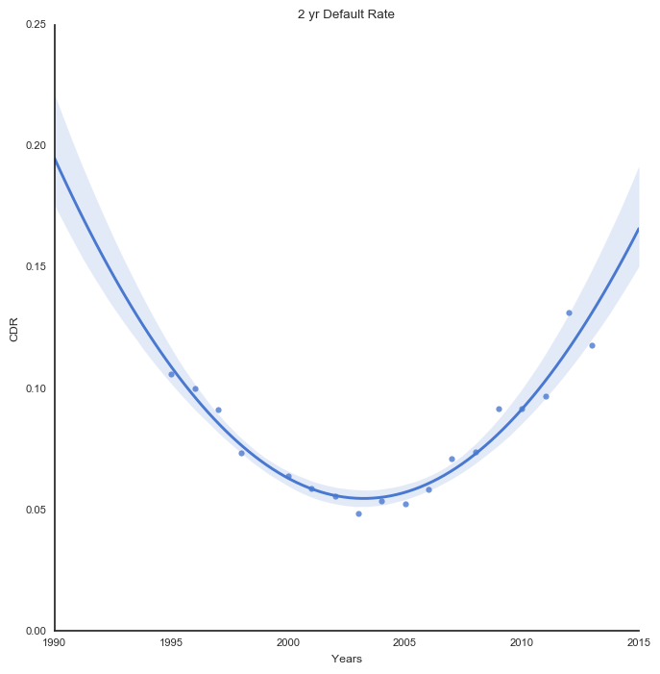
2yr Cohort Default Rate
* The 2013 and 2014 cohorts moved to a 3yr default measurement
Notes:
We can examine the cohort default rate going back to 1995

Slide 13
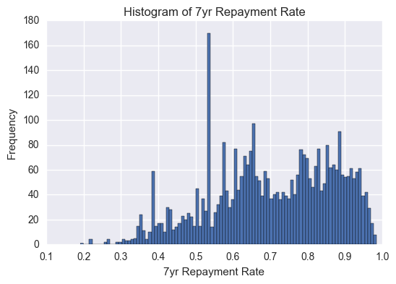
Distribution of Repayment Rates

Slide 14
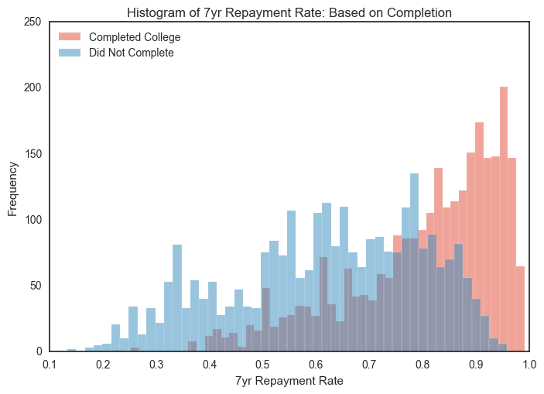
College Completion

Slide 15
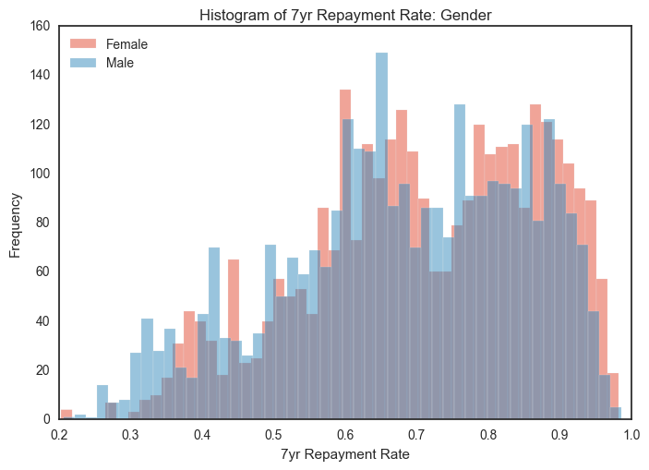
Gender

Slide 16
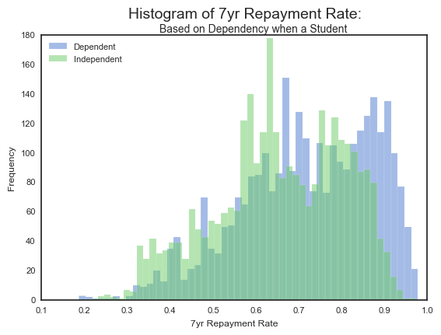
Dependency Status

Slide 17
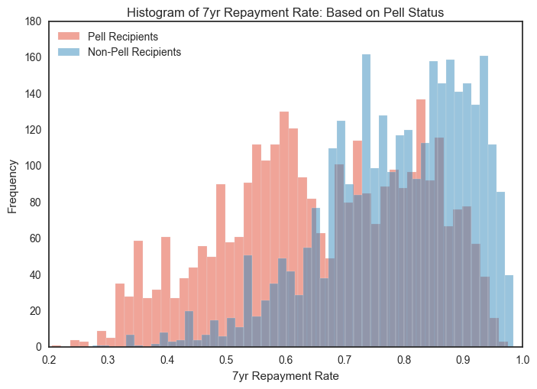
Pell Eligibility

Slide 18
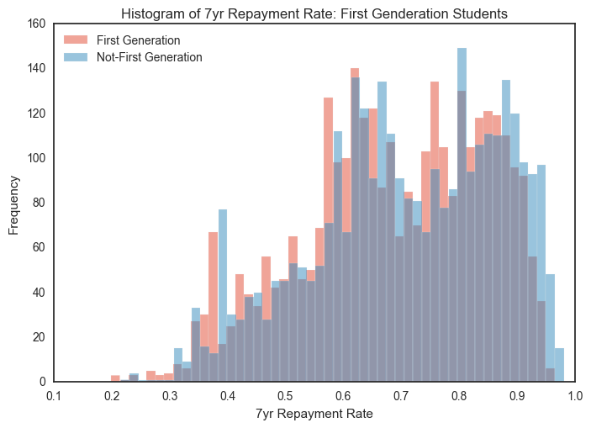
First Generation

Slide 19
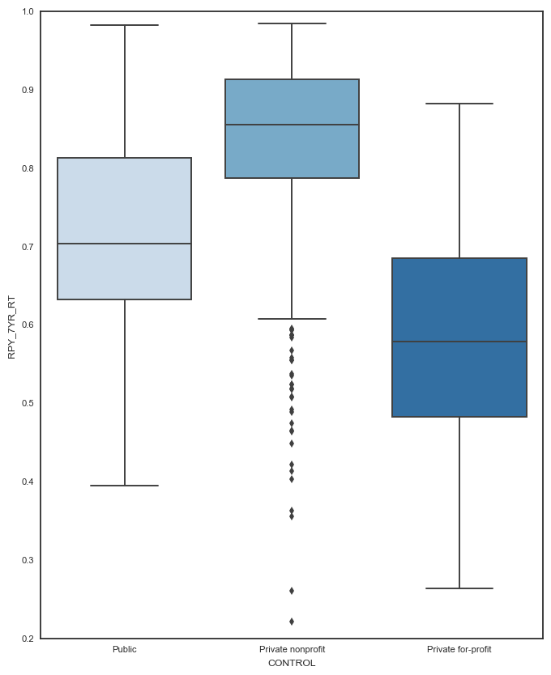
Control

Slide 20
Feature Selection
This can be examined by calling 'feature importance's' on the random forest model. We've selected random forests for a couple of reasons;
Limited preprocessing steps.
The method of splitting based on the features ability to divide the data provides a good indication of the importance of that feature.
It looks as though our data could have multicollinearity and random forests is best suited to not over fit based on this.

Slide 21
Random Forest Feature Importance
Feature | Feature Importance
FAMINC | 0.508795
INC_PCT_M1 | 0.066574
PELL_EVER | 0.058634
PCTPELL | 0.047115
INC_PCT_LO | 0.031309
ENRL_ORIG_YR2_RT | 0.024091
MD_FAMINC | 0.023885
DEP_INC_AVG | 0.017953
PAR_ED_PCT_PS | 0.016900
WDRAW_ORIG_YR2_RT | 0.016264
IND_INC_AVG | 0.002685

Slide 22
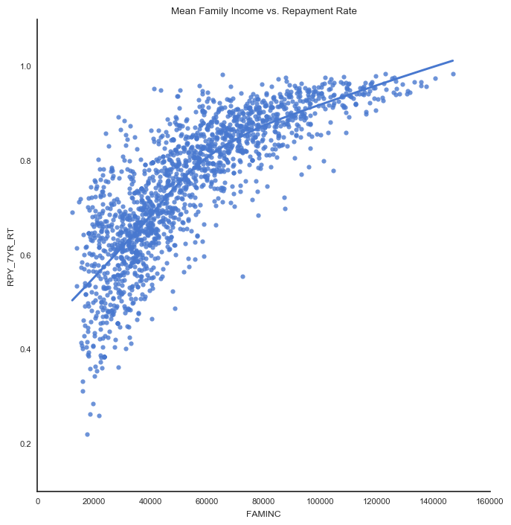
Family Income vs. Repayment Rate

Slide 23
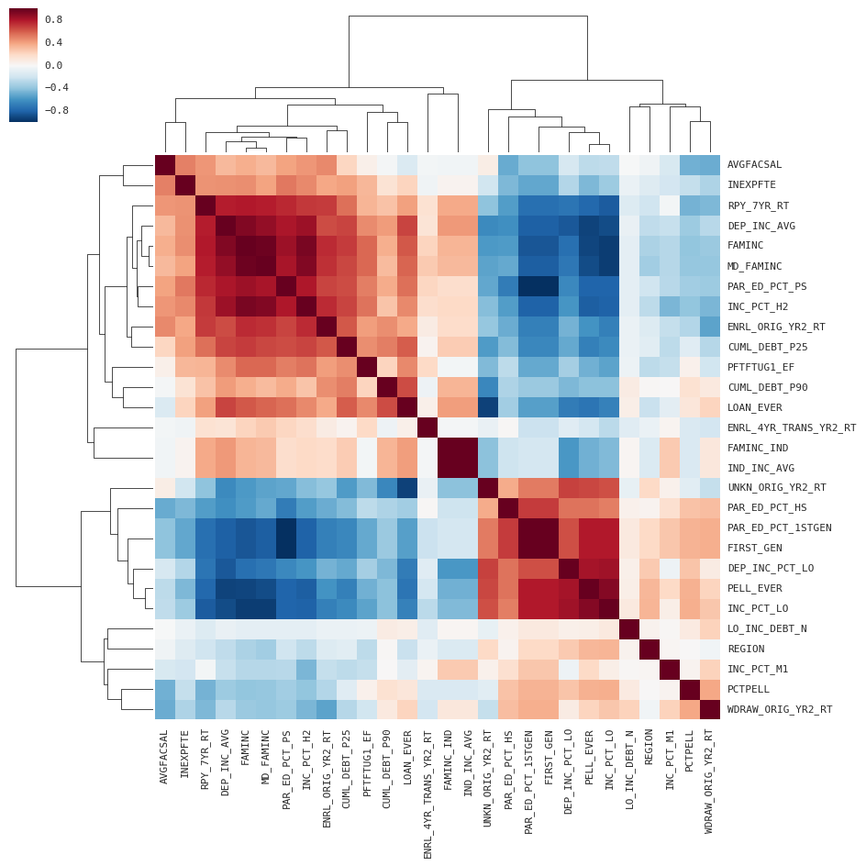
Heatmap

Slide 24
Model Development

Slide 25
Extra Trees Regressor
Model Selection Criteria:
Can be extended to a multi-output problem. Eg. Predict 5yr and 7yr default rates.
It looks as though our data could have multicollinearity.
Model errors remain uncorrelated.
The decision tree ensemble methods represent a balance between fitting non-linear data, and keeping some level of interpretability.
Performance
MSE: 0.0015
R²: 0.9249

Slide 26
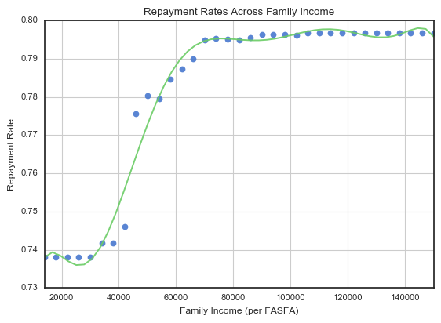
Repayment Rates Across Family Income Levels
The graph to the right shows the expected repayment rate for the average institution with all variables held constant with the exception of mean family income.
The family income number moves from the minimum of the dataset to the maximum of the dataset.
Family income is taken from the FAFSA when the student first enters the university.

Slide 27
Conclusion & Recommendations

Slide 28
Interpretation
Students who have family incomes less than about $35K are caught by the safety nets in place. Therefore, family income below $35K doesn't impact repayment rates. The same is true for students who have family incomes above $70K, they often have no trouble paying for college and family income is not all that important.
However, for students with family incomes in the middle range, their family income is massively important. Extrapolating out from the institution level, the difference in repayment rate between a student who comes from a family that makes $35K and on that makes $70k is almost 6%!
Possible uses:
As a university administer I would use this data to focus resources on these students. The good news here too is that this data was pulled from the FASFA filings, which means the university has access to this information for each student and they have early in the students college career.
For student loan originators, (and potential student loan originators) this analysis comes at a critical time in the market.

Slide 29

The Student Debt Landscape is Changing
Notes:
This is an opportunity for new entrance with a better understanding of what contributes to student defaults.

Slide 30
Questions?

