Slide 1
Automatic Speaker Recognition
Matz Radloff – Seminar „Aktuelle Themen der Audiosignalverarbeitung“

Slide 2
Contents
1 Use Cases
2 Challenges
3 Human vs. Machine
4 NN-based Speaker Recognition
5 Performance / Conclusion

Slide 3

Use Cases
Source: [3]

Slide 4
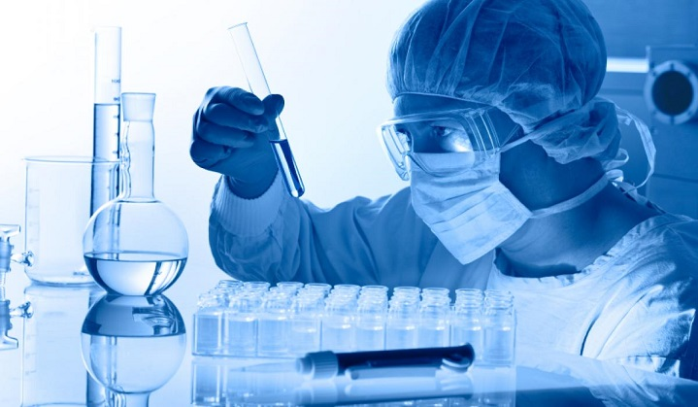
Use Cases
Source: [4]

Slide 5
Challenges
performance metric (how, not what)
high variability
situational task stress (car, hands-free, distraction)
vocal style (whisper, shout)
emotion
physiological (illness, intoxication, aging)
disguise
technological (different microphones)
environmental (background noise, room acoustic)
data quality (duration, sample-rate, compression)

Slide 6
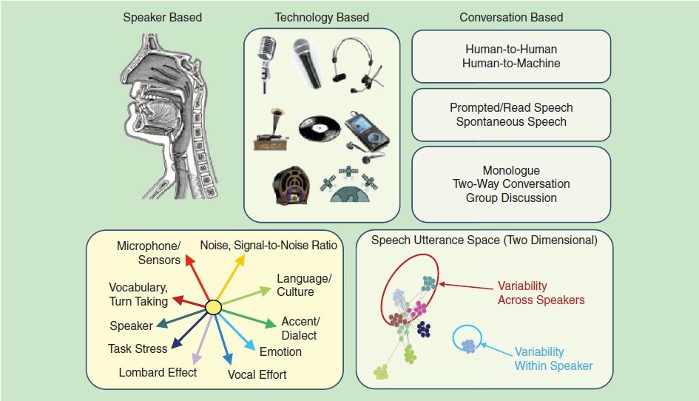
Challenges
Source: [1]

Slide 7
Human vs. Machine
Human
Machine
aquired trait
better if language if known
bad at identifying unfamiliar voices
susceptible to bias
requires sufficient training data
does not need to „know“ language
consistent performance when adequate data is available
only biased towards training data

Slide 8
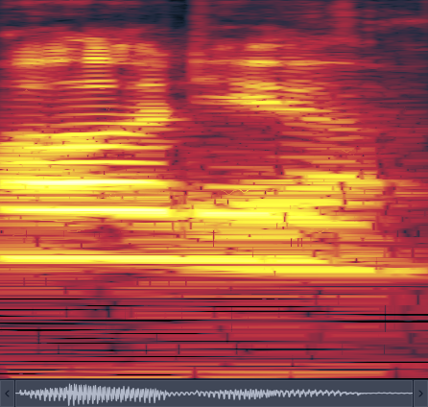
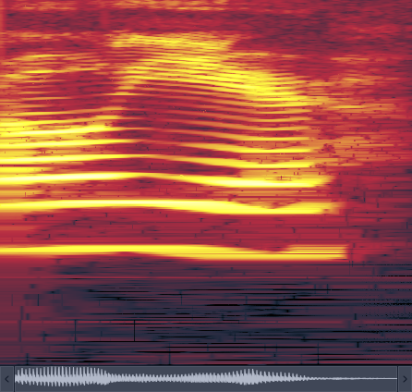
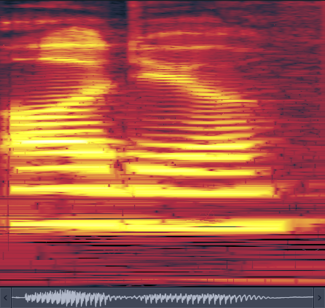
Human vs. Machine
#1
#2
#3

Slide 9
NN-based Speaker Recognition
“Neural Network Based Speaker Classification and Verification Systems with Enhanced Features”
paper by Zhenhao Ge et al. [2]
TIMIT 8K dataset (200 speakers)
100% classification rate

Slide 10
NN-based Speaker Recognition
preprocessing:
normalization
VAD (Voice Active Detection)
MFCC (Mel-Frequency Cepstral Coefficients)
Concatenation
neural network
shallow, 1 hidden layer (390:200:200)

Slide 11
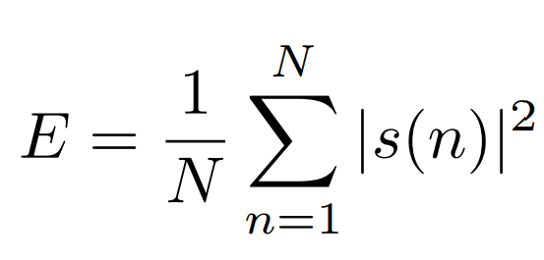
NN-based Speaker Recognition
VAD
Short-Term Energy (remove environmental noise)

Slide 12
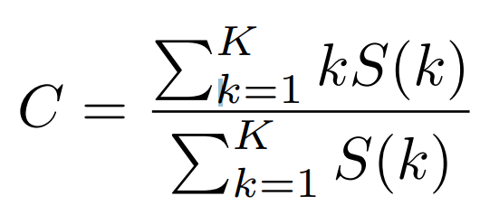
NN-based Speaker Recognition
VAD
Spectral Centroid (remove non-environmental noise)
„center of mass“ of spectrum

Slide 13
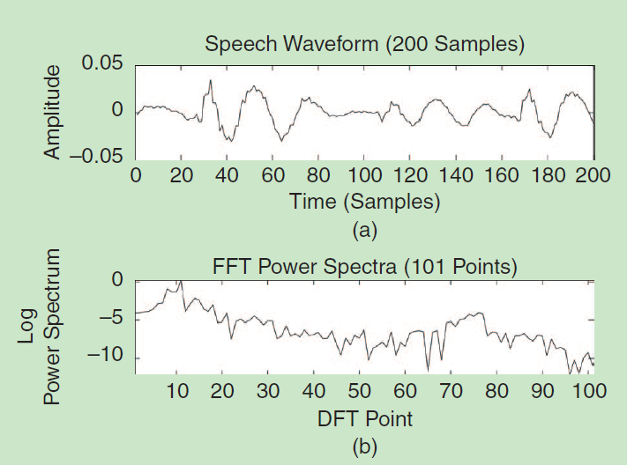
NN-based Speaker Recognition
Mel-Frequency Cepstral Coefficients
Source: [1]

Slide 14
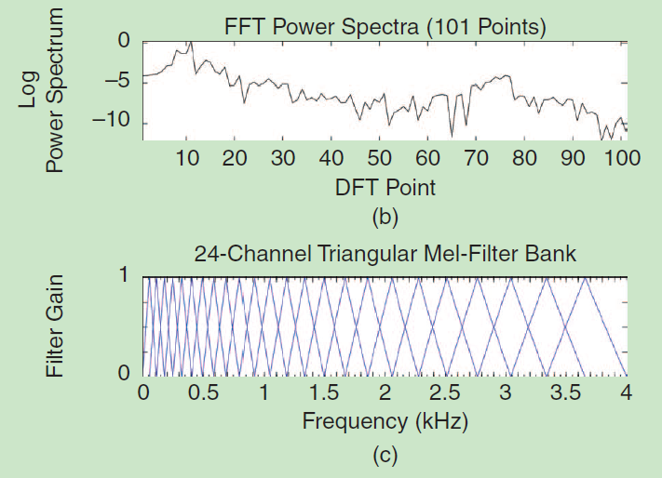
NN-based Speaker Recognition
Mel-Frequency Cepstral Coefficients
Source: [1]

Slide 15
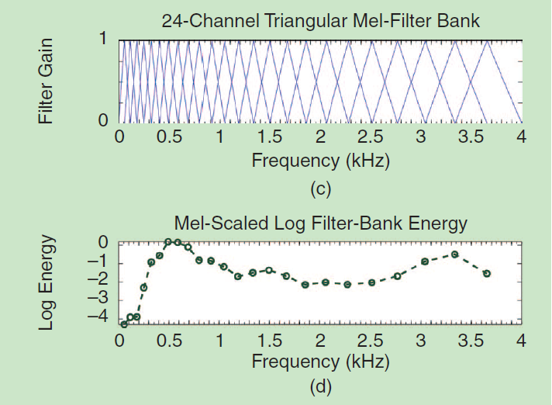
NN-based Speaker Recognition
Mel-Frequency Cepstral Coefficients
Source: [1]

Slide 16
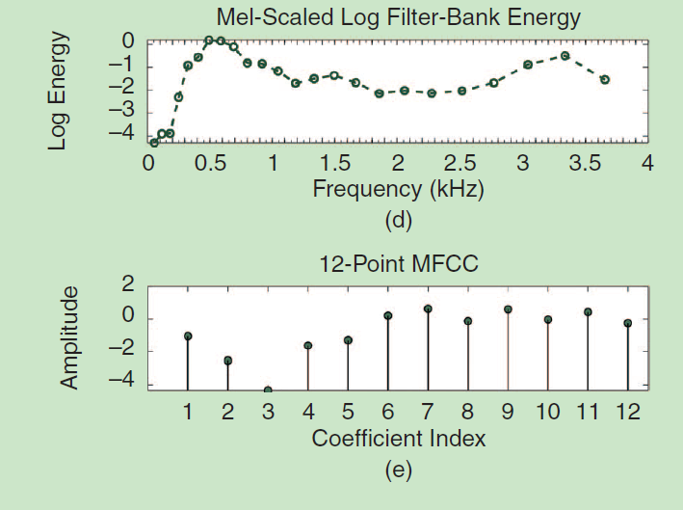
NN-based Speaker Recognition
Mel-Frequency Cepstral Coefficients
Source: [1]

Slide 17
NN-based Speaker Recognition
Concatenation
39-point MFCC
25ms overlapping windows (10ms hop)
normalization with SMVN (speaker-level multivariate normal distribution)

Slide 18
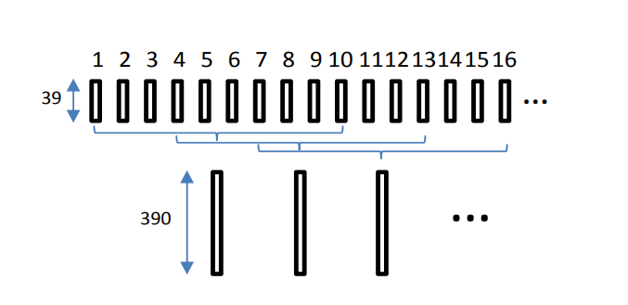
NN-based Speaker Recognition
Concatenation
10 frames concatenated (3 frames hop)
39 * 10 = 390 (NN input-vector size)
Source: [2]

Slide 19
NN-based Speaker Recognition
Neural-Network
390:200:200
forward-backward propagation
sigmoid activation-function

Slide 20
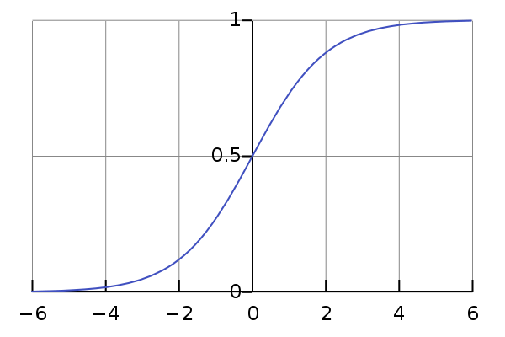
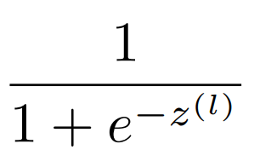
NN-based Speaker Recognition
Neural-Network
Sigmoid function:
Source: [5]

Slide 21
NN-based Speaker Recognition
Neural-Network
Output: 200-dimensional vector
„likelihood“ (0-1) of speaker

Slide 22
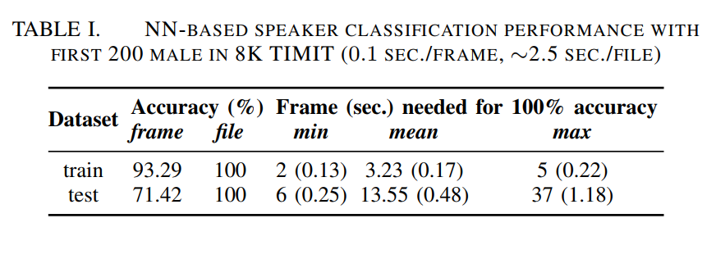
Performance / Conclusion
13.55 frames (0.48s) needed on average to achieve
100% accuracy
Source: [2]

Slide 23
Sources
[1] Speaker Recognition by Machines and Humans, John H.L. Hansen and Taufiq Hasan, IEEE signal processing magazine, Nov 2015
[2] Neural Network Based Speaker Classification and Verification Systems with Enhanced Features, Zhenhao Ge et al., Intelligent Systems Conference 2017, last access: 11.12.2017 14:43
[3] https://cdn0.vox-cdn.com/thumbor/FLjQuk0OsV2LEAUWcL7X_Fpex7k=/0x37:1848x1005/fit-in/1200x630/cdn1.vox-cdn.com/uploads/chorus_asset/file/9259995/OHYvMm8.jpg
[4] http://www.jobmail.co.za/blog/wp-content/uploads/2015/08/forensic-investigation.jpg
[5] https://en.wikipedia.org/wiki/Sigmoid_function#/media/File:Logistic-curve.svg

