Slide 1






I need to find the Arm & Hammer Toothpaste product page to count occurrences of "baking soda". Currently, I'm on the homepage of the WebShop. I should use the search bar to look for the product.
1. Use the search bar to search for "Arm & Hammer Toothpaste"
2. Navigate to the product page once found
3. Count occurrences of "baking soda" in
Description, Features, and Reviews sections
1
I need to search for "Arm & Hammer Toothpaste" using the search bar to locate the product page.
fill('21', 'Arm & Hammer Toothpaste')

Slide 2
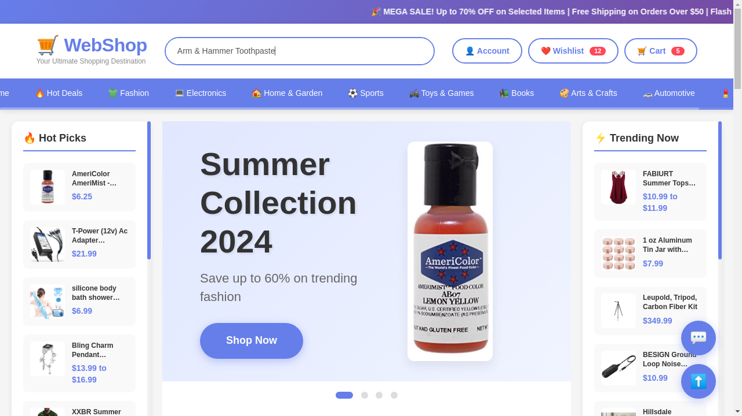
I need to find the Arm & Hammer Toothpaste product page to count occurrences of "baking soda". Currently, I'm on the homepage of the WebShop. I should use the search bar to look for the product.
1. Use the search bar to search for "Arm & Hammer Toothpaste"
2. Navigate to the product page once found
3. Count occurrences of "baking soda" in
Description, Features, and Reviews sections
1
I need to search for "Arm & Hammer Toothpaste" using the search bar to locate the product page.
fill('21', 'Arm & Hammer Toothpaste')

Slide 3
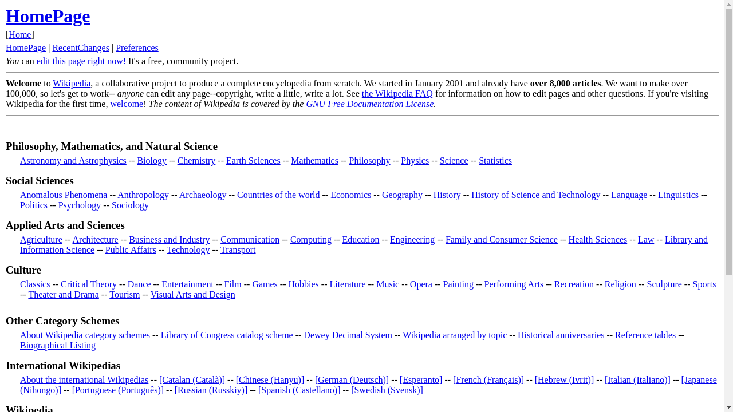
I need to search for "China" on the local Wiki, then navigate to the Hong Kong and Macau pages to find their populations and compute the difference. I'll use the search box on the current Wiki homepage.
1. Use the Wiki search box to search for "China".
2. Open the China article.
3. Find and click the Hong Kong link; note its population.
4. Go back to China page; find and click Macau;
note its population.
5. Compute absolute difference and send the
required message.
1
Opened Wiki homepage; ready to search for "China".
fill('161', 'China')

Slide 4
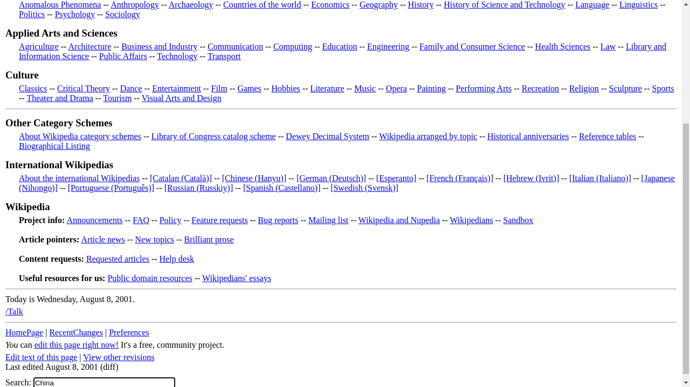
I need to search for "China" on the local Wiki, then navigate to the Hong Kong and Macau pages to find their populations and compute the difference. I'll use the search box on the current Wiki homepage.
1. Use the Wiki search box to search for "China".
2. Open the China article.
3. Find and click the Hong Kong link; note its population.
4. Go back to China page; find and click Macau;
note its population.
5. Compute absolute difference and send the
required message.
1
Opened Wiki homepage; ready to search for "China".
fill('161', 'China')

Slide 5

I opened the second search result and landed on a redirect page. I should go back to the search results to proceed with the next steps.
1. Go back to the search results.
2. Open the third result (valid), remember its title.
3. Go back, verify no other valid articles, then send "One".
5
I opened the second result and confirmed it was a redirect. I will go back to the search results page.
go_back()

Slide 6
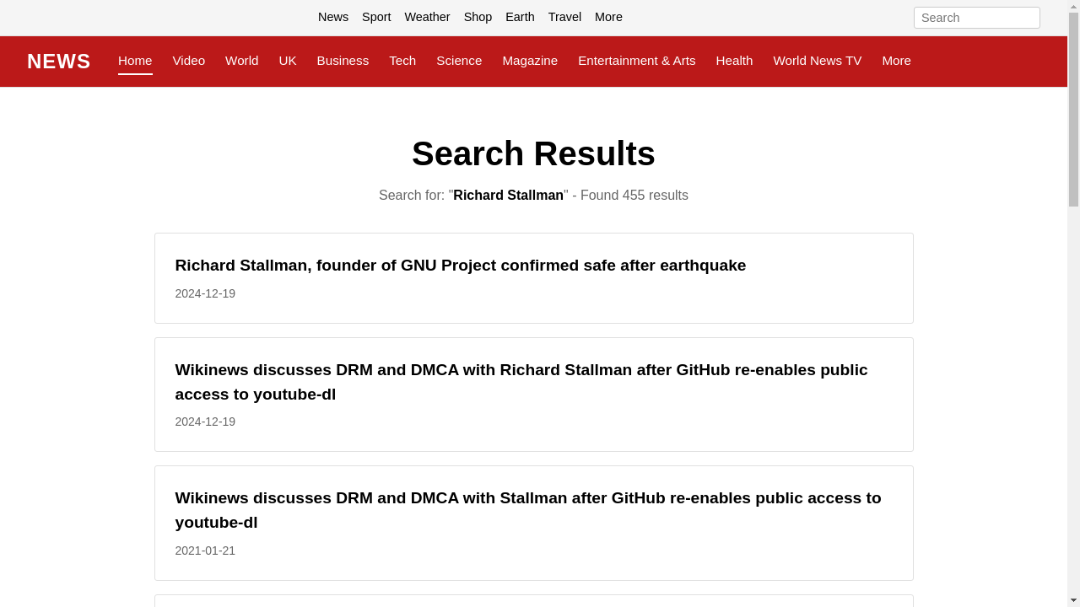
I opened the second search result and landed on a redirect page. I should go back to the search results to proceed with the next steps.
1. Go back to the search results.
2. Open the third result (valid), remember its title.
3. Go back, verify no other valid articles, then send "One".
5
I opened the second result and confirmed it was a redirect. I will go back to the search results page.
go_back()

