Slide 1
Delimited continuations in Scala
08/14/2014
PREPARED BY
Tim Myer
Programmer
tmyer@solutionsiq.com

Slide 2
SolutionsIQ
Join a great team of developers, consultants and Agile experts at a company that is Agile through and through.
We are hiring XP developers and coaches.
Swing by our booth or talk to me afterwards for more information.

Slide 3

SolutionsIQ
Join a great team of developers, consultants and Agile experts at a company that is Agile through and through.
We are hiring XP developers and coaches.
Swing by our booth or talk to me afterwards for more information.

Slide 4
Scala

Slide 5
“
if you look at the features Scala provides, it is substantially a functional language, but on the surface it does not always look like one, and it does not force you to adopt the functional style. For many of its users, the functional programming constructs in Scala are the most important set of tools it has to offer but they are not the only tools. In fact, great care has been spent in the Scala design to make functional constructs, imperative constructs, and objects all play well together. I think postfunctional is a good term for that blend.
”
- Martin Odersky
A Postfunctional Language

Slide 6
“
Scala: you stare at your foot for 3 days without any sleep, you then figrue [sic] out how to shoot yourself in the foot with one line of code… recursively.
”
Comment from Roberto Leibman on
How to Shoot Yourself in the Foot in Any Programming Language
by Mike Walker

Slide 7
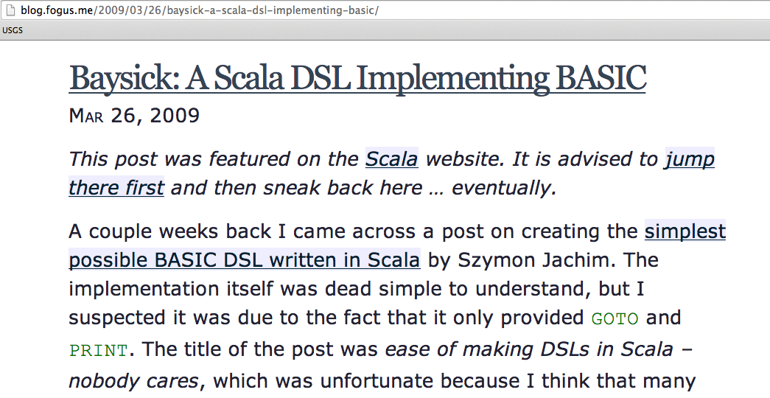

Slide 8
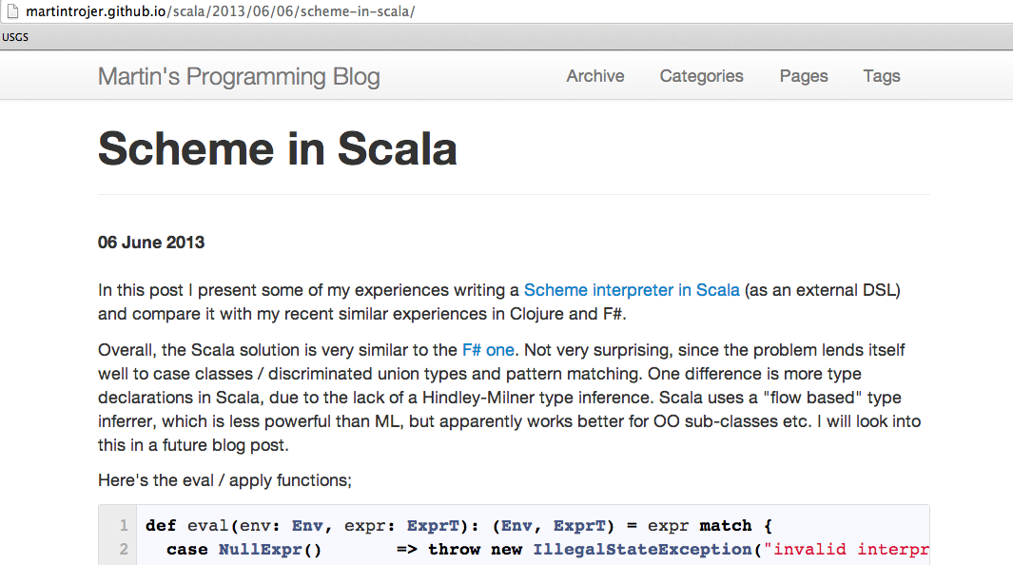

Slide 9
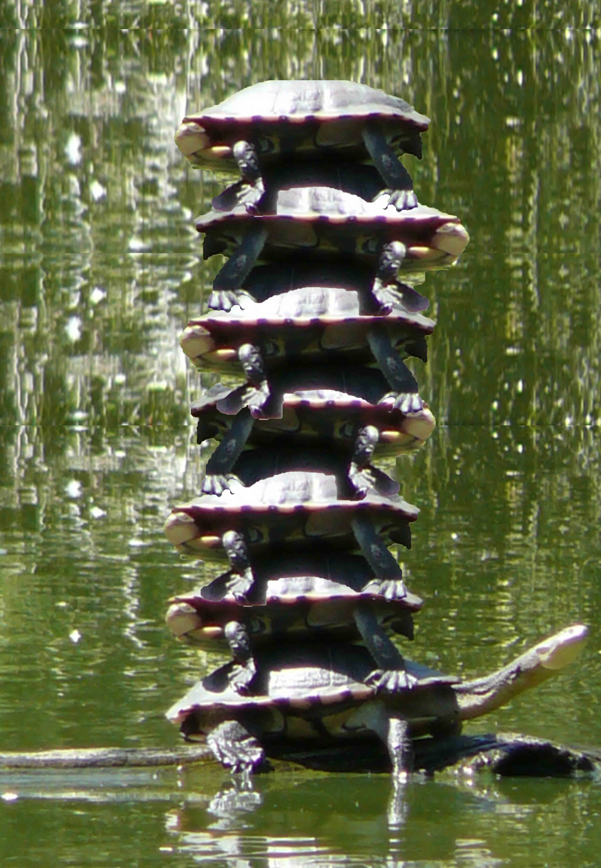

Slide 10
Continuations

Slide 11
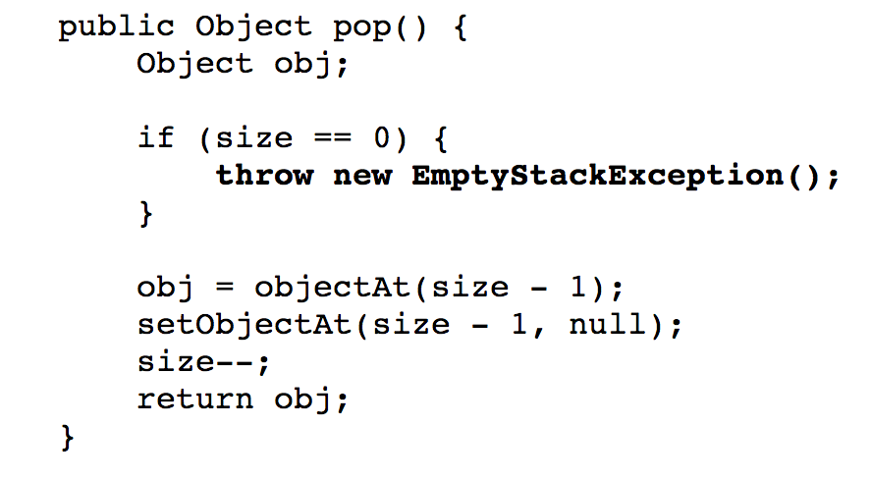

Slide 12
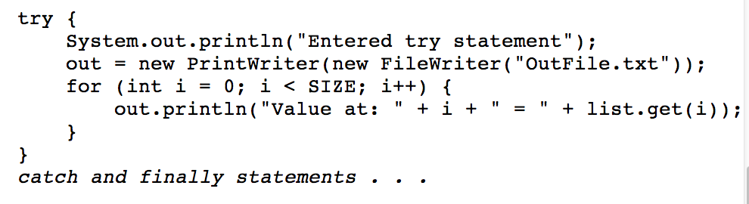

Slide 13
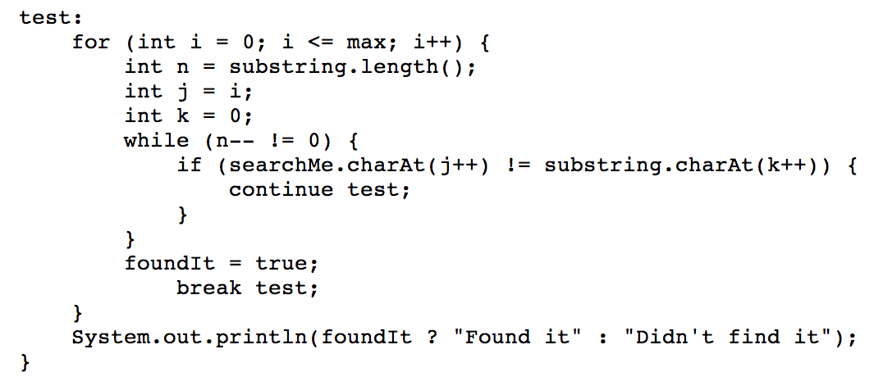

Slide 14
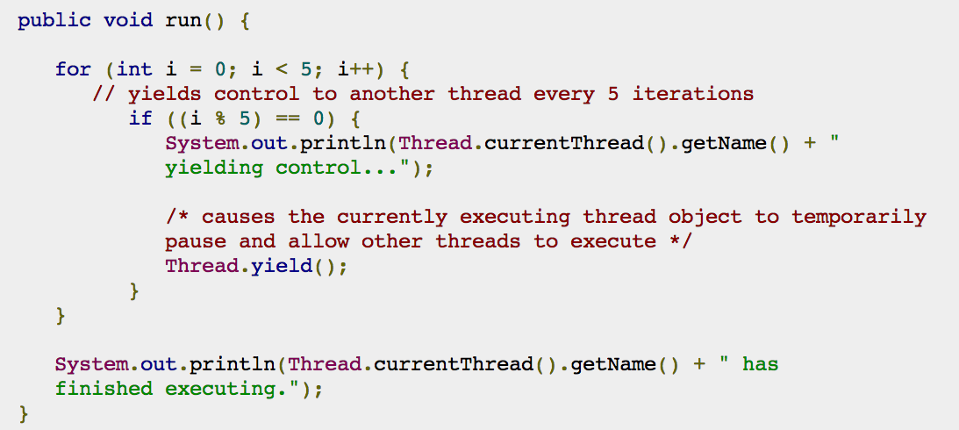

Slide 15
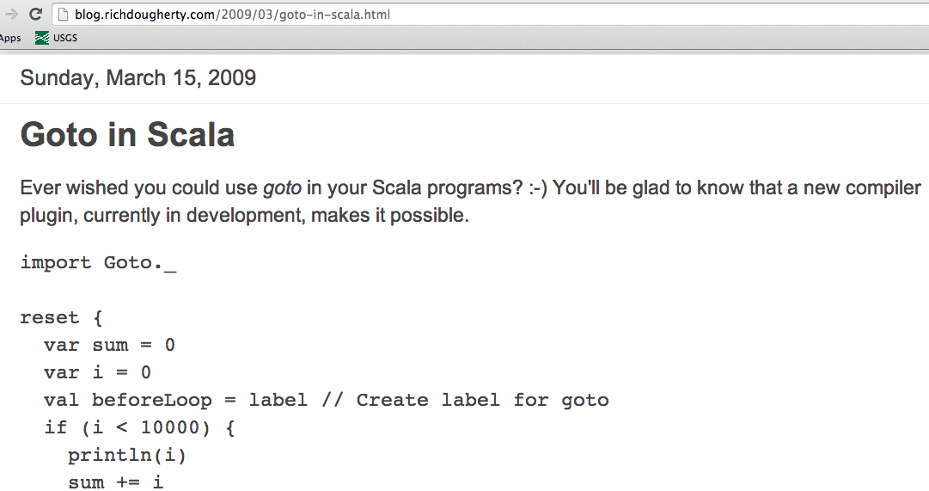

Slide 16
Delimited

Slide 18
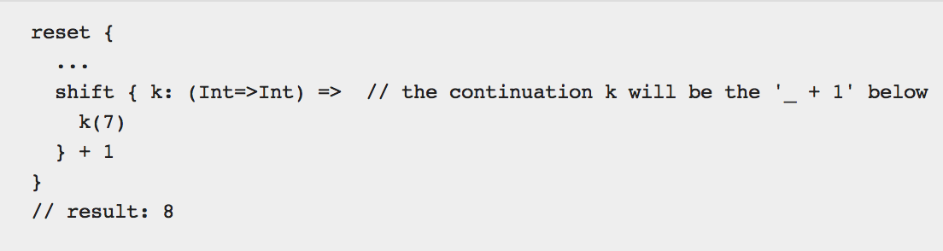

Slide 19
<Footer Content: Presentation Title, Partner Name, Other>
<number>
To be continued….

Slide 20
<Footer Content: Presentation Title, Partner Name, Other>
<number>
Thank you!
solutionsiq.com / 1.800.235.4091

