Slide 1
λ the eχtreme
test-driving a functional language
PREPARED BY
Tim Myer
Programmer
tmyer@solutionsiq.com

Slide 2
SolutionsIQ
Join a great team of developers, consultants and Agile experts at a company that is Agile through and through.
We are hiring XP developers and coaches.
Swing by our booth or talk to me afterwards for more information.

Slide 3
“
Scala: you stare at your foot for 3 days without any sleep, you then figrue [sic] out how to shoot yourself in the foot with one line of code… recursively.
”
Comment from Roberto Leibman on
How to Shoot Yourself in the Foot in Any Programming Language
by Mike Walker

Slide 4
Agenda
Tools of the Trade
First test
A synchronicity
Network independence
More of the same
Changing Station
And so on and so forth and so on….

Slide 5
Prelude

Slide 6
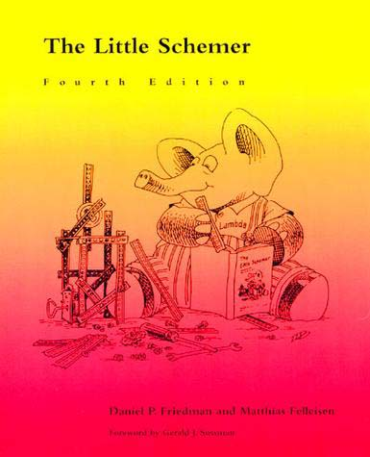
The Little Schemer

Slide 7
“
if you look at the features Scala provides, it is substantially a functional language, but on the surface it does not always look like one, and it does not force you to adopt the functional style. For many of its users, the functional programming constructs in Scala are the most important set of tools it has to offer but they are not the only tools. In fact, great care has been spent in the Scala design to make functional constructs, imperative constructs, and objects all play well together. I think postfunctional is a good term for that blend.
”
- Martin Odersky
A Postfunctional Language

Slide 8
Tools
Git
Maven
Scala IDE
A Dropbox account

Slide 9
TheBeginning
Where do we start?
We can start at
TheBeginning.
How can we do
that?
Check it out!

Slide 10
$ git clone https://github.com/timezra/LambdaTheExtreme.git && cd LambdaTheExtreme $ git checkout tags/TheBeginning

Slide 11
TheBeginning
We got git, now do
we get an
elephant?
We get a canary
instead.

Slide 12
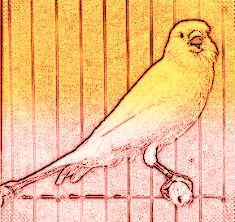
Canary

Slide 13
Canary
What does a canary
have to do with
this?
It’s an early
indication that
something has
gone very wrong.

Slide 14
$ git checkout tags/Canary

Slide 15
Interlude

Slide 16
Recap
A Case Class
An Object
A FeatureSpec
A FunSpec!

Slide 17
Canary
Can our canary get
account info?
Only with a
Dropbox account.

Slide 18
Actors

Slide 19
Actors
What happens
when our account
info changes?
Our expectation is
wrong.
What happens
when we change
our expectation?
Our test fails.

Slide 20
Actors
Why does it fail?
Our
implementation is
wrong.
Where do we find
the right
implementation?
Look in the upper
left.

Slide 21
$ git checkout tags/Actors

Slide 22
Actors
How can we call
Dropbox?
Using HTTP
How will Dropbox
know us?
We’ll give it a
token.

Slide 23
Actors
When will we get
our account info?
In the future!

Slide 24
Interlude

Slide 25
Recap
Configuration Management
Implicit conversions
An Actor
An Actor Testkit
The Future!

Slide 26
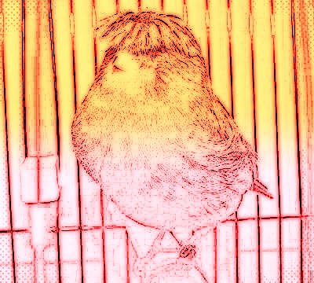
Care and Feeding

Slide 27
MinedReading
What happens if we
fail?
You tell me!
Do we catch an
exception?
We intercept it.

Slide 28
MinedReading
Sprechen Sie
Deutsch?
Wenn Sie möchten

Slide 29
$ git checkout tags/MinedReading

Slide 30
Etude

Slide 31
Recap
Stubbing a probe’s return value
Intercepting an expected exception
Iterating over an optional value

Slide 32
Putting it out there

Slide 33
Zed
May I share
something with
you?
Of course!
I would rather you
put than post.

Slide 34
Zed
What if I don’t have
a file lying around?
You can share
anything you like
over the web.
But how will you
know what it
should look like on
the other side?

Slide 35
Zed
Maybe Zed can
help.
Who’s Zed?
Scalaz!

Slide 36
$ git checkout tags/Zed

Slide 37
Interlude

Slide 38
Zed
Does Zed use
Monads?
Of course!
Where’s a good
definition of what
a Monad is?
Anywhere but
urbandictionary.com

Slide 39
Zed
This one is pretty good:
You Could Have Invented Monads!
The original is still the best:
Monads for functional programming
For today, we can look at them as a way
of chaining operations.

Slide 40
Recap
Implicit transformation from a File to an
abstract representation of its contents

Slide 41
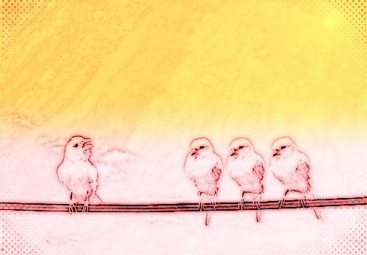
Birds of a feather

Slide 42
Bof
What if I want to
share all my
pictures of
canaries with
friends at once?
We just need a little
coordination.

Slide 43
Bof
How about a little
recursion?
Recursive
traversal fits a tree
like a glove.

Slide 44
$ git checkout tags/Bof

Slide 45
Interlude

Slide 46
CallCC
But what happens
if the recursion
goes on and on?
And on and on?

Slide 47
CallCC
And on and on and on and on and on and on and on and on and on and on and on and on and on and on and on and on and on and on and on and on and on and on and on and on and on and on and on and on and on and on and on and on and on and on and on and on and on and on and on and on and on and on and on and on and on and on and on and on and on and on and on and on and on and on and on and on and on and on and on and on and on and on and on and on and on and on and on and on and on and on and on and on and on and on and on and on and on and on and on and on and on and on and on and on and on and on and on and on and on and on and on and on and on and on and on and on and on and on and on and on and on and on and on and on and on and on

Slide 48
Recap
Changing recursive traversal to iterative
using continuations

Slide 49
To be continued….

Slide 50
Thank you! solutionsiq.com / 1.800.235.4091

