Slide 1
Assignment 6

Slide 2
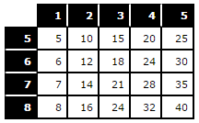
Assignment 6 - A Dynamic JavaScript Table
For this assignment, you will create a table dynamically based on parameters entered in an HTML form.
First, you must create a form that accepts the starting and ending numbers for both the horizontal (multiplier) and vertical (multiplicand) axes of a multiplication table.
Second, you will use the numbers entered
into the form to create a multiplication table
completely dynamically.
Ex: Inputs Multiplier: 1, 5 ; Multiplicand: 5, 8

Slide 3
Assignment 6 - Tips
When clicked, the submit button should kick off a JavaScript function, not submit the form.
No table is initially present before submit.
A table appears after valid submit.
A table is replaced if new valid values are submitted.
Encapsulate your JavaScript in functions with parameters so that the code you write for this assignment can be reused.

Slide 4
Assignment 6 - Validation
The input elements need to be validated.
When validating inputs, display a message/ indicate/ highlight invalid input to a user.
Make sure a user only enters numbers, or be prepared to handle otherwise.
Make sure the starting number is less than or equal to the end number, or be prepared to handle the case.
Validate your page and test many parameters to make sure you hit all use cases.

Slide 5
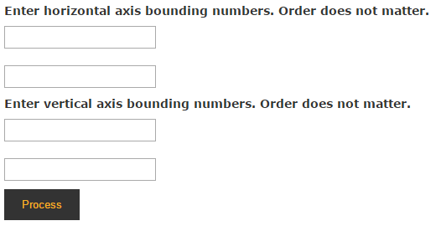
Before Validation
What could be improved?

Slide 6
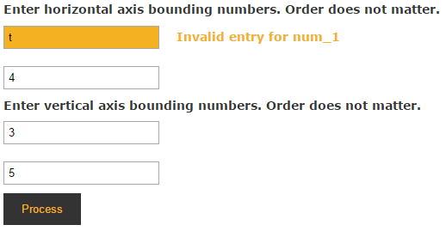
Validated With Errors
What could be improved?

Slide 7
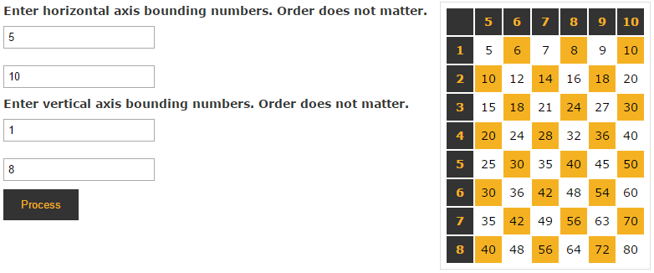
Assignment 6 - Sample Output

Slide 8
Assignment 6 - CSS
Use CSS to style the table in an appropriate way.
Be creative, but be mindful of usability.
The :nth-child() and other CSS3 pseudo-classes will be very helpful.
css-tricks.com/useful-nth-child-recipies
reference.sitepoint.com/css/css3psuedoclasses

Slide 9
Assignment 6 - Pseudo Selectors
Single Colon
Double Colon
:active :after :before :checked :default :disabled :empty :enabled :first-child :first-letter
:first-line :first-of-type :focus :hover :in-range :indeterminate :invalid :lang :last-child :last-of-type
:not :nth-child :nth-last-child :nth-last-of-type :nth-of-type :only-child :only-of-type :optional :out-of-range :read-only
:read-write :required :root :target :valid :visited
::after
::before
::first-letter
::first-line
::link
::selection
Experimental
:dir ::backdrop :fullscreen :scope ::placeholder
smashingmagazine.com/2016/05/an-ultimate-guide-to-css-pseudo-classes-and-pseudo-elements/

Slide 10
Assignment 6 - Useful Pseudo Selectors
:first-child
the first child of its parent element.
:last-child
the last child of its parent element.
:nth-child(param) * ↓
:nth-last-child(param) * ↑
targets one or more elements depending on order.
:focus
Styles elements that have come into focus.
:required, :optional, :invalid, :valid
Styles elements marked required through the corresponding attribute.
<input type=”text” required/>
<input type=”text” valid/>
<input type=”text” invalid/>
<ul> <li>1</li> <li>2</li> <li>3</li> </ul>
* Param can be the values odd, even, or a function() in the form of { A n [OP OFFSET] : OP is +- } so 2n+1 is valid
https://www.smashingmagazine.com/2016/05/an-ultimate-guide-to-css-pseudo-classes-and-pseudo-elements/#nth-child

Slide 11
Github Submission

Slide 12
Node/ Automation/ Testing
JavaScript Server
nodejs.org/en/
Task Runner
npmjs.com/
Package Manager
npmjs.com/package/gulp
Transpiler
babeljs.io/
Test Framework
mochajs.org/

Slide 13
Setting Up An Assignment
Create your directories where # is the assignment number
$ mkdir a#
$ cd a#
$ mkdir dep app
$ mkdir app/css app/js app/img
Commit
$ git add -A
$ git commit -m "Setting up a#"
$ git push -u origin master
Create your files
Commit Again

Slide 14
Application 6 - Submission
Once you have everything working on your local system, upload your assignment to GitHub.
Submit your assignment by submitting the GitHub URL where your application resides. By following the instructions you will be able to submit with a URL like this one
username.github.io/username/a#/index.html
Where
username is your Github user name
# is the assignment number

Slide 15
JavaScript Resources

Slide 16


Recommended Reading
Discusses what parts of the JavaScript language should be used and how to create error free and effective code.
How to implement algorithms and data structures specifically in the JavaScript language.

