Slide 1
Python Language Basics
Introduction
Data Types
NumPy
Packages
Pandas

Slide 2
Python Data Types
Introduction
Data Types
NumPy
Packages
Pandas

Slide 3
Python Language Basics
Operators
Data Types
Control Flow and Comprehensions
Functions
Strings
Files and Exception Handling
Multithreaded Programming

Slide 4
Lesson Objectives
Operators and Data Types
Control Flow – Conditionals and Loops
List Comprehensions
Functions and Modular Programming
Strings
Files and Exception Handling
Multithreaded Programming
Object Oriented Programming Concepts

Slide 5
Operators
Operators
Data Types
Control Flow and Comprehensions
Functions
Strings
Files and Exception Handling
Multithreaded Programming

Slide 6
Python Operators (Assignments / Boolean)
operation | operator | Example
Assignment | = | a = 10
Logical
And | and | a and b
Or | or | a or b
Not | not | not a

Slide 7
Python Operators: Arithmetic
Operation | operator | Example
Addition | + | a + b
Subtraction | - | a - b
Multiply | * | a * b
Division | / | a / b
Exponent | ** | a ** 2
modulus | % | 5 % 2 is 1
Integer division | // | 5 // 2 is 2

Slide 8
Python Operators: Bitwise
Operation | operator | Example
Bitwise And | & | a & b
Bitwise Or | | | a | b
Bitwise Xor | ^ | a ^ b
Bitwise 1’s complement | ~ | ~a
Logical shift left | << n | a << 2
Logical Shift Right | >> n | a >> 2

Slide 9
Python Operators: Comparison
Comparison | operator | Example
less | < | a < b
Greater | > | a > b
Less than equal | <= | a <= b
Greater than equal | >= | a >= b
Equal | == | a == b
Not equal | != | a != b

Slide 10
Data Types
Operators
Data Types
Control Flow and Comprehensions
Functions
Strings
Files and Exception Handling
Multithreaded Programming

Slide 11
Python Data Types
Python has no value types or primitive types
Everything is an object.
Objects are referred to by reference.
Even simple integers are references.
Variables are always references
References are untyped. (loose typing)
References can point to anything.
Some types are immutable (can’t be changed)
most numeric types
Strings
tuples

Slide 12
Python Data Types
Scalar
float (3.1)
int (10)
long (10L)
complex (1+3j)
bool (True / False)
str (“hello world”)
Complex
list: [1, 2, 2, 3]
set [1, 2, 3] #No dups
tuple (1,”hello”)
dict {“cat”: 3, “dog”, 4}

Slide 13
Converting types
Some types can be auto-converted without a warning
There is a hierarchy:
bool -> int -> long -> float -> complex
Upcasting is never a problem.
Downcasting requires loss of information.
Explicit conversion / casting
Casting is accomplished by passing the value to the constructor
Example: int(3.1) # float is passed into the constructor of int
Casting always copies the data and makes a new object.

Slide 14
Lists
List are a mutable ordered collection of objects
Can mix and match types (unlike NumPy Arrays)
Slicing : returns copy of sub-list (zero based index)
a[1:3] -- gets [”abc”, 3.1]
a[:] -- gets a copy of the whole list #pythonic way to copy list
a[-3:-1] – goes from three from the end to the last.
a = [1, “abc”, 3.1]
a[1]
"abc”

Slide 15
Lists
Lists are mutable ordered collection of objects
Can mix and match types (unlike NumPy Arrays)
Slicing - [m:n] returns copy of sub-list from m to n-1 (zero based index)
>>> a = [1, “abc”, 3.1]
>>> a[0]
1
>>> a.append(“appended element”)
>>> a
[1, 'abc', 3.1, 'appended element’]
>>> a[1:3]
[‘abc’, 3.1]
>>> a[:]
[1, ‘abc’, 3.1]
>>> a[-3:-1]
[1, ‘abc’]

Slide 16
Sets
Sets are an unordered collection of objects, with no dups
Can mix and match types like lists
Sets can be used to de-dup a list
frozenset() is an immutable set
a = set{1, “abc”, 3.1} #Note the curly braces
a = list(set(a)) # original order not kept
a = frozenset({’a’,’b’,’c’}) #immutable

Slide 17
Sets
Sets are an unordered collection of objects, with no dupes
Can mix and match types, just like lists
Sets can be used to de-dup a list
Frozen Sets
>>> a = {1, “abc”, 3.1, “abc”, 2, 1, 10, 1}
>>> a
{1, 2, 3.1, 10, 'abc'}
>>> a = [1, “abc”, 3.1, “abc”, 2, 1, 10, 1]
>>> a
[1, 'abc', 3.1, 'abc', 2, 1, 10, 1]
>>> a = list(set(a))
>>> a
[1, 2, 3.1, 10, 'abc']
>>> a = frozenset({“a”, “b”, “c”})

Slide 18
dicts
dicts are groups of key-value pairs
Objects can be of ANY type (mix and match)
>>> a = {“one”: 1, “two”: 2, “three” : 3}
>>> a[“one”]
1

Slide 19
Named Items in dicts
Here we are creating a list with key=value (or name=value) pairs
>>> stock = {"symbol”:"goog",
"ask”:100.1,
"sell”:100.5}
>>> stock
{'sell': 100.6, 'symbol': 'GOOG', 'ask': 100.1}
# refer data by symbols / names
>>> stock[‘ask’]
100.1

Slide 20
dicts : Adding New Attributes
> stock = {'symbol':'GOOG', 'ask':100.1, 'sell':100.6}
# Add a new attribute using []
> stock[‘company name’] = ‘Google’
> stock[‘exchange’] = ‘NASDAQ’
> stock
{'Company Name': 'Google', 'sell': 100.6, 'symbol': 'GOOG', 'ask': 100.1, 'Exchange': 'NASDAQ'}

Slide 21
Dictionaries
You can think of a dict as a key-value pairs.
Accessing list elements
By name (most common). e.g. stock[‘price’]
dicts are *IMPORTANT* in Python
Lots of Python functions return dicts as a result.
Need to know how to navigate the dicts.

Slide 22
Dictionaries
Dictionaries are groups of key-value pairs
Objects can be of ANY type (mix and match)
>>> a = {“cats”: 8, “dogs”: 3, “tigers” : 2}
>>> a[“dogs”]
3
>>> a[“cats”]
8
>>> stock = {“symbol” : “aapl”, “ask” : 190.1, “sell” : 196.5}
>>> stock
{'symbol': 'aapl', 'ask': 190.1, 'sell': 196.5}
>>> stock[“ask”]
100.1

Slide 23
Dictionaries: Adding New Attributes
New attributes or key/value pairs can be added as follows
Dictionaries are important in Python
>>> stock = {“symbol” : “aapl”, “ask” : 190.1, “sell” : 196.5}
>>> stock
{'symbol': 'aapl', 'ask': 190.1, 'sell': 196.5}
>>> stock[“company”] = “apple”
>>> stock[“stock”] = “nasdaq”
>>> stock
{'symbol': 'aapl', 'ask': 190.1, 'sell': 196.5, 'company': 'apple', 'stock': 'nasdaq'}

Slide 24
Tuples
Tuples are groups of data
How is a tuple different from a list?
Tuples are immutable (can’t be changed in any way)
Tuples aren’t able to be iterated over.
Tuples are fixed length
Used for:
Returning more than one thing from a function
Forcing mutable data to be immutable
lambda x : (x, x*2) # returns 2 arguments
a = [1,2,3] # Mutable list of size 3
b = tuple(a) #Immutable tuple of size 3

Slide 25
Tuples
Example – To convert 2D to 3D coordinates
>>> coordinates = (5.3, 4.8)
>>> coordinates
(5.3, 4.8)
>>> coordinates.append(3.4)
<error>
>>> p = list(coordinates)
>>> p
[5.3, 4.8]
>>> p.append(3.4)
>>> p
[5.3, 4.8, 3.4]
>>> coordinates = tuple(p)
>>> coordinates
(5.3, 4.8, 3.4)

Slide 26
Arrays
Python has no native array functionality
List will serve in a pinch, but is very S-L-O-W
The package numpy introduces a native array,
We will discuss shortly.

Slide 27
Lab: Python datatypes
Lab
Overview: Quick intro lab to Python
Approximate time: 10 mins
Instructions: 03-languageintro / types

Slide 28
Lab: Python Data Types
Lab
Overview: Introduction Python Data Types
Approximate time: 10 mins
Instructions:
03__pythonLanguageBasics | 3.1-types.ipynb

Slide 29
Ranges
range(<stop>)
range(5) creates a sequence from 0 to 4
range(<start>, <stop>, <step>)
range(5, 15, 1) creates a sequence from 5 to 14 with a step of 1
range(1, 10, 2) creates a sequence from 1 to 9 with a step of 2
It is more flexible than range(<stop>)
>>> a = list(range(5))
>>> b = list(range(5, 15, 1))
>>> c = list(range(1, 10, 2))
>>> print(a)
[0, 1, 2, 3, 4]
>>> print(b)
[5, 6, 7, 8, 9, 10, 11, 12, 13, 14]
>>> print(c)
[1, 3, 5, 7, 9]

Slide 30
Ranges
range(5) creates a sequence from 0 to 4
range(start, stop step) function is more flexible
range(1,10, 2) => 1,3,5,7,9
range(0, 0.1, 0.01) => 0.0, 0.01, …, 0.10
More options: ?range

Slide 31
Control Flow and Comprehensions
Operators
Data Types
Control Flow and Comprehensions
Functions
Strings
Files and Exception Handling
Multithreaded Programming

Slide 32
Blocks in Python
Python does not have curly braces (like Java)
Blocks are delimited by indentation
Whitespace matters! But why?
Because it’s good style to use indentation (in Java too!)
Why not have it do meaning too, instead of just ignored.
Curly braces are redundant, and can cause unexpected errors.
statement:
indented block
indented block
statement:
statements

Slide 33
Control Flow: IF-Else
if (condition or expression):
statements
elif: #else if (note the syntax)
statements
else:
statements

Slide 34
One-liner
Can do a one-liner like this:
This is similar to the C++/Java ternary operator.
But arguably more readable.
isApple = True if fruit==‘Apple’ else False

Slide 35
Control Flow – Conditionals - One Liners
It is possible to condense code from an if-else statement into just one line
This is similar to the c++/Java ternary operator, but arguably more readable.
>>> fruit = “Apple”
>>> isAppleFlag = True if fruit == “Apple” else False
>>> isAppleFlag
True
>>> fruit = “Orange”
>>> isAppleFlag = True if fruit == “Apple” else False
>>> isAppleFlag
False

Slide 36
Lab: Conditionals
Lab
Overview: Conditional Statements in Python
lab
Approximate time: 10 mins
Instructions: 03-languageintro / Conditionals

Slide 37
Lab: Python Control Flow - Conditionals
Lab
Overview: Write conditionals in Python
Approximate time: 10 mins
Instructions:
03__pythonLanguageBasics | 3.2-conditionals.ipynb

Slide 38
Control Loops
# for loop
for (x in range(10)): # range generates list print(x)
# while loop
x = 10
while (x >= 0):
print(x) #break, continue work here
x = x - 1

Slide 39
For loops and lists
For loops are designed to operate over lists
Can also operate over strings
In by itself tests membership in a list
squares = [1, 4, 9, 16]
sum = 0
for num in squares:
sum += num
print sum ## 30
list = [’Tim', ‘Mark', ‘Sujee']
if ‘Sujee' in list:
print ‘Present!'

Slide 40
Control Flow – Loops – for and while loops
The following is the syntax for loops in Python
# while loop
x = 10
while (x >= 0):
print(x)
x = x - 1
# for loop
for (x in range(10)):
print(x)
# while loop with break and continue
x = 100
while (x >= 0):
if x%17 == 0:
print(x)
break
else
x -= 1
continue

Slide 41
For loops and lists
For loops are designed to operate over lists
Can also operate over strings
In by itself tests membership in a list
squares = [1, 4, 9, 16]
sum = 0
for num in squares:
sum += num
print sum ## 30
list = [’Tim', ‘Mark', ‘Sujee']
if ‘Sujee' in list:
print ‘Present!'

Slide 42
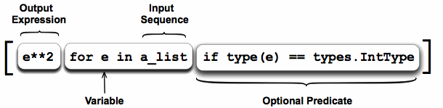
Comprehensions
Python allows an elegant way to iterate through ranges and lists called comprehensions.
a_list = [1, ’4’, 9, ‘a’, 0, 4]
squared_ints = [ e**2 for e in a_list if type(e) == types.IntType ]
print squared_ints
# [ 1, 81, 0, 16 ]

Slide 43
Comprehensions
Python allows an elegant way to iterate through ranges and lists called comprehensions.
The example below is a list comprehension
>>> a_list = [1, “4”, 9, “a”, 0, 4]
>>> squared_ints = [e**2 for e in a_list if “int” in str(type(e))]
>>> print(squared_ints)
[1, 81, 0, 16]

Slide 44
Lab: Control Loops
Lab
Overview: Quick intro lab to Python
Approximate time: 10 mins
Instructions: 03-languageintro / control loops

Slide 45
Lab: Python Control Flow - Loops
Lab
Overview: Write loops in Python
Approximate time: 10 mins
Instructions:
03__pythonLanguageBasics | 3.3-loops.ipynb

Slide 46
Functions
Introduction
Data Types
Functions
Packages
Pandas

Slide 47
Functions
Operators
Data Types
Control Flow and Comprehensions
Functions
Strings
Files and Exception Handling
Multithreaded Programming

Slide 48
User Functions
Easy to write custom user functions and extend Python.
Return type can by any type : scalar / object / NULL
If end of function is reached without explicit return,
the value of last evaluated expression is returned.
def function (arg1, arg2, …. ):
statements
return(result) #don’t need to say return

Slide 49
User Functions
Concept of modular programming
Easy to write custom user functions and extend Python
“return” statements are optional
def function (arg1, arg2, … ):
statements
return(result) # don’t need to say return

Slide 50
User Function Example
def my_max(x,y):
if (x > y)
return x
else
return y

Slide 51
User Functions
Return type can be any type - scalar/complex data type or user defined object / NULL
If end of function is reached without explicit return, the value of last evaluated expression is returned.
def my_max(x,y):
if (x > y):
return x
else:
return y
>>> val = my_max(5,8)
>>> print(val)
8

Slide 52
DocStrings
Functions can (and should) define a docstring
def my_max(x,y)
””” This re-implements the max function
“””
if (x > y):
return x
else :
return y
print(my_max.__doc__)
This re-implements the max function

Slide 53
DocStrings
Functions can (and should) define a docstring to help understand the inputs and outputs of the function
def my_max(x,y):
’’’
This function re-implements the max function
Inputs: Two numbers x, y
Outputs: The maximum of the two numbers
‘’’
if (x > y):
return x
else:
return y
print(my_max.__doc__)
This function re-implements the max function
Inputs: Two numbers x, y
Outputs: The maximum of the two numbers

Slide 54
Lambda Functions
A Lambda is an anonymous function.
Usually used as an argument to another function
Many functions require other functions as parameters:
lambda x : x * x #generate square
people = [(1, ‘Sara’), (2, ‘Bob’), (3, ‘Mary)]
people.sort(key = lambda x: x[1])
[(2, ‘Bob’), (3, ’Mary’), (1, ‘Sara’)]

Slide 55
Lambda
“Lambda Function” is an anonymous function.
Usually used as an argument to another function
The syntax is as follows:
Many functions require other functions as parameters. For example, sorting a list of tuples by the second element in the tuple
lambda <inputs> : <output>
>>> people = [(2, “Sara”), (1, “Bob”), (3, “Mary”)]
>>> people.sort()
>>> print(people)
[(1, 'Bob'), (2, 'Sara'), (3, 'Mary')]
>>> people.sort(key = lambda x: x[1])
>>> print(people)
[(1, ‘Bob’), (3, ’Mary’), (2, ‘Sara’)]

Slide 56
Map
Performing an operation on a Array / matrix… Should I use a loop to go through?
Another option is to use a map
Returns:
a = [1, 2, 3, 4, 5]
list(map(lambda x: x * 2, a))
[2, 4, 6, 8, 10]

Slide 57
Map
Performs an operation on any list type for each element
The syntax is as follows:
Example:
Note that map returns a map-object that is converted to a list, set, etc.
map(<function>, <sequence>)
>>> a = [1, 2, 3, 4, 5]
>>> a_square = list(map(lambda x : x*x, a))
>>> print(a_square)
[1, 4, 9, 16, 25]

Slide 58
Filter
Performs a filter operation on any list type and returns an object, that can be converted to a sub-list
The syntax is as follows:
Example:
filter(<function>, <sequence>)
>>> a = [1, 2, 3, 4, 5, 6, 7, 8, 9, 10]
>>> a_even = list(filter(lambda x : x%2==0, a))
>>> a_odd = list(filter(lambda x : x%2!=0, a))
>>> print(a_even)
[1, 4, 9, 16, 25]
>>> print(a_odd)
[1, 4, 9, 16, 25]

Slide 59
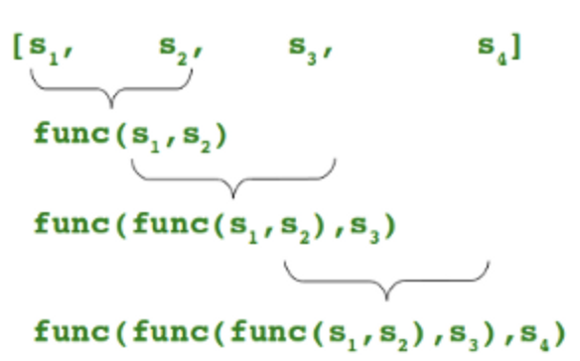
Reduce
Performs a reduce operation on any list type. It continually applies a function to the input sequence and returns a single result.
Example: One line statement to find the maximum number from a sequence
from functools import reduce
reduce(lambda a,b: a if (a>b) else b, [47,11,42,102,13])
102

Slide 60
Lab: Functions
Lab
Overview: Quick intro lab to Python
Approximate time: 10 mins
Instructions: 03-languagebasics / functions

Slide 61
Lab: Functions
Lab
Overview: Write functions in Python
Approximate time: 10 mins
Instructions:
03__pythonLanguageBasics | 3.4-functions.ipynb

Slide 62
Strings
Introduction
Data Types
Strings
Packages
Pandas

Slide 63
Strings
Operators
Data Types
Control Flow and Comprehensions
Functions
Strings
Files and Exception Handling
Multithreaded Programming

Slide 64
Strings
Class str()
Immutable arrays of variable length
All strings Unicode in Python 3
No separate “char” type – just single length string
Examples of literal strings:
‘single quotes’
“double quotes”
“””triple quotes””” # allows multi-line
b’\xea’ # binary escaped characters
u’ नमस्ते’ # Unicode characters
r’\d\d’ # Raw string, good for regexes

Slide 65
Formatted strings
Uses C (not C++) style printf syntax
Use parenthesis for longer formatted strings (as shown above)
text = (“Hi %s! You are the %dth visitor here today” % (”Mary”, 56))

Slide 66
Formatted strings
Python uses C style formatting syntax – printf(x)
Python doesn’t use C++ style formatting syntax – cout << x
Use parenthesis for longer formatted strings (as shown above)
>>> text = (“Hi %s! You are visitor %d today” % (”Mary”, 56))
>>> print(text)
'Hi Mary! You are visitor 56 today'

Slide 67
Referencing Strings
Slicing similar to list slicing.
‘Hello’[1:3] : ’el’ # start from 1 up to but not including 3.
‘Hello’[1:-1] : ‘ell’ # star t from 1 up to but not including last

Slide 68
Referencing Strings
String slicing is similar to lists:
‘Hello’[1:3] gives ’el’ # start from 1 up to but not including 3
‘Hello’[1:-1] gives ‘ell’ # start from 1 up to but not including last
>>> text = “Hello world!”
>>> print(text)
’Hello world!’
>>> print(text[:])
’Hello world!’
>>> print(text[:5])
’Hello’
>>> print(text[6:11])
’world’
>>> print(text[6:-1])
’world’

Slide 69
String Methods
Method | Description
.lower(), .upper() | Changes to lower/upper case
.strip() | Removes whitespace from beginning and end.
.startswith(’abc’), .endswith(‘abc’) | Tests whether string starts with or ends with the given string.
.isalpha(‘abc’), .isdigit(), .isspace() | Tests if all charcaters in string are alpha/digit/whitespace
.find(‘abc’) | Will find index of substring ’abc’ and return index, or -1 if not found (NOT a regex)
.replace(‘old’,’new’) | Will replace string with another string (NOT regex)
.split(’,’) | Returns a list of strings given by delimiter (comma in this case) ”a,b,c,d” => [‘a’,’b’,’c’,’d’]
.join([‘a’,’b’,’c’,d’] | Will join the list using the string itself as delimiter: “,”.join([‘a’,’b’,’c’,’d’])

Slide 70
Regular Expressions
Python has very powerful (and fast) regex engine
import re
p = re.compile(r'ab*’, re.IGNORECASE)
p.match(‘abbb’)
<_sre.SRE_Match object; span=(0, 4), match='abbb'>
m = p.match(‘abbb’).group(0) #returns string

Slide 71
Regex
re.match(‘pattern’) – matches regex at beginning of sring
re.search(‘pattern’) – matches regex anywhere in string
re.findall(‘pattern’) – matches regex
re.sub(‘pattern’, ‘replace’) – does regex substtitution

Slide 72
Lab: String
Lab
Overview: Quick intro lab to Python
Approximate time: 10 mins
Instructions: 03-languagebasics / strings

Slide 73
Lab: Strings
Lab
Overview: Play with strings in Python
Approximate time: 10 mins
Instructions:
03__pythonLanguageBasics | 3.5-strings.ipynb

Slide 74
Exceptions
Introduction
Data Types
Exceptions
Packages
Pandas

Slide 75
Files and Exception Handling
Operators
Data Types
Control Flow and Comprehensions
Functions
Strings
Files and Exception Handling
Multithreaded Programming

Slide 76
Files
Syntax to open a file – txt
Syntax to open a file – csv
filename = “../data/files/file.txt”
with open(filename, 'r') as myfile:
for line in myfile:
print(line)
filename = “../data/files/file.csv”
with open(filename) as myfile:
myfilereader = csv.reader(myfile, delimiter=',')
for row in myfilereader:
print(' '.join(row))

Slide 77
Python Exceptions
Python can throw exceptions.
We should catch Exceptions
try:
f = open(filename, 'rU')
text = f.read()
f.close()
except IOError:
## If exception, comes here.
sys.stderr.write('problem reading:' + filename)
## In any case, the code then continues with the line after the try/except

Slide 78
Python Exception Handling
Python can throw exceptions
Exception handling helps in attempts to open non-existent files, corrupt files etc
try:
with open(filename, 'r') as myfile:
for line in myfile:
print(line)
except IOError:
sys.stderr.write('problem reading:' + filename)
try:
with open(filename, 'r') as myfile:
for line in myfile:
print(line)
except:
print("Sorry! The file either doesn't exist or is corrupt!")

Slide 79
Lab: Files
Lab
Overview: Play with files in Python
Approximate time: 10 mins
Instructions:
03__pythonLanguageBasics | 3.6-files.ipynb

Slide 80
Multithreaded Programming
Introduction
Data Types
Exceptions
Packages
Pandas

Slide 81
Multithreaded Programming
Operators
Data Types
Control Flow and Comprehensions
Functions
Strings
Files and Exception Handling
Multithreaded Programming

Slide 82
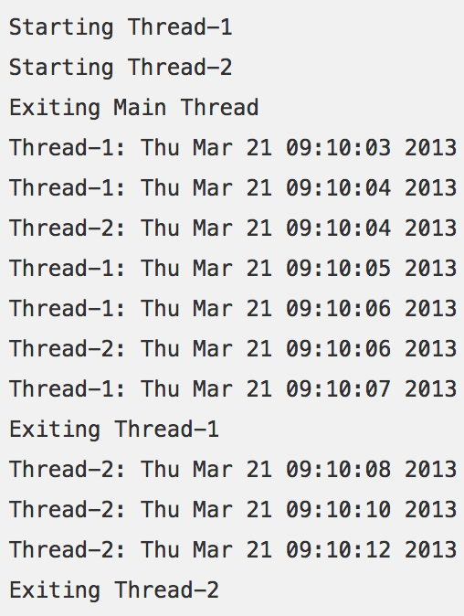
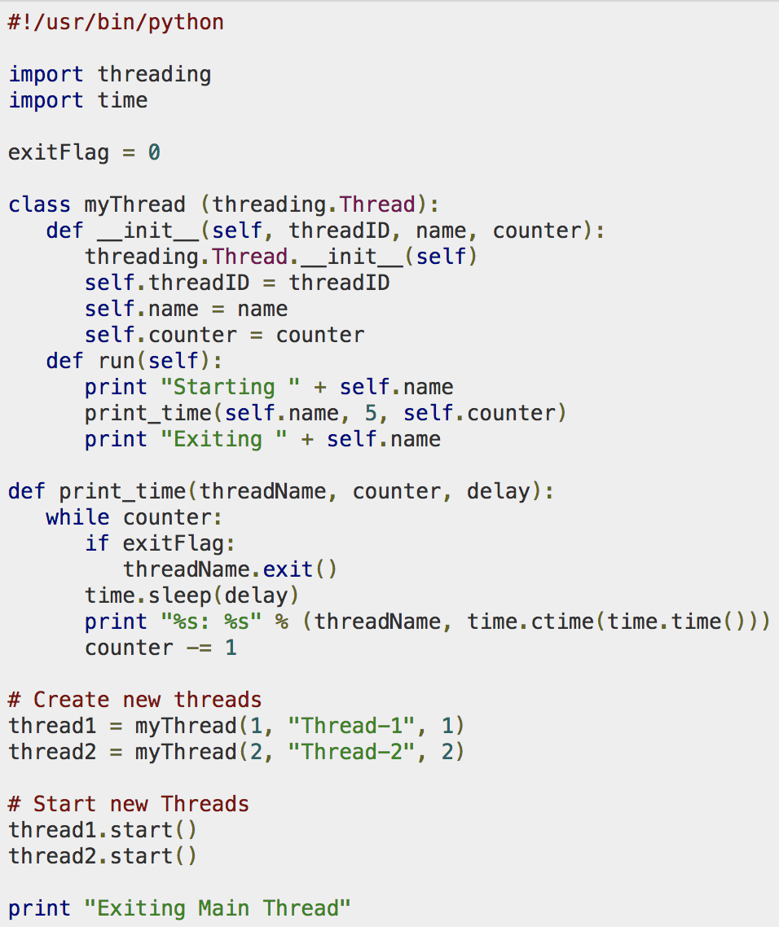
Multithreaded programming
Python supports multithreaded programming
Works very similar to Java (identical interface)
The ’threading’ class is used

Slide 83
Threads
Python supports multithreaded programming
Works very similar to Java (identical interface)
Can also inherit from Thread class
import threading
def dowork():
# Do something
threading.Thread(target=dowork).start()
class MyThread(threading.Thread);
def run(self): #override this
#Do Something

Slide 84
Thread Safety
Immutability is very nice when we have threads!
tuple/frozenset are a thread-safe collection type.
Strings and numerics (ints, floats) are thread-safe.
Otherwise, we need to use lock, semaphore, etc.
class MyThread(threading.Thread):
l = threading.Lock()
def run(self):
with l: # auto acquires/closes the lock.
#Do Something while locking
# Do something else after lock

Slide 85
Multithreaded programming
Python supports multithreaded programming
Works very similar to Java (identical interface)
The ’threading’ class is used

Slide 86
Events / Callbacks
Event handling is multiple threads of another type
Code in event handlers will be run on different thread
Need to keep thread safety in mind in callbacks.
Python provides the signal class to handle messaging.
import signal, os
def handler(signum, frame):
print('Signal handler called with signal', signum)
raise OSError("Couldn't open device!")
# Set the signal handler and a 5-second alarm
signal.signal(signal.SIGALRM, handler)
signal.alarm(5)
# This open() may hang indefinitely
fd = os.open('/dev/ttyS0', os.O_RDWR)
signal.alarm(0) # Disable the alarm

