Slide 1
Python OOP
Introduction
Classes
Modules/Packages

Slide 2
Object Oriented Programming
Operators
Data Types
Control Flow and Comprehensions
Functions
Strings
Files and Exception Handling
Multithreaded Programming
Object Oriented Programming

Slide 3
Lesson Objectives
Learn Python language OOP

Slide 4
OOP Intro
Introduction

Slide 5
What is OOP?
Most languages today follow the principles of Object-Oriented Programming
What are the Principles of OOP?
Classes vs. Objects
Encapsulation
Inheritance
Polymorphism
Exception Handling

Slide 6
What is OOP?
Most languages today follow the principles of Object-Oriented Programming
What are the Principles of OOP?
Classes vs. Objects
Inheritance
Encapsulation
Data Abstraction and Access Modifiers
Polymorphism

Slide 7
Classes/Objects
Introduction
Classes/Objects
Modules/Package

Slide 8
Example: The Door Class
CONSTRAINTS
All Doors are brown
All Doors have unique number and a status (“open”/”closed”)
Normal Doors have double handles and can be “big”/”small”
Security Doors have a locked variable (True/False)
Color = “brown”
Door
door1.number = 10
door1.status = “open”
door2.number = 11
door2.status = “closed”
Normal Door
door1.doubleHandle = “big”
Security Door
door2.locked = True

Slide 9
OOP in Python
Class
Objects (instances of the class)
Class Variables (belong to the class)
Methods (functions of class)
Instance Variables (belong to the object)
door1 = Door()
door2 = Door()
Color = “brown”
door1 = Door()
door2 = Door()
door1 = Door()
door2 = Door()

Slide 10
Classes and Objects
Python allows Classes to be defined
Classes are instantiated as objects.
Methods are defined inside the class
class Door: # Note Class Names are usually CamelCase
def __init__(self, number, status): # Constructor method
self.number = number
self.status = status
def open(self):
self.status = 'open'
def close(self):
self.status = 'closed'

Slide 11
Class, Object, Instance Variable, Method
Python allows Classes to be defined
Classes are instantiated as Objects
Each object can have Instance Variables
Methods are defined inside the class
Class names are usually CamelCase
class Door:
def __init__(self, number, status):
self.number = number
self.status = status
def open(self):
self.status = “open“
def close(self):
self.status = “closed“
door1 = Door(10, “open“)

Slide 12
Classes Variable
Python allows Class Variables to be defined
These variables are common to any object / instance of the class
Changing the class variable or class attribute will change the value of the variable for all instances of the class.
class Door:
color = “brown“
def __init__(self, number, status):
self.number = number
self.status = status
def open(self):
self.status = “open“
def close(self):
self.status = “closed“
door1 = Door(10, “open“)

Slide 13
Class Methods
Static methods are known as Class Methods
The decorator @classmethod is used to denote a static method that is common to all instances of the class
This will give us a reference to the static class (not the object)
Example:
class A:
def __init__(self, x, y):
self.x = x
self.y = y
@classmethod
def cMethod():
print(“This is a class method“)

Slide 14
Constructor and Destructor
Classes can define constructors and destructors
Constructors are called after a class is instantiated with an object, and should ideally initialize all class menbers
Constructor is defined by __init__()
Constructors should completely initialize all class members
Destructors are called at GC time (Garbage Collection for auto-memory-allocation)
Destructor is defined by __del__()

Slide 15
Constructor and Destructor
Example:
class Door:
color = “brown“
def __init__(self, number, status):
print(“Constructor Running!“)
self.number = number
self.status = status
def open(self):
self.status = “open“
def close(self):
self.status = “closed“
def __del__(self):
print(“Destructor Running!“)
door1 = Door(10, “open“)

Slide 16
Accessing Attributes
class Door:
color = “brown“
def __init__(self, number, status):
print(“Constructor Running!“)
self.number = number
self.status = status
def open(self):
self.status = “open“
def close(self):
self.status = “closed“
def __del__(self):
print(“Destructor Running!“)
door1 = Door(10, “open“)
door1.status = “closed“ # will close the door
door1.open() # will open the door again

Slide 17
Attributes
Classes can have attributes called class attributes
These are static to the class (not to the object)
Changing one instance attribute will change it on entire class
class Door: # Note Class Names are usually CamelCase
color = 'brown' # static: common to all instantiations
def __init__(self, number, status): # Constructor method
self.number = number
self.status = status
def open(self):
self.status = 'open'
def close(self):
self.status = 'closed'

Slide 18
Members
Member variables are referred to by with reference to self
class Door: # Note Class Names are usually CamelCase
color = 'brown' # static: common to all instantiations
def __init__(self, number, status): # Constructor method
self.number = number
self.status = status
def open(self):
self.status = 'open'
def close(self):
self.status = 'closed'
door1.status = “closed“ # setting member

Slide 19
Access Modifiers
Unlike in C++/Java/C#, access is not strictly enforced
Convention:
public: MyClass.my_member #public
protected: MyClass._my_member # protected
private: MyClass.__my_member #private
Protected members can be accessed from within class or sub-classes
Private members accessible only within class
Protected and Private members are not shown in metadata to outside users
Exception is thrown if users attempt to use them
Notes:
Protected members are renamed “behind the scenes” so a class knows the difference between an inherited member and a local member

Slide 20
Constructors and Destructors
Classes can define a constructor and destructor
Strictly speaking, constructors are called after and not before the class is instantiated.
Constructor
Name is __init__()
Constructors should completely initialize all class members
Destructor
Called at GC time
Name is __del__()
class Door
def __init__(self, number, status): # Constructor method
self.number = number
self.status = status
def __del__(self): #Destructor method
print(“Bye!“)

Slide 21
Methods
Functions defined in class are methods
Methods have the same access modifier conventions as members
public: MyClass.my_method(self, ..) #public
Protected MyClass._my_method(self …) # protected
Private: MyClass.__my_method(self, …) #private
class Door
def open(self): #Method Call
self.status = 'open‘
def close(self): # Method Call
self.status = 'closed‘
def __rekey_lock(self): # Private method call
print(“rekeying lock“)

Slide 22
Class Methods
Static methods are known as class methods
We can use a decorator @classmethod
This will give us a reference to the static class (not the object)
Example usage: Factory Method
class Door:
@classmethod
def fromSourceData(cls, srcData):
…

Slide 23
Exception Handling
We can catch exceptions using try/except/raise/else
for arg in sys.argv[1:]:
try:
f = open(arg, 'r')
except OSError: #Exception
print('cannot open', arg)
except:
print(“Unexpected error:“, sys.exc_info()[0])
raise
else: # like finally in Java
print(arg, 'has', len(f.readlines()), 'lines')
f.close()

Slide 24
Inheritance
Python allows us to inherit from base classes
Super() refers to the superclass (or superclasses)
class SecurityDoor(Door):
def open(self):
if self.locked:
return
super().open()

Slide 25
Inheritance
Python allows us to inherit attributes from one or more base classes
Example:
class SubClassName(ParentClass1[, ParentClass2, ...]):
<class body>
class SecurityDoor(Door):
def __init__(self, locked):
self.locked = locked
def lock(self):
self.locked = “locked“
def unlock(self):
self.locked = “unlocked“
Class 1 (Door)
Class 2 (SecurityDoor)
door2 = SecurityDoor()

Slide 26
Multiple Inheritance
Python has multiple inheritance
Therefore, does not need interface contracts
What about the ”diamond problem”?
Use name resolution:
Specify the base class by name instead of super()
class Lockable(Door, Lockable):
def __init__(self, locked):
self.locked = locked
class SecurityDoor(Door, Lockable):
def open(self):
if self.locked:
return
super().open()

Slide 27
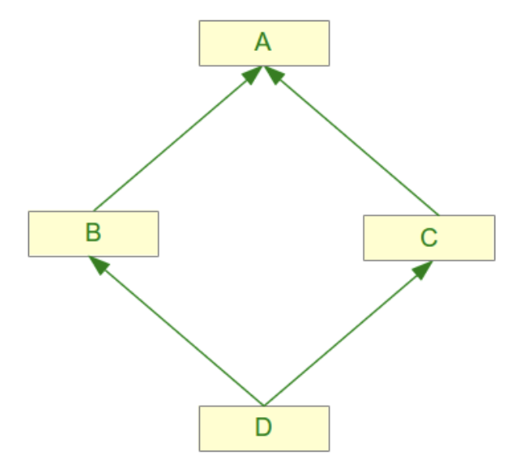
Multiple Inheritance
Python has multiple inheritance (can inherit from multiple parent classes)
Example of the ”diamond problem”:
class A:
def m(self):
print("m of A called")
class B(A):
def m(self):
print("m of B called")
class C(A):
def m(self):
print("m of C called")
class D(B,C):
pass

Slide 28
Multiple Inheritance – super()
Example usage of super()
class A:
def m(self)
print("m of A called")
class B(A):
def m(self):
print("m of B called")
super().m()
class C(A):
def m(self):
print("m of C called")
super().m()
class D(B,C):
def m(self):
print("m of D called")
super().m()
>>> x = D()
>>> x.m()
m of D called
m of B called
m of C called
m of A called

Slide 29
Encapsulation
Encapsulation is the idea of wrapping data and operations that are performed on that data into one entity
This allows more secured access of data
The idea of writing <class object>.<instance variable> is itself encapsulation
Data Abstraction has a subtle difference from encapsulation

Slide 30
Data Abstraction and Access Modifiers
Abstraction is the process of separation of presentation details from implementation details
Unlike in C++/Java/C#, access is not strictly enforced and there are well defined access modifiers
Members are by default Public, and can be accessed from anywhere
Protected members can be accessed from within class or sub-classes (Preceded by single underscore)
Private members accessible only within class (Preceded by double underscore)
Protected and Private members are not shown in metadata to outside users
An exception is thrown if users attempt to use them
Methods have the same access modifier conventions as members

Slide 31
Data Abstraction and Access Modifiers
class TeslaModelS:
def __init__(self, updateVersion, keyFobModule):
print("Parent Class Constructor Running!")
self._updateVersion = updateVersion
self.__keyFobModule = keyFobModule
def checkModule(self):
return self.__keyFobModule
class MyTesla(TeslaModelS):
def __init__(self, updateVersion, keyFobModule, color):
print("Child Class Constructor Running!")
super().__init__(updateVersion, keyFobModule)
# TeslaModelS.__init__(self, updateVersion, keyFobModule)
self.color = color
def checkVersion(self):
return self._updateVersion
myCar = MyTesla("v8.1.4", "VXC3542", "color")
print(myCar.color)
print(myCar.checkVersion())
print(myCar.checkModule())

Slide 32
Abstract classes
Python includes a module for Abstract Base Classes (ABC)
from abc import ABC
class Portal(ABC):
@abstractmethod
def open():
pass
@staticmethod
@abstractmethod

Slide 33
Lab: OOP
Lab
Overview: Learn Object Oriented Programming in Python
Approximate time: 10 mins
Instructions:
03__pythonLanguageBasics | 3.7-oop.ipynb

Slide 34

Review

